Slide 1


COMPUTER SCIENCE
JSON, AJAX and Content Negotiation

Slide 2
COMPUTER SCIENCE
JSON
JavaScript Object Notation
basic JSON syntax
use of JSON in Javascript
use of JSON in Java.

Slide 3
COMPUTER SCIENCE
JSON for AJAX (AJAJ?)
Works just like with XML, just use json data type!

Slide 4
COMPUTER SCIENCE
JSON for AJAX
$(document).ready(function () {
$.ajax({
type: "GET",
url: "library.json",
dataType: "json",
success:
function (obj) {
('<strong></strong>').html(obj.dvds[0].title).appendTo('#main');
},
error: function (xhr, status, error) {
var errorMessage = xhr.status + ': ' + xhr.statusText;
alert('Error - ' + errorMessage);
}
}); //close $.ajax(
}); //close $(

Slide 5
COMPUTER SCIENCE
While we’re at it: HTML for AJAX
$(document).ready(function () {
$.ajax({
type: "GET",
url: "library.html",
dataType: "html",
success:
function (response) {
$("html").html(response); // not really recommended, but it works!
},
error: function (xhr, status, error) {
var errorMessage = xhr.status + ': ' + xhr.statusText;
alert('Error - ' + errorMessage);
}
}); //close $.ajax(
}); //close $(

Slide 6
COMPUTER SCIENCE
Excursion: content (type) negotiation
In HTTP, content negotiation is the mechanism that is used for serving different representations of a resource at the same URI, so that the user agent can specify which is best suited for the user (for example, which language of a document, which image format, or which content encoding).
https://developer.mozilla.org/en-US/docs/Web/HTTP/Content_negotiation

Slide 7
COMPUTER SCIENCE
ACCEPT request header field
The Accept request HTTP header advertises which content types, expressed as MIME types, the client is able to understand. Using content negotiation, the server then selects one of the proposals, uses it and informs the client of its choice with the Content-Type response header.
https://developer.mozilla.org/en-US/docs/Web/HTTP/Headers/Accept

Slide 8
COMPUTER SCIENCE
Content negotiation
1. Client sends request with a specific content type value in the ACCEPT field:
  application/xml, application/json, text/html, …
2. Server checks this field and decides if it can provide this format
3. If yes, server places the type in the CONTENT-TYPE response header and
places the requested object in the response body
4. If no, the server should (!) either pick a content-type and let the client decide
if it wants it or send a status code back (415?)
5. Requires the client to provide ACCEPT field and server to act accordingly!

Slide 9

COMPUTER SCIENCE
Examples using Postman
Postman is an “API Development and Testing Platform”
Here: Send controlled http requests to a server and analyze the responses.

Slide 10
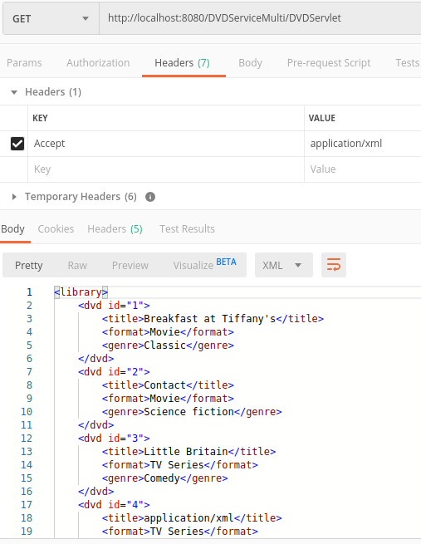
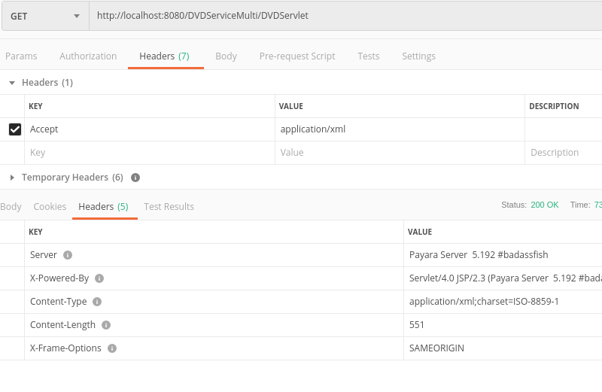
COMPUTER SCIENCE
Testing the multi-format DVD service

Slide 11
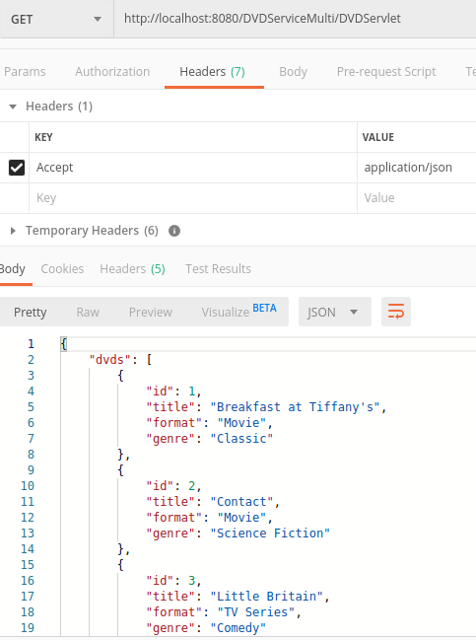
COMPUTER SCIENCE
Testing the multi-format DVD service

Slide 12
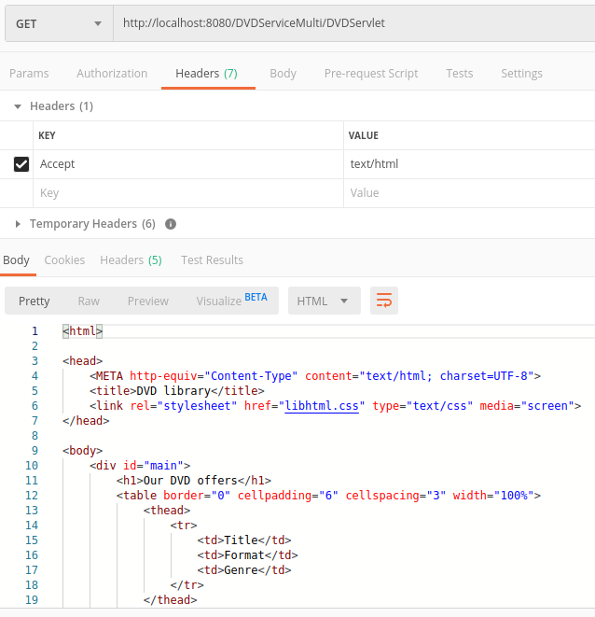
COMPUTER SCIENCE
Testing the multi-format DVD service

Slide 13
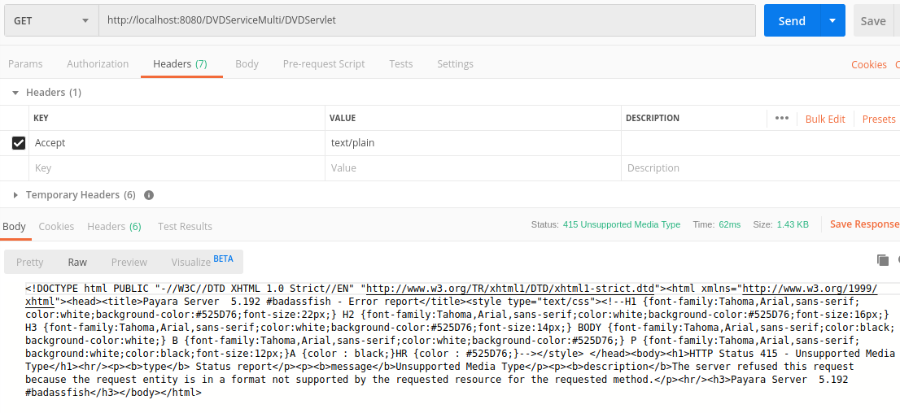
COMPUTER SCIENCE
Testing the multi-format DVD service

Slide 14
COMPUTER SCIENCE
Remote multi-format request for JSON
$(document).ready(function () {
$.ajax({
beforeSend: function (req) {
req.setRequestHeader("Accept", "application/json");
},
type: "GET",
url: "http://localhost:8080/DVDServiceMulti/DVDServlet",
dataType: "json",
success:
function (obj) {
...
},
error: function (xhr, status, error) {
var errorMessage = xhr.status + ': ' + xhr.statusText;
alert('Error - ' + errorMessage);
}
}); //close $.ajax(
}); //close $(

