Slide 1

Quantum Computing: Deutsch-Jozsa Algorithm
By: Brady Phelps (B.S.A.C. ’25)

Slide 2
Deutsch-Josza Algorithm
One of first instance of Quantum speedup found by David Deutsch and Richard Josza in 1992.
The Deutsch-Josza algorithm determines if a function is balanced
Balanced means all inputs map to an even distribution of outputs
If our outputs are 0 and 1, it means we will get 0 for half of our inputs and 1 for the other half.

Slide 3
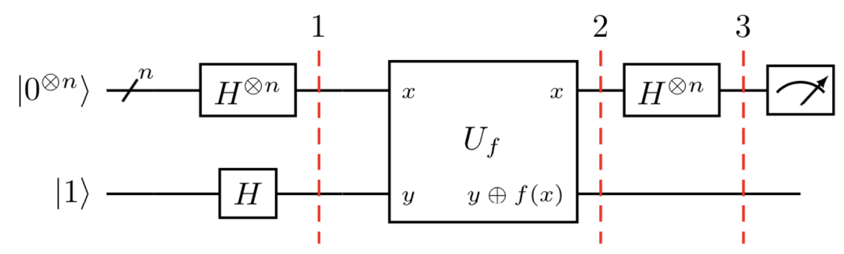
Deutsch-Josza The Circuit
Overview of the circuit

Slide 4

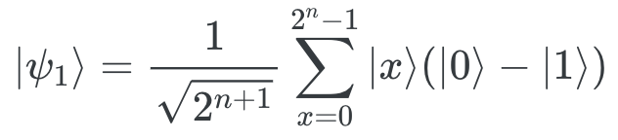
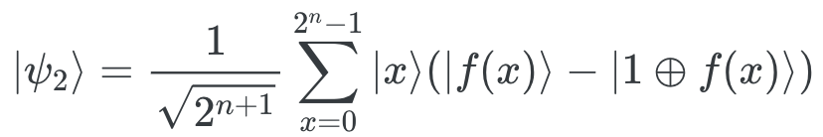
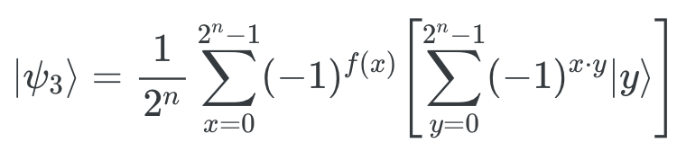
Deutsch-Josza Algorithm Steps
First instance of Quantum initialize n-qubit register to 0 and another single qubit register to 1
Apply Hadamard to each qubit
Apply oracle (y bitwise f(x))
Apply Hadamard to first register
Measure first register, if we get a 1, we know it is constant

Slide 5
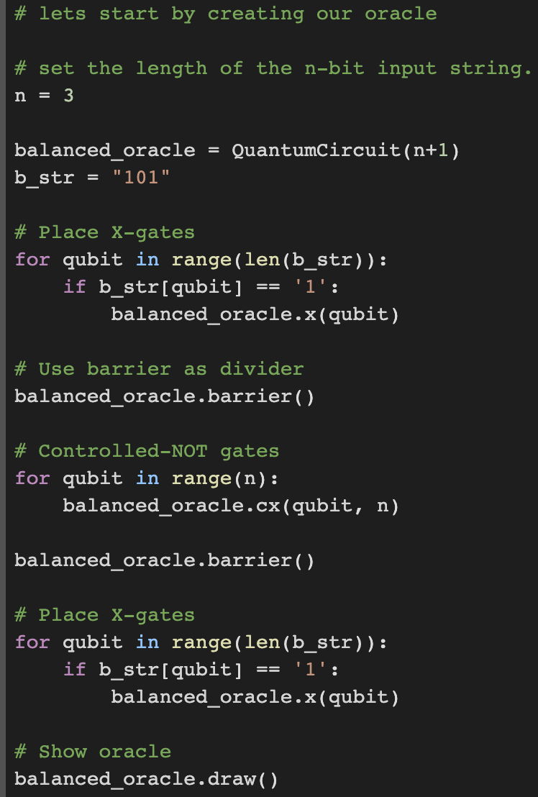
Qiskit implementation
We start our algorithm by creating the oracle we will use later in the circuit.
Our oracle will be apply the CNOT gate for each of our qubits.
The X gates you see correspond to our input string.

Slide 6
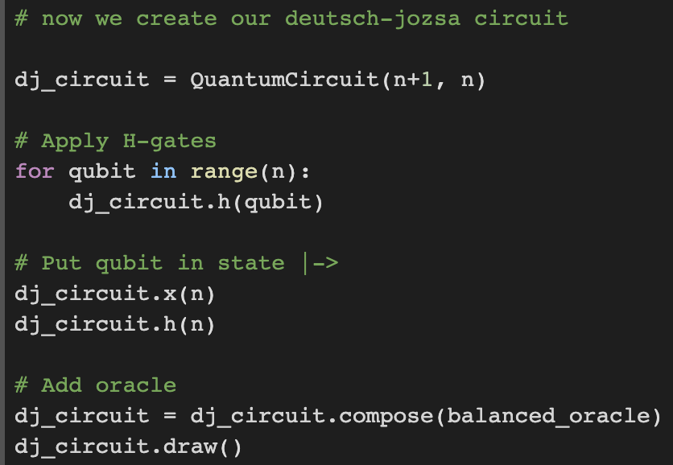
Qiskit implementation
Now we begin making our Deutsch-jozsa circuit. In this step, we flip the last bit to make it 1 and apply a Hadamard to put it in |-> state. We also add our oracle

Slide 7
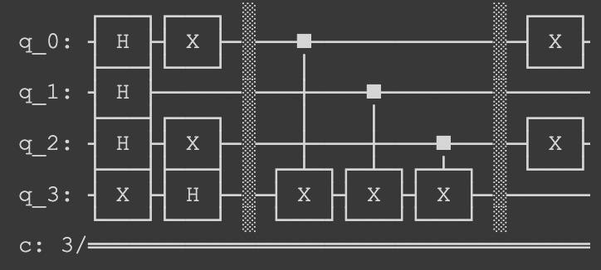
Qiskit implementation
Current state of circuit

Slide 8
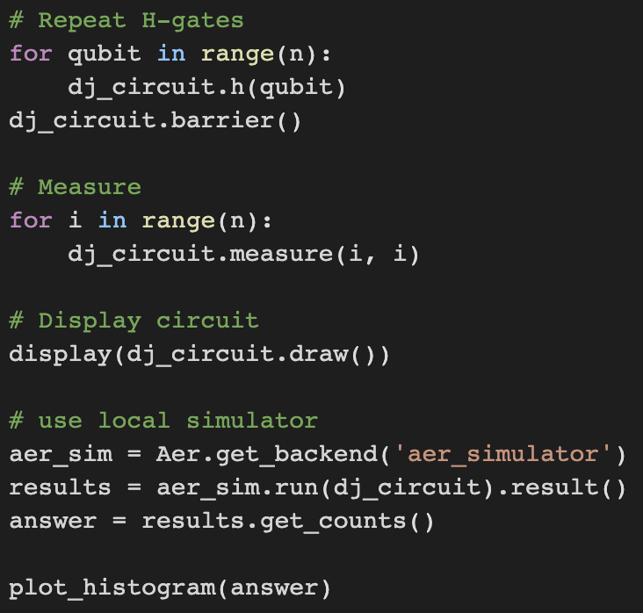
Qiskit implementation
Next we apply our hadamards back to the first register and then take our measurements.

Slide 9
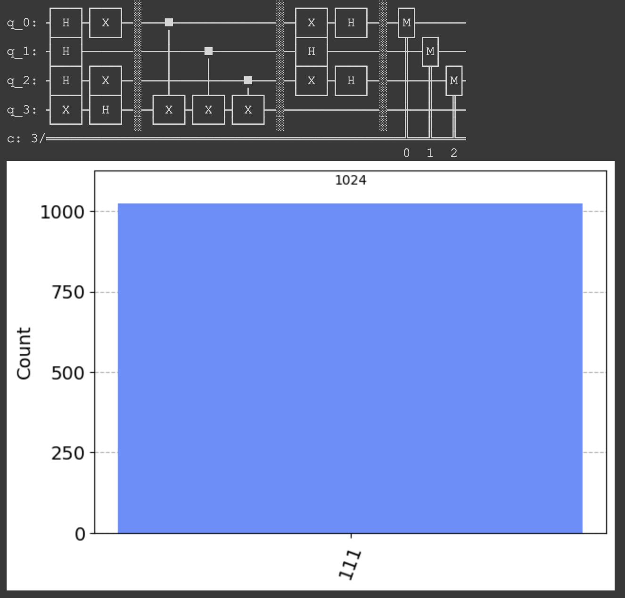
Qiskit implementation
We can see our circuit and our current output. This shows us that we have a balanced function since we have a 0% of measuring 000.

Slide 10
This example can be found on the Qiskit textbook.
https://learn.qiskit.org/course/ch-algorithms/deutsch-jozsa-algorithm#const_oracle

