Slide 1

Quantum Computing: Introduction to Quantum Cryptography
By: Brady Phelps (B.S.A.C. ’25)

Slide 2
What is Cryptography?
Definition: Practice or technique used to encrypt messages and communication between parties.
Example:
Original Phrase
Ciphertext
Original Phrase
”Hi!”
”GQ&”
”Hi!”
Encryption Key
Decryption Key

Slide 3
What is Quantum Cryptography?
Definition: Quantum Cryptography is just cryptography using quantum mechanics
Quantum Cryptography is one of the most researched and discussed field of Quantum Computing!
Government
Financial Institutions
Other industries
Why is this so important?

Slide 4
Why?
Algorithms such as Shors algorithm threaten to destroy modern cryptographic systems used to encrypt almost every secure system.
With Quantum Computing, we can potentially achieve a stronger level of security, and we can also launch stronger attacks. It is important for us to research this field so we can discover it before our counterparts do.

Slide 5
Quantum Key Distribution
QKD stands for Quantum Key Distribution. This is a method of exchanging cryptographic keys which is how we encrypt data using quantum phenomena
Types of protocols:
BB84
Ekerts
B92

Slide 6
QKD example
Let’s imagine a scenario between two people, Alice and Bob, who wish to exchange keys. We will also introduce a third player known as Eve, who wishes to eavesdrop on Alice and Bob’s conversation.
First, we can generate a pseudo-random key for Alice. This will correspond to Alice’s bits

Slide 7
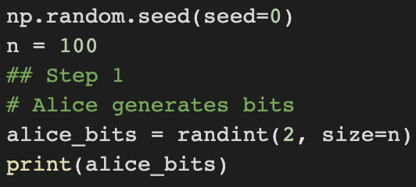
QKD example code

Slide 8
QKD example
Next, we will instantiate a series of bases for Alice’s bits.
These bases will correspond to gates to be run on our qubits. (0 means Z basis and 1 means X basis).

Slide 9
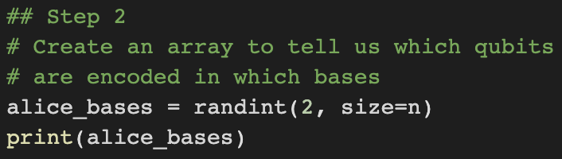
QKD example code

Slide 10
QKD example
Next, we will create a list of quantum circuits, each containing 1 qubit. This qubit will represent our either X or Z basis being applied to each of our original bits.
Logic:
if Z basis, then we create a qubit to mirror state of random value originally generated
else, then we create a qubit to mirror the state of the random value originally generated and apply a Hadamard
Original Bits | Basis | Qubit
0 | Z | |0>
1 | Z | |1>
0 | X | |+>
1 | X | |->

Slide 11
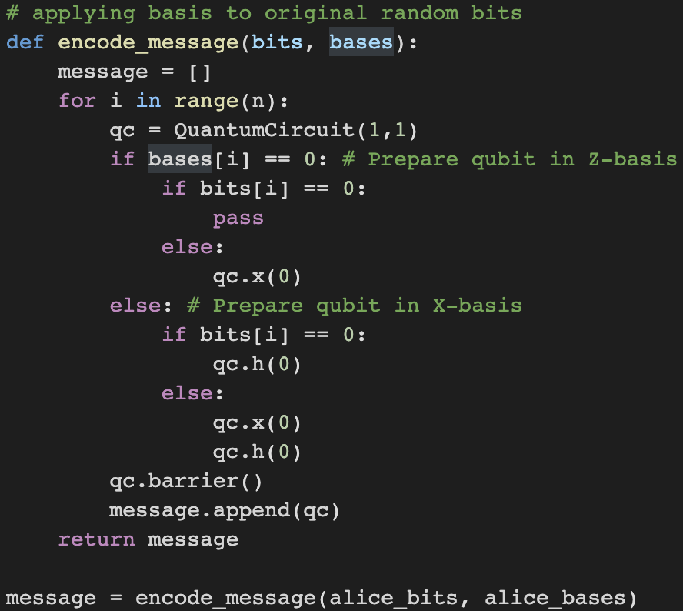
QKD example code

Slide 12
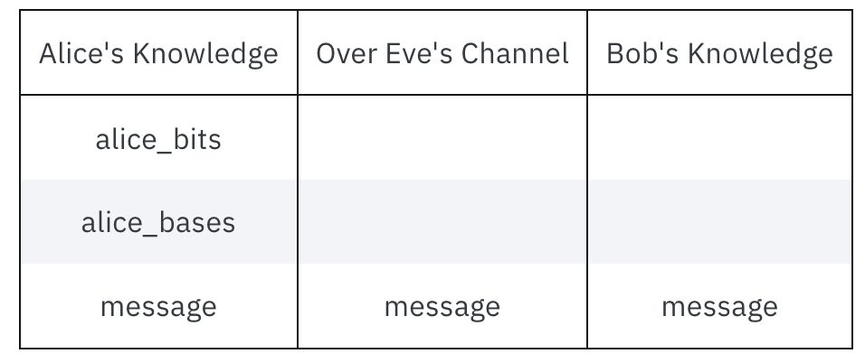
QKD example status
The current information we have and who it is dispersed among.
We are assuming we have now formally sent the message.

Slide 13
QKD example
In the following step, Bob will create a series of random bases to measure the message with.
Bob will use these random bases to read in each given qubit and apply the corresponding measurement basis to get a series of classical bits that represent Alice’s original message. As you may notice, there are more steps after this because Bob will likely not get Alice’s original message from this step.

Slide 14
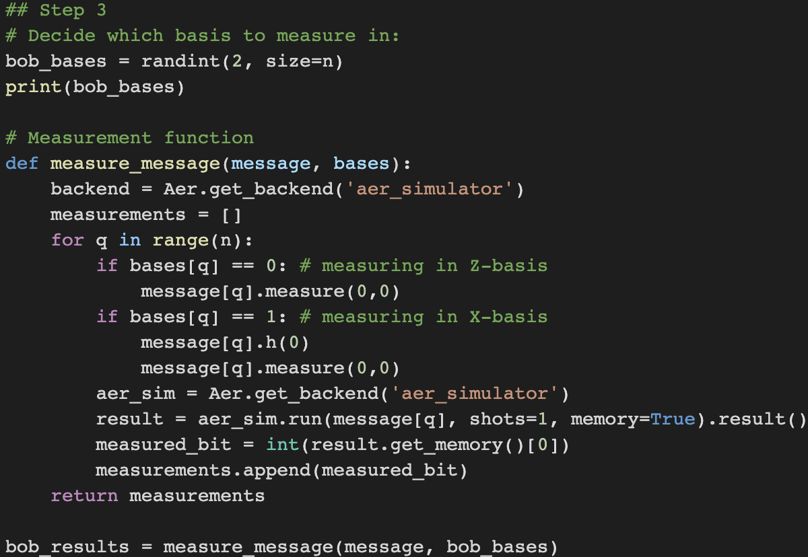
QKD example code

Slide 15
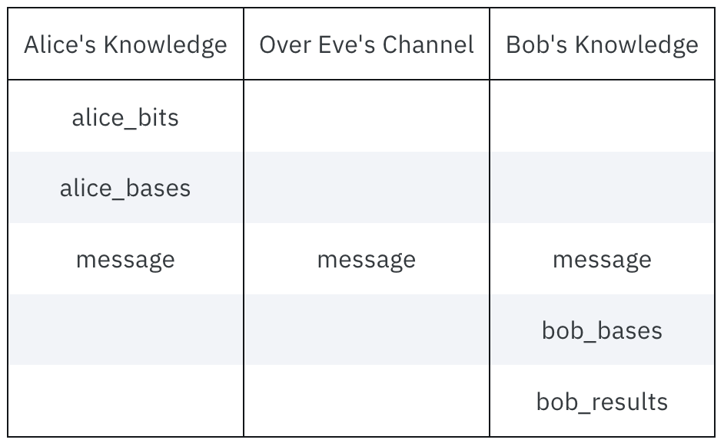
QKD example status

Slide 16
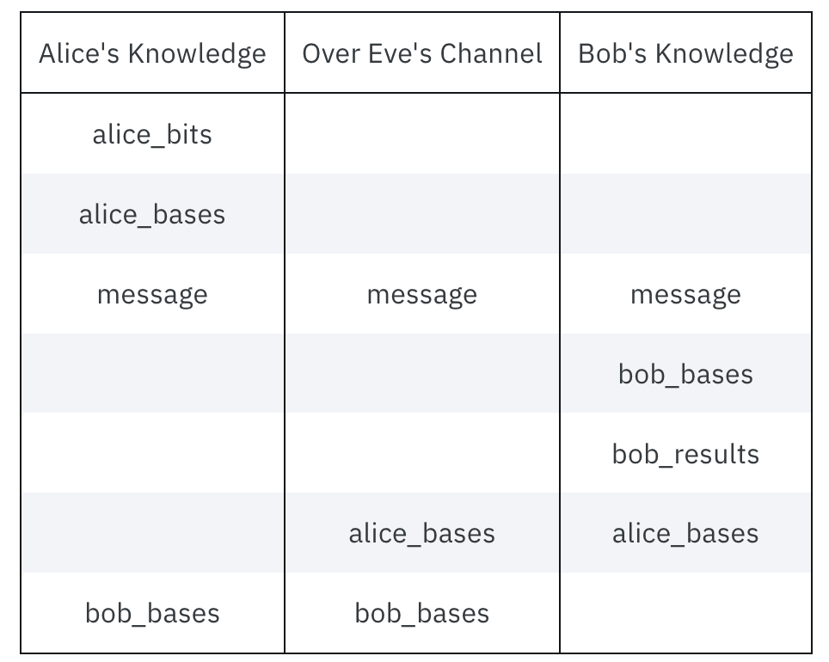
QKD example status continued
Next, Alice and Bob will exchange their basis information. This will allow Alice and Bob to see which of their basis match. If the basis match, they know they have the same value. If they used different basis, the result Bob found is random and they can discard the data.

Slide 17
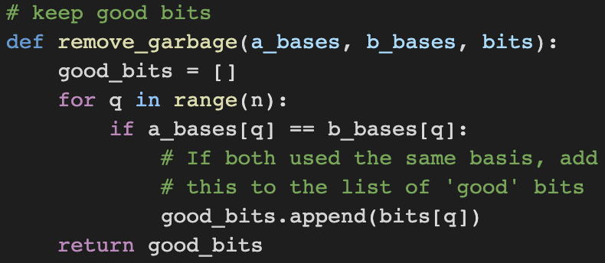
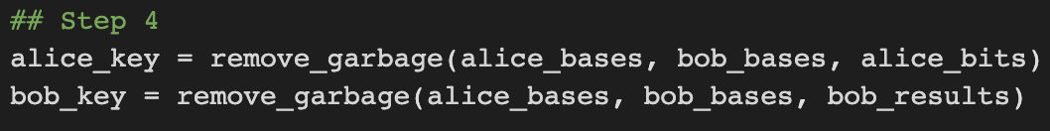
QKD example code
Keeping the good (matched basis) bits

Slide 18
QKD example
We will then take a random sample of bits from both Alice and Bob’s results and compare them. If they are the same, we know the protocol worked. After we compare them, we can discard them as they are no longer a secret.
Example of matching bits

Slide 19
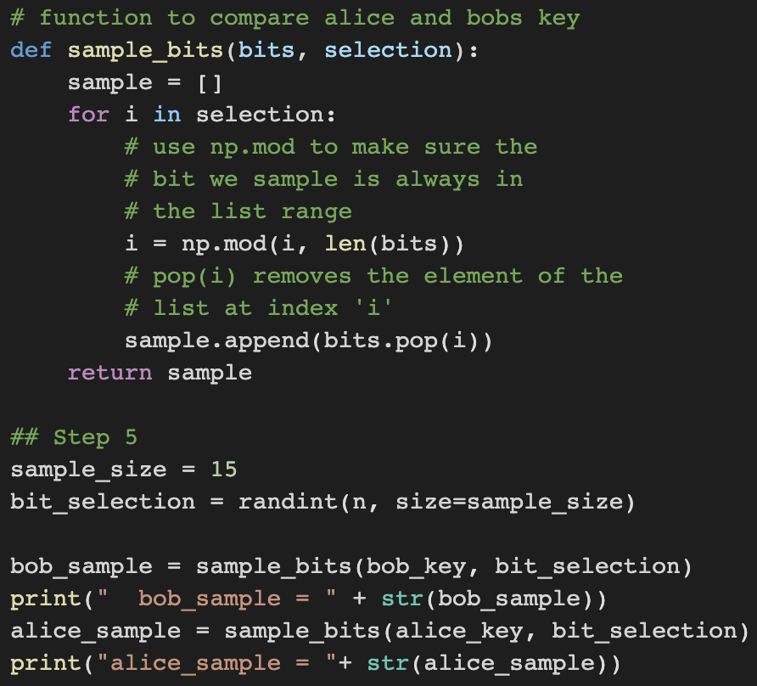
QKD example code

Slide 20
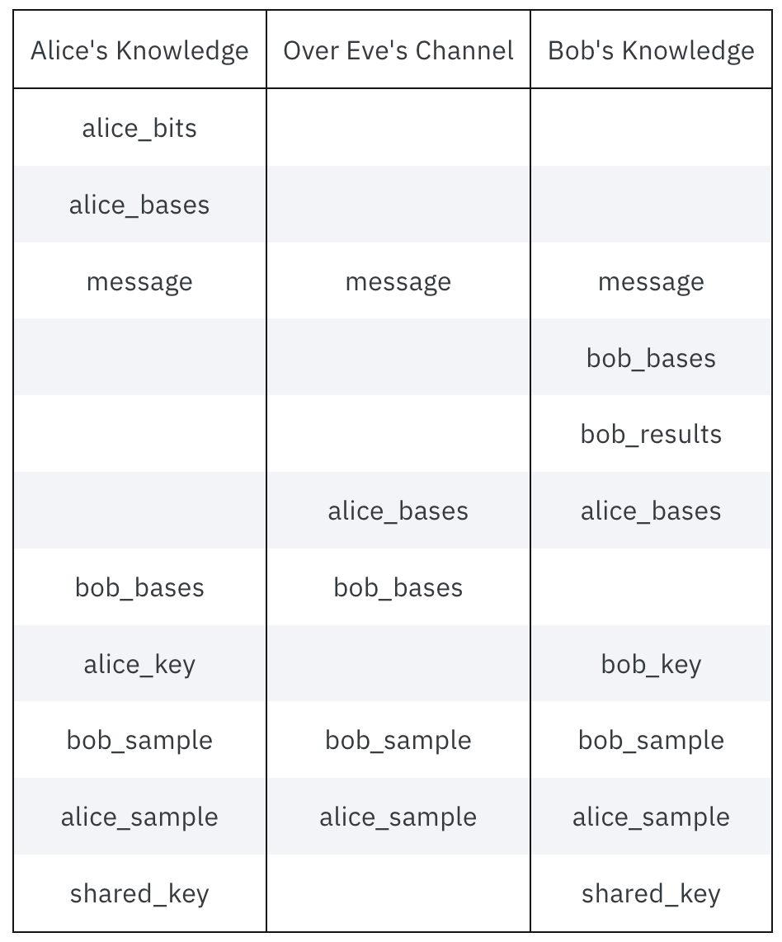
QKD example status
We now have two identical keys shared between Alice and Bob which they can use to encrypt their messages!

Slide 21
QKD example interference
Throughout this example we have ignored the presence of Eve. So, what happens if Eve tries to interfere and steal our key?
Eve would first apply a series of random bases to try and read Alice’s original message, similar to how Bob applies a series of random bases.
Due to Quantum Phenomena, this will collapse the quantum states which will give Bob a false reading.
When we get to our final step and compare our random string of bits, we will see differences in our bits, which will alert us that our communication has been compromised, and we will discard our current key.

Slide 22

QKD Risk
Let’s analyze how risky this method is…
We have a .5 chance of Eve choosing the same basis as Alice and Bob (Either X or Z basis, which will go undetected)
We have a .5 chance Eve chooses a different basis than Alice and Bob, with this disruption, there is a .5 chance that Eve disrupts the qubit to cause Bob to get a different reading. (Overall, .25 chance of being detected)
So, we can formulate that the chance of Eve not being detected is (.75)^x where x is number of qubits.

Slide 23
This example can be found on the Qiskit textbook.
https://learn.qiskit.org/course/ch-algorithms/quantum-key-distribution#quantum-8-0

