Slide 1

Quantum Computing
By: Brady Phelps (B.S.A.C. ’25)

Slide 2

What is Quantum Computing?
Quantum Computing is a form of computing which utilizes quantum phenomena to solve problems too complex for classical computers.
*not too complex, just different kinds

Slide 3

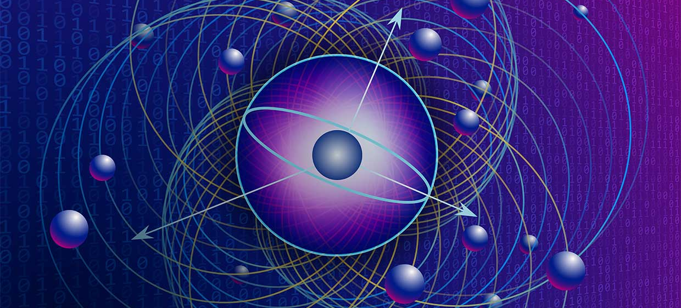
Main components of Quantum Computing
Qubits
Superposition
Entanglement
Interference
Quantum Gates
These properties are what make quantum computing special and we will talk more about them in the following slides…

Slide 4
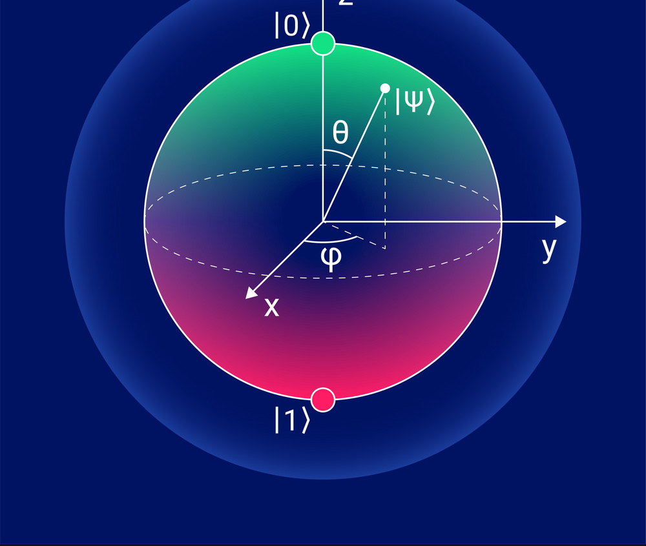
Qubits
The basic unit of quantum information

Slide 5
What makes a Qubit special?
Classical Bits
Qubits
Deterministic behavior
1’s and 0’s
Single unit of information
Example value:
0 or 1
Probabilistic behavior
Can represent many states (superposition)
Utilizes quantum mechanics
Example value:
|+> which represents both 0 or 1 in classical terms

Slide 6
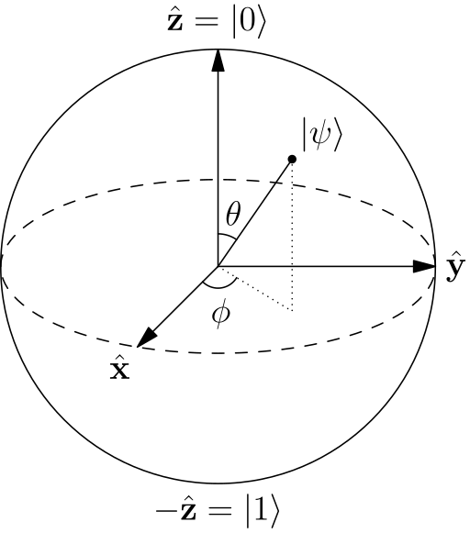
How can we visualize a Qubit?
Few ways to visualize a Qubit…
Bloch Sphere
Geometrical representation of a quantum state in a two-level system.
We can visualize the value stored in a qubit as a point on the bloch sphere (pure state) and in the bloch sphere (mixed states)
This is particularly useful when visualizing gate operations.
Notes:
Super helpful video: https://www.youtube.com/watch?v=AYGHS9hXgyw

Slide 7
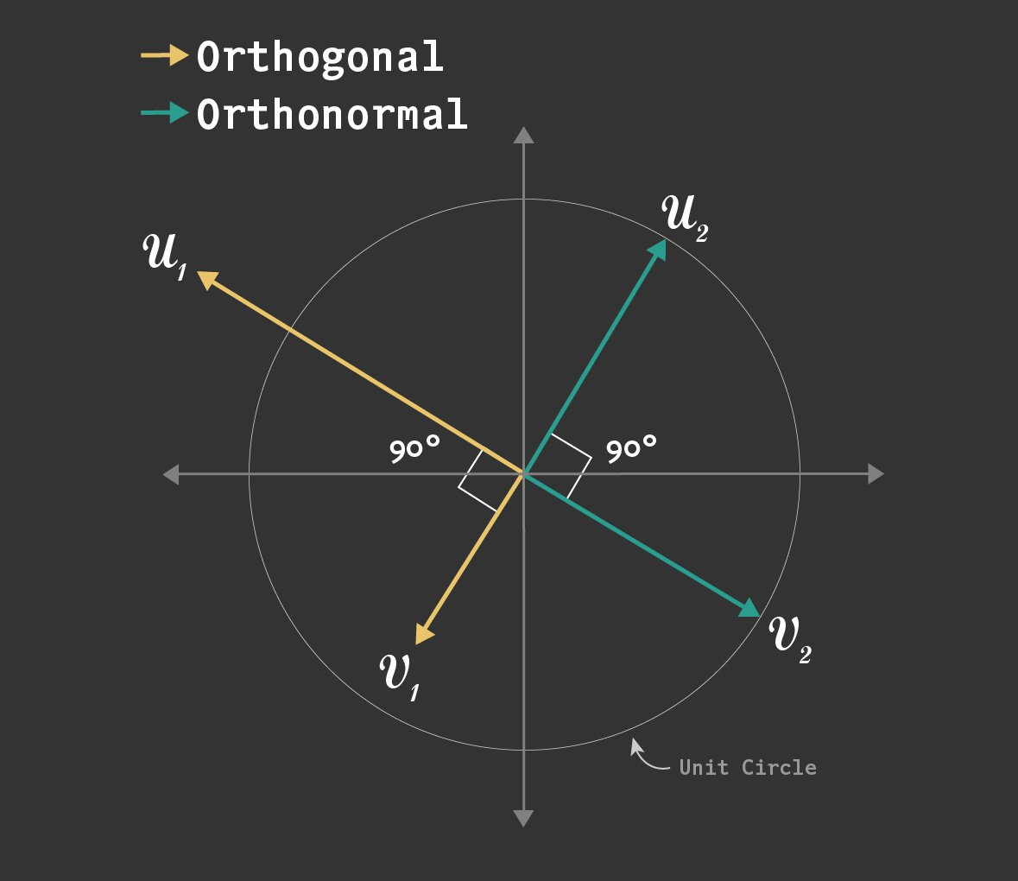

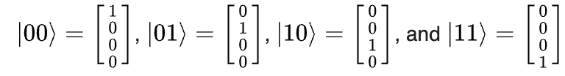
Other representations
State Vector and Bra-Ket/Dirac notation
The basis states are orthonormal to each other. This means the states are mutually orthogonal to each other and have the same unit length of one.
Basis states
Superposition of basis states
Notes:
Orthonormality: https://en.wikipedia.org/wiki/Orthonormality
Intro to Quantum Physics has good explanation on state vectors: https://catalogimages.wiley.com/images/db/pdf/9780470525890.excerpt.pdf

Slide 8
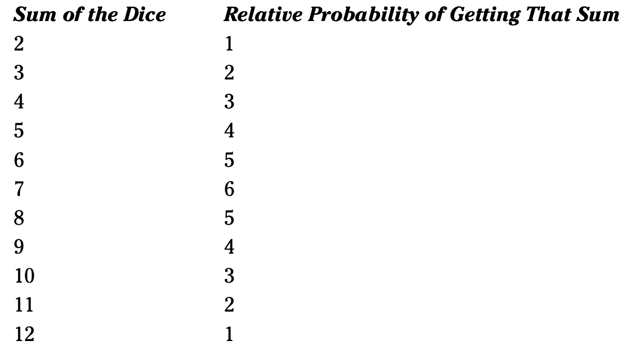

State Vectors example
So, what does this notation really represent?
Let’s explain with an example…
Q. What’s the state vector for the various possible states of a pair of dice?
Step one
First, lets create a vector that holds
all relative probabilities for rolling
a pair of dice
Notes:
Orthonormality: https://en.wikipedia.org/wiki/Orthonormality
Intro to Quantum Physics has good explanation on state vectors: https://catalogimages.wiley.com/images/db/pdf/9780470525890.excerpt.pdf

Slide 9


State Vectors example
Next, lets take these values and convert them to probability
amplitudes by taking the square root of each value.
Then, we normalize these values by dividing by the square root
of the total number of possible outcomes (36)
Notes:
Orthonormality: https://en.wikipedia.org/wiki/Orthonormality
Intro to Quantum Physics has good explanation on state vectors: https://catalogimages.wiley.com/images/db/pdf/9780470525890.excerpt.pdf

Slide 10
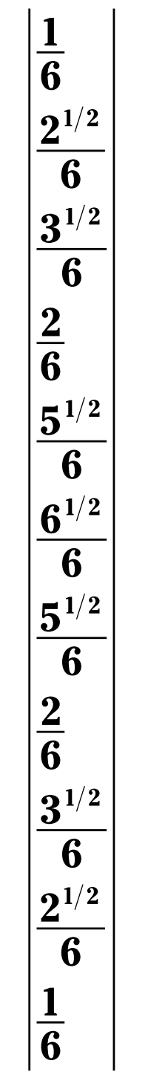
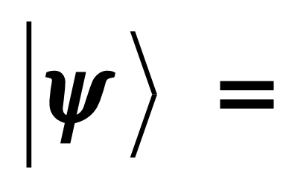
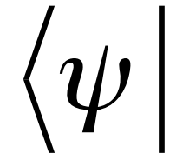
State Vectors example
This provides us with our final state vector…
This state vector represents the relative probability
amplitude of being in each state.
You might also sometimes see state vectors written as which
represents a row vector, we will talk more about this later.
Notes:
Orthonormality: https://en.wikipedia.org/wiki/Orthonormality
Intro to Quantum Physics has good explanation on state vectors: https://catalogimages.wiley.com/images/db/pdf/9780470525890.excerpt.pdf

Slide 11
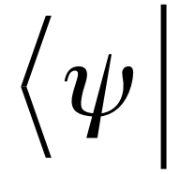
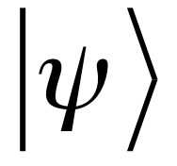
Bra-Ket/Dirac notation
The Bra-Ket or Dirac notation is what we use to represent state vectors.
This is a bra (column vector)
This is a ket (row vector)
This simplified notation allows us to avoid writing out state vectors each time. It is important
although both representations mean the same thing, it is important to be fluent in both as they
are both frequently used.
This is also called Dirac notation.
Notes:
Orthonormality: https://en.wikipedia.org/wiki/Orthonormality
Intro to Quantum Physics has good explanation on state vectors: https://catalogimages.wiley.com/images/db/pdf/9780470525890.excerpt.pdf

Slide 12
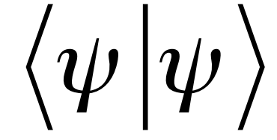
Bra-Ket/Dirac example
We can multiply Bras and Kets together following the rules of matrix multiplication.
Q. What is the product of this statement, using the values from the dice problem?
(This the multiplication representation of the bra and ket we found earlier.)
Notes:
Orthonormality: https://en.wikipedia.org/wiki/Orthonormality
Intro to Quantum Physics has good explanation on state vectors: https://catalogimages.wiley.com/images/db/pdf/9780470525890.excerpt.pdf

Slide 13

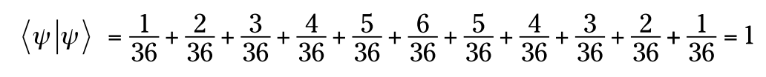
Bra-Ket/Dirac example
We can solve this by multiplying the bra by the ket
Bra
Ket
Which provides us with…
Which means = 1
Notes:
Orthonormality: https://en.wikipedia.org/wiki/Orthonormality
Intro to Quantum Physics has good explanation on state vectors: https://catalogimages.wiley.com/images/db/pdf/9780470525890.excerpt.pdf

Slide 14
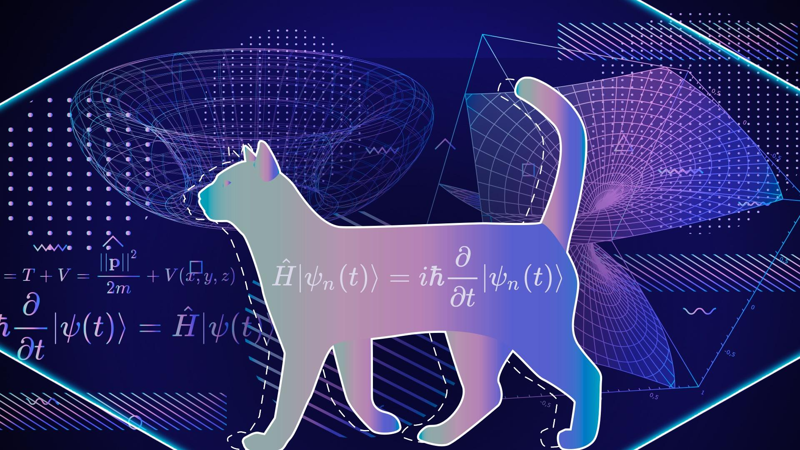
Superposition
A unique quantum phenomena in which a Qubit can exist in multiple states at the same time

Slide 15
Schrödinger's Cat
One of the most popular explanations of Superposition was given to us by Erwin Schrödinger called Schrödinger’s cat.
If you place a cat inside of a box, with something that can kill the cat, you will not know if the cat is dead until you open the box. Therefore, the cat can be both dead and alive while in the box.
This is the same principle for our Qubits. They can exist in a multitude of states until we measure them. Once we measure them, we destroy the quantum state.

Slide 16

Entanglement
A phenomena in which groups of particles are generated such that the quantum state of each particle cannot be described independently of others.
Notes:
https://en.wikipedia.org/wiki/Quantum_entanglement
https://www.technologyreview.com/2019/01/29/66141/what-is-quantum-computing/

Slide 17
Entanglement
How does entanglement present itself in quantum computing?
We will see this later when we use gates and create entanglement between multiple quantum particles.
For now, you just need to know that entanglement can be used to make two qubits rely on each other. You cannot make independent changes to entangled qubits.

