Slide 1

Quantum Computing Lecture 2
By: Brady Phelps (B.S.A.C. ’25)

Slide 2
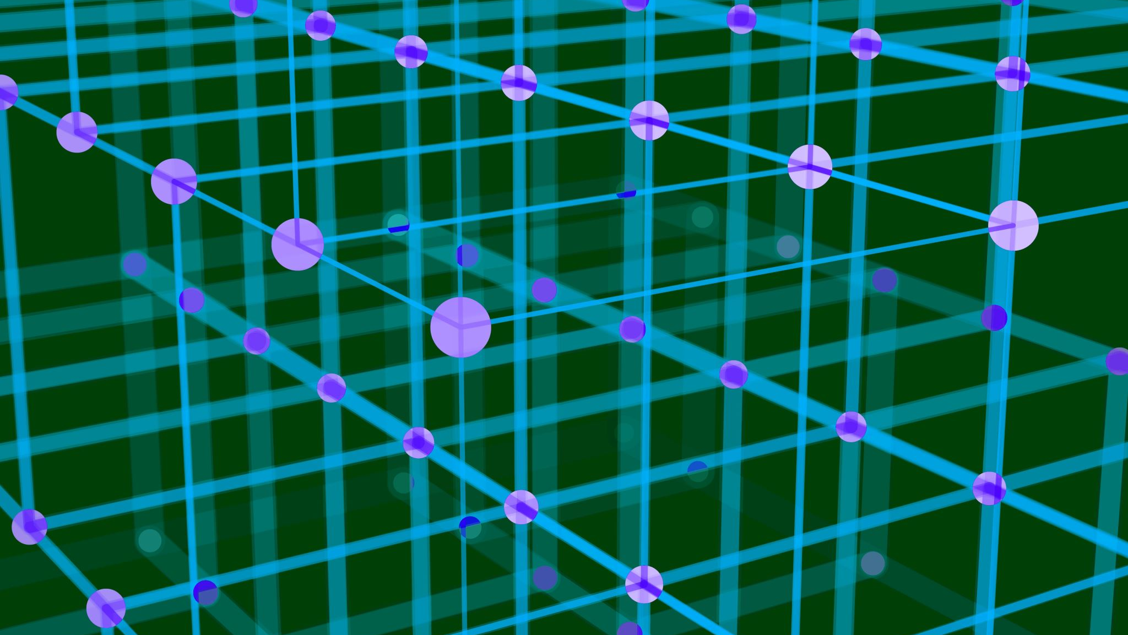
Quantum Circuits and Getting Started With Qiskit.

Slide 3


What options are there for quantum languages?
Q#

Slide 4
At a glance…
Qiskit
Cirq
Q#
IBM
Largest community
Documentation
Python package
Run on real quantum computer
Qiskit Website
Google
Python package
Quantum AI initiative with NASA
Cirq Website
Microsoft
Plans to make full stack Azure ecosystem
Azure workspace has support for Cirq and Qiskit as well
Q# Website

Slide 5
Setup for Qiskit
Step One
Download Python
Step Two
pip install qiskit (or pip3 if using Python3)
Step Three
Lets begin
Make sure you have Python installed.
You will also want to have Python installed for Cirq as well.
Notes:
https://qiskit.org/documentation/getting_started.html

Slide 6
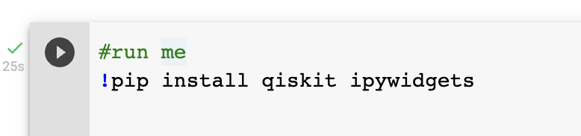
Lets begin…
Let’s create your first Quantum Circuit!
I am running these examples using a Google Colaboratory Notebook, so I will need to load in the proper dependencies.
All examples will be available in the linked Colaboratory.
Notes:
https://colab.research.google.com/drive/18Zzt3lSYNuiJheRG-kiVUKGmiGpmOrEi#scrollTo=TbCUccDt-xYQ

Slide 7
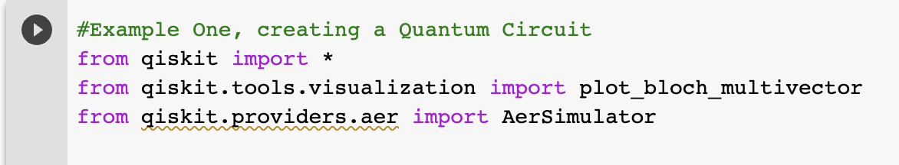
Quantum Circuits
Next, we will import the correct libraries we will be using in this example.

Slide 8
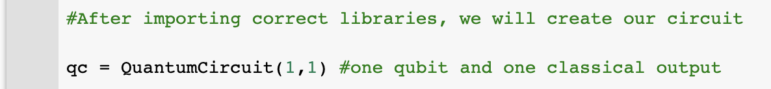
Creating an empty circuit with one classical bit and one quantum bit. The default Quantum bit value is |0>

Slide 9
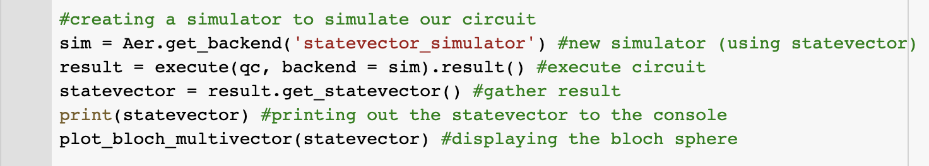
Now, if we want to see what our circuit looks like at this point, we can measure it. This can be done in a variety of ways, but for now let’s model the qubit with a bloch sphere.

Slide 10
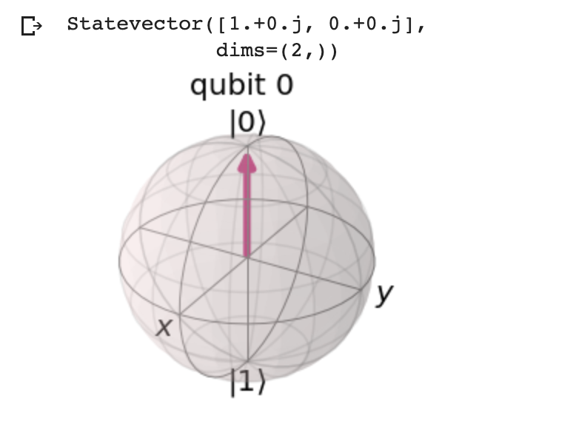
Output: We can see our qubit in the bloch sphere. When taking a measurement, the qubit represents 0 in classical bits
Notes:
https://qiskit.org/documentation/getting_started.html

Slide 11
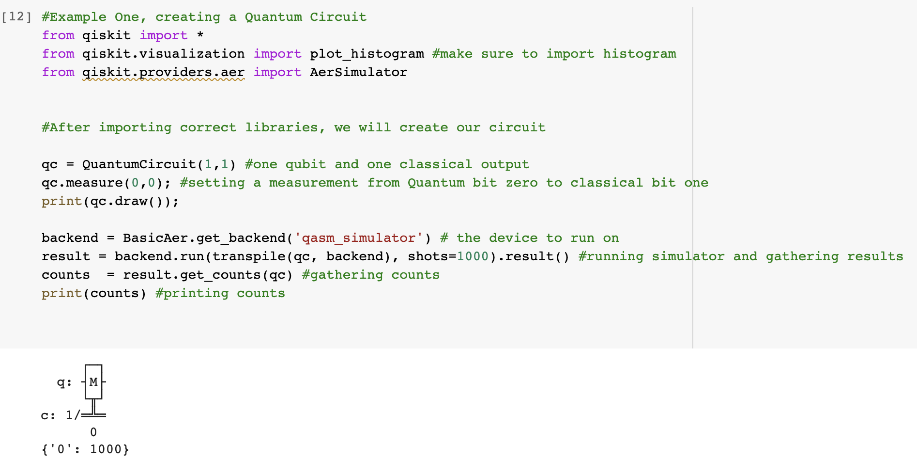
Here we take the same circuit but we measure the circuit and print out a diagram. We also use the simulator to gather the output.

Slide 12
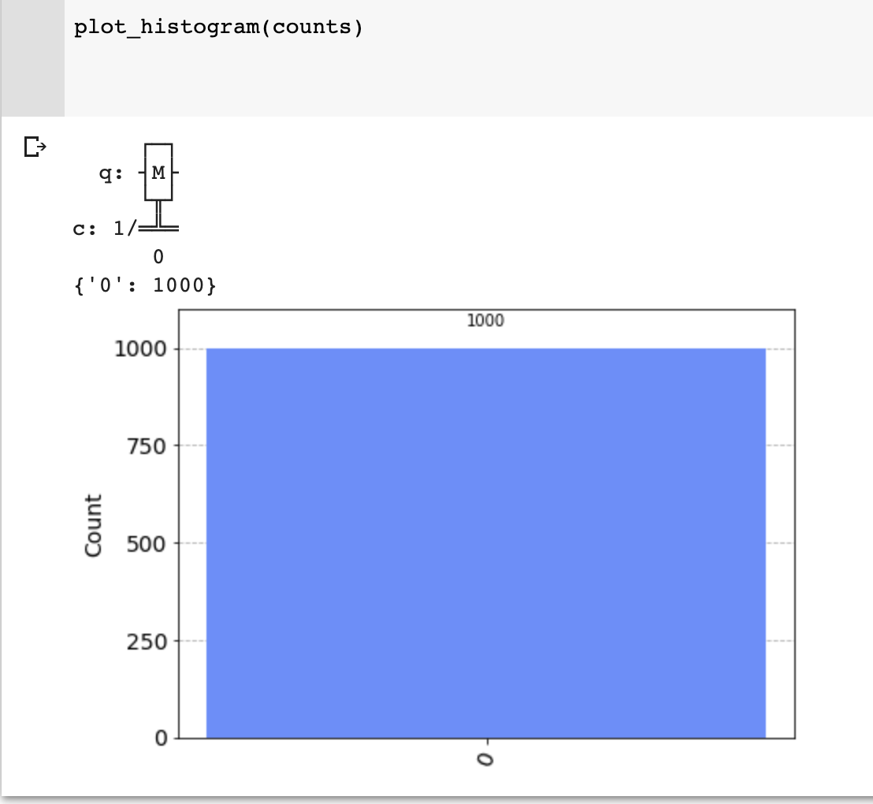
We can then call plot_histogram(counts) to create a plot of our output. We can see the simulator runs 1000 times and receives a ’0’ value every time. This makes sense because the default value of our qubit is zero in classical terms.

Slide 13
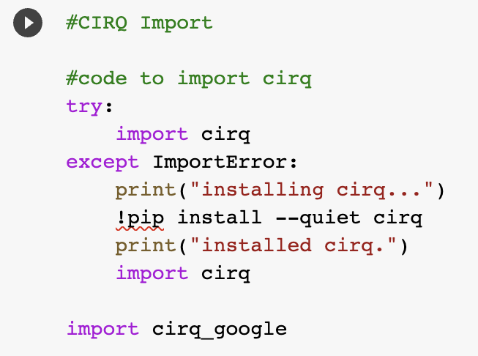
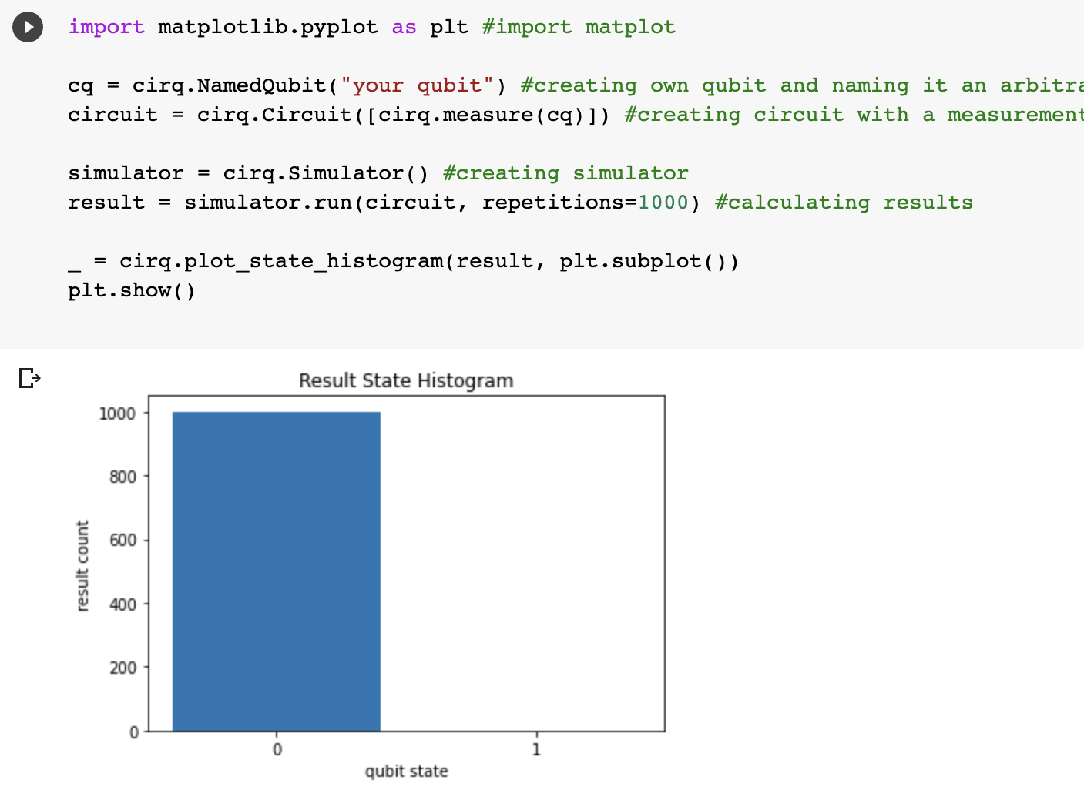
The same example done with cirq

Slide 14
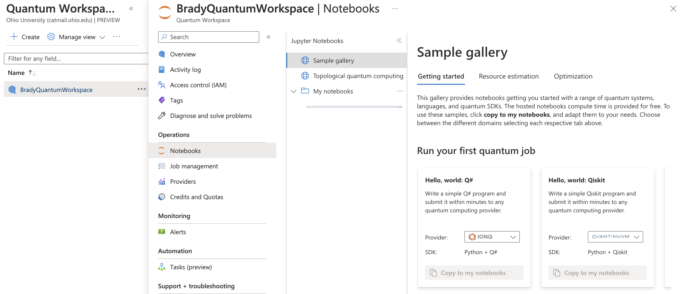
Q#, also a look at the Azure workspace
Notice they have examples notebooks in Q#, Cirq, and Qiskit
Notes:
The Hello, world Q# notebook does a good introductory example. Q# is a bit longer code so I am electing not to screenshot the whole example.

