Slide 1

Quantum Computing: Gates
By: Brady Phelps (B.S.A.C. ’25)

Slide 2
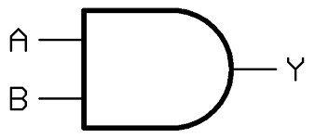
What are gates?
The gates we see in quantum computing mirror the functionality of those we see in classical computing.
To the left we have the AND gate which takes two inputs and returns 1 if they are both 1.

Slide 3
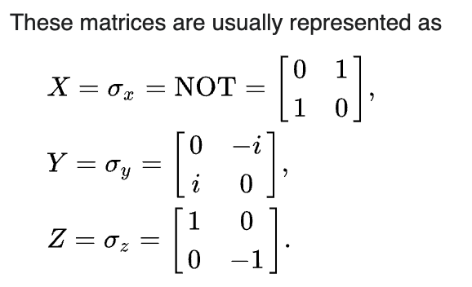
The gates we see in quantum
Pauli Gates
X Gate
Y Gate
Z Gate
This rotates a qubit 180 degrees around the X axis. This is the quantum equivalent to the NOT gate. Maps |0> to |1> and |1> to |0>
Rotates qubits 180 degrees around the Y axis. This maps |0> to i|1> and |1> to –i|0>
Rotates qubits 180 degrees around the axis. This leaves |0> unchanged and maps |1> to |-1>
(sometimes called a phase flip)
We can think of phase as quantum values
that accompany each qubit value that does
not come through when we take a classical
Measurement. These are complex values.
Notes:
https://en.wikipedia.org/wiki/Quantum_logic_gate

Slide 4
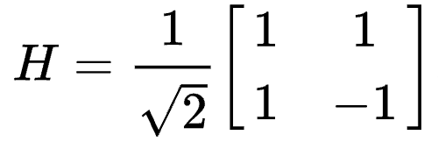
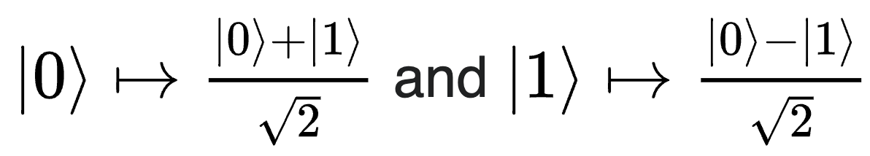
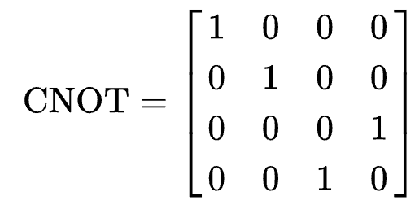
More important gates…
CNOT Gate
Hadamard Gate
This gate acts on two qubits.
Uses the first qubit as the control, and if it is |1>, then it will enact an X gate on the second bit.
Used to create a state of superposition.
Maps:
When we use this gate on a |0> value, when we take measurements, we will get |0> half the time and |1> half the time
We can undo a Hadamard by calling it again because it is involutory
Notes:
https://en.wikipedia.org/wiki/Quantum_logic_gate

Slide 5
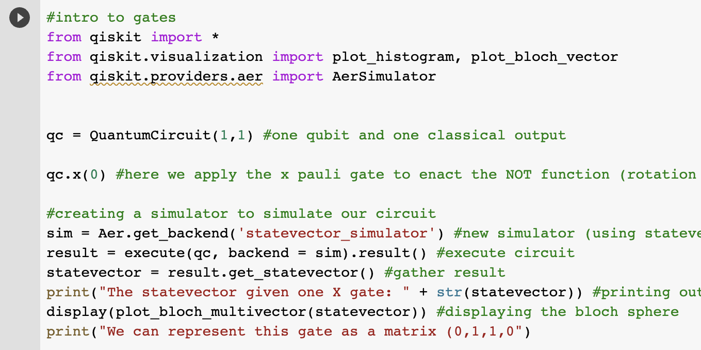
Practice with gates using Qiskit
Follow along as we test out some of our gates.
Above we apply the X gate to a single qubit.
Notes:
https://colab.research.google.com/drive/18Zzt3lSYNuiJheRG-kiVUKGmiGpmOrEi?usp=sharing my COLAB

Slide 6
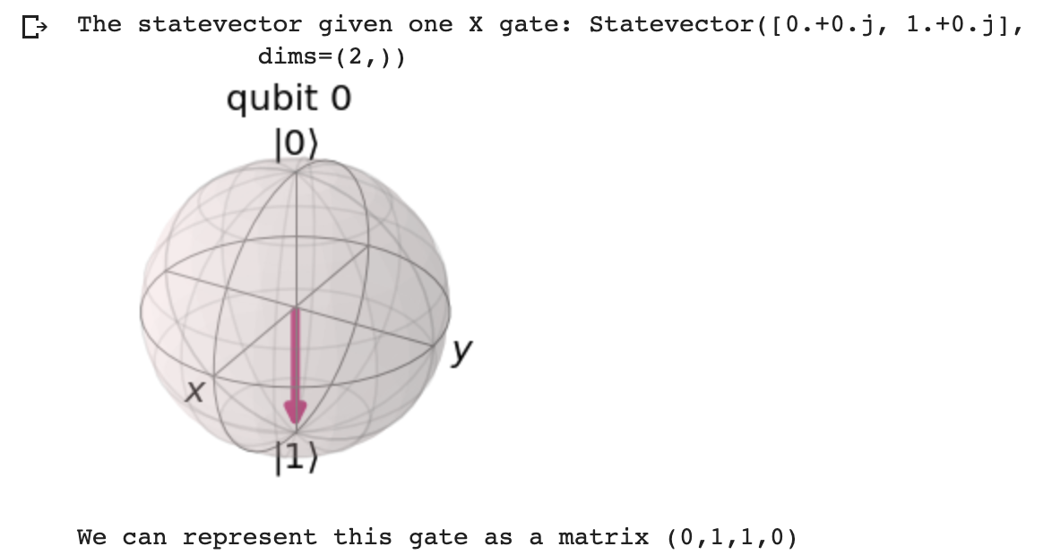
Here we can see the effect of adding one x gate
Notes:
https://colab.research.google.com/drive/18Zzt3lSYNuiJheRG-kiVUKGmiGpmOrEi?usp=sharing

Slide 7
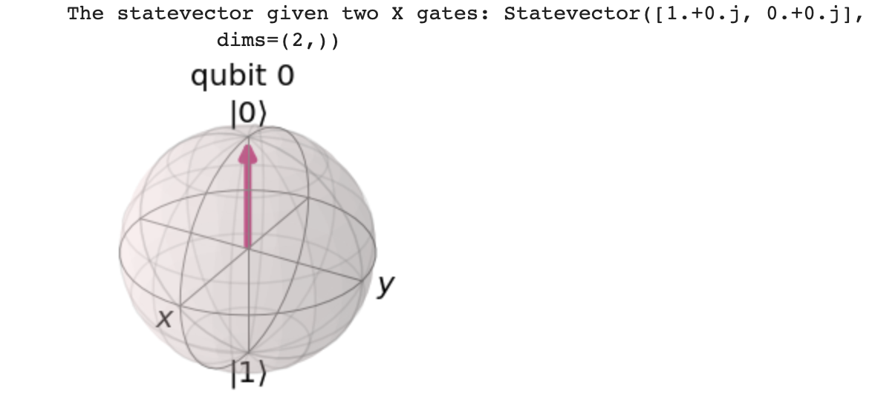
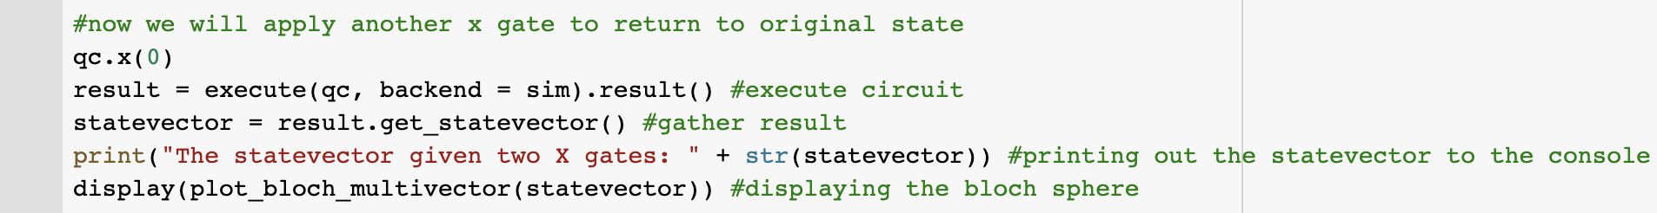
Let’s apply another x gate and view the results
As we can see, the Qubit returns to its original state (|0>)

Slide 8
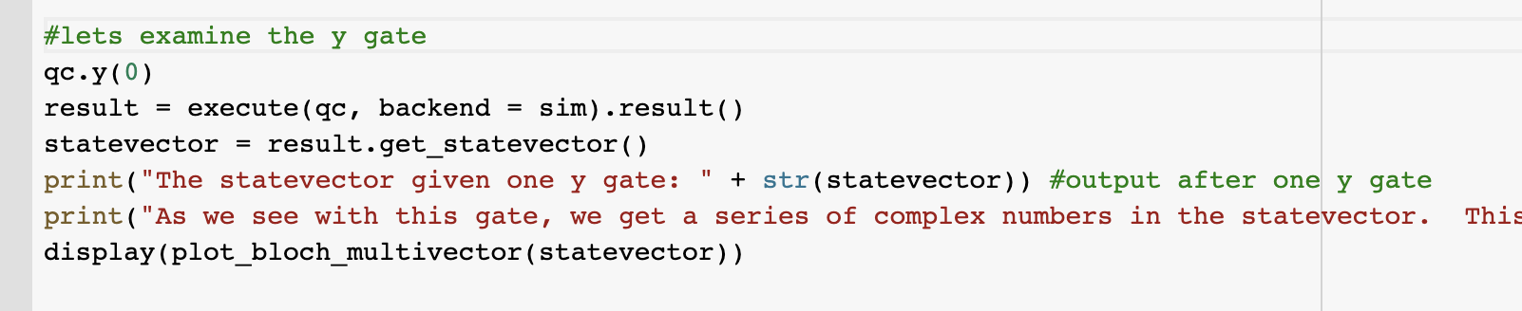
Now let’s apply the y gate.

Slide 9
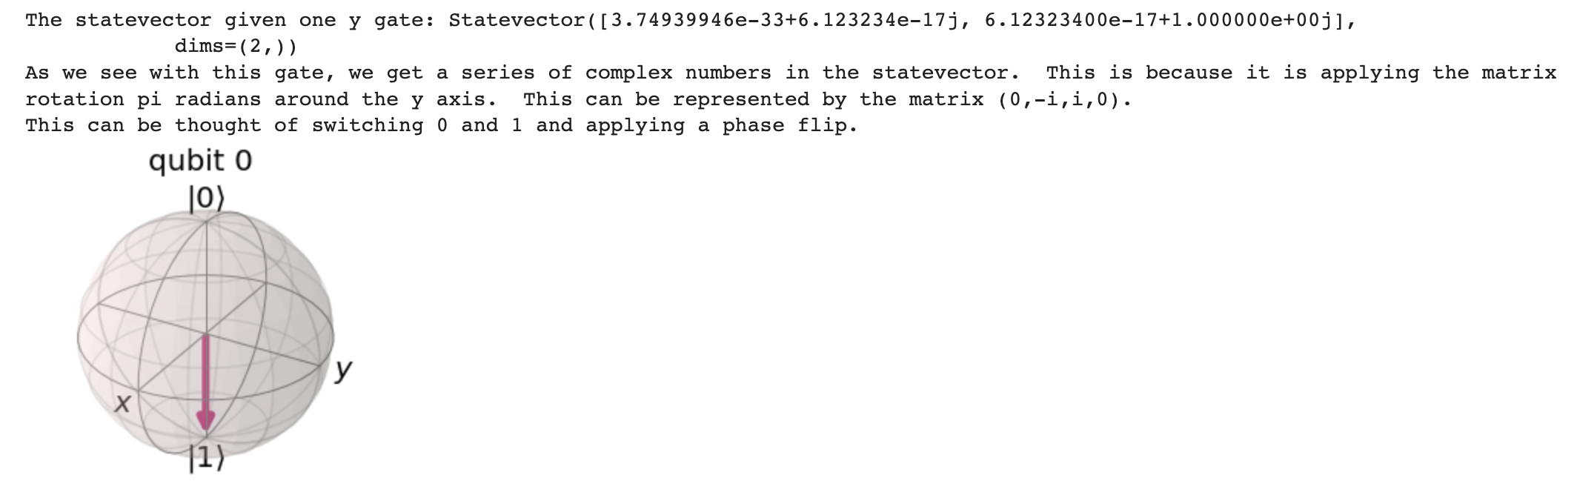
Results:

Slide 10
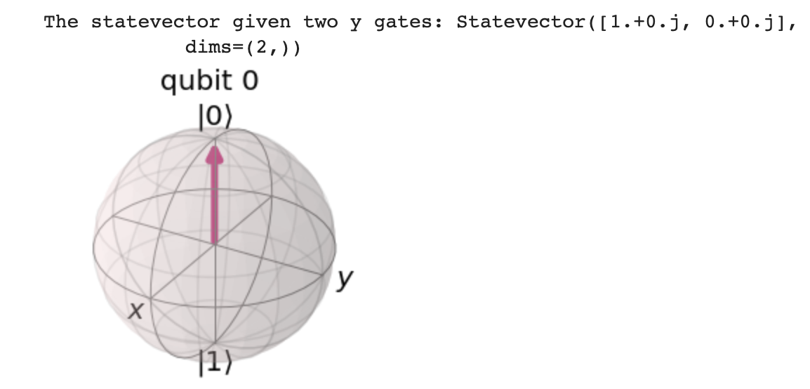
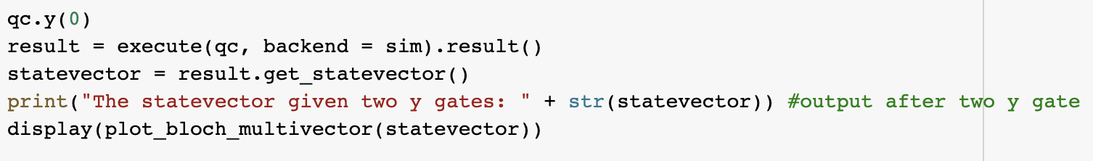
As we can see, the y gate undoes itself.

Slide 11
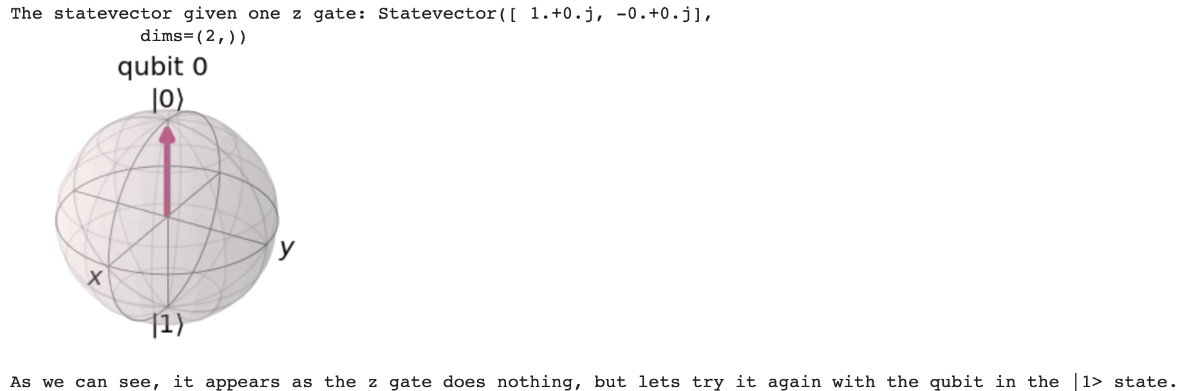
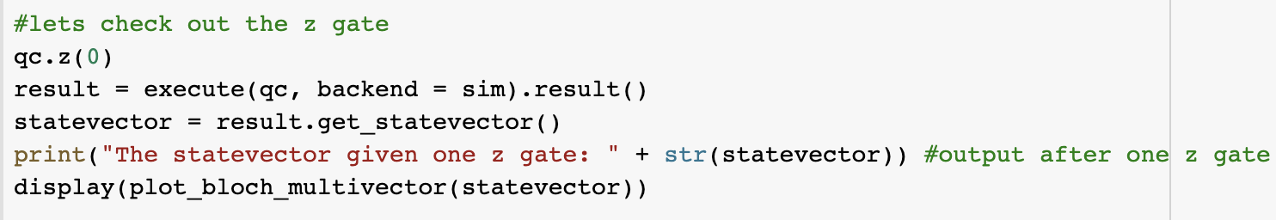
Applying one z gate appears to do nothing to a Qubit in the |0> state

Slide 12
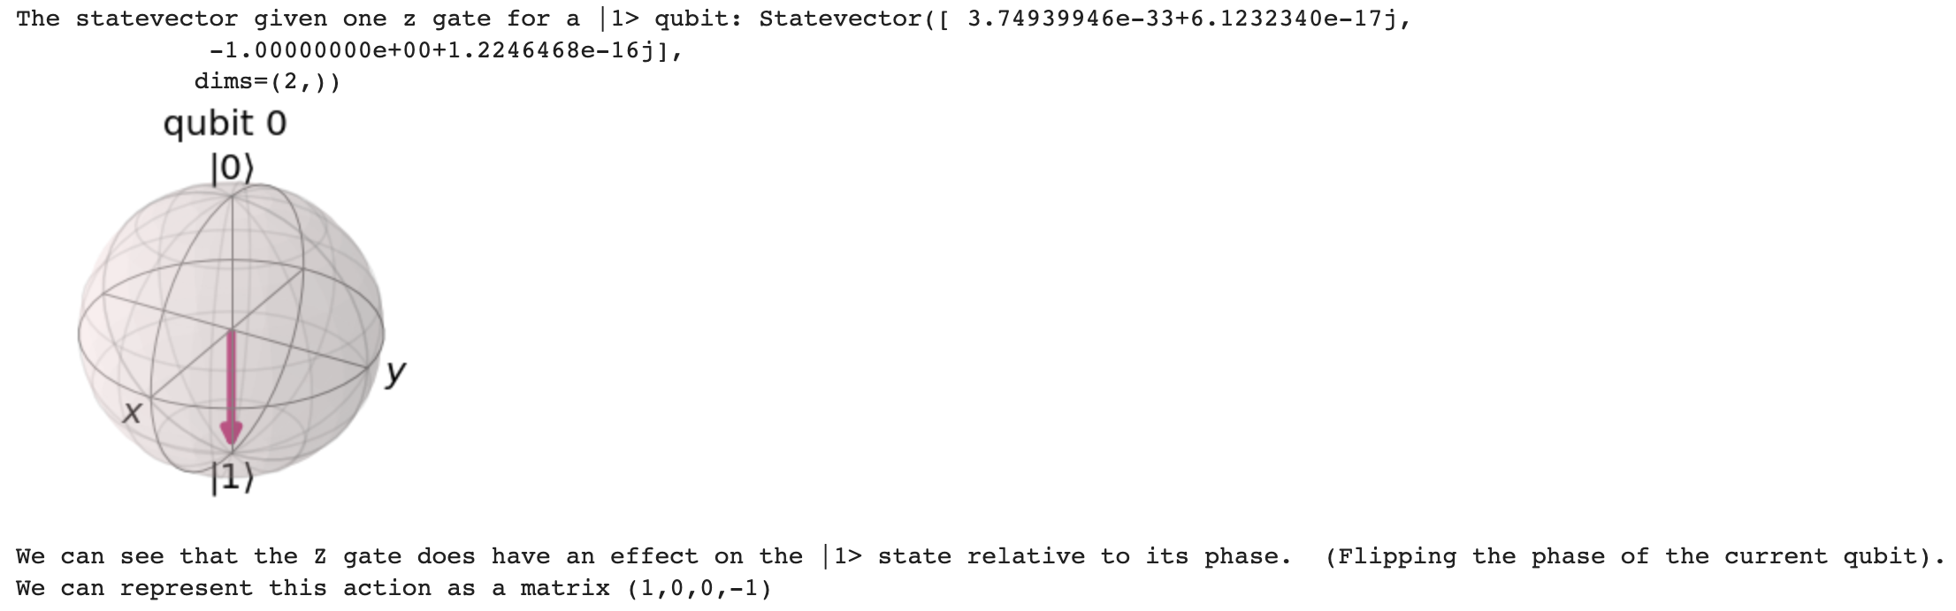
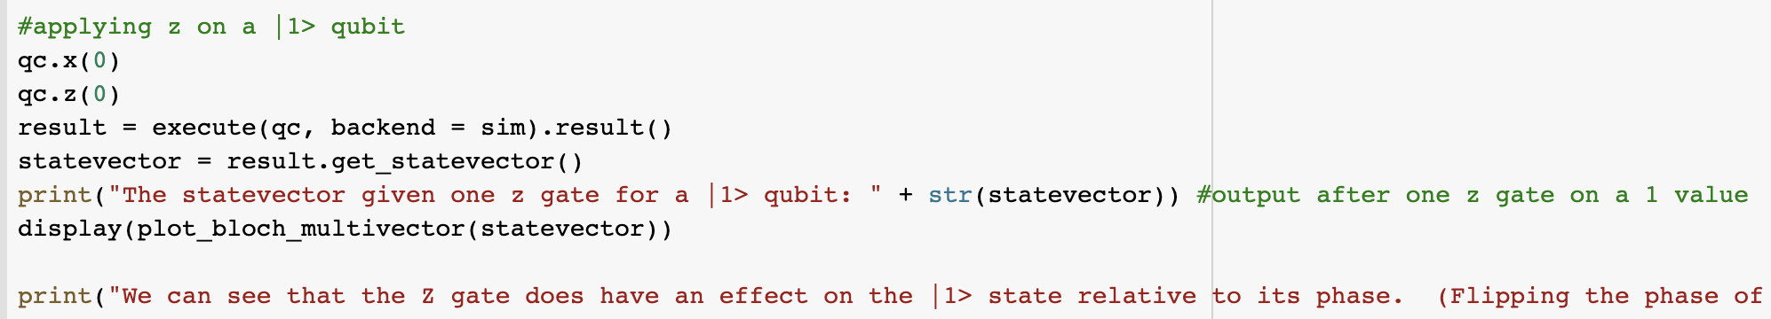
We can observe that Z does have an affect on a Qubit in the |1> state (flipping the phase)

