Slide 1

Quantum Computing: Grover’s Algorithm
By: Brady Phelps (B.S.A.C. ’25)

Slide 2
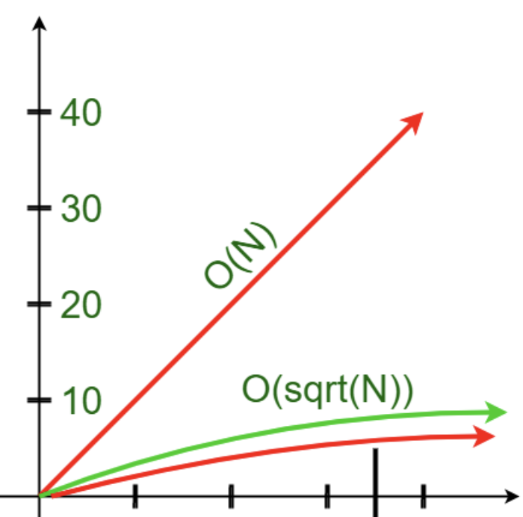
What is Grover’s Algorithm?
Grovers algorithm is a more efficient form of a search of an unordered list.
Time complexity
Imagine an unordered list [2,0,9,3,1,5,8,4,7,6]
To search this list for 7, we would have to check every element until we reached 7 in a classical algorithm.
This leads to a complexity of O(n)
Notes:
https://www.geeksforgeeks.org/trial-division-algorithm-for-prime-factorization/

Slide 3
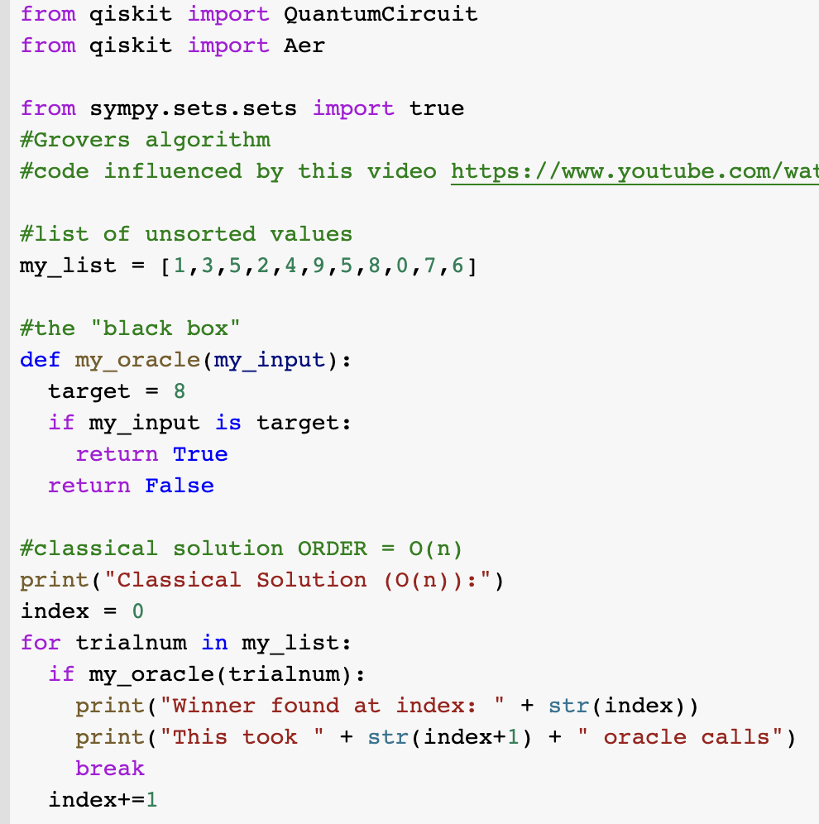
Let’s draft up some code to simulate a classical version of our algorithm. In this version we are using an oracle as a black box to indicate if we got the correct value.

Slide 4
What is Grover’s Algorithm?
Grover’s algorithm allows us to search an unordered list with a complexity of O(sqrt(n)) by utilizing quantum properties.
Code
Oracle: our oracle is a blackbox
that we use to return a correct value.
if the correct value is found, we will
flip the amplitude
Create a state of superposition on our default circuit
Run this circuit through our oracle
Then run through the diffuser
Big picture physics
We have a vector in superposition |S> and a target vector |W> (S is almost orthogonal to W)
We also have |S’>, which is orthogonal to |W>, but |S’> = |S> - |W>
We then run our algorithm which if the correct value is found, will reflect |S> about the |S’> axis because we will flip the phase if given the correct value.
We will then perform amplitude amplification to normalize the amplitude which will flip |S> back over the |S’> axis by twice the original reflection.
This will repeat until we become close enough to the target of |W>

Slide 5
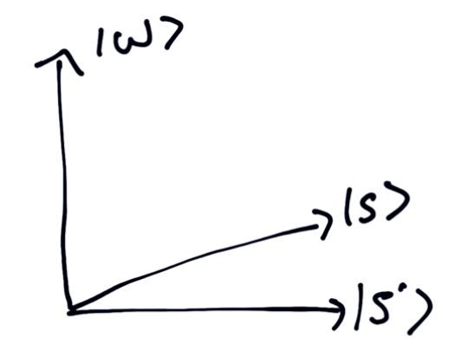
Visual Representation
Here is a representation of the target state |W>, |S> and |S’>
When the oracle is applied to |S>, it will apply a negative to the correct value which will flip it over the |S’> axis.
Notes:
https://www.youtube.com/watch?v=0RPFWZj7Jm0

Slide 6
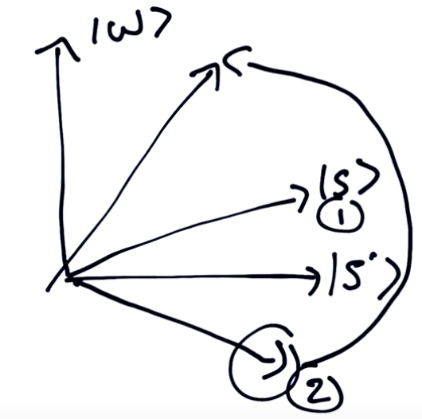
Visual Representation
Now we can see how |S> gets flipped over the |S’> axis. Then the diffusion is applied which brings it back into the first quadrant and closer to target state |W>
Notes:
https://www.youtube.com/watch?v=0RPFWZj7Jm0

Slide 7
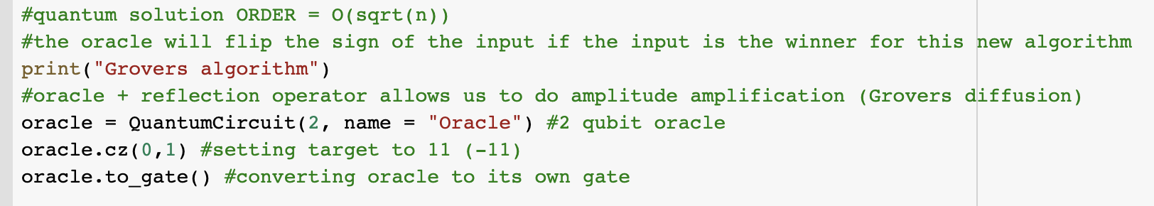
The code (oracle)
First, let’s make an oracle. We will be searching for 11 value, so we can apply
The cz gate to our oracle to get our desired negative for the correct value.
oracle
[1,0,0,0]
[0,1,0,0]
[0,0,1,0]
[0,0,0,-1]

Slide 8
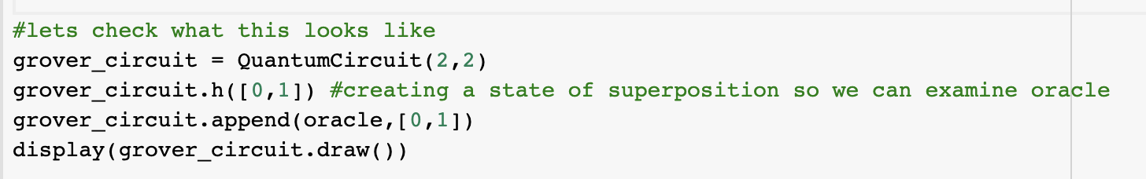
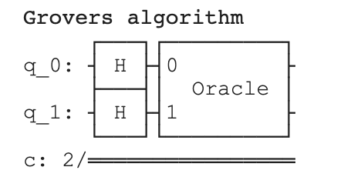
The code (starting Grover’s circuit)
Now we will make a blank circuit, create a state of superposition, and append our oracle to the circuit

Slide 9
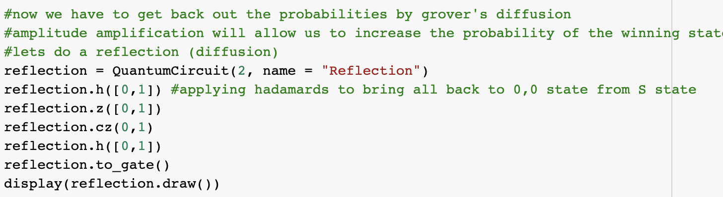
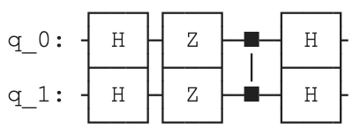
The code (diffusion)
Now we create the diffuser (called reflection). This amplifies the correct solution and reflects over |S’>

Slide 10
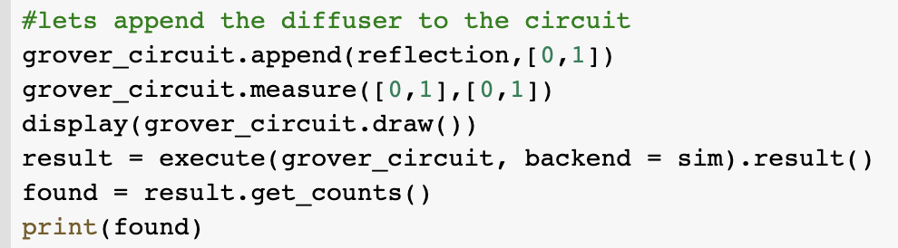
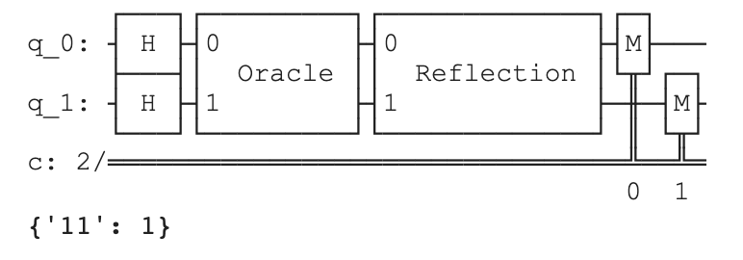
The code (altogether)
Now we add the diffuser the Grover circuit and add some measurements to get our output.
As we can see, the output we found is our target value!
This process is repeated O(n) times

Slide 11
Future of Grover’s Algorithm
As previously mentioned, Grover’s algorithm is already a quadratic speedup compared to classical methods.
However, this could be furthered sped up as people continue to develop and work on these algorithms. (Introducing multiple dimensions for instance)
Uses: Polynomial Root Finding, Transcendental Logarithm Problem, estimating means and medians, collision problem, which has application to almost all industries.

