Slide 1

Quantum Computing: Quantum Teleportation
By: Brady Phelps (B.S.A.C. ’25)

Slide 2
What is Quantum Teleportation?
Quantum Teleportation is a way of teleporting quantum information from one qubit to another
Why do we need to teleport quantum information?
This is because copying information in Quantum Computing is impossible.
Copying is impossible because we cannot know coefficient values of each state
Notes:
https://www.geeksforgeeks.org/trial-division-algorithm-for-prime-factorization/

Slide 3
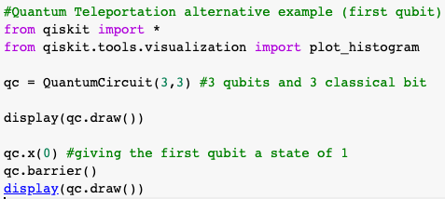
Let’s code a quantum teleportation circuit First let’s import our libraries, create an empty 3 qubit circuit, and add an x gate so the first qubit will store the 1 value.

Slide 4
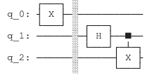
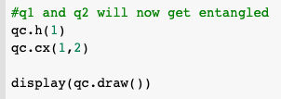
Part 2: Entangle Qubits 2 & 3 by creating a Bell State

Slide 5

Point of information: Bell States
When we create a Bell State between Q_1 and Q_2, we are applying a Hadamard to Q_1, which randomizes the output of Q_1 when we measure it. By adding the CX gate to Q_2, we are creating a situation in which Q_1 will be either 0 or 1, and whatever Q_1 is, Q_2 will be the same.
Mathematical Representation of a Bell State
Notes:
https://brilliant.org/wiki/quantum-teleportation/

Slide 6
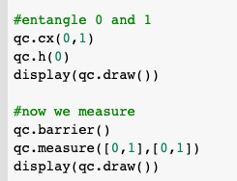
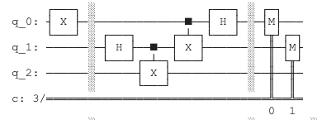
Part 3
Next, we add a CNOT Gate between first and second qubit, and then apply a Hadamard to the first qubit.
We will then take measurements of the first and second qubit.
Notes:
https://www.youtube.com/watch?v=0RPFWZj7Jm0

Slide 7
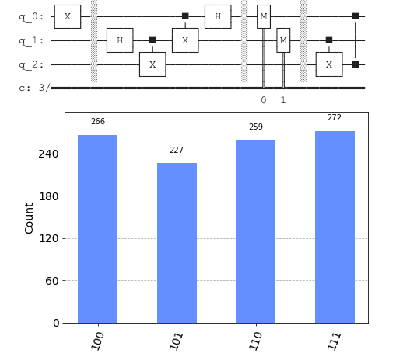
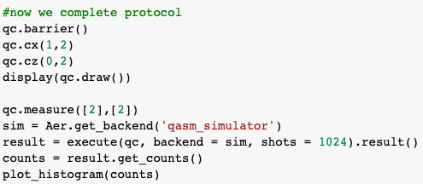
Now we apply a Cx and Cz gate to the specified bits and take measurements. This graph shows us that our original value of |1> stored in the first qubit has been moved to the third qubit!
Notes:
https://colab.research.google.com/drive/18Zzt3lSYNuiJheRG-kiVUKGmiGpmOrEi#scrollTo=p2XMKFMRq26E

Slide 8
This same formula can be followed to teleport data from any combination of bits. Linked is a repo to an example I made to showcase this utility.
https://github.com/BP-2/QuantumTeleportation

