Slide 1

Quantum Computing: Simon’s Algorithm
By: Brady Phelps (B.S.A.C. ’25)

Slide 2
What is Simon’s Algorithm?
Simon’s algorithm finds the hidden bitstring of a 2 – 1 function
The first example of exponential speed up vs best classical algorithms O(2^n-1) vs O(n)
What is a 2-1 function?
A function in which two inputs can have the same output. Say 011 and 110 both output to 100, we can say the hidden bitstring is 101 because both 011 and 110 bitstring with 101 result in 100.

Slide 3
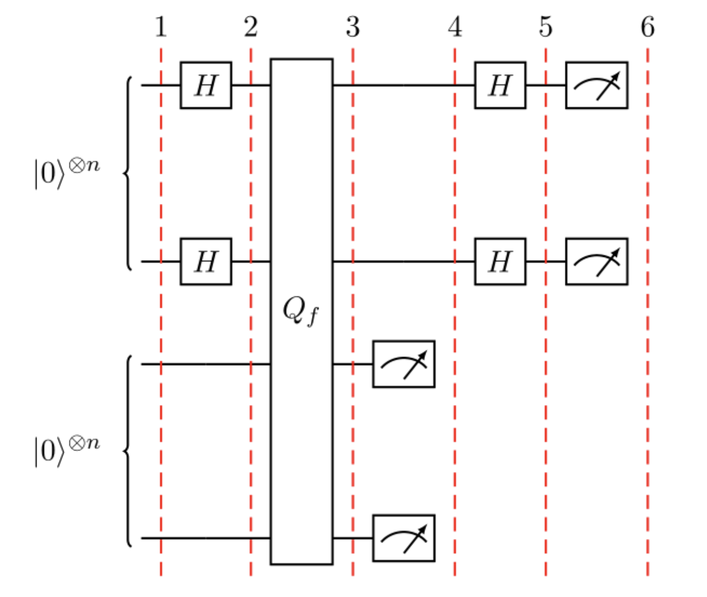
This is what our circuit will look like. You can refer back to this image as we explain what is happening in the following slides.
Notes:
https://qiskit.org/textbook/ch-algorithms/simon.html#introduction

Slide 4

Part 1
We shall break this circuit up into 5 states (outlined as the first 5 red bars in the graph)
In state one we start with two n bit registers with all bits set to zero.
Notes:
https://www.youtube.com/watch?v=0RPFWZj7Jm0

Slide 5
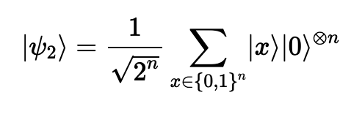
Part 2
Next, we shall apply a Hadamard gate to the first register. This notation below represents we have one register with all outcomes for an n bit register and an n bit register populated with 0’s

Slide 6
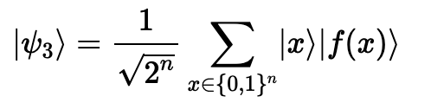
Part 3
Now we apply the query function Qf to our circuit. You may notice that only the second register changes. This is because we are performing a controlled operation from the first register to the second register.
The first register will now contain all possible inputs and the f(x) will contain the corresponding output.
A possible pairing could be |000> |111> if that is the output for |000>

Slide 7
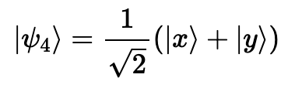
Part 4
At this point we have measured the second register and have observed the value. This means our first register will contain either |x> or |x+s>
s being the bit string and y being |x+s>
We know this because if we get the corresponding output, then you have to have one of the 2-1 inputs that matches it. These inputs being either |x> or |x+s>

Slide 8
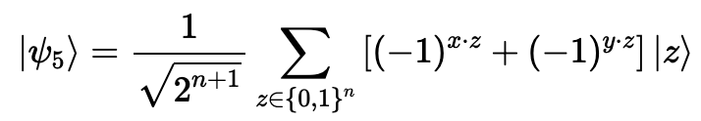
Part 5
Now we apply a Hadamard gate to the first register which provides us with the following state.
This will only give us an output if y.s = 0
For example, if y = |000> and s = | 101>, then we can see that 0 * 1 + 0 * 0 + 0 * 1 = 0 and 0 mod 2 = 0 which means that y.s = 0
Notes:
https://qiskit.org/textbook/ch-algorithms/simon.html#introduction

Slide 9
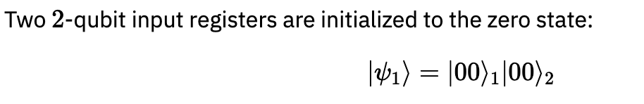
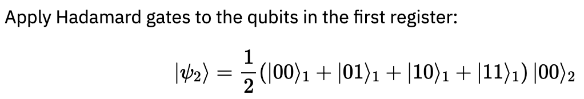
Brief example
Step 1:
Step 2:
Notes:
https://qiskit.org/textbook/ch-algorithms/simon.html#introduction

Slide 10
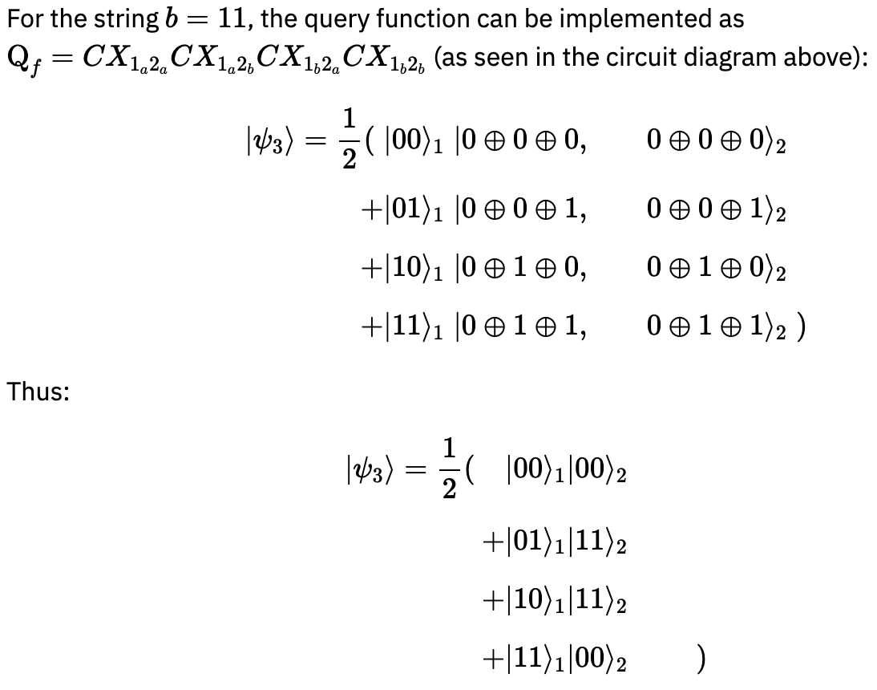
Brief example
Step 3:
Notes:
https://qiskit.org/textbook/ch-algorithms/simon.html#introduction

Slide 11
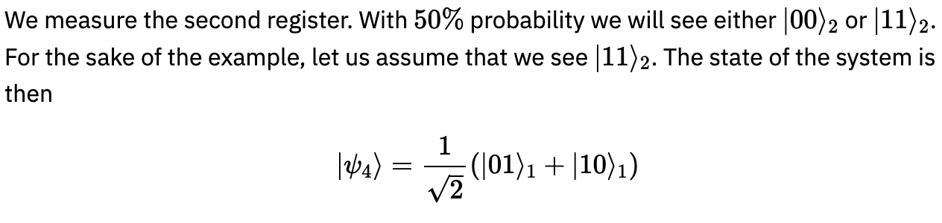
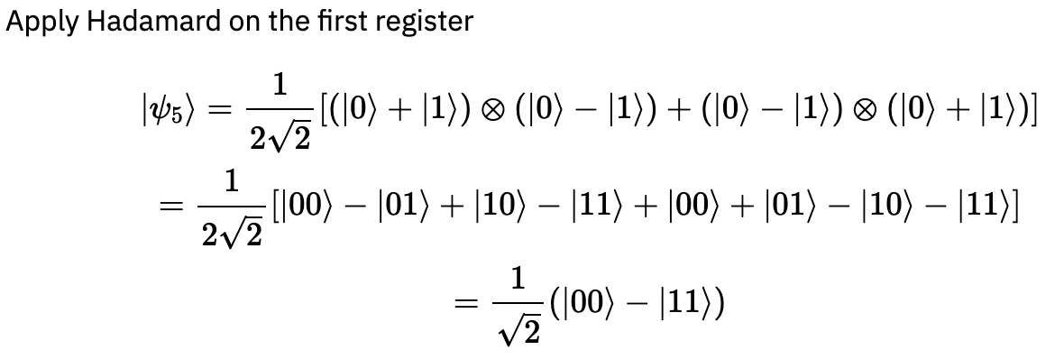
Brief example
Step 4:
Step 5:
Notes:
https://qiskit.org/textbook/ch-algorithms/simon.html#introduction

Slide 12
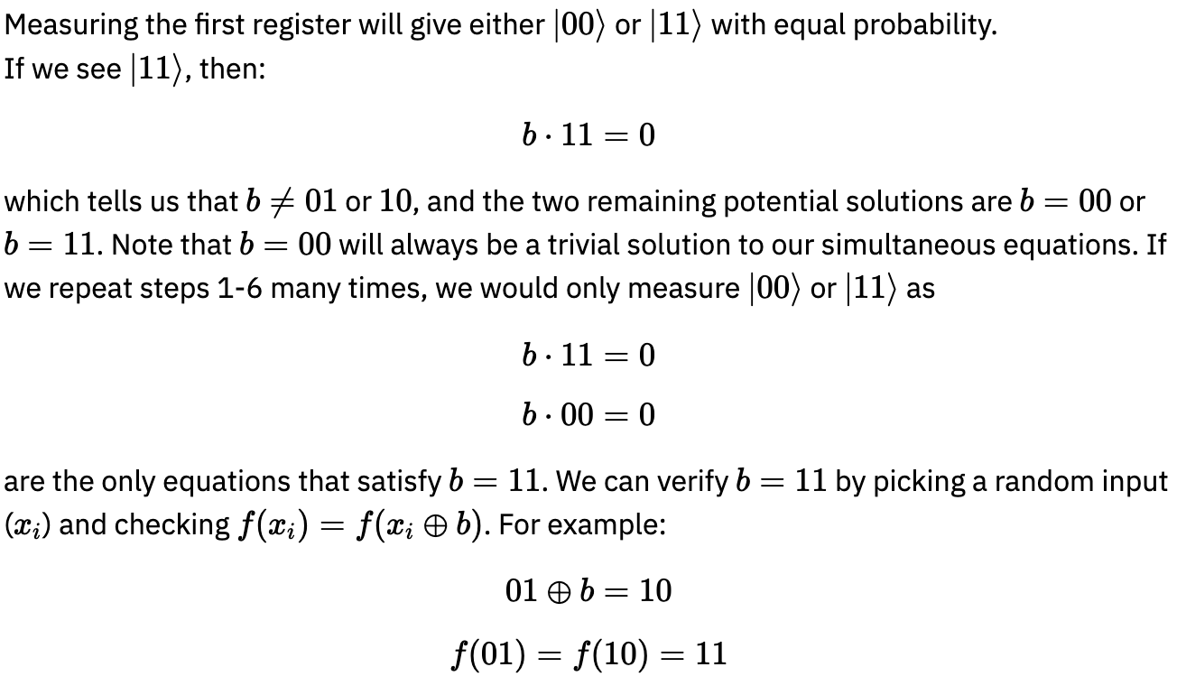
Brief example
Step 6:
Notes:
https://qiskit.org/textbook/ch-algorithms/simon.html#introduction

Slide 13
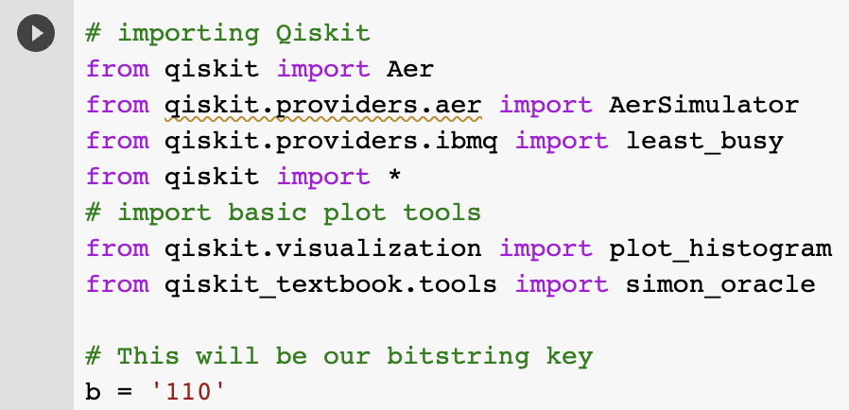
Implementation
We will use a built in simons operator to make the black box used for this algorithm. You must run the following command to install the correct packages.
!pip --quiet install git+https://github.com/qiskit-community/qiskit-textbook.git#subdirectory=qiskit-textbook-src
Import proper packages and declare a bitstring key
Notes:
https://colab.research.google.com/drive/18Zzt3lSYNuiJheRG-kiVUKGmiGpmOrEi#scrollTo=fduOMARvq60c

Slide 14
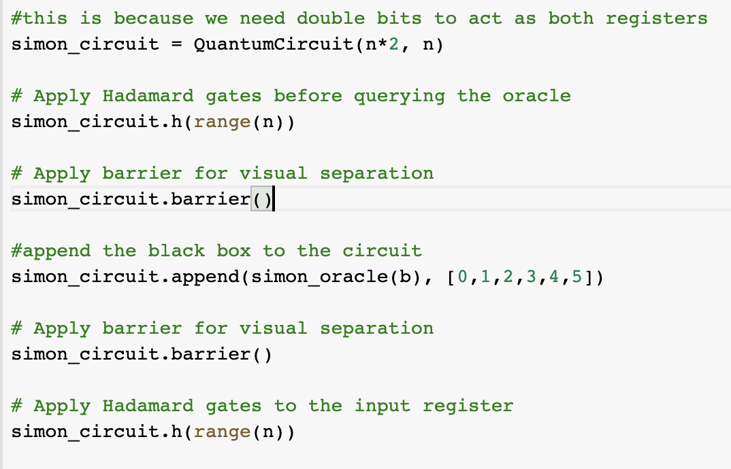
Now we apply the Hadamard to the first register, add our black box, and then add the Hadamard the first register again. (We also add some visuals)
Notes:
https://colab.research.google.com/drive/18Zzt3lSYNuiJheRG-kiVUKGmiGpmOrEi#scrollTo=p2XMKFMRq26E

Slide 15
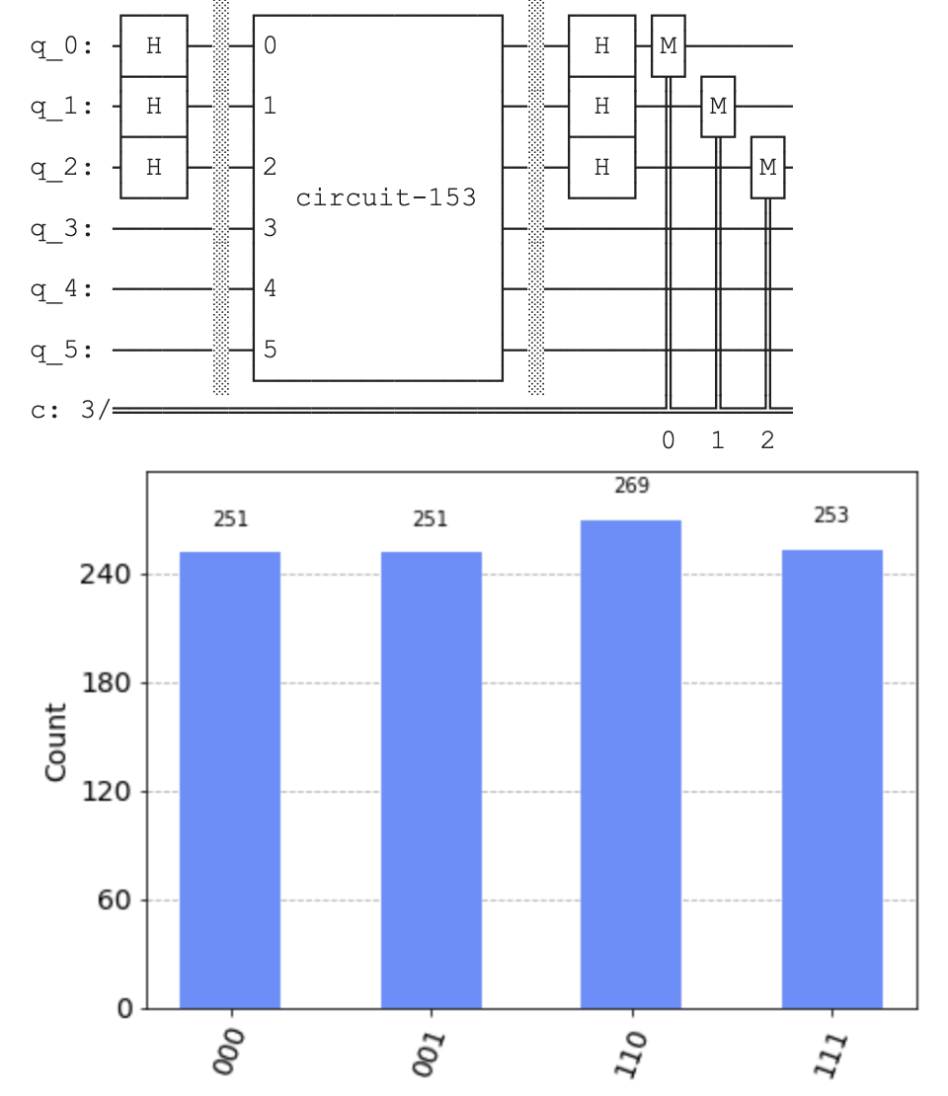
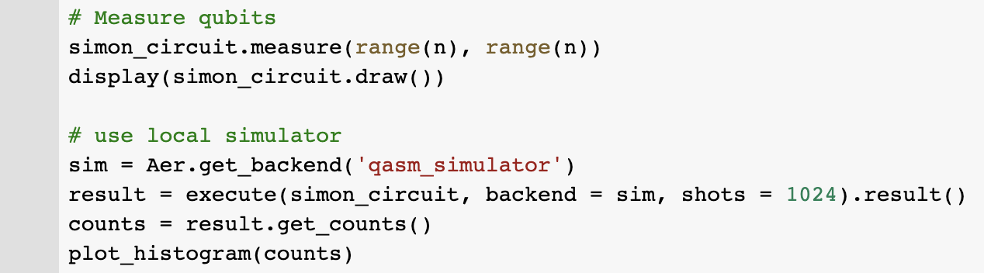
Finally, we run our simulator and display the output

Slide 16
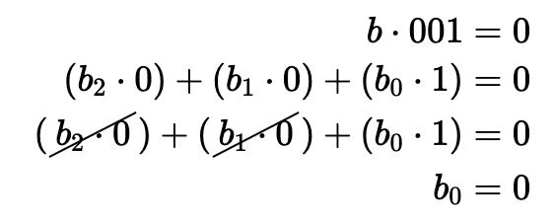
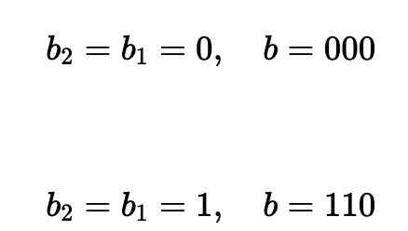
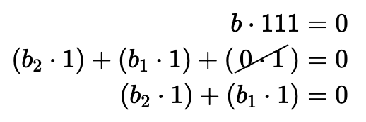
Results
With this output, we can see four correct states satisfy b . Z = 0 (mod 2)
Say we read 001 first, we can deduce…
Then we read 111 to deduce
Which tells us b = 000 or b = 110. Since 000 will always be a solution, we can tell 110 is the hidden bitstring!

Slide 17
Future of Simons Algorithm
As previously mentioned, Simon’s Algorithm achieves exponential speedup over classical methods.
This has potential to be improved upon as researchers continue to improve on quantum algorithms.
Uses: Cryptography, search and optimization, simulation of quantum systems, and solving large systems of linear equations. This has a variety of uses in almost all major industry.

Slide 18
This example can be found at the following repo.
https://github.com/BP-2/SimonsAlgorithm.git

