Slide 1

Probabilistic programming Jure Demšar

Slide 2
Problems of the two approaches
The two approaches (analytical, brute force) do not scale!
Useful only for the simplest models.
Solution: MCMC and probabilistic programming.
We only have one very minor limitation: likelihood and prior must be easily calculated (up to a multiplicative constant).

Slide 3
Imperative programming
Under the term programming languages we generally think about imperative (general purpose) programming languages (e.g. c++, python, R ...).
In imperative programming we are given a set of inputs (input parameters or input data).
Our goal is to develop an algorithm (define a step-by-step procedure) that uses given inputs to produce desired outputs

Slide 4
Probabilistic programming
Wikipedia: “Probabilistic programming is a programming paradigm in which probabilistic models are specified and inference for these models is performed automatically.”

Slide 5
Probabilistic programming language (PPL)
PPLs are programming languages designed specifically for developing probabilistic models and inferring from them.
They enable us to focus on the modelling part while they take care of the mathematical and computational problems required for statistical inference.
Under the hood, PPLs are developed via traditional, imperative programming.

Slide 6
Imperative vs. probabilistic programming
With imperative (traditional) programming your task is to develop an algorithm (a set of steps) that generates some outputs based on given inputs. In other words, we are developing a process that generates some data.
With probabilistic programming we are going the other way, we are given the “output” (some data) and our task is to “reverse engineer” the process (or algorithm) that generated the data.

Slide 7
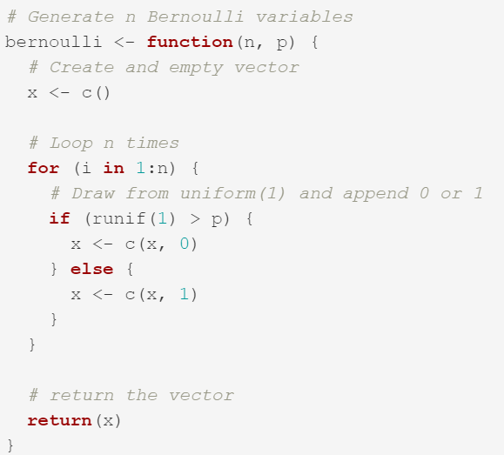
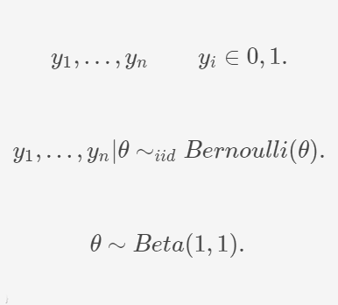
Imperative vs. probabilistic programming

Slide 8
Imperative vs. probabilistic programming
We need both!
We need imperative programing to load and prepare the input data for our probabilistic program.
We need PPLs to design the model and do the statistical inference.
After the inference is completed, we again need imperative programing to diagnose the outputs, analyze results, prepare visualizations ...

Slide 9
All models are wrong, but some are useful
Problems we are solving with probabilistic programming are in its essence unsolvable. There are infinite ways to generate the given data and no mechanism to prove which of them is correct.
We are not developing a perfect model, but a useful model!
Probabilistic model development is an iterative process guided by knowledge, experience and intuition.
Do not get discouraged if your initial models fail in a spectacular manner.

Slide 10
Example

Slide 11

Stan
Stan is a state-of-the-art platform for statistical modelling and high-performance statistical computation.
It is one of the most popular probabilistic programming languages as thousands of users rely on it for statistical modelling in many domains. It has an excellent support forum and great documentation.
Stan’s main sampling algorithm is called the No-U-Turn Sampler (NUTS), a variant of Hamiltonian Monte Carlo.
Pairs well with many popular programming languages (e.g. R, python ...).

Slide 12
Basic variable types in Stan
int n; // integer number
real r; // real number
// we can specify lower and upper bounds for almost all types
real<lower=0> sigma;
real<lower=0,upper=1> success_rate;
// array, Stan starts indexing from 1
int a[n];
real b[n];

Slide 13
Basic variable types in Stan
// 2D array matrix [rows, columns]
int A[n, n];
// vector (real number)
// computationly vectors are more efficient then arrays
vector[n] v;
// matrix (real number)
// just like vectors, matrices are more efficient then arrays
matrix[n, n] M;

Slide 14
Structure of Stan models
Stan models are usually stored in .stan files and are composed of blocks.
There are 7 types of blocks:
functions,
data,
transformed data,
parameters,
transformed parameters,
model,
generated quantities.

Slide 15
The data block
data {
// input data definition
... declarations ...
}
Declaration of variables which represent the input data.
Putting constraints on the variables by specifying the lower and upper bounds (<lower=0,upper=1>) is a safety net for us so we do not provide Stan with erroneous data.

Slide 16
The parameters block
parameters {
// definition of model's parameters
... declarations ...
}
Declaration of parameters we are interested in estimating.
From a user’s perspective, the parameters in the program block are the parameters being sampled by Stan. Their values will be passed back to the interface programming language.
Lower and upper constraints define the minimal and maximal value which can be accredited to the parameter.

Slide 17
The model block
model {
// model definition
... declarations ...
... statements ...
}
Variable declaration is optional, defined variables are local and are not part of the output.
Statements in this block define the probabilistic model.
We use probability distributions as the core building blocks in our modelling process.

Slide 18
Distributions
Bernoulli distribution (y ~ bernoulli(theta);), where y is a vector of successes (1) and failures (0) and theta is the probability of a success.
Beta distribution (y ~ beta(alpha, beta);), where y is a vector of real numbers between 0 and 1 and alpha and beta are the parameters of the beta distribution.
Normal distribution (y ~ normal(mu, sigma);), where y is a vector of real numbers, mu is the mean and sigma the standard deviation.
Gamma distribution (y ~ gamma(alpha, beta);), where y is a vector of positive real numbers and alpha and beta are the parameters of the beta distribution.
Obviously, Stan supports many other probability distribution, for a complete list consult Stan's documentation.

Slide 19
Questions, problems … jure.demsar@fri.uni-lj.si

