Slide 1
Home Security
BY
PONNAM BALAKRISHNA
SIRISHA VALLURI
Ramesh Kuthala
Shiva ShANKAR KOMMINENI

Slide 2
IDEA….
HOME SECURTY MONITORING APPLICATION
This application is designed for detecting the particular door and windows are opened or closed.
Also indicates which light is ON/OFF.

Slide 3
FUNCTIONALITIES
On selecting the door or window, based on the selected state it shows all the doors or windows with that state.
Similarly with the light, if we have selected the light which is ON it displays all the lights which are ON.
The items get displayed on the selected state of item. We can also see the status of every item.

Slide 4
VIRTUAL SENSOR:
Our virtual sensor works like a real sensor which detects the state of doors and windows in a particular building.
We can modify the state of a door or a window.

Slide 5
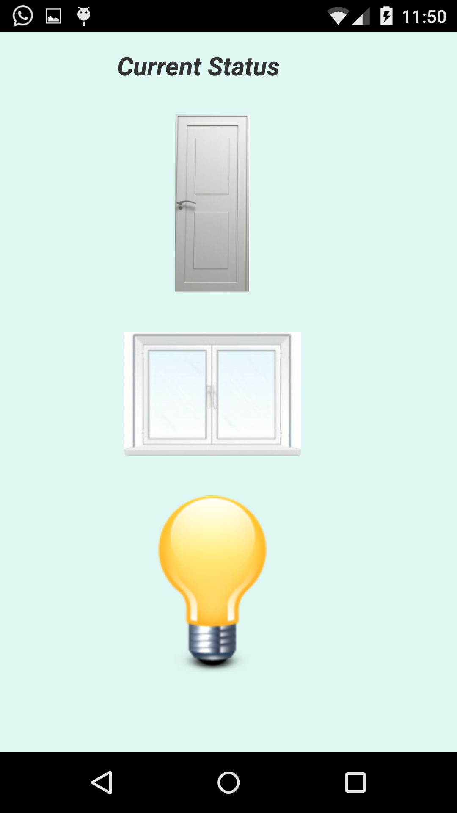

Slide 6
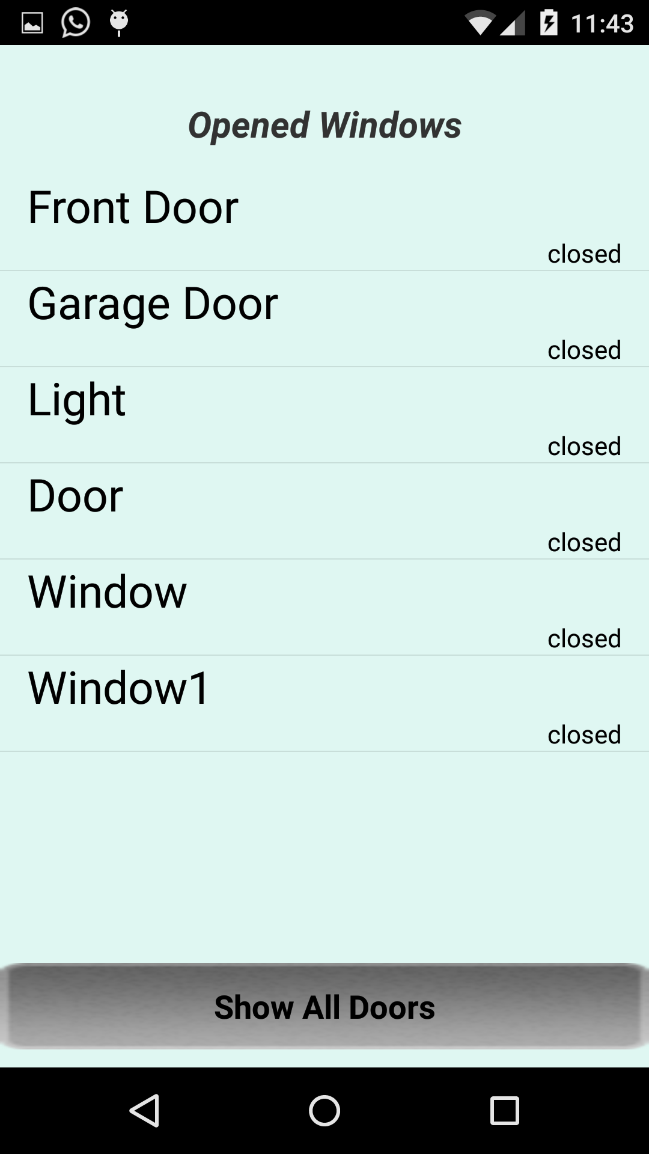

Slide 7
WORKING STRATEGY :
In our application we add sensors and each sensor will be having 4 attributes in turn.
Sensor_type
Sensor_status
Sensor_id
Sensor_name
The sensor functioning is done by using another application
We have created that application which is connected to this application, that shows the status of the items.
If you have updated anything in that application, then changes are reflected back in main application.

Slide 8
USAGE….
This application can be mostly used in the buildings which contains more number of doors, windows and lights.
For the building like malls, office buildings, complexes having many doors , lights and windows. At the time of closing it is very hard to look at each door and light.
Rather than looking at each door and light it is easy checking from the app which door is open and which door is close.
So that the operation can be performed on particular item.

Slide 9
TECHNOLOGY :
ANDROID
MOBILE DATA FROM IBM BLUE MIX
VIRTUAL SENSOR APPLICATION WHICH CREATES AN APPLICATION OF ACTUAL SENSOR

Slide 10


Slide 11

ANY QUERIES

