Slide 1
ESHOPPE
Balakrishna Ponnam
Sirisha Valluri
Ramesh Kuthala
Shiva Shankar Kommineni

Slide 2
Contents
Introduction
Services Implemented
Services Used
Sequence Diagram for Services
Screenshots

Slide 3
Introduction
Online shopping has become more popular these days.
We developed native android application.
Provides rich and user friendly UI

Slide 4
Services Implemented
GET /validate/{username}/{password} to validate the registered user
POST /register which requires json data in the following format to store the user details in database.
{
“fname”:”user fname”,
“lname”:”user lname”,
“address”:”address”,
“city”:”city”,
“state”:”state”,
“phonenum”:phonenum,
“user_name”:”unique username”,
“pwd”:”password”
}

Slide 5
Services Used
Walmart’s public API to search for any product.
http://api.walmartlabs.com/v1/search?&query=“prod”
Google Maps API to retrieve the nearest stores.
https://maps.googleapis.com/maps/api/place/textsearch

Slide 6
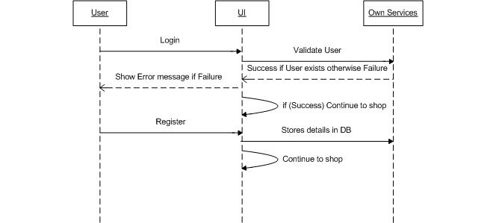
Sequence Diagram for Services

Slide 7
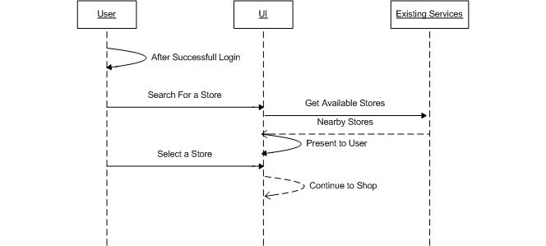
Sequence Diagram for Services

Slide 8
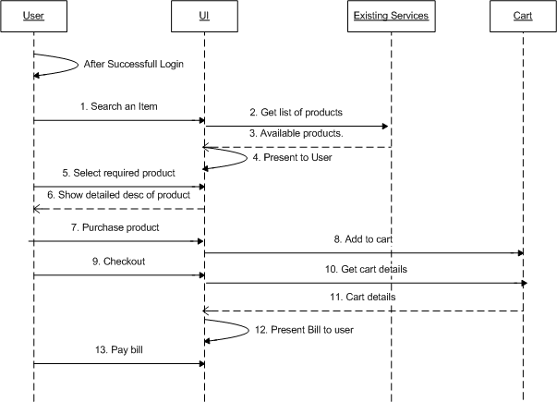
Sequence Diagram for Services

Slide 9
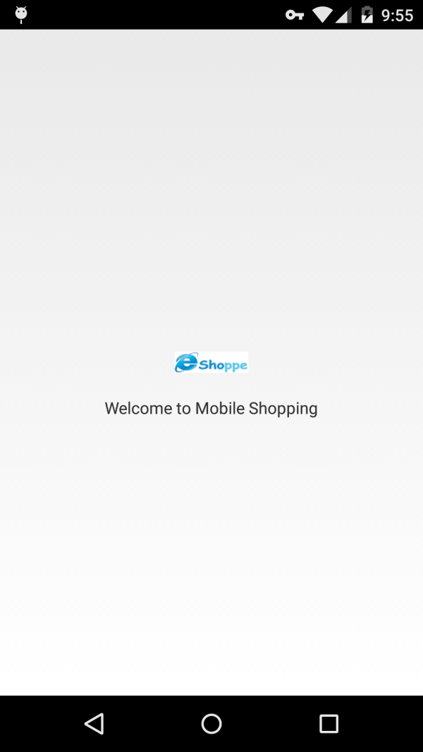
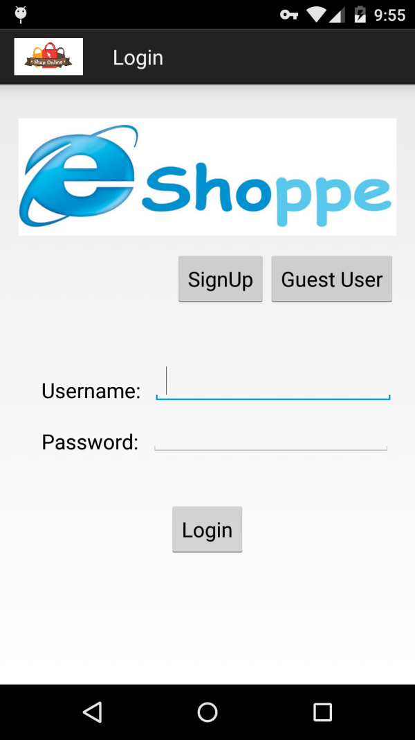
Screenshots

Slide 10
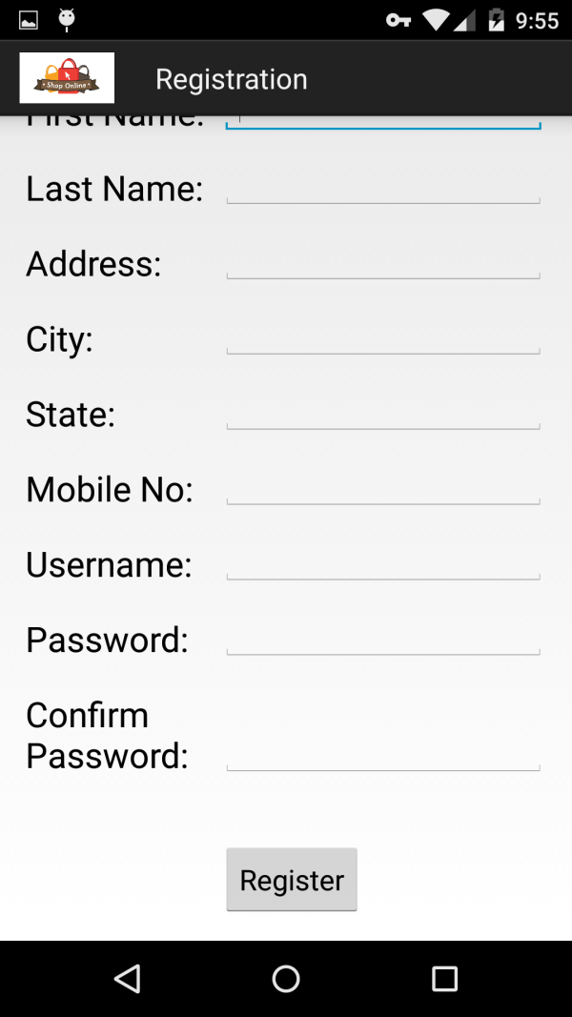
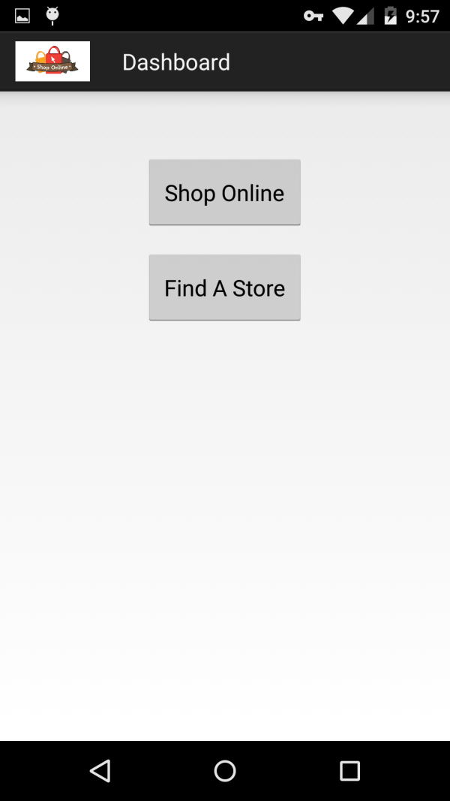
Screenshots

Slide 11
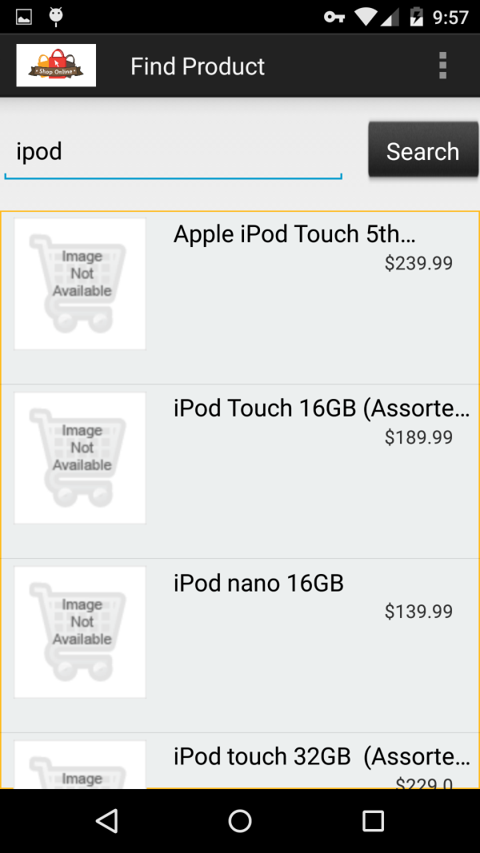
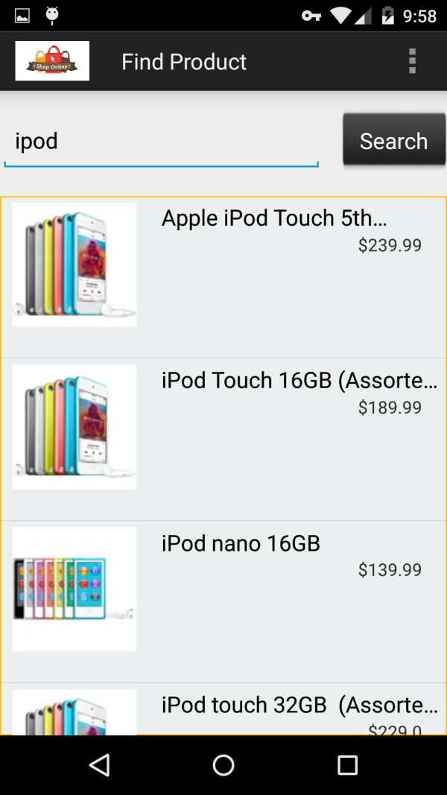
Screenshots

Slide 12
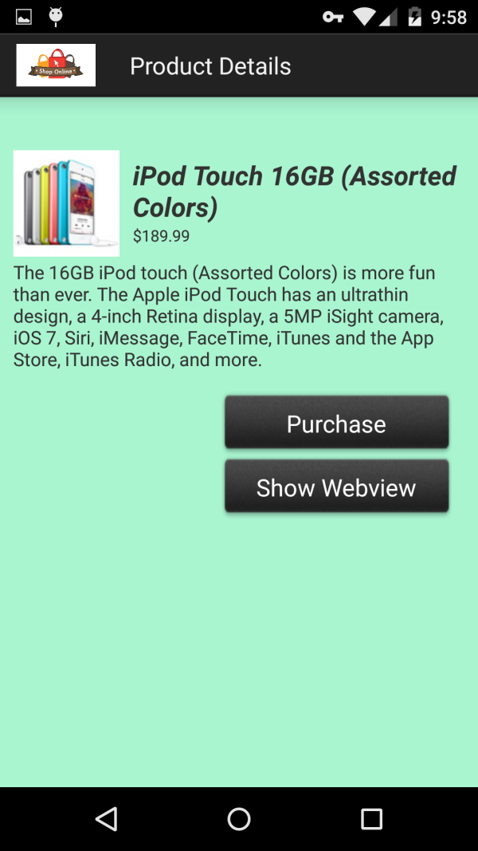
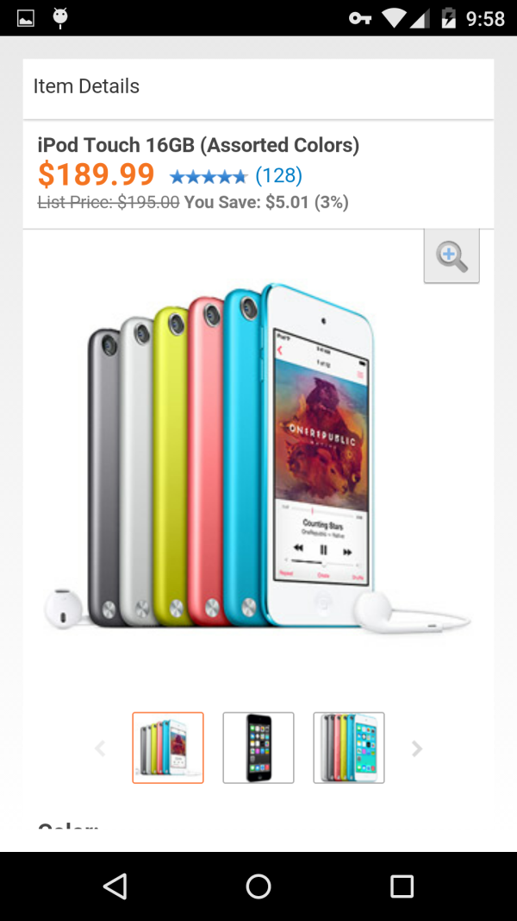
Screenshots

Slide 13
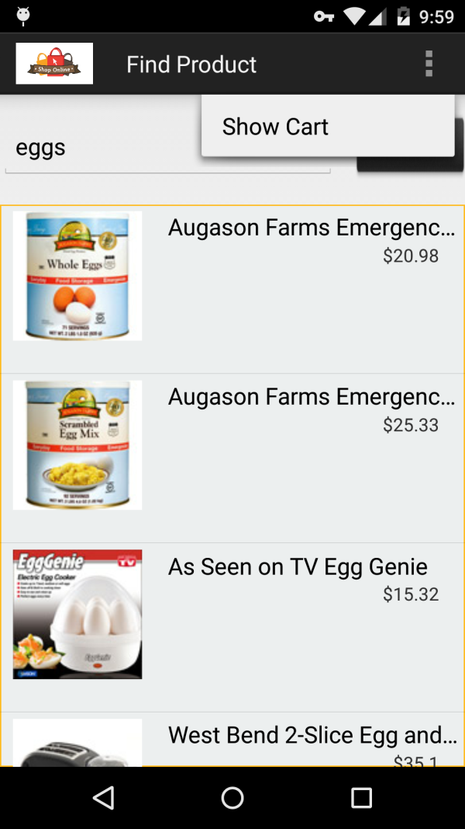
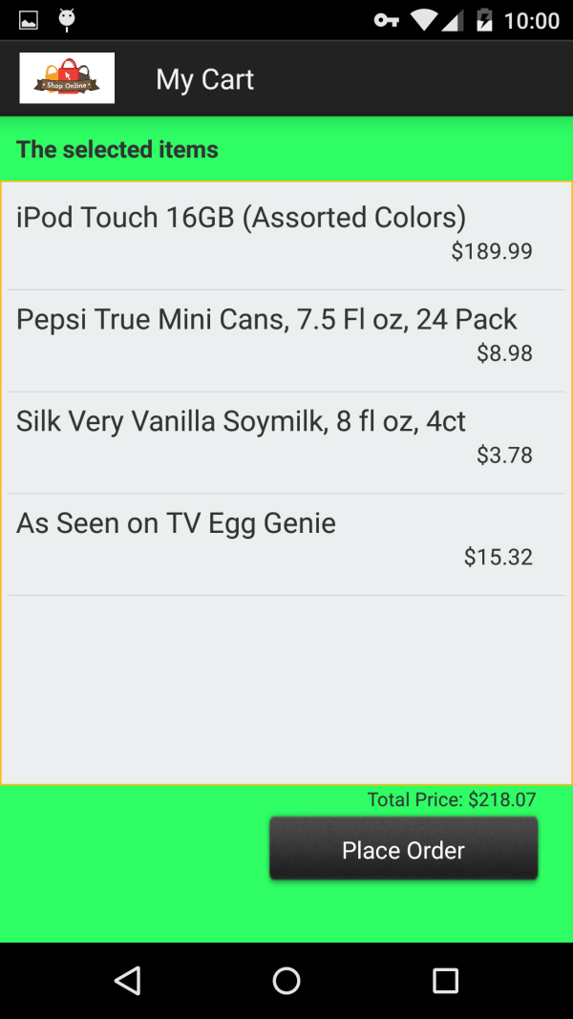
Screenshots

Slide 14
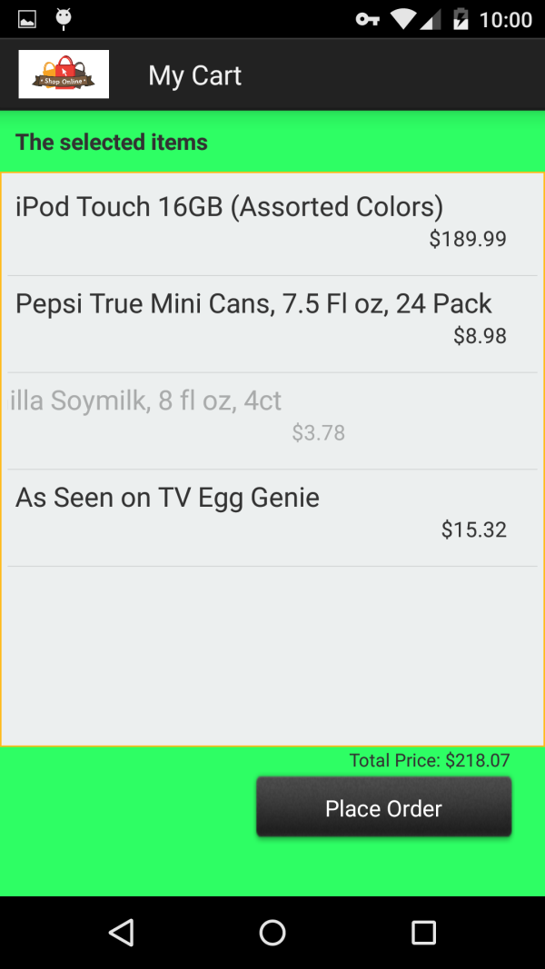
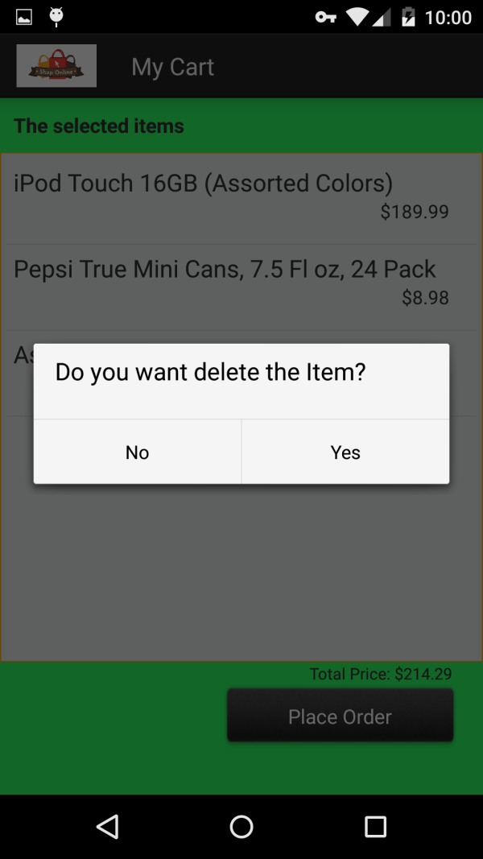
Screenshots

Slide 15
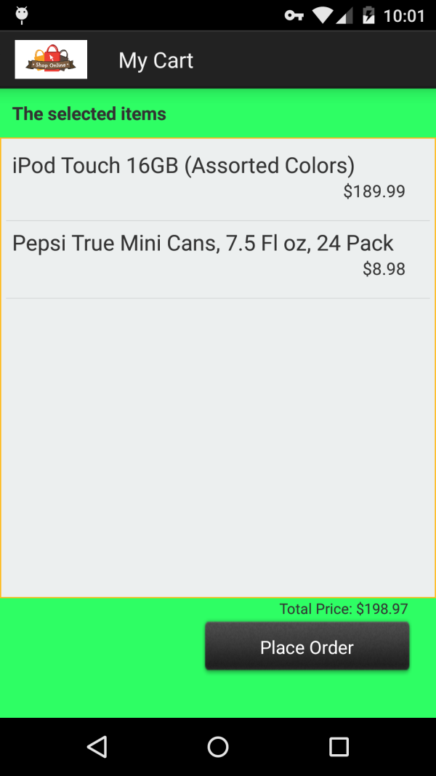
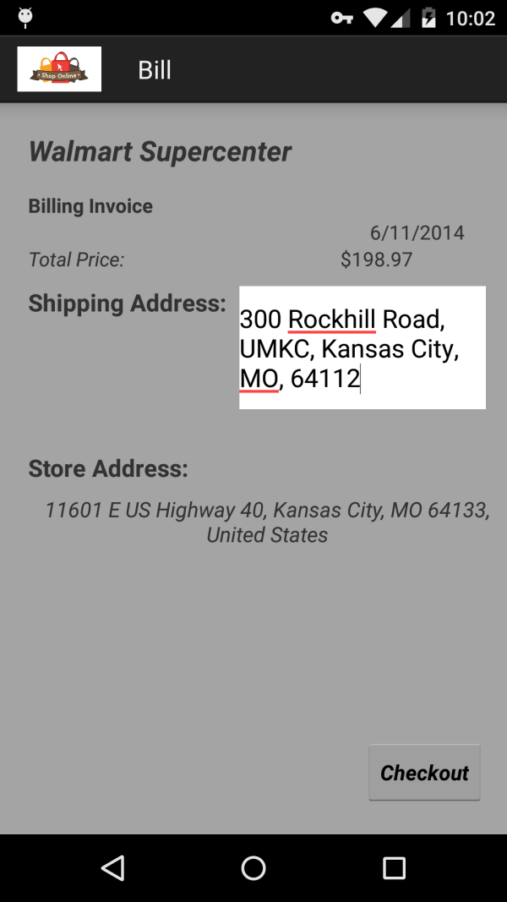
Screenshots

Slide 16
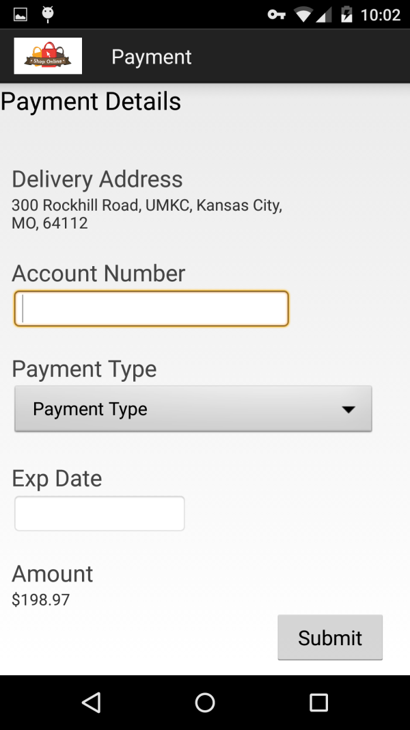
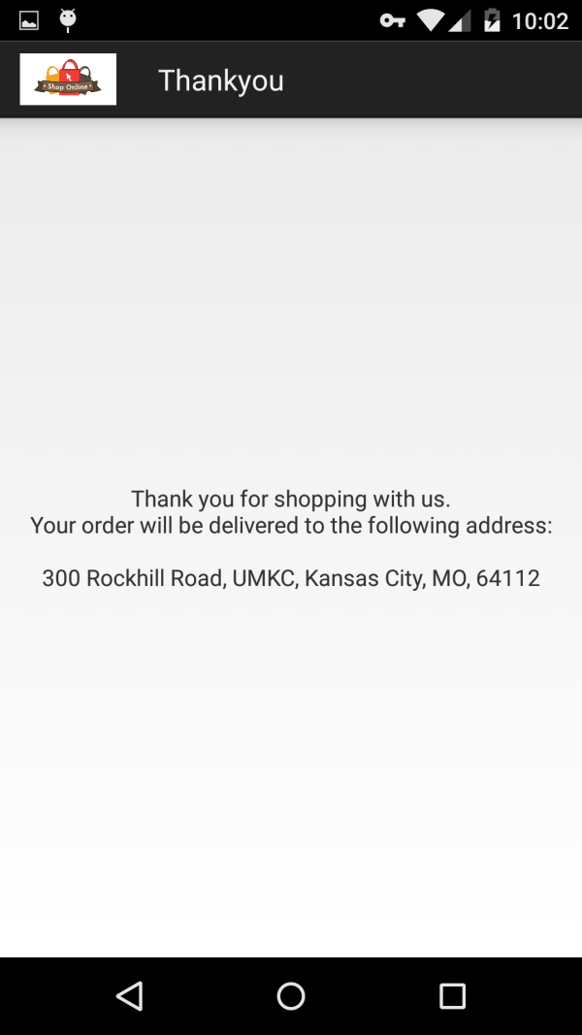
Screenshots

Slide 17
Thank You

Slide 18
?

