Slide 1
Introduction to the Command-line
Presenters Name
Organisation
23rd- 25th June 2015
Queensland University of Technology

Slide 2
Unix
UNIX is an operating system which was first developed in the 1960s, and has been under constant development ever since
UNIX systems usually have a graphical user interface (GUI) similar to Microsoft Windows which provides an easy to use environment
Today Unix is ubiquitous; found everywhere from supercomputers to smartphones

Slide 3
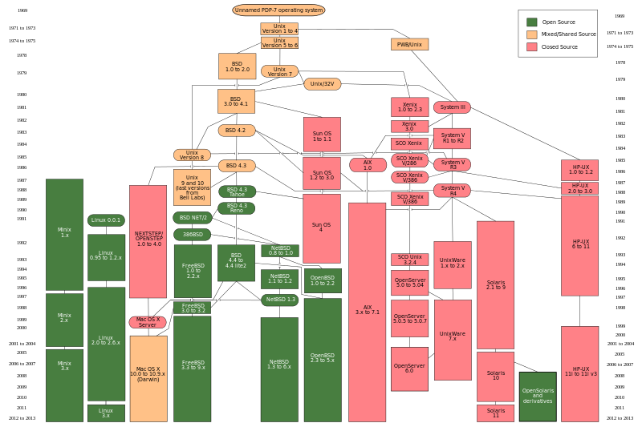

Slide 4
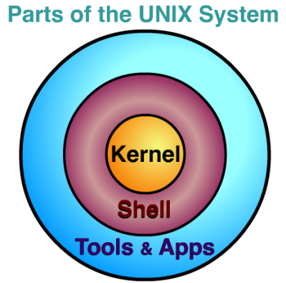
Unix Components

Slide 5

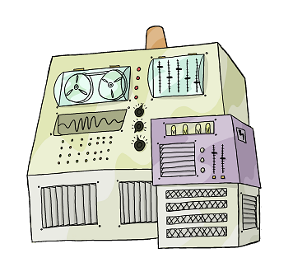
user logs in
user types command
computer executes command
and prints output
user types another command
computer executes command
and prints output
⋮
user logs off
shell
Notes:
5

Slide 6

A shell is just a program that runs other programs
Most popular is bash (the Bourne again shell)
Using it feels a lot more like programming
than using windows, a mouse, etc.
Commands are terse and often cryptic
Use it because:
– many tools only have command-line interfaces
– allows you to combine tools in powerful new ways
Notes:
6

Slide 7
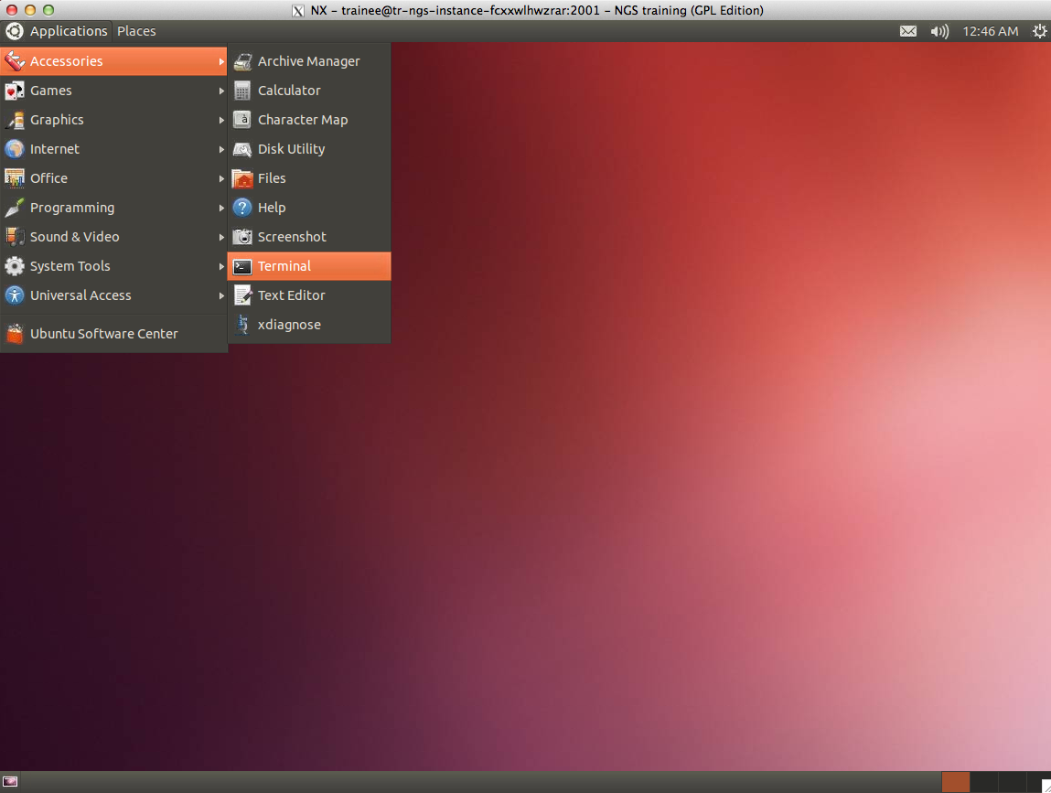
Starting the command-line

Slide 8
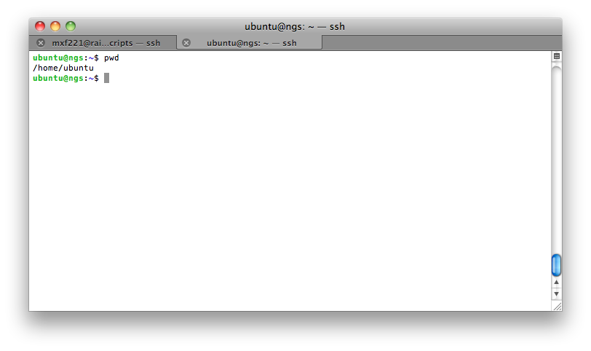
The “prompt”; where you type your commands
The host
The current directory (“path”)

Slide 9
Commands You Will Need to Know
Talk will focus on some basic commands you will need to run through the workshop
In general a Unix command has the format:
‘Command’ ‘flags’ ‘arguments’
To access the documentation for any Unix command type ‘man command’
Type ‘man mkdir’ into your shell now

Slide 10
The first command
Type the command whoami, then press the Enter key (sometimes marked Return) to send the command to the shell.
The command's output is the ID of the current user
More specifically, when we type whoami the shell:
finds a program called whoami,
runs that program,
displays that program's output, then
displays a new prompt to tell us that it's ready for more commands.

Slide 11
Where are we: pwd
-To find your current path use “pwd”

Slide 12
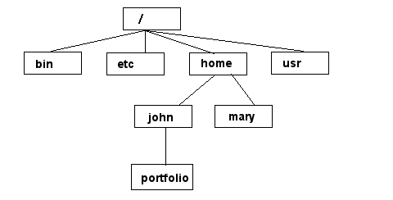
Unix File Systems Tree Structure
NOTE: Unix file names
are CASE SENSITIVE!
/home/mary/
/home/john/portfolio/
The Path

Slide 13
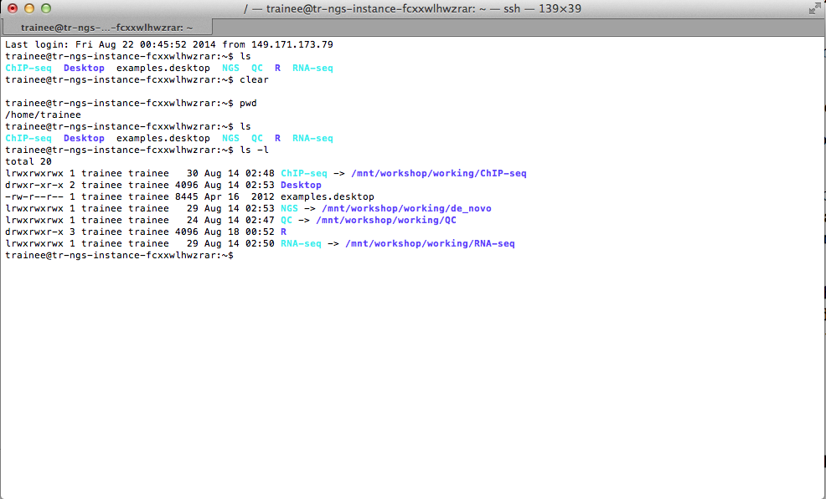
View Files: ls
To view all the files in your current directory use “ls”
Unix options or flags modify the default behavior
-l flag gives you long list
-a stands for "show all”
-r tells ls to display things in reverse order

Slide 14
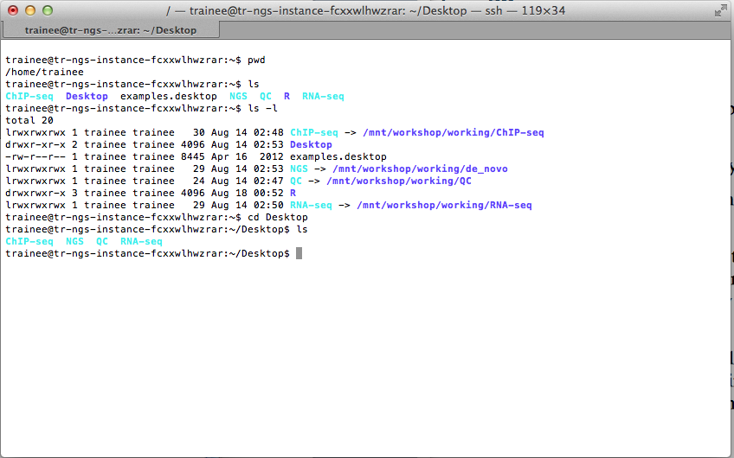
Changing Directories: cd
Trick: type ‘cd <directory_name>’ and hit TAB; this is autocomplete
cd stands for "change directory”
cd doesn't print anything, but if we run pwd after it, we can see where we are

Slide 15
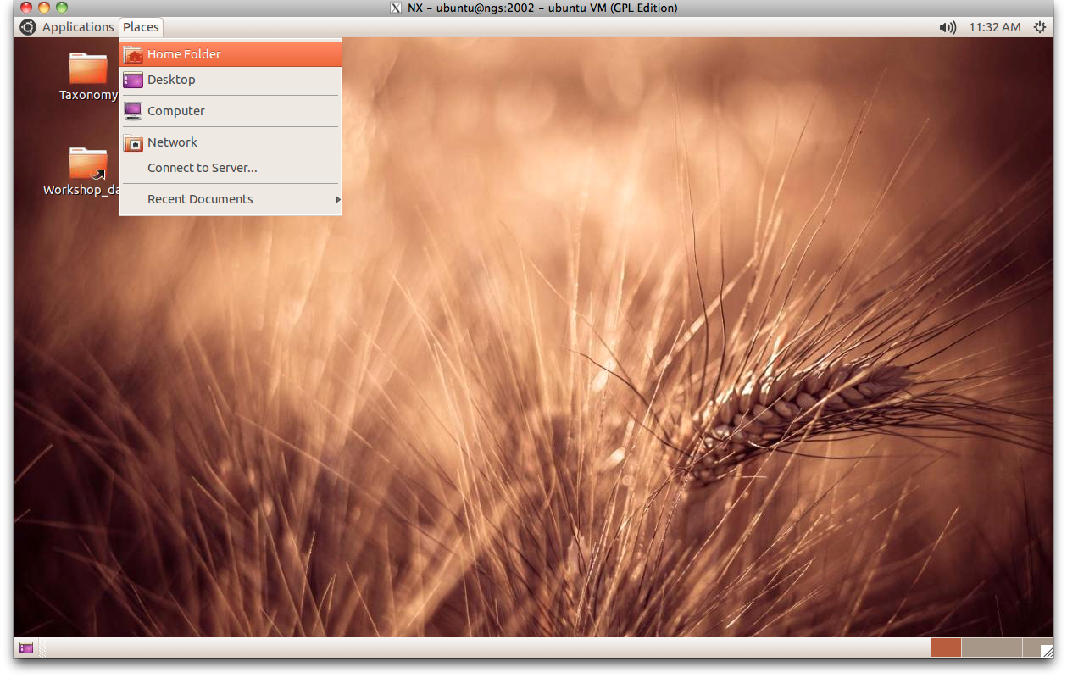
View the Files Another Way
You can still use a GUI to view the directory

Slide 16
Creating Things
Objectives
Create a directory
Create files in that hierarchy using an editor or by copying and renaming existing files.
Display the contents of a directory using the command line.
Delete specified files and/or directories.

Slide 17
Let's create a new directory called thesis using the command mkdir thesis (which has no output):
$ mkdir thesis
However, there's nothing in it yet:
$ ls -F thesis
Let's change our working directory to thesis using cd, then run a text editor called Nano to create a file called draft.txt
$ cd thesis
$ nano draft.txt

Slide 18
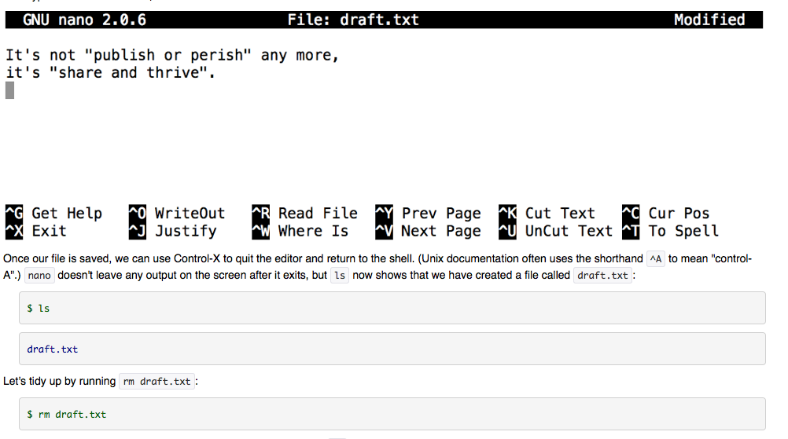
Deleting Is Forever!
Unix doesn't have a trash bin

Slide 19
Let's re-create that file and then move up one directory using “cd..”
If we try to remove the entire thesis directory using “rm thesis”, we get an error message:
$ rm thesis
rm: cannot remove `thesis': Is a directory
This happens because “rm” only works on files, not directories. The right command is “rmdir”, which is short for "remove directory". It doesn't work yet either, though, because the directory we're trying to remove isn't empty
$ rmdir thesis
rmdir: failed to remove `thesis': Directory not empty
This little safety feature can save you a lot of grief, particularly if you are a bad typist. To really get rid of thesis we must first delete the file draft.txt:
$ rm thesis/draft.txt
$ ls thesis
The directory is now empty, so “rmdir” can delete it:
$ rmdir thesis

Slide 20
Moving and Copying
Let's create that directory and file one more time.
$ mkdir thesis
$ nano thesis/draft.txt
$ ls thesis
draft.txt
Let's move quotes.txt into the current working directory.
$ mv thesis/draft.txt thesis/quotes.txt
$ ls thesis
quotes.txt
The “cp” command works very much like “mv”, except it copies a file instead of moving it.
$ cp quotes.txt thesis/quotations.txt
$ ls quotes.txt thesis/quotations.txt
quotes.txt thesis/quotations.txt

Slide 21
Pipes and Filters
Objectives
Redirect a command's output to a file.
Process a file instead of keyboard input using redirection.
Construct command pipelines with two or more stages

Slide 22
$ ls molecules
cubane.pdb ethane.pdb methane.pdb
octane.pdb pentane.pdb propane.pdb
$ cd molecules
$ wc *.pdb
20 156 1158 cubane.pdb
12 84 622 ethane.pdb
9 57 422 methane.pdb
30 246 1828 octane.pdb
21 165 1226 pentane.pdb
15 111 825 propane.pdb
107 819 6081 total

Slide 23
Wildcards
* is a wildcard. It matches zero or more characters, so *.pdb matches ethane.pdb, propane.pdb, and so on.
? is also a wildcard, but it only matches a single character. This means that p?.pdb matches pi.pdb or p5.pdb, but not propane.pdb.

Slide 24
If we run wc -l instead of just wc, the output shows only the number of lines per file
$ wc -l *.pdb
20 cubane.pdb
12 ethane.pdb
9 methane.pdb
30 octane.pdb
21 pentane.pdb
15 propane.pdb
107 total
$ wc -l *.pdb > lengths
$ ls lengths
Lengths
$ cat lengths
20 cubane.pdb
12 ethane.pdb
9 methane.pdb
30 octane.pdb
21 pentane.pdb
15 propane.pdb
107 total

Slide 25
Sorting and piping
$ sort -n lengths
9 methane.pdb
12 ethane.pdb
15 propane.pdb
20 cubane.pdb
21 pentane.pdb
30 octane.pdb
107 total
$ sort -n lengths > sorted-lengths
$ head -1 sorted-lengths
9 methane.pdb
$ sort -n lengths | head -1
9 methane.pdb
$ wc -l *.pdb | sort -n | head -1
9 methane.pdb

Slide 26
Finding Things
Use grep to select lines from text files that match simple patterns.
Use find to find files whose names match simple patterns.
Use the output of one command as the command-line parameters to another command.

Slide 27
Finding a pattern with ‘grep’
$ grep "tane" lengths
30 octane.pdb
21 pentane.pdb
Option -n, which numbers the lines that match
$ grep –n "tane" lengths
4: 30 octane.pdb
5: 21 pentane.pdb
-i makes matching case-insensitive
-v inverts the match
Options can be combined, such as: -iv

Slide 28
Finding files
“grep” finds lines in files, the “find” command finds files themselves
$cd ..
$ find . -type d Finding a directory
./
./molecules
$ find . -type f Finding a file
./molecules/cubane.pdb
./molecules/ethane.pdb
./molecules/lengths
./molecules/methane.pdb
./molecules/octane.pdb
./molecules/pentane.pdb
./molecules/propane.pdb

Slide 29
Finding a file by name
$ find . -name *.pdb
./molecules/cubane.pdb
./molecules/ethane.pdb
./molecules/methane.pdb
./molecules/octane.pdb
./molecules/pentane.pdb
./molecules/propane.pdb
$ find . -name cubane.pdb
./molecules/cubane.pdb
Listing vs. Finding
ls and find can be made to do similar things given the right options, but under normal circumstances, ls lists everything it can, while find searches for things with certain properties and shows them.

Slide 30
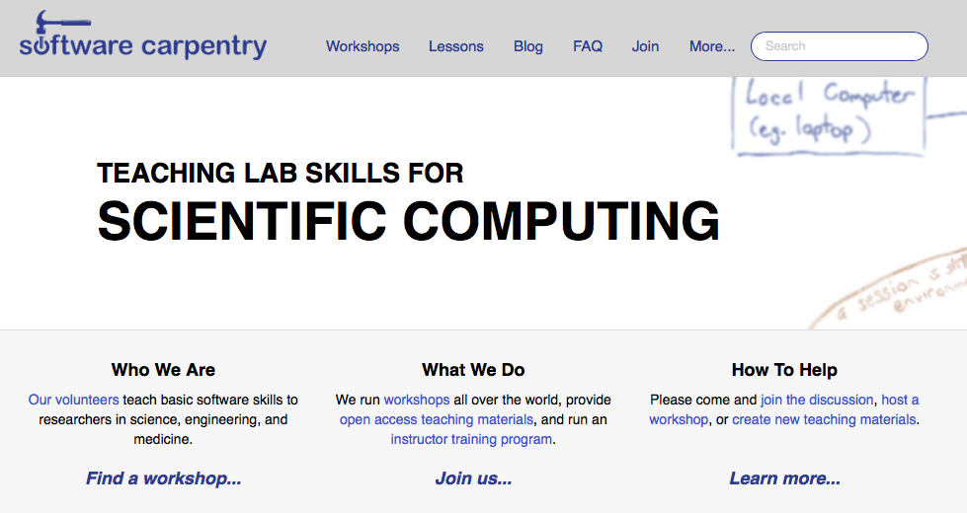
Useful Resource
http://software-carpentry.org

Slide 31
Introduction to R
Presenters Name
Organisation
23rd- 25th June 2015
Queensland University of Technology

Slide 32
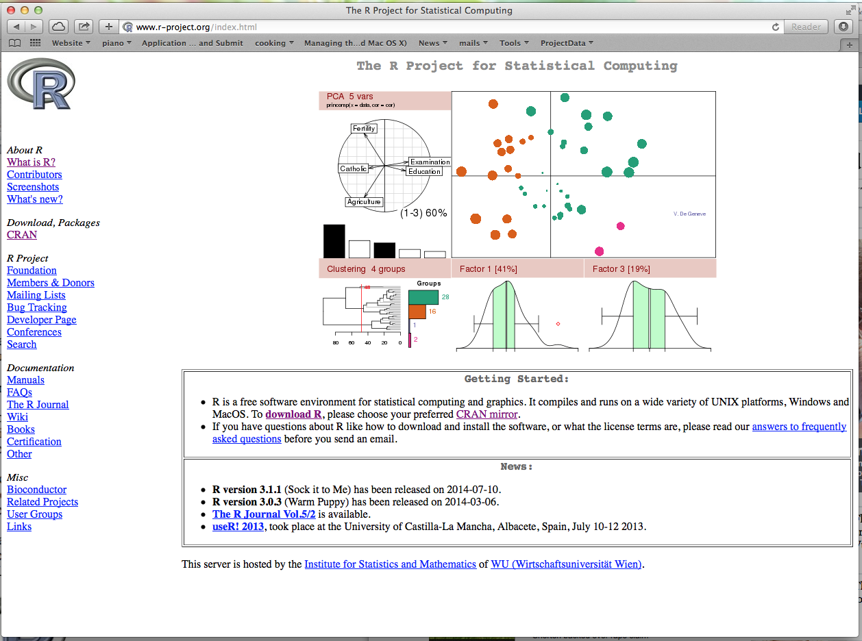

Slide 33
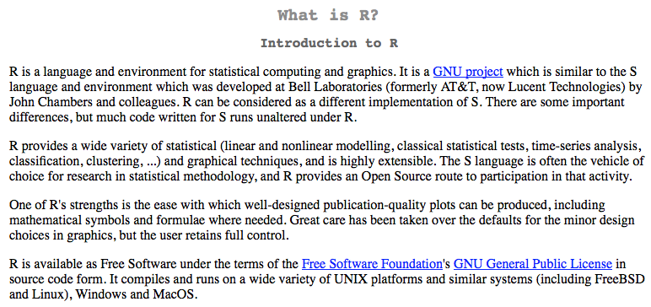

What is R?

Slide 34
Installing R
You can downloaded R freely from
http://cran.r-project.org
Click on your favorite operating system (Windows, Linux or MacOS) and simply follow the instructions.

Slide 35
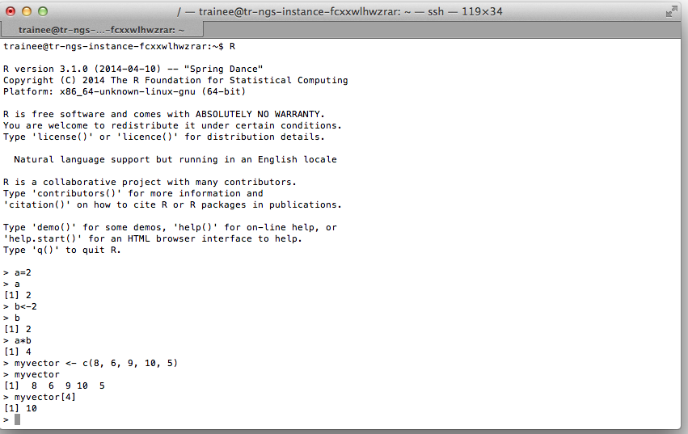

Slide 36
Reading text files into R
Reading spreadsheet-like data into R is commonly used in bioinformatics data analysis
The function read.table is the most convenient way to read in a rectangular grid of data
E.g.
>data = read.table("~/RNA-Seq/edgeR/pnas_expression.txt ", header=T, row.names=1, com=' ')
> head(data)

Slide 37
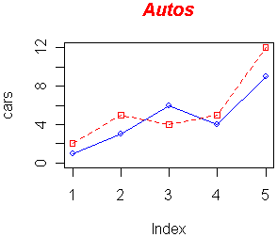
R Graphics
R has great graphics and plotting capabilities and can produce a wide range of plots very easily
# Define 2 vectors
cars <- c(1, 3, 6, 4, 9)
trucks <- c(2, 5, 4, 5, 12)
# Graph cars using a y axis that ranges from 0 to 12
plot(cars, type="o", col="blue", ylim=c(0,12))
# Graph trucks with red dashed line and square points
lines(trucks, type="o", pch=22, lty=2, col="red“)
# Create a title with a red, bold/italic font
title(main="Autos", col.main="red", font.main=4)

Slide 38
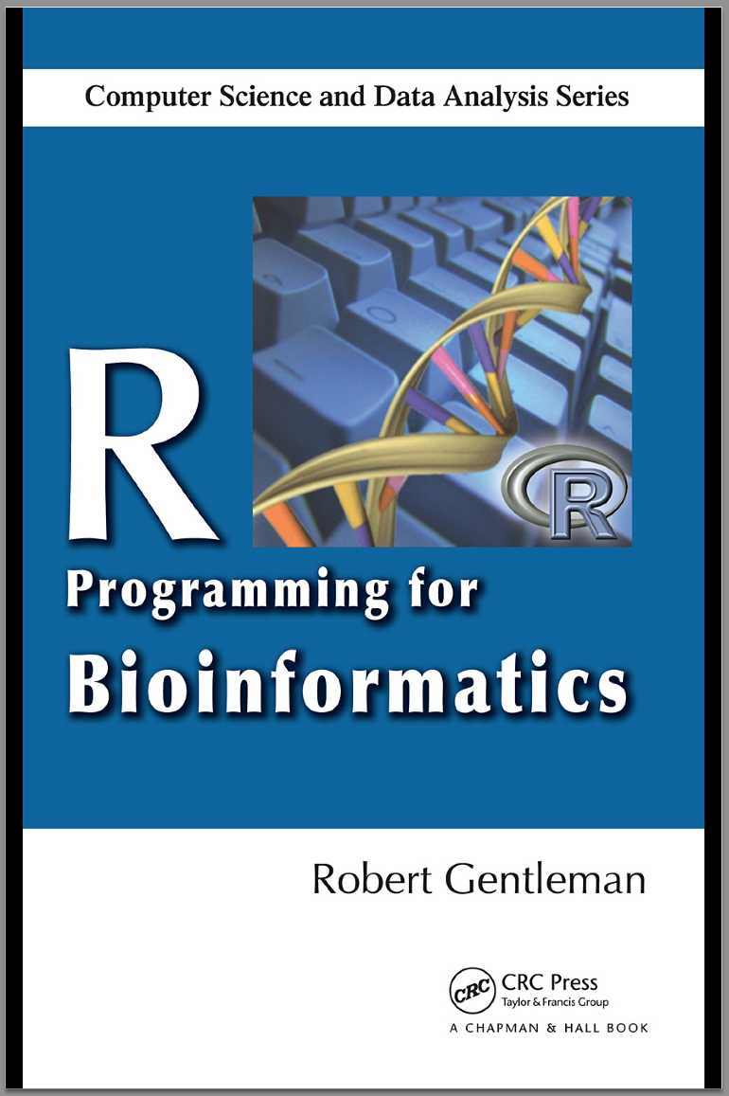
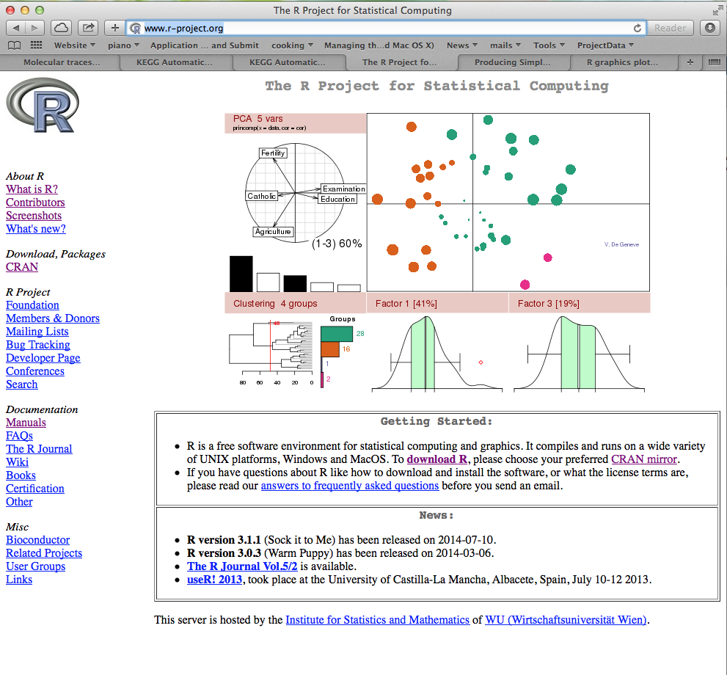
R Resources
http://www.r-project.org

