Slide 1
Introduction to R
Written by Zhiliang Chen (SBI, UNSW) & Philippe Moncuquet (CSIRO)
Perth NGS Workshop, 12th - 14th July 2016

Slide 2

What is R ?
R is a free software environment for statistical computing and graphics. It compiles and runs on a wide variety of UNIX platforms, Windows and MacOS
R provides a wide variety of statistical (linear and nonlinear modelling, classical statistical tests, time-series analysis, classification, clustering, …) and graphical techniques, and is highly extensible

Slide 3
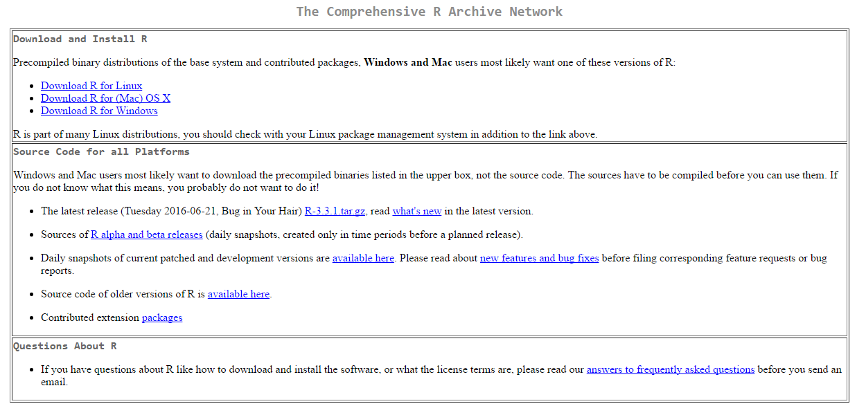
Where to get it ?
You can download R on one of the many CRAN mirrors, for instance :
http://cran.csiro.au/

Slide 4
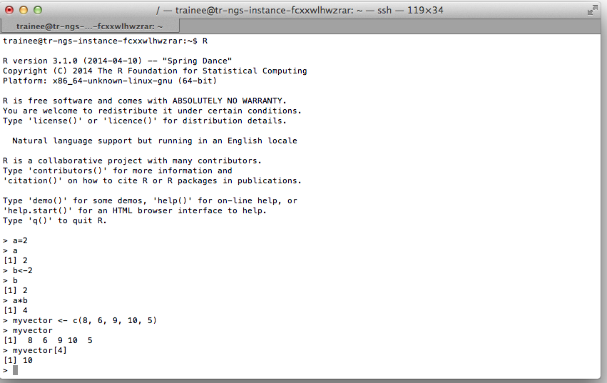
How does it work ?

Slide 5
examples from the workshop ?
Loading a library
Function to load the library
Name of the library
Prompt
Reading Data
Function to read
File
Parameters that tells the function that first column contains row names
Parameters that tells the function that first row contains columns header
Object we are creating to put the data in

Slide 6
examples from the workshop ?
Loading a library
Function to load the library
Name of the library
Prompt
Reading Data
Assignment variable
Parameters of the function
Function to read
File
Parameter that tells the function that first column contains row names
Parameter that tells the function that first row contains columns header
Object we are creating to put the data in

Slide 7
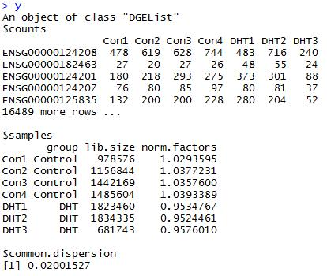
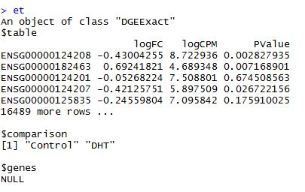
examples from the workshop ?
Produces an object of class ‘TopTags’ of which we are extracting stats that are in $table
Function to read
File
Parameter that tells the function that first column contains row names
Parameter that tells the function that first row contains columns header

Slide 8
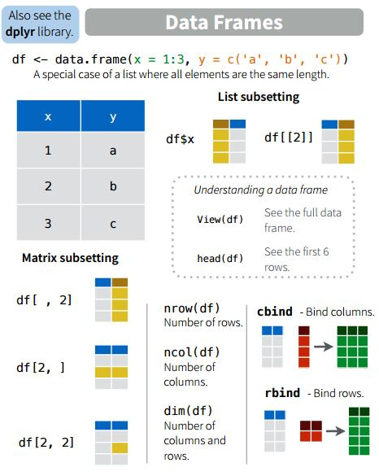
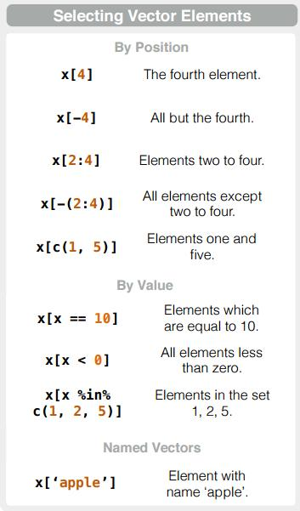
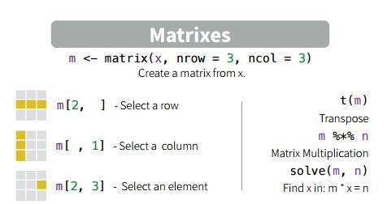
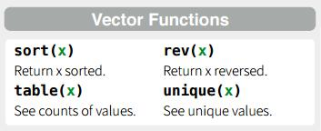
Useful stuff
Function to read
File
Parameter that tells the function that first column contains row names
Parameter that tells the function that first row contains columns header

Slide 9
R Graphics
R is very powerful at creating graphics. It used to be the only way to create figures up to standard of publication
You will create a few graphics in this workshop. We won’t cover in detail how to. Online help is available
http://www.statmethods.net/graphs/creating.html
Notes:
Type=“o” Plot points overlaid by lines
pch= option to specify symbols to use when plotting points
lty = line type

Slide 10

Keep calm and don’t Rxit ☺
There are lots and lots of online documentation and tutorial
I strongly recommend to work under the Rstudio environment

