Slide 1
Introduction to Quality Control
Presented by
Matt Field
JCSMR, ANU
Annette McGrath | CSIRO, Canberra
Sean McWilliam | CSIRO, Brisbane
Notes:
1

Slide 2
Overview
What does raw data look like!?
FASTQ format
Illumina error profile
Contamination
Errors and contamination
Impact and dealing with them
QC practical

Slide 3
FASTQ
ID
@HWI-EAS209_0006_FC706VJ:5:58:5894:21141#ATCACG/1
TTAATTGGTAAATAAATCTCCTAATAGCTTAGATNTTACCTTNNNNNNNNNNTAGTTTCT
+
efcfffffcfeefffcffffffddf`feed]`]_Ba_^__[YBBBBBBBBBBRTT\]][B

Slide 4
FASTQ
Sequence string
@HWI-EAS209_0006_FC706VJ:5:58:5894:21141#ATCACG/1
TTAATTGGTAAATAAATCTCCTAATAGCTTAGATNTTACCTTNNNNNNNNNNTAGTTTCT
+
efcfffffcfeefffcffffffddf`feed]`]_Ba_^__[YBBBBBBBBBBRTT\]][B

Slide 5
FASTQ
ID - optional
@HWI-EAS209_0006_FC706VJ:5:58:5894:21141#ATCACG/1
TTAATTGGTAAATAAATCTCCTAATAGCTTAGATNTTACCTTNNNNNNNNNNTAGTTTCT
+
efcfffffcfeefffcffffffddf`feed]`]_Ba_^__[YBBBBBBBBBBRTT\]][B

Slide 6
FASTQ
Quality string
@HWI-EAS209_0006_FC706VJ:5:58:5894:21141#ATCACG/1
TTAATTGGTAAATAAATCTCCTAATAGCTTAGATNTTACCTTNNNNNNNNNNTAGTTTCT
+
efcfffffcfeefffcffffffddf`feed]`]_Ba_^__[YBBBBBBBBBBRTT\]][B

Slide 7
FASTQ
@HWI-EAS209_0006_FC706VJ:5:58:5894:21141#ATCACG/1
TTAATTGGTAAATAAATCTCCTAATAGCTTAGATNTTACCTTNNNNNNNNNNTAGTTTCT
+
efcfffffcfeefffcffffffddf`feed]`]_Ba_^__[YBBBBBBBBBBRTT\]][B
Each base has an associated Phred quality score (0-40)

Slide 8
Phred Scores and Error Probability
Phred Quality Score | Error Probability | Accuracy of the base call (%)
10 | 0.1 | 90
20 | 0.01 | 99
30 | 0.001 | 99.9
40 | 0.0001 | 99.99
50 | 0.00001 | 99.999

Slide 9
FASTQ
@HWI-EAS209_0006_FC706VJ:5:58:5894:21141#ATCACG/1
TTAATTGGTAAATAAATCTCCTAATAGCTTAGATNTTACCTTNNNNNNNNNNTAGTTTCT
+
efcfffffcfeefffcffffffddf`feed]`]_Ba_^__[YBBBBBBBBBBRTT\]][B
Each base has an associated Phred quality score (0-40)
Represented by a single printable ASCII character
!"#$%&'()*+,-./0123456789:;<=>?@ABCDEFGHIJKLMNOPQRSTUVWXYZ[\]^_`abcdefgh
Printable ASCII characters

Slide 10
FASTQ
@HWI-EAS209_0006_FC706VJ:5:58:5894:21141#ATCACG/1
TTAATTGGTAAATAAATCTCCTAATAGCTTAGATNTTACCTTNNNNNNNNNNTAGTTTCT
+
efcfffffcfeefffcffffffddf`feed]`]_Ba_^__[YBBBBBBBBBBRTT\]][B
Each base has an associated Phred quality score (0-40)
Represented by a single printable ASCII character
Decimal values
33 64 104
| | |
!"#$%&'()*+,-./0123456789:;<=>?@ABCDEFGHIJKLMNOPQRSTUVWXYZ[\]^_`abcdefgh

Slide 11
FASTQ Encoding/Offset
33 64 104
| | |
!"#$%&'()*+,-./0123456789:;<=>?@ABCDEFGHIJKLMNOPQRSTUVWXYZ[\]^_`abcdefgh
Sanger (Phred+33)
Solexa (Phred+64)
Illumina 1.3+ (Phred+64)
Illumina 1.5+ (Phred+64)
Illumina 1.8+ (Phred+33)

Slide 12
FASTQ Encoding/Offset
Problem area
33 64 104
| | |
!"#$%&'()*+,-./0123456789:;<=>?@ABCDEFGHIJKLMNOPQRSTUVWXYZ[\]^_`abcdefgh
Sanger (Phred+33)
Solexa (Phred+64)
Illumina 1.3+ (Phred+64)
Illumina 1.5+ (Phred+64)
Illumina 1.8+ (Phred+33)
http://shop.alterlinks.com/ascii-table/ascii-table-us.php
http://en.wikipedia.org/wiki/FASTQ_format#Encoding

Slide 13
FASTQ Encoding/Offset
@HWI-EAS209_0006_FC706VJ:5:58:5894:21141#ATCACG/1
TTAATTGGTAAATAAATCTCCTAATAGCTTAGATNTTACCTTNNNNNNNNNNTAGTTTCT
+
CCCBDDDCCBDDEEEEEEEFFFFFFEEEEEEEEEEDDDDDDEECDFFFHGGGGHHHIICC
Good Phred+33 encoded
or
Bad Phred+64 encoded?
33 64 104
| | |
!"#$%&'()*+,-./0123456789:;<=>?@ABCDEFGHIJKLMNOPQRSTUVWXYZ[\]^_`abcdefgh
Sanger (Phred+33)
Solexa (Phred+64)
Illumina 1.3+ (Phred+64)
Illumina 1.5+ (Phred+64)
Illumina 1.8+ (Phred+33)

Slide 14
FASTQ Encoding/Offset
Most tools provide a means to explicitly state if Phred+33 or Phred+64 encoding is used for the quality string
Many can automatically detect the correct encoding
Best you state this explicitly, especially for quality trimmed data

Slide 15
Illumina Error Profile
Base miscalls
Quality deterioration towards the 3' end
Ledergerber, C. & Dessimoz, C. Base-calling for next-generation sequencing platforms. Brief Bioinform 12, 489–497 (2011)

Slide 16
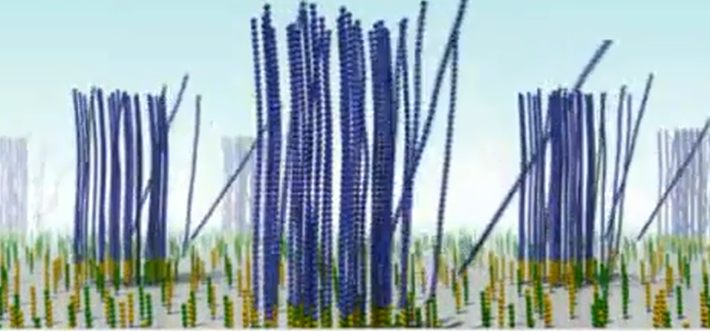

Each Spot Is a Cluster
Clusters close together, mixed clusters
Multiple signals
Phasing issues
Some sequences in a cluster start to lag behind
Cross-talk
Emission spectra of the 4 dyes partially overlap
Cluster lights up In C channel also partially lights up in the A channel
Fading
Accumulation of T fluorophore

Slide 17
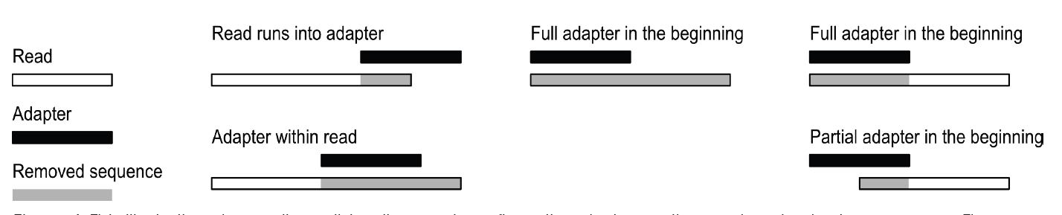
Contamination
Biological sequences
Bacteria, host, symbiont, human, alien …
Artificial sequences
PCR primers
Adapters

Slide 18

Impact of Errors and Contamination
All downstream analysis depend on finding overlaps/alignments
Align/map reads to reference
Find overlaps between pairs of reads in de novo assembly
X = error
= SNP
Kelley et al. Genome Biology 2010 11:R116

Slide 19
Impact of Errors and Contamination
Sequencing errors blow out memory requirements of de Bruijn graphs
Fail to find overlaps/alignments
Chimeric sequences

Slide 20
Dealing with Errors and Contamination
Check quality scores
Trim away poor quality bases
Remove adapter and primer sequences
Trim or remove whole reads
Remove reads below a minimum length
Error correction methods

Slide 21
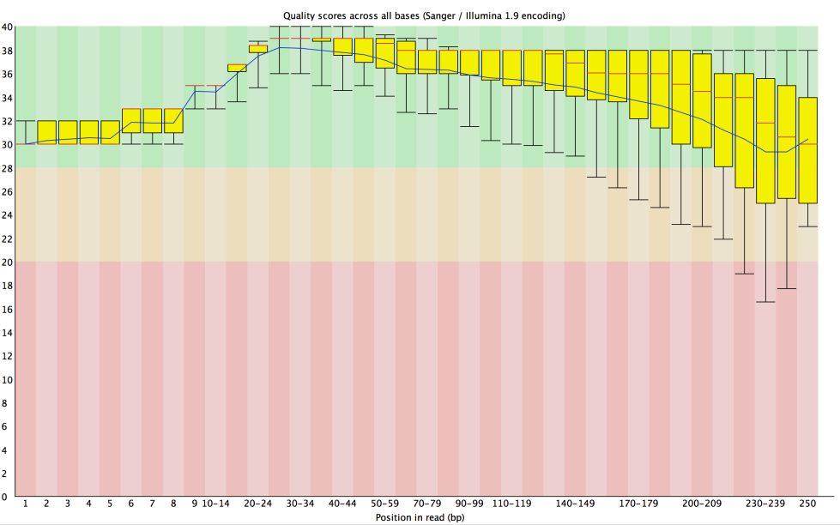
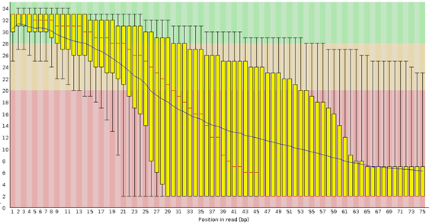
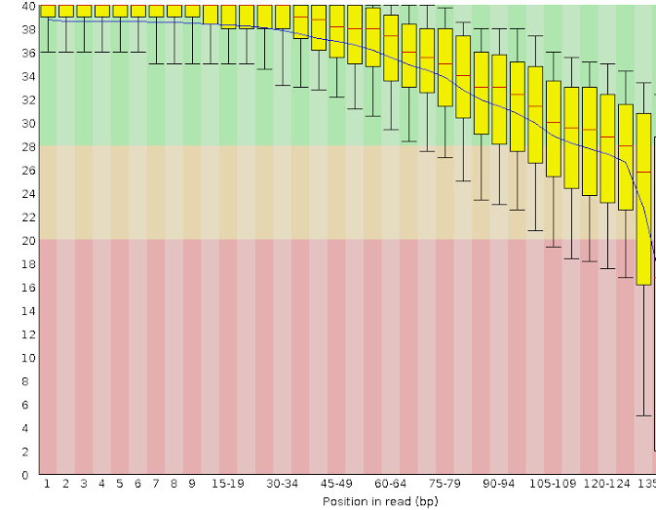
Check Quality Scores
FastQC: http://www.bioinformatics.babraham.ac.uk/projects/fastqc/

Slide 22
Read Trimming
Fixed length trimming
Remove all bases before/after a given base
Quick, computationally easy
Throws away good data and shortens reads
Quality-based trimming
Remove bases following a "poor" quality base
Retains more good data
Throws away good data if there is a single spurious "poor" quality base
Sliding window
Defines trim points based on average quality in a sliding window across each read
Computationally more expensive
Allows spurious "poor" quality bases to be retained

Slide 23
Practical
FastQC to visualise the read information
FASTX-Toolkit for quality-based trimming
Some additional information about
Fixed-length trimming
Adapter removal
Read duplicate removal

Slide 24
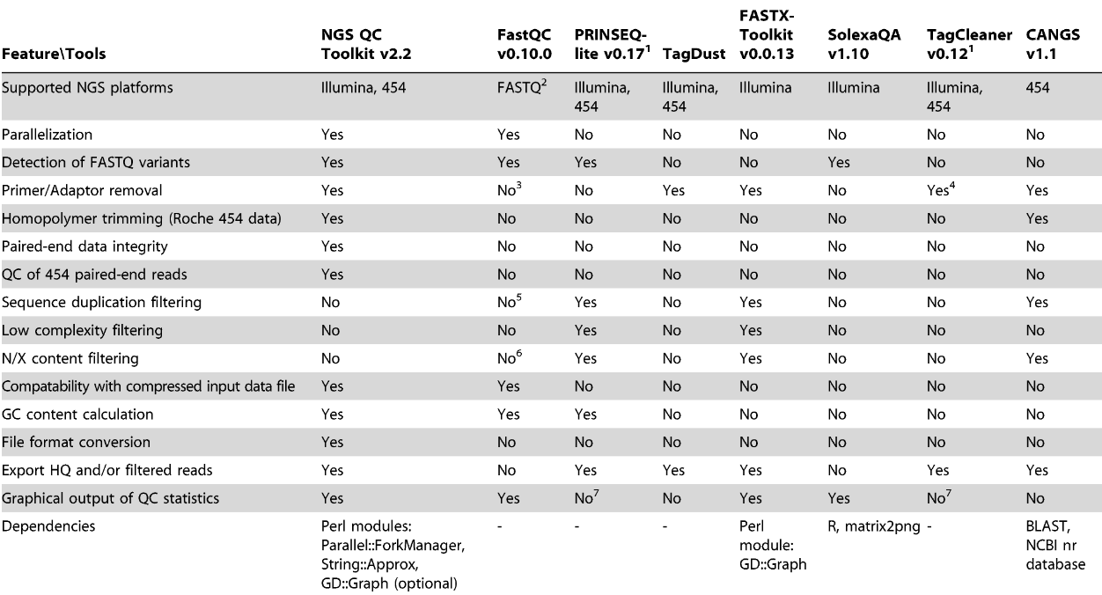
Comparison of NGS QC Tools
Patel, R. K. & Jain, M. PLoS ONE 7, e30619 (2012)

Slide 25
Conclusions
QC is an critical for downstream analyses
A range of tools exist to visualise and deal with poor quality data and contaminants
If you're stressing about throwing away the data, you haven't done enough sequencing! ☺

Slide 26
Thank you

Slide 27
Read Duplicates
Duplicates are identical reads mapping to the same genomic location.
Effects of PCR amplification bias
Excess computational resources and errors
Picard: MarkDuplicates
http://picard.sourceforge.net/
Condetri: filterPCRDupl.pl
http://code.google.com/p/condetri/
http://proteo.me.uk/2011/05/interpreting-the-duplicate-sequence-plot-in-fastqc
Notes:
27

Slide 28
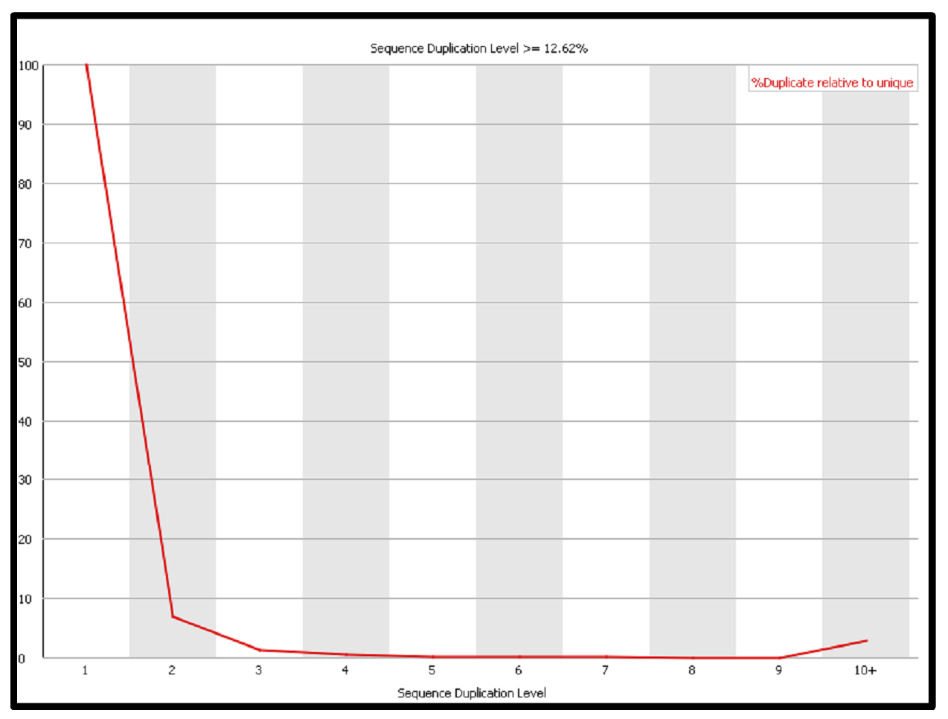
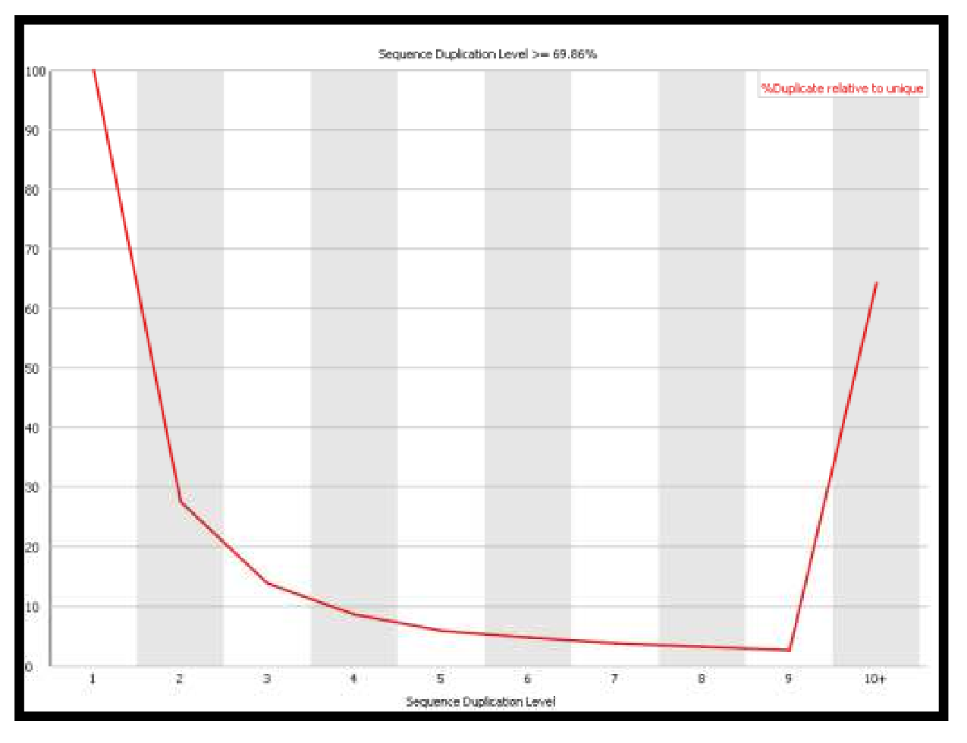
Read Duplicates: RNA-Seq

Slide 29
Sequencing-error correction
Corrected Read
Read
Read
Discarded Read
Read
k-spectrum based approach
e.g. Quake, Reptile, Hammer
Suffix tree/array-based
e.g. SHREC
MSA-based methods
e,g. Coral, ECHO
K-mers
?
Create K-mers
from Reads
FASTQ
Corrected Read
Discarded Read
Yang, X., Chockalingam, S. P. & Aluru, S. Brief Bioinform (2012).

Slide 30
Reference based processing for error correction
Removal of read duplications
Duplicates are identical reads mapping to the same genomic location.
Effects of PCR amplification bias.
Excess computational resources and errors.
Picard: MarkDuplicates - http://picard.sourceforge.net/
Local realignment around indels
Read-mapping algorithms operate on each read independently.
Lead to misaligned reads due to indels.
Result in mistaken SNP identification.
Local realignment cleans the reads and assist standard variant discovery approaches.
GATK: Indel Realigner - http://www.broadinstitute.org/gsa/wiki/index.php/Local_realignment_around_indels

