Slide 1
de novo genome assembly with Velvet
Sean McWilliam| CSIRO
Nathan Watson-Haigh| ACPFG, AU
Matthias Haimel| University of Cambridge, UK
July 14, 2016

Slide 2
Presentation Aims
Fundamental understanding of de novo genome assembly
de Bruijn graphs
Use Velvet for de novo genome assembly of small genomes
Be able to assess genome assembly continuity and quality in terms of paired-end data

Slide 3
Structure
Genome assembly problem
de Bruijn graphs
Hands-on session
Compiling Velvet
Paired-end/mate-pair libraries in assemblies
Quality scores and de Bruijn graphs
Hands-on session
Paired-end assembly
Quality trimming
Assembly visualisation
Hybrid assembly if time permits

Slide 4
Structure
Genome assembly problem
de Bruijn graphs
Hands-on session
Compiling Velvet
Paired-end/mate-pair libraries in assemblies
Quality scores and de Bruijn graphs
Hands-on session
Paired-end assembly
Quality trimming
Assembly visualisation
Hybrid assembly if time permits

Slide 5
Genome assembly problem
Aim is to determine the complete genome sequence of an organism
Current technologies cannot sequence a whole chromosome in one go
We can generate many (many) sub-sequences (reads) which are much (much) smaller than the genome
Must assemble (stitch) reads together to reconstitute the genome
Generating contigs and scaffolds
Assessing assemblies
N50, N90, Nxx
Mate-pair constraint violation

Slide 6
Genome Assembly Problem: Overlaps

Slide 7
Overlaps: Which do you trust?
Short overlap
Long overlap
Short overlap with
mismatches
Long overlap with
mismatches
Assembling reads requires sufficiently long overlaps to be sure the reads are from the same genomic loci
Diploid, ploidy, heterozygosity, repeats, affine gap penalties

Slide 8
Some terminology
Read
Mate-pair
Contig
Scaffold
Consensus

Slide 9
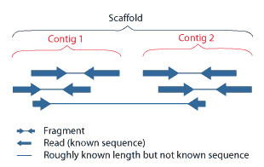
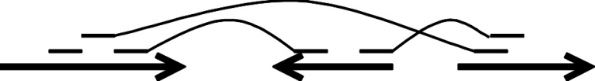
Reads, Contigs and Scaffolds
Reads from Sanger sequencing machines are limited to about ~750bp.
Therefore the genomic DNA must be fragmented into short and long fragments which are cloned and we generate sequence reads on either end.
Reads are then assembled into contigs, then scaffolds.

Slide 10
Genomes, sequencing data and issues to be mindful of
Repeats
Shorter than read length are ok
With more differences than sequencing errors
Sequencing errors
All DNA sequencing technologies have error rates
Different for each technology
Reads are not truly generated at random
Fragmentation bias
Cloning bias
Sequencing bias

Slide 11
Sanger Sequencing
Read lengths: 700-1000bp
5-10x coverage
Long (ish) read length mean we can tolerate mismatches in the overlap

Slide 12
Next Generation Sequencing (NGS)
Read lengths: 36 – 600bp (typically 100-200bp)
20-100x coverage
Huge amounts of data, not amenable to traditional genome assembly algorithms
Short read lengths mean we can’t tolerate mismatches in the overlap – would result in spurious overlaps
Enter de Bruijn graphs

Slide 13
Overlap-layout-consensus
Given a set of short fragments from shotgun sequencing, find
The overlap between all pairs
Determine the layout of the reads
Construct a consensus sequence

Slide 14
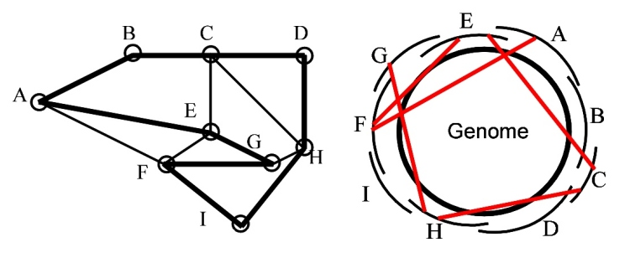
OLC graph
http://www.cbcb.umd.edu/research/assembly_primer.shtml

Slide 15
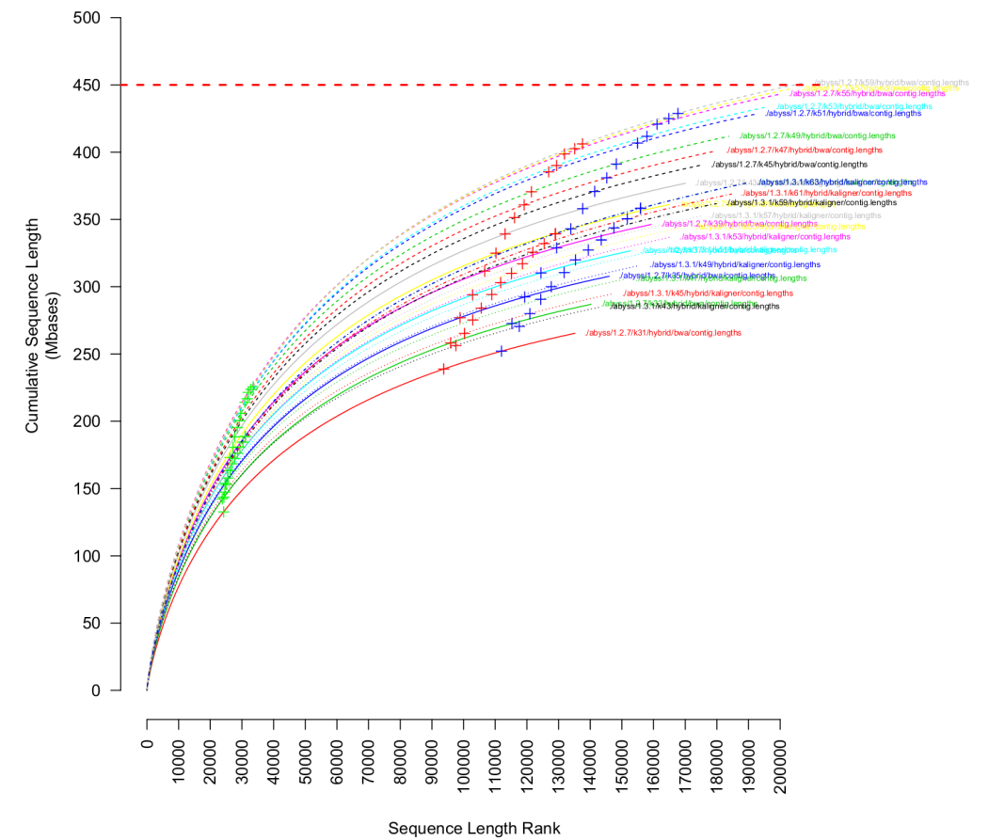
Assessing assemblies– N50, N90, Nxx
Expected genome size
Less fragmented
Less fragmented != better quality
+ = N50
+ = N90
+ = N95
More fragmented
Notes:
The N50 is the most widely reported metric for de novo assemblies
It is a single measure of the contig length size distribution of an assembly
These stats DO NOT say anything about assembly quality
Automated assemblies need to be checked for mis-assemblies
Need paired-end/matepair reads
Need tools to visualise paired-end data
Need editors to break/join/reassemble parts of the assembly

Slide 16
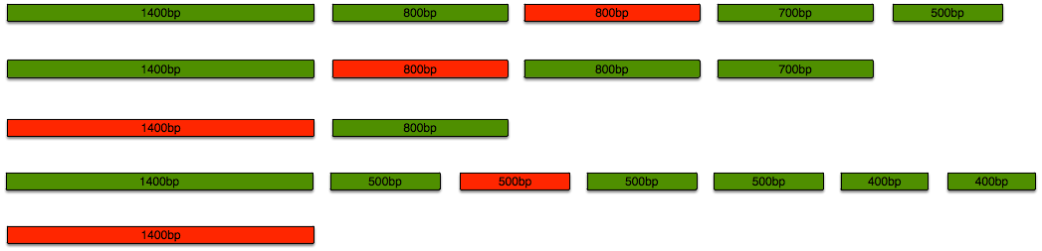
Beware of N50
N50 is the most used metric in assembly world... And it should not be.
Using contiguity as a primary goal reward “risky joining”
N50 is affected by filtering, and not very sensitive!

Slide 17
De novo genome assembly: what every biologist should know
Monya Baker
Nature Methods Vol 9 No.4 April 2012

Slide 18
Structure
Genome assembly problem
de Bruijn graphs
Hands-on session
Compiling Velvet
Paired-end/mate-pair libraries in assemblies
Quality scores and de Bruijn graphs
Hands-on session
Paired-end assembly
Quality trimming
Assembly visualisation
Hybrid assembly if time permits

Slide 19
de Bruijn Graphs
Bruijn is pronounced more like brown
Based on strings of length, k (k-mer), present in the set of reads
Used to represent overlaps
Nodes are k-mers present in the set of reads
Edges are drawn when two k-mers perfectly overlap each other by k-1 bases
The genome is represented as a path through the graph

Slide 20
Constructing de Bruijn Graphs
Based on the concept of a k-mer
ACGGAGCTTCGGAGCTGAG
ACGG
ACGG
CGGA
CGGA
GGAG
GGAG
GAGC
GAGC
AGCT
AGCT
GCTT
GCTT
CTTC
CTTC
TTCG
TTCG
TCGG
TCGG
CGGA
CGGA
GGAG
GGAG
GAGC
GAGC
AGCT
AGCT
GCTG
GCTG
CTGA
CTGA
TGAG
TGAG
Notes:
I find it more useful to think of k-mers in the context of the genome sequence rather than the reads, even in the absence of a genome during de novo assembly.
A sliding window of length k over the genome means:
K-mers whose 3’ end overlaps with the 5’ end of another k-mer by k-1 bp

Slide 21
Constructing de Bruijn Graphs
Based on the concept of a k-mer
ACGGAGCTTCGGAGCTGAG
ACGG
ACGG
ACGG
CGGA
CGGA
CGGA
GGAG
GGAG
GGAG
GAGC
GAGC
GAGC
AGCT
AGCT
AGCT
GCTG
GCTT
GCTT
GCTT
CTGA
CTTC
CTTC
CTTC
TGAG
TTCG
TTCG
TTCG
TCGG
TCGG
TCGG
CGGA
CGGA
GGAG
GGAG
GAGC
GAGC
AGCT
AGCT
GCTG
GCTG
CTGA
CTGA
TGAG
TGAG
Notes:
I find it more useful to think of k-mers in the context of the genome sequence rather than the reads, even in the absence of a genome during de novo assembly.
A sliding window of length k over the genome means:
K-mers whose 3’ end overlaps with the 5’ end of another k-mer by k-1 bp

Slide 22
Constructing de Bruijn Graphs
ACGGAGCTTCGGAGCTGAG
ACGG
CGGA
GGAG
GAGC
AGCT
GCTG
GCTT
CTGA
CTTC
TGAG
TTCG
TCGG
GCTG
CTGA
TGAG
ACGG
CGGA
GGAG
GAGC
AGCT
GCTT
CTTC
TTCG
TCGG
Notes:
I find it more useful to think of k-mers in the context of the genome sequence rather than the reads, even in the absence of a genome during de novo assembly.
A sliding window of length k over the genome means:
K-mers whose 3’ end overlaps with the 5’ end of another k-mer by k-1 bp

Slide 23
de Bruijn Graphs
De Bruijn graphs are appealing for short read data since:
We need perfect overlaps to be sure overlaps are not spurious
Compact, memory efficient representation of the data
Fast to find overlaps as we only consider perfect overlaps of k-1 in length
Ideally, k-mers should:
Be long enough that all k-mers of that length are unique in the genome
Be short enough that its existence is supported by multiple reads (k-mer coverage)

Slide 24
Sequencing Error: mis-call
ACGGAGCTTCGG
ACGG
CGGA
GGAG
GAGC
AGCT
GCTT
CTTC
TTCG
TCGG

Slide 25
Sequencing Error: mis-call
ACGGAGCTTCGG
ACGGACCTTCGG
ACGG
CGGA
GGAG
GGAC
GAGC
GACC
AGCT
ACCT
GCTT
CCTT
CTTC
TTCG
TCGG
GGAG
GAGC
AGCT
GCTT
ACGG
CGGA
CTTC
TTCG
TCGG
GGAC
GACC
ACCT
CCTT
+k nodes
Notes:
Sequencing errors cause bubbles of length k. Thus large k-mers introduce many more spurious nodes and edges and more k-mers will contain more errors. Errors less than k nt apart will produce bubbles within bubbles making assembly more difficult.
In non-haploid organisms, different alleles may look like sequencing errors.
E.g in diploid organisms, you’d expect the alternative paths of a bubble to have equal coverage. Determining if the data deviates from this null hypothesis is difficult, especially at low coverage

Slide 26
Sequencing Error: deletion
ACGGAGCTTCGG
ACGGA-CTTCGG
ACGG
CGGA
GGAG
GGA-C
GAGC
GA-CT
AGCT
A-CTT
GCTT
CTTC
TTCG
TCGG
GGAG
GAGC
AGCT
GCTT
ACGG
CGGA
CTTC
TTCG
TCGG
GGA-C
GA-CT
A-CTT

Slide 27
Sequencing Error: insertion
ACGGA-GCTTCGG
ACGGATGCTTCGG
ACGG
CGGA
GGAG
GGAT
GAGC
GATG
AGCT
ATGC
GCTT
TGCT
CTTC
TTCG
TCGG
GGA-G
GA-GC
A-GCT
GCTT
ACGG
CGGA
CTTC
TTCG
TCGG
GGAT
GATG
ATGC
TGCT

Slide 28
Sequencing Errors
Mis-call
GGAG
GAGC
AGCT
GCTT
ACGG
CGGA
CTTC
TTCG
TCGG
GGAC
GACC
ACCT
CCTT
Deletion
GGAG
GAGC
AGCT
GCTT
ACGG
CGGA
CTTC
TTCG
TCGG
GGA-C
GA-CT
A-CTT
Insertion
GGA-G
GA-GC
A-GCT
GCTT
ACGG
CGGA
CTTC
TTCG
TCGG
GGAT
GATG
ATGC
TGCT

Slide 29
Heterozygosities
SNP
GGAG
GAGC
AGCT
GCTT
ACGG
CGGA
CTTC
TTCG
TCGG
GGAC
GACC
ACCT
CCTT
Deletion
GGAG
GAGC
AGCT
GCTT
ACGG
CGGA
CTTC
TTCG
TCGG
GGA-C
GA-CT
A-CTT
Insertion
GGA-G
GA-GC
A-GCT
GCTT
ACGG
CGGA
CTTC
TTCG
TCGG
GGAT
GATG
ATGC
TGCT

Slide 30
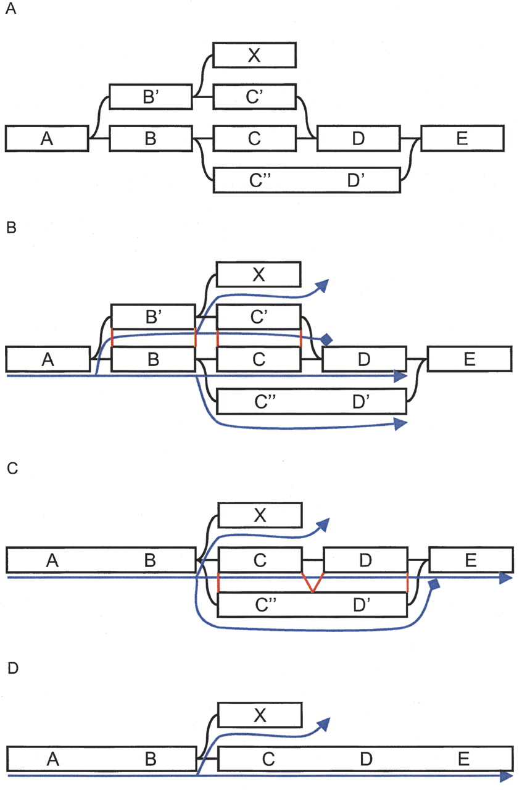
Velvet algorithms
Remove Bubbles
Tour Bus
velvetg parameters
-max_branch_length
-max_divergence
-max_gap_count

Slide 31
Loss of Information
Reads carved up into k-mers where k < length of the read
Some assemblers try to overcome this by “read threading” (Velvet)
Determine which edges (k-1 overlaps) in the de Bruijn graph are actually supported by the reads
Loss of information increases as read lengths increase
Increase k-mer length will eventually hit a wall
k-mers become more likely to hit sequencing errors, heterozygosities etc
Explosion in graph complexity – Time and memory
Decreased coverage of edges by reads
Fragmented assembly

Slide 32
The K tradeoff
Longer kmers are more unique in the target, disentangling the graph.
Smaller kmers will overlap more often, favouring contiguity
Every read produces L-k+1 kmers
Higher k -> less coverage
Every single error affects k kmers
Higher k -> more errors
A typical choice for 100 bp reads is k=71

Slide 33
Hands-on session
Compile Velvet
Illumina single ended assembly
K-mer length
Coverage cut-offs
Assembly visualisation with AMOS Hawkeye
Whole genome sequence as input
Only if you are quick and have time

Slide 34
Structure
Genome assembly problem
de Bruijn graphs
Hands-on session
Compiling Velvet
Paired-end/mate-pair libraries in assemblies
Quality scores and de Bruijn graphs
Hands-on session
Paired-end assembly
Quality trimming
Assembly visualisation
Hybrid assembly if time permits

Slide 35
Read Information
Paired-end (and mate-pairs) provide additional information since read pairs are constrained by:
A separation distance governed by the insert-size distribution
Relative orientation
Most mis-assemblies violate these constraints
Who knows the difference between pairs and mates?
Terms used interchangably

Slide 36
Paired-ends
~300bp

Slide 37
Mate-pairs
~3-20kb

Slide 38
Why are pairs/mates so important?

Slide 39
pair constraint violation

Slide 40
pair constraint violation
Incorrect orientation
Incorrect distance

Slide 41
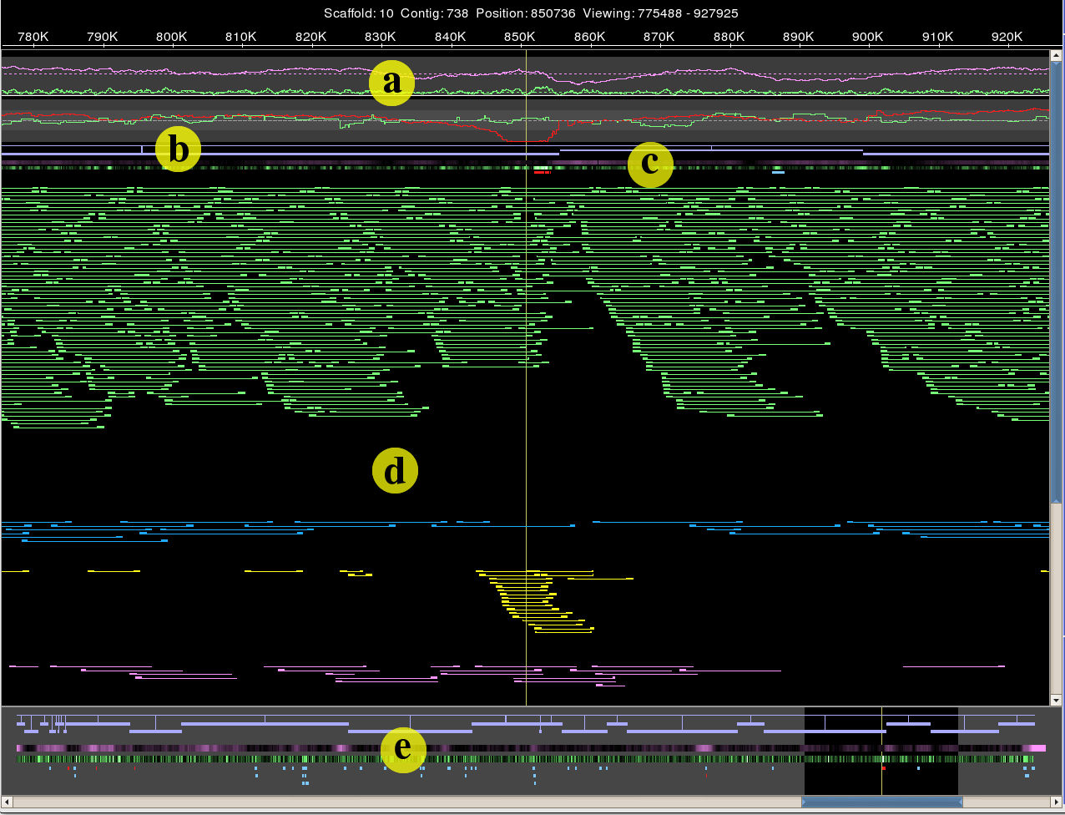
Visualising pair constraint violation

Slide 42
Velvet algorithms: Pebble
Paired-end information
Velvet parameters
-min_pair_count

Slide 43
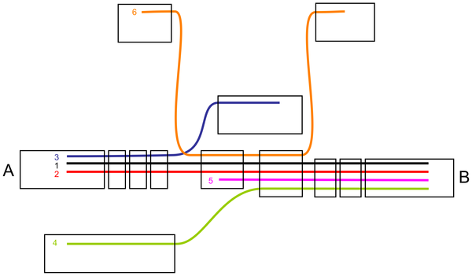
Velvet algorithms: Rock Band
Long read information (e.g. 454)
Velvet parameters
-long_mult_cutoff

Slide 44
Paired-ends in Velvet
Hugely improves quality of assembly
Insert length greater than repeat
Greater than the length of the most common genomic repeat
Mixed insert length improves results
Short: helps for local assembly
Long: get over repeats
Large genomes
Very memory intensive
Calculation intensive

Slide 45
Structure
Genome assembly problem
de Bruijn graphs
Hands-on session
Compiling Velvet
Paired-end/mate-pair libraries in assemblies
Quality scores and de Bruijn graphs
Hands-on session
Paired-end assembly
Quality trimming
Assembly visualisation
Hybrid assembly if time permits

Slide 46
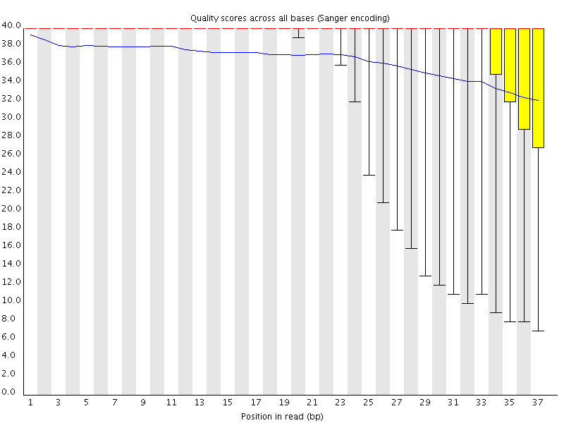
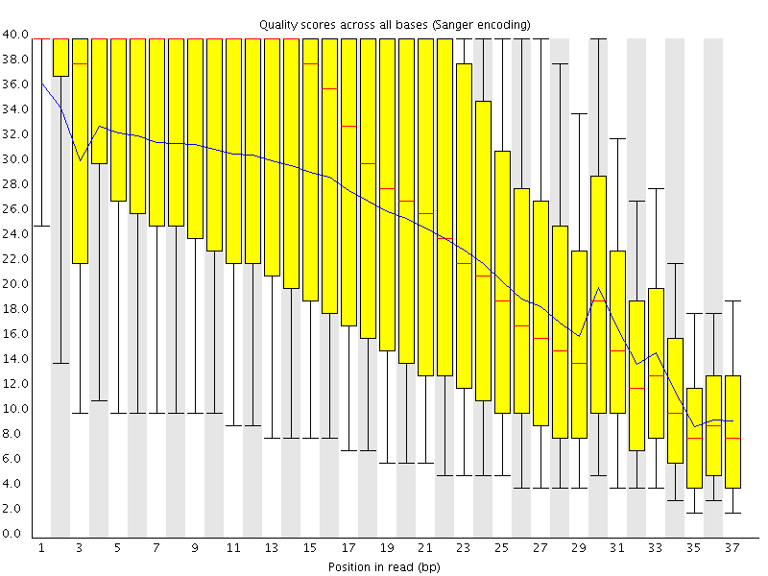
Velvet and data quality
Quality scores are NOT used
Sequence errors blow out the de Bruijn graph size

Slide 47
Sequencing Errors
Mis-call
GGAG
GAGC
AGCT
GCTT
ACGG
CGGA
CTTC
TTCG
TCGG
GGAC
GACC
ACCT
CCTT
Deletion
GGAG
GAGC
AGCT
GCTT
ACGG
CGGA
CTTC
TTCG
TCGG
GGA-C
GA-CT
A-CTT
Insertion
GGA-G
GA-GC
A-GCT
GCTT
ACGG
CGGA
CTTC
TTCG
TCGG
GGAT
GATG
ATGC
TGCT

Slide 48
Velvet and data quality
Quality scores are NOT used
Sequence errors blow out the de Bruijn graph size
Get rid of crappy data
If you think throwing away 1/3 of your data will not leave you with enough coverage, you didn’t do enough sequencing!

Slide 49
Hands-on session
Illumina Paired-end assembly
Explore parameters
Assembly visualisation with AMOS Hawkeye
Quality trim data
Effect on assembly, run time memory
Hybrid assembly of Illumina paired-ends and 454 single-ends
Only if you are quick and have time

Slide 50
Summary/Recap
Calculating overlaps is computationally intensive
de Brujin graphs provide a way to model perfect overlaps between k-mers present in reads
Really good for short read data
Paired-ends and long sequences dramatically improve assemblies
N50 not a perfect quality metric
Identifying mis-assemblies through mate-pair constraint violation

Slide 51
Thank you

