Slide 1
De novo Assembly Using PacBio Long Reads
Sean McWilliam| CSIRO
Annette McGrath| CSIRO
July 14, 2016

Slide 2

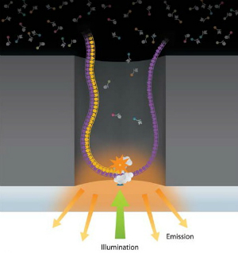
Single Molecule Sequencing (SMRT)
A Third-generation sequencing strategy
Single molecule sequencing
Zero-mode waveguide (ZMW)
DNA polymerase is affixed to the bottom of a tiny hole (~70nm).
Only the bottom portion of the hole is illuminated allowing for detection of incorporation of dye-labeled nucleotide.
Notes:
Third-generation sequencing strategy
The Single molecule real time sequencing (also known as SMRT) is a parallelized single molecule DNA sequencing by synthesis technology developed by Pacific Biosciences.
A single active DNA polymerase with a single molecule of single stranded DNA template is immobilized to the bottom through which light can penetrate and create a visualization chamber that allows monitoring of the activity of the DNA polymerase at a single molecule level.
The DNA sequencing is done on a chip that contains many ZMWs.
ZMWs : A zero-mode waveguide is an optical waveguide that guides light energy into a volume that is small in all dimensions compared to the wavelength of the light.
The DNA polymerase attaches itself to a strand of DNA to be replicated, examines the individual base at the point it is attached, and then determines which of four building blocks, or nucleotides, is required to replicate that individual base.
After determining which nucleotide is required, the polymerase incorporates that nucleotide into the growing strand that is being produced.
Application
1) De-novo
Read lengths from the single molecule real time sequencing are comparable to or greater than that from the Sanger sequencing method.
The longer read length allows de novo genome sequencing and easier genome assemblies.
Scientists are also using single molecule real time sequencing in hybrid assemblies for de novo genomes to combine short-read sequence data with long-read sequence data
2) Full isoform sequencing
Long reads make it possible to sequence full gene isoforms, including the 5' and 3' ends.
3) Methylation detection: The dynamics of polymerase can indicate whether a base is methylated

Slide 3
Single Molecule Sequencing (SMRT)
Advantages
No amplification required.
Extremely long read lengths.
Average 2500 bp. Longest 40,000bp.
Disadvantages
High error rates.
Error rate of ~15% for Indels. 1% Substitutions.
Notes:
Indels errors occur when multiple nucleotide are incorporated too fast for the camera to detect.
Improvements to the technology primarily have come with advances in it’s chemistry. Primarily it’s polymerase enzyme. Improvements include higher nucleotide incorporation accuracy. Higher tolerance to heat ( longer reads ).

Slide 4
Platform | Chemistry | Read Length | Run Time | Gb/Run | Advantage | Disadvantage
454 GS Junior (Roche) | Pyro-sequencing | 500 | 8 hrs. | 0.04 | Long Read Length | High error rate in homopolymer
454 GS FLX+ (Roche) | Pyro-sequencing | 700 | 23 hrs. | 0.7 | Long Read Length | High error rate in homopolymer
HiSeq (Illumina) | Reversible Terminator | 2*100 | 2 days (rapid mode) | 120 (rapid mode) | High-throughput / cost | Short reads Long run time (normal mode)
SOLiD (Life) | Ligation | 85 | 8 days | 150 | Low Error Rate | Short reads Long run time
Ion Proton (Life) | Proton Detection | 200 | 2 hrs. | 100 | Short Run times | New*
PacBio RS | Real-time Sequencing | 3000 (up to 15,000) | 20 min | 3 | No PCR Longest Read Length | High Error Rate
Notes:
SOLiD has lowest error rate. Good for resequencing.
Illumina has the highest throughput / cost.
PacBio has the longest read length. Up to 15,000 bp. Applications in DeNovo sequencing and structural variation studies.
Ion Torrent from Life Technologies has two instruments. The Personal Genome Machine which has been out since 2010. It’s mostly only applicable for small genome sequencing like bacterial genomes. The Ion Proton, which promises much greater throughput and it has been recently made commercially available. There is however limited information on it’s actual performance.

Slide 5
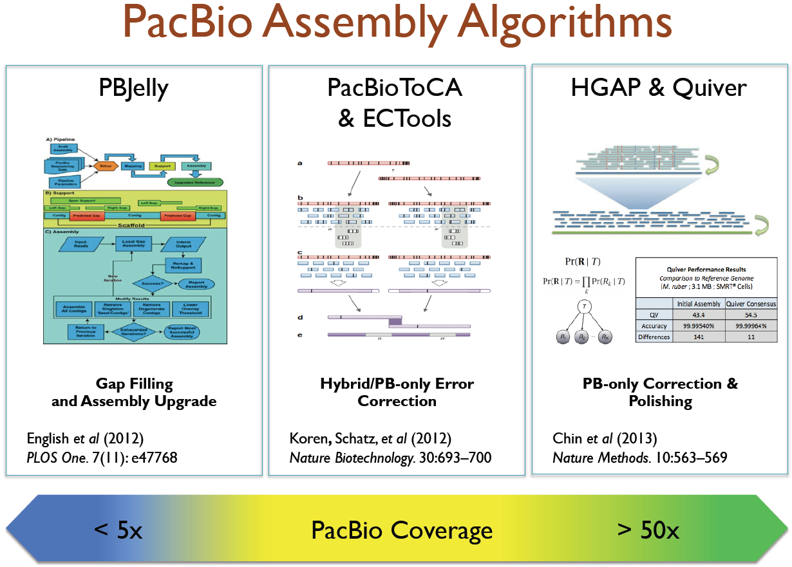
PacBio Assembly Algorithms

Slide 6
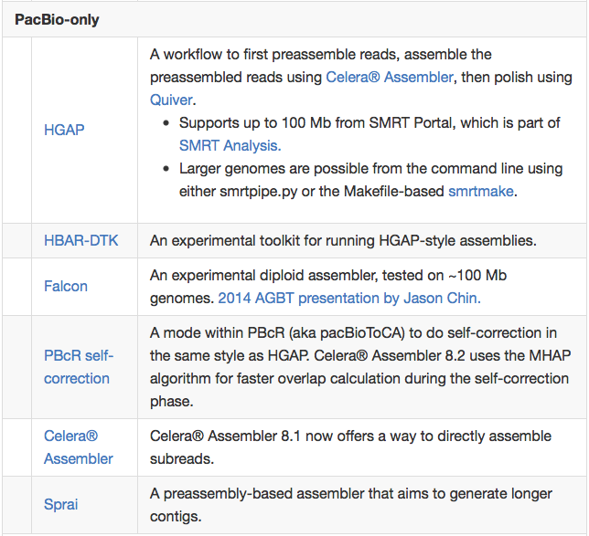
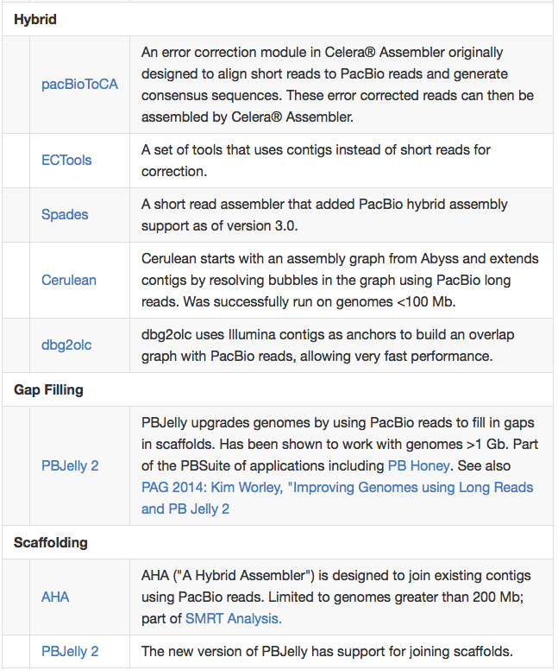
Software Options

Slide 7
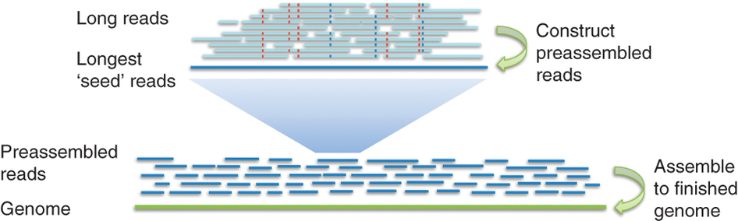
Hierarchical Genome Assembly Process (HGAP)

Slide 8
Large Genome Assembly with PacBio Long Reads
PacBio long reads can be used in a number of ways to generate and improve de novo assemblies for large genomes. You can take several different approaches:
PacBio-only de novo assembly. Using just PacBio reads from a long insert library, the reads are often preprocessed before being assembled using an Overlap-Layout-Consensus algorithm. The best known implementation of this is HGAP.
Hybrid de novo assembly. Using a combination of PacBio and short read data, the reads are used together during assembly to generate a hybrid assembly.
Gap filling. Starting with an existing mate-pair based assembly, the internal gaps (consisting of Ns) inside the scaffolds are filled using PacBio sequences.
Scaffolding. Using an existing assembly (such as an assembly based on short read data), PacBio reads are used to join contigs.

Slide 9
To find more information on PacBio
Find open source software, data, documentation and tips for PacBio sequencing at;
  PacBio Githu- https://github.com/PacificBiosciences
  PacBio Devnet- http://www.pacb.com/devnet/

