Slide 1
Introduction to Quality Control
Presented by:
Gayle Philip
VLSCI, Melbourne
Curtin University, Perth
12-14th July 2016
Notes:
1

Slide 2
Overview
What does raw data look like?
FASTQ format
Errors in sequences
Types of contamination
Errors and contamination
Impact and dealing with them
QC practical

Slide 3
FASTQ
ID
@HWI-EAS209_0006_FC706VJ:5:58:5894:21141#ATCACG/1
TTAATTGGTAAATAAATCTCCTAATAGCTTAGATNTTACCTTNNNNNNNNNNTAGTTTCT
+
efcfffffcfeefffcffffffddf`feed]`]_Ba_^__[YBBBBBBBBBBRTT\]][B

Slide 4
FASTQ
Sequence string
@HWI-EAS209_0006_FC706VJ:5:58:5894:21141#ATCACG/1
TTAATTGGTAAATAAATCTCCTAATAGCTTAGATNTTACCTTNNNNNNNNNNTAGTTTCT
+
efcfffffcfeefffcffffffddf`feed]`]_Ba_^__[YBBBBBBBBBBRTT\]][B

Slide 5
FASTQ
ID - optional
@HWI-EAS209_0006_FC706VJ:5:58:5894:21141#ATCACG/1
TTAATTGGTAAATAAATCTCCTAATAGCTTAGATNTTACCTTNNNNNNNNNNTAGTTTCT
+
efcfffffcfeefffcffffffddf`feed]`]_Ba_^__[YBBBBBBBBBBRTT\]][B

Slide 6
FASTQ
Quality string
@HWI-EAS209_0006_FC706VJ:5:58:5894:21141#ATCACG/1
TTAATTGGTAAATAAATCTCCTAATAGCTTAGATNTTACCTTNNNNNNNNNNTAGTTTCT
+
efcfffffcfeefffcffffffddf`feed]`]_Ba_^__[YBBBBBBBBBBRTT\]][B

Slide 7
FASTQ
@HWI-EAS209_0006_FC706VJ:5:58:5894:21141#ATCACG/1
TTAATTGGTAAATAAATCTCCTAATAGCTTAGATNTTACCTTNNNNNNNNNNTAGTTTCT
+
efcfffffcfeefffcffffffddf`feed]`]_Ba_^__[YBBBBBBBBBBRTT\]][B
Each base has an associated Phred quality score (typically 0-40)

Slide 8
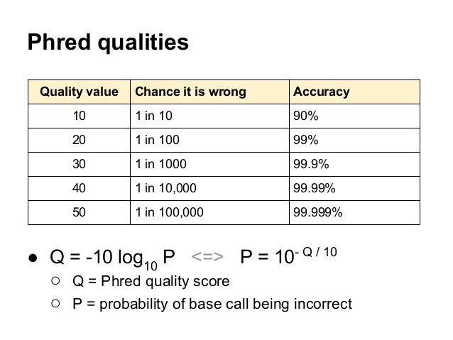

Slide 9
FASTQ
@HWI-EAS209_0006_FC706VJ:5:58:5894:21141#ATCACG/1
TTAATTGGTAAATAAATCTCCTAATAGCTTAGATNTTACCTTNNNNNNNNNNTAGTTTCT
+
efcfffffcfeefffcffffffddf`feed]`]_Ba_^__[YBBBBBBBBBBRTT\]][B
Each base has an associated Phred quality score (typically 0-40)
Represented by a single printable ASCII character
!"#$%&'()*+,-./0123456789:;<=>?@ABCDEFGHIJKLMNOPQRSTUVWXYZ[\]^_`abcdefgh
Printable ASCII characters

Slide 10
FASTQ
@HWI-EAS209_0006_FC706VJ:5:58:5894:21141#ATCACG/1
TTAATTGGTAAATAAATCTCCTAATAGCTTAGATNTTACCTTNNNNNNNNNNTAGTTTCT
+
efcfffffcfeefffcffffffddf`feed]`]_Ba_^__[YBBBBBBBBBBRTT\]][B
Each base has an associated Phred quality score (0-40)
Represented by a single printable ASCII character
Decimal values
33 64 104
| | |
!"#$%&'()*+,-./0123456789:;<=>?@ABCDEFGHIJKLMNOPQRSTUVWXYZ[\]^_`abcdefgh
Notes:
With an offset of 64, an @ (ASCII code 64) is 0, and h (ASCII code 104) is 40

Slide 11
FASTQ Encoding/Offset
33 64 104
| | |
!"#$%&'()*+,-./0123456789:;<=>?@ABCDEFGHIJKLMNOPQRSTUVWXYZ[\]^_`abcdefgh
Sanger (Phred+33)
Solexa (Phred+64)
Illumina 1.3+ (Phred+64)
Illumina 1.5+ (Phred+64)
Illumina 1.8+ (Phred+33)
Notes:
The Solexa pipeline (i.e., the software delivered with the Illumina Genome Analyzer
Newer sequencers that offer longer reads and higher throughput
With an offset of 64, an @ (ASCII code 64) is 0, and h (ASCII code 104) is 40

Slide 12
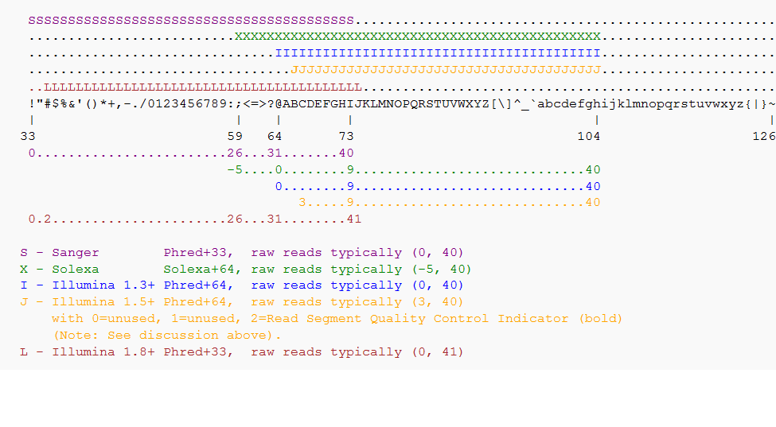
Spoiled for choice

Slide 13
FASTQ Encoding/Offset
Problem area
33 64 104
| | |
!"#$%&'()*+,-./0123456789:;<=>?@ABCDEFGHIJKLMNOPQRSTUVWXYZ[\]^_`abcdefgh
Sanger (Phred+33)
Solexa (Phred+64)
Illumina 1.3+ (Phred+64)
Illumina 1.5+ (Phred+64)
Illumina 1.8+ (Phred+33)
http://shop.alterlinks.com/ascii-table/ascii-table-us.php
http://en.wikipedia.org/wiki/FASTQ_format#Encoding

Slide 14
FASTQ Encoding/Offset
@HWI-EAS209_0006_FC706VJ:5:58:5894:21141#ATCACG/1
TTAATTGGTAAATAAATCTCCTAATAGCTTAGATNTTACCTTNNNNNNNNNNTAGTTTCT
+
CCCBDDDCCBDDEEEEEEEFFFFFFEEEEEEEEEEDDDDDDEECDFFFHGGGGHHHIICC
Good Phred+33 encoded
or
Bad Phred+64 encoded?
33 64 104
| | |
!"#$%&'()*+,-./0123456789:;<=>?@ABCDEFGHIJKLMNOPQRSTUVWXYZ[\]^_`abcdefgh
Sanger (Phred+33)
Solexa (Phred+64)
Illumina 1.3+ (Phred+64)
Illumina 1.5+ (Phred+64)
Illumina 1.8+ (Phred+33)

Slide 15
FASTQ Encoding/Offset
Most tools provide a means to explicitly state if Phred+33 or Phred+64 encoding is used for the quality string
Many can automatically detect the correct encoding
Best you state this explicitly, especially for quality trimmed data

Slide 16
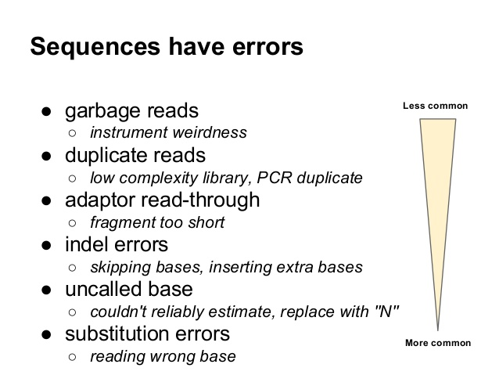

Slide 17
Illumina Error Profile
Base miscalls
Quality deterioration towards the 3' end
Ledergerber, C. & Dessimoz, C. Base-calling for next-generation sequencing platforms. Brief Bioinform 12, 489–497 (2011)

Slide 18
Contamination
Biological sequences
Bacteria, host, symbiont, human, alien …
Artificial sequences
PCR primers
Adapters

Slide 19
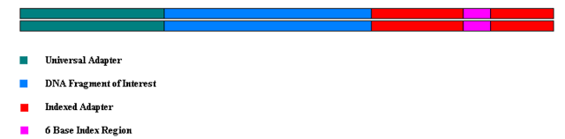
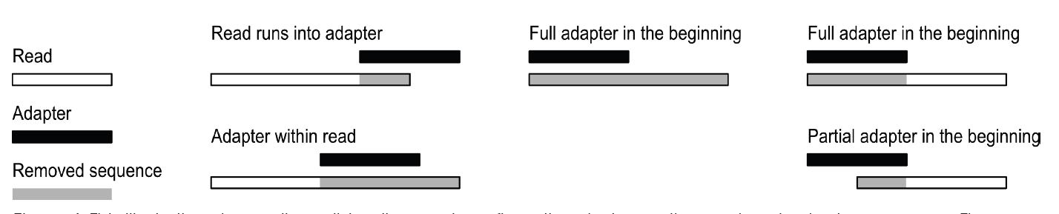
Adapters

Slide 20

Impact of Errors and Contamination
All downstream analysis depend on finding overlaps/alignments
Align/map reads to reference
Find overlaps between pairs of reads in de novo assembly
X = error
= SNP
Kelley et al. Genome Biology 2010 11:R116

Slide 21
Impact of Errors and Contamination
Erroneous data may cause software to:
Run more slowly
Use more RAM
Produce poor/biased/incorrect results
Fail to find overlaps/alignments
Chimeric sequences

Slide 22
Dealing with Errors and Contamination
Check quality scores
Trim away poor quality bases
Remove adapter and primer sequences
Trim or remove whole reads
Remove reads below a minimum length
Error correction methods

Slide 23
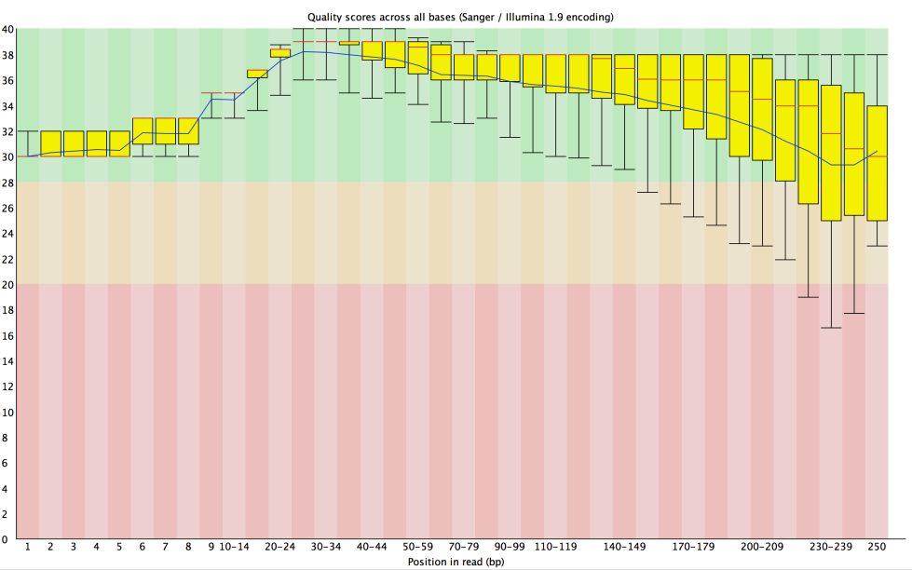
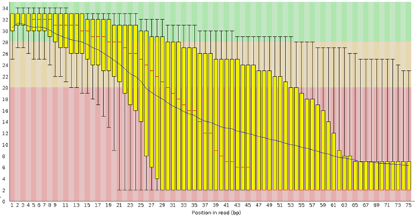
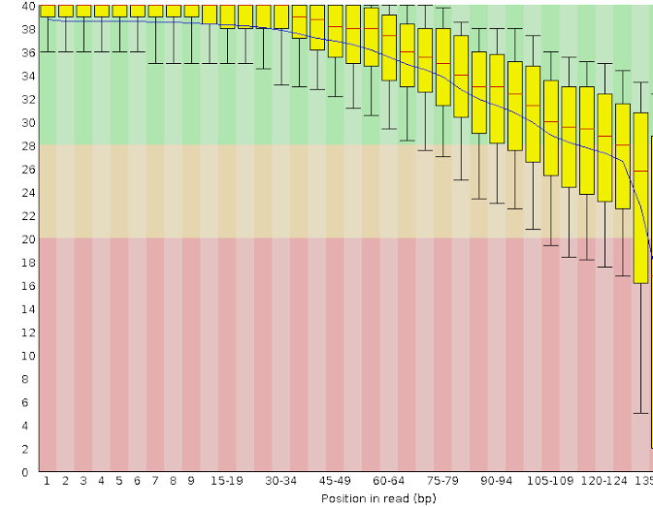
Check Quality Scores
FastQC: http://www.bioinformatics.babraham.ac.uk/projects/fastqc/

Slide 24
Read Trimming and Adapter clipping
1) Fixed length trimming
Remove all bases before/after a given base
Quick, computationally easy
Throws away good data and shortens reads
2) Quality-based trimming
Remove bases following a "poor" quality base
Retains more good data
Throws away good data if there is a single spurious "poor" quality base
Notes:
A tool scans through all reads, and when it encounters a base with a quality score of less than 30, trims off the rest of the read. Trimmed reads shorter than 50 bases are removed.

Slide 25
Read Trimming and Adapter Clipping
3) Sliding window
Defines trim points based on average quality in a sliding window across each read
Computationally more expensive
Allows spurious "poor" quality bases to be retained
4) Adapter clipping
The clipper removes any read ends that match the defined adapter sequences

Slide 26
Practical
FastQC to visualise the quality scores and other metrics to get an idea about the quality of a read data set
Skewer for quality-based trimming.
Skewer for adapter clipping on a small RNA dataset.
Some additional information about
Fixed-length trimming

Slide 27
Comparison of NGS QC Tools
Jiang et al. BMC Bioinformatics( 2014) 15:182

Slide 28
Conclusions
QC is critical for downstream analyses
A range of tools exist to visualise and deal with poor quality data and contaminants
If you're stressing about throwing away the data, you haven't done enough sequencing! ☺
GARBAGE IN, GARBAGE OUT

Slide 29
Thank you

