Slide 1
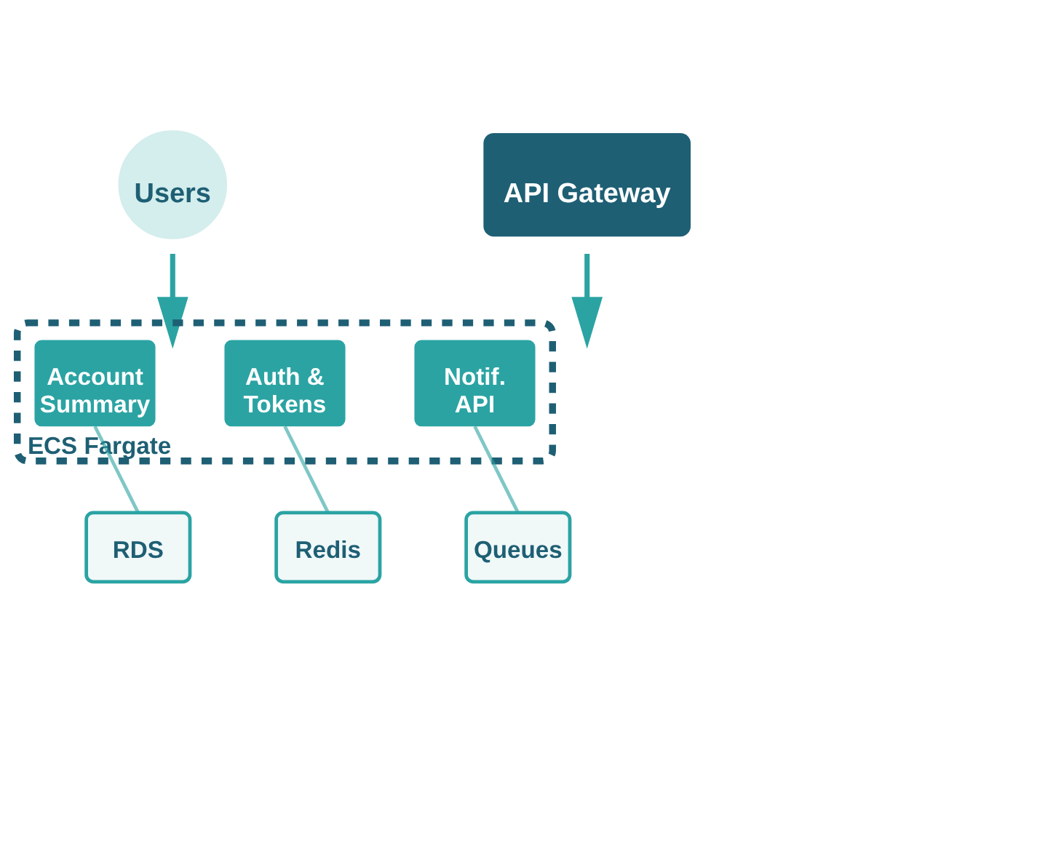
🧩 Long-Running Services (ECS Fargate)
Persistent microservices with always-on availability and consistent throughput
💾 ACCOUNT SUMMARY
REST API aggregating portfolio data. Always-on availability with consistent RDS connections.
🔐 AUTH & TOKENS
JWT validation and SSO integration. Isolated runtime with VPC endpoint controls.
📬 NOTIFICATIONS
Webhook queues and email templates. Persistent connections with in-memory caching.
✓ Durable, state-aware services ensure uptime and consistent throughput

