Slide 1
SideFX
Capability
Studio
Interactive capability design
and live execution
THE RENDERED HTML EXPERIENCE
Product concept
Notes:
Product experience concept, not an implemented application or a record of a real run. The UI mockups are generated raster assets. Slide headings and captions are editable. Source brief: C:/Users/Sidney Jones/.codex/attachments/96e2cf0e-e6eb-4bd4-8705-577bdf3285cb/Pasted text.txt. The semantic model belongs to the estate; the UI projects it. The catalog uses the retained Python 3.15.2 documentation snapshot, not a claim about today's current Python release. Circuit structure reference: C:/lab/repos/sfx-providers/outputs/oal-minimal-continuation-deck-20261018-simulated-variants/volume-01/slide-002.svg. The walkthrough follows a textwrap documentation use case through catalog, preview, inspection, review, generation, invocation and live observation. The user explicitly required the existing layered circuit structure and the ability to invoke generated capabilities and watch their execution.

Slide 2
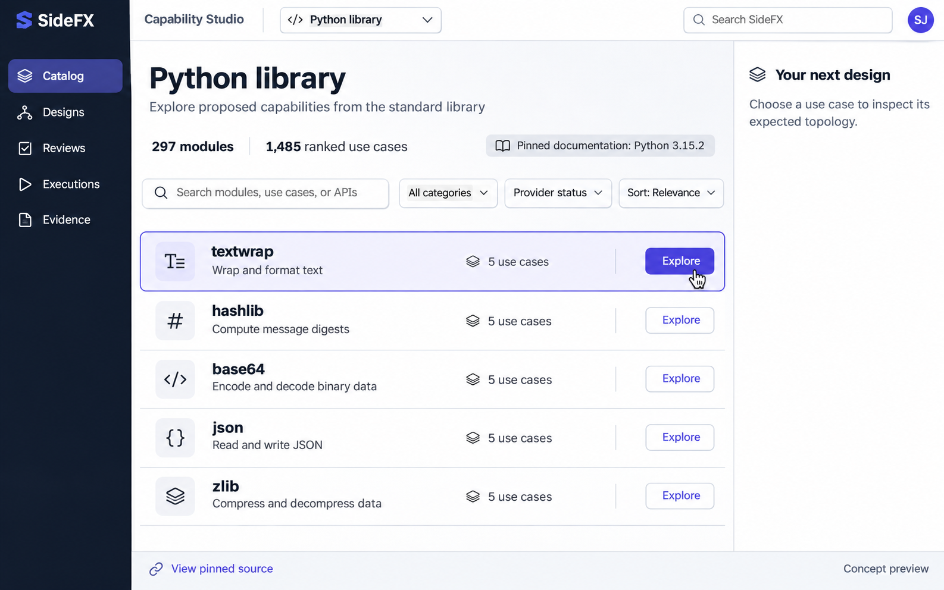
02 / CAPABILITY STUDIO
Python
catalog
Search modules and use cases in one calm, navigable workspace.
Start with intent
Open a module to see the proposed uses it can support.
Product experience concept
02
Notes:
Product experience concept, not an implemented application or a record of a real run. The UI mockups are generated raster assets. Slide headings and captions are editable. Source brief: C:/Users/Sidney Jones/.codex/attachments/96e2cf0e-e6eb-4bd4-8705-577bdf3285cb/Pasted text.txt. The semantic model belongs to the estate; the UI projects it. The catalog uses the retained Python 3.15.2 documentation snapshot, not a claim about today's current Python release. Circuit structure reference: C:/lab/repos/sfx-providers/outputs/oal-minimal-continuation-deck-20261018-simulated-variants/volume-01/slide-002.svg.
Catalog counts come from C:/lab/ov3-workflow-authority-spec/outputs/python-library-provider-report.md: 297 current modules, five ranked use cases each, totaling 1,485. These are source-grounded proposals, not 1,485 admitted capabilities. The visible documentation version is the pinned source identity. The source link exposes provenance.
Visual asset: C:\lab\ov3-workflow-authority-spec\outputs\capability-studio-deck\assets\catalog.png. Generated with the built-in Image Generation tool. Brief: premium enterprise web UI with white workspace, navy navigation, indigo actions, and the supplied canonical circuit geometry where a circuit appears.

Slide 3
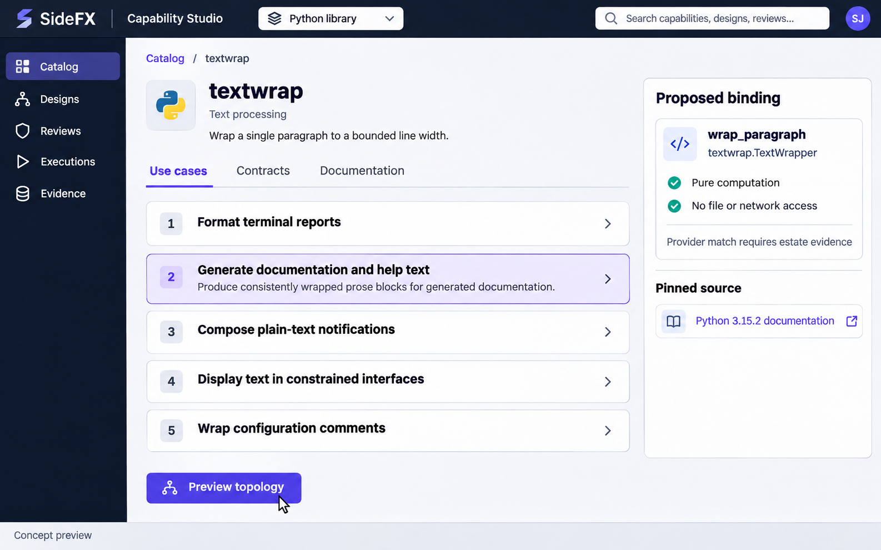
03 / CAPABILITY STUDIO
Ranked
use cases
Ranked uses explain what the module could do before any capability is generated.
Preview topology
The selected use case opens a candidate circuit.
Product experience concept
03
Notes:
Product experience concept, not an implemented application or a record of a real run. The UI mockups are generated raster assets. Slide headings and captions are editable. Source brief: C:/Users/Sidney Jones/.codex/attachments/96e2cf0e-e6eb-4bd4-8705-577bdf3285cb/Pasted text.txt. The semantic model belongs to the estate; the UI projects it. The catalog uses the retained Python 3.15.2 documentation snapshot, not a claim about today's current Python release. Circuit structure reference: C:/lab/repos/sfx-providers/outputs/oal-minimal-continuation-deck-20261018-simulated-variants/volume-01/slide-002.svg.
The five labels paraphrase the ranked textwrap use cases in C:/lab/ov3-workflow-authority-spec/outputs/python-library-provider-report.md. The walkthrough selects documentation and help-text generation. The proposal wraps one paragraph with textwrap.TextWrapper and returns lines and line_count. Provider availability is not inferred from the Python module name.
Visual asset: C:\lab\ov3-workflow-authority-spec\outputs\capability-studio-deck\assets\usecases.png. Generated with the built-in Image Generation tool. Brief: premium enterprise web UI with white workspace, navy navigation, indigo actions, and the supplied canonical circuit geometry where a circuit appears.

Slide 4
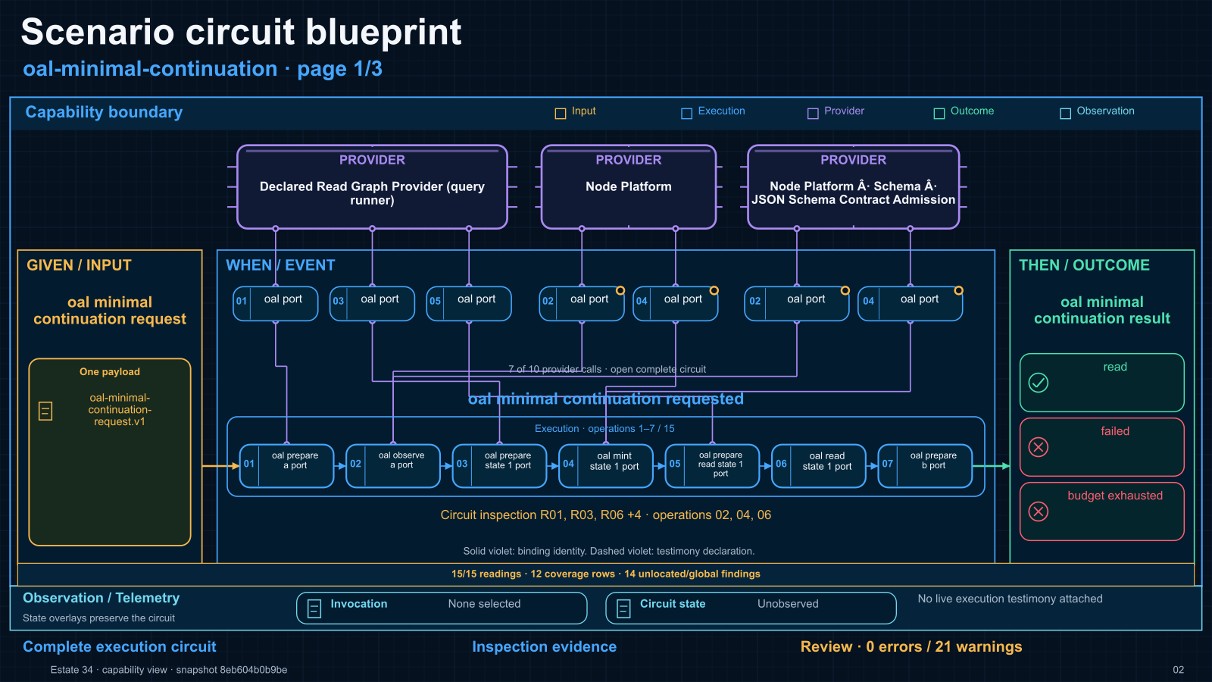
Notes:
Required circuit structure supplied by the user: C:/lab/repos/sfx-providers/outputs/oal-minimal-continuation-deck-20261018-simulated-variants/volume-01/slide-002.svg. This is a reference artifact, not a newly executed run. It demonstrates capability boundary, Given/Input left, When/Event center, Then/Outcome right, providers above, numbered ports and operation flow, and Observation/Telemetry below. The original labels, findings and source text are preserved unchanged. Later concept screens project a smaller textwrap example into the same structural grammar. The diagram's original annotation says state overlays preserve the circuit.

Slide 5
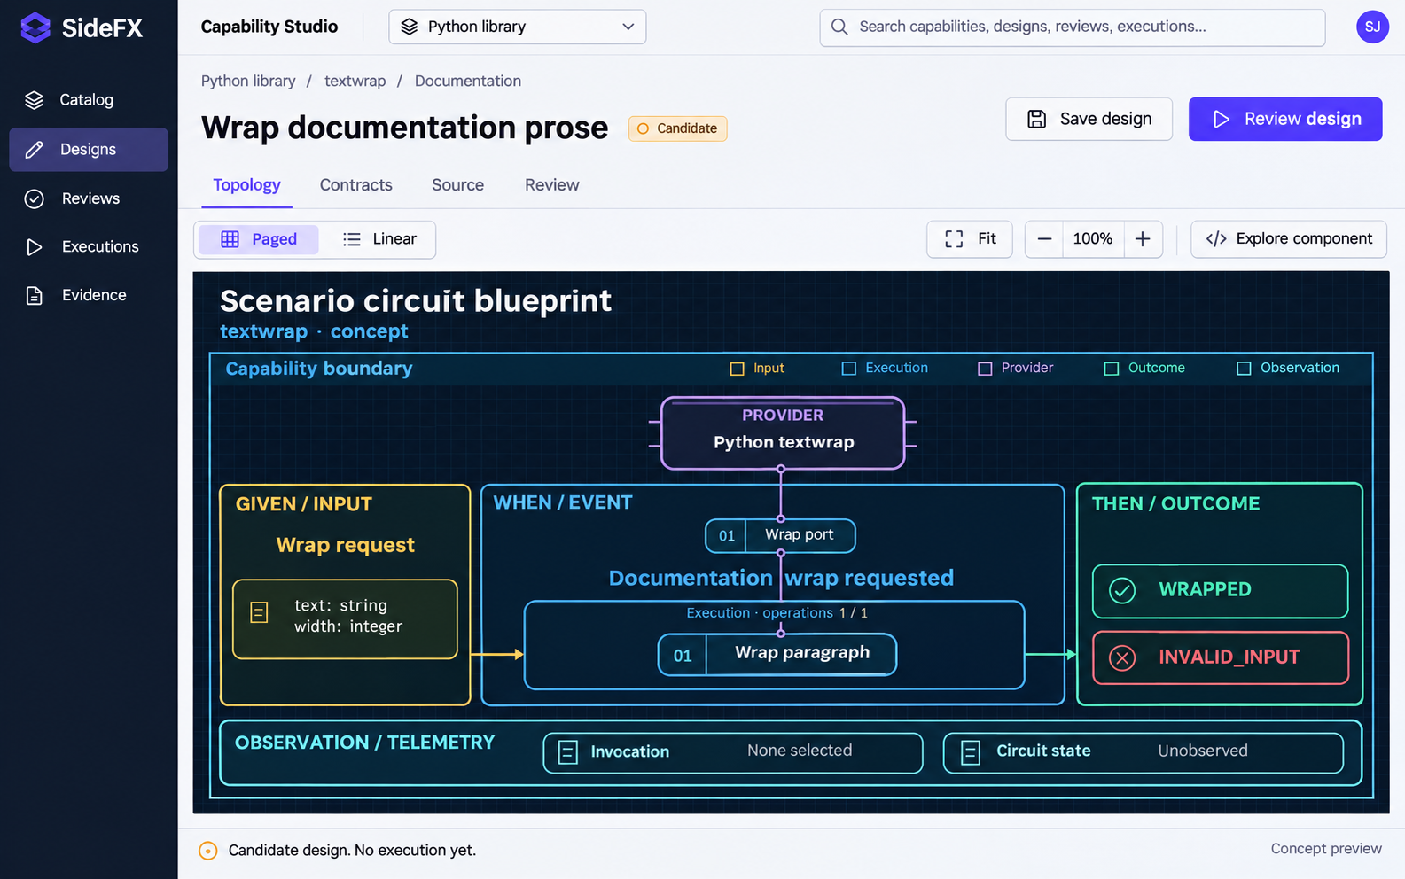
05 / CAPABILITY STUDIO
Scenario
circuit
The preview uses the existing SideFX circuit structure inside the new product shell.
One visual grammar
Providers sit above the event. Telemetry stays beneath the circuit.
Product experience concept
05
Notes:
Product experience concept, not an implemented application or a record of a real run. The UI mockups are generated raster assets. Slide headings and captions are editable. Source brief: C:/Users/Sidney Jones/.codex/attachments/96e2cf0e-e6eb-4bd4-8705-577bdf3285cb/Pasted text.txt. The semantic model belongs to the estate; the UI projects it. The catalog uses the retained Python 3.15.2 documentation snapshot, not a claim about today's current Python release. Circuit structure reference: C:/lab/repos/sfx-providers/outputs/oal-minimal-continuation-deck-20261018-simulated-variants/volume-01/slide-002.svg.
Preserve the canonical spatial relationships and color roles: amber input, blue execution, violet providers, green outcomes and cyan observation. Given/Input and Then/Outcome are end caps. The named event contains the numbered operation sequence. Provider identities descend through ports to the operation, independently of the horizontal execution path. Candidate variants WRAPPED and INVALID_INPUT are illustrative proposed declarations.
Visual asset: C:\lab\ov3-workflow-authority-spec\outputs\capability-studio-deck\assets\topology.png. Generated with the built-in Image Generation tool. Brief: premium enterprise web UI with white workspace, navy navigation, indigo actions, and the supplied canonical circuit geometry where a circuit appears.

Slide 6
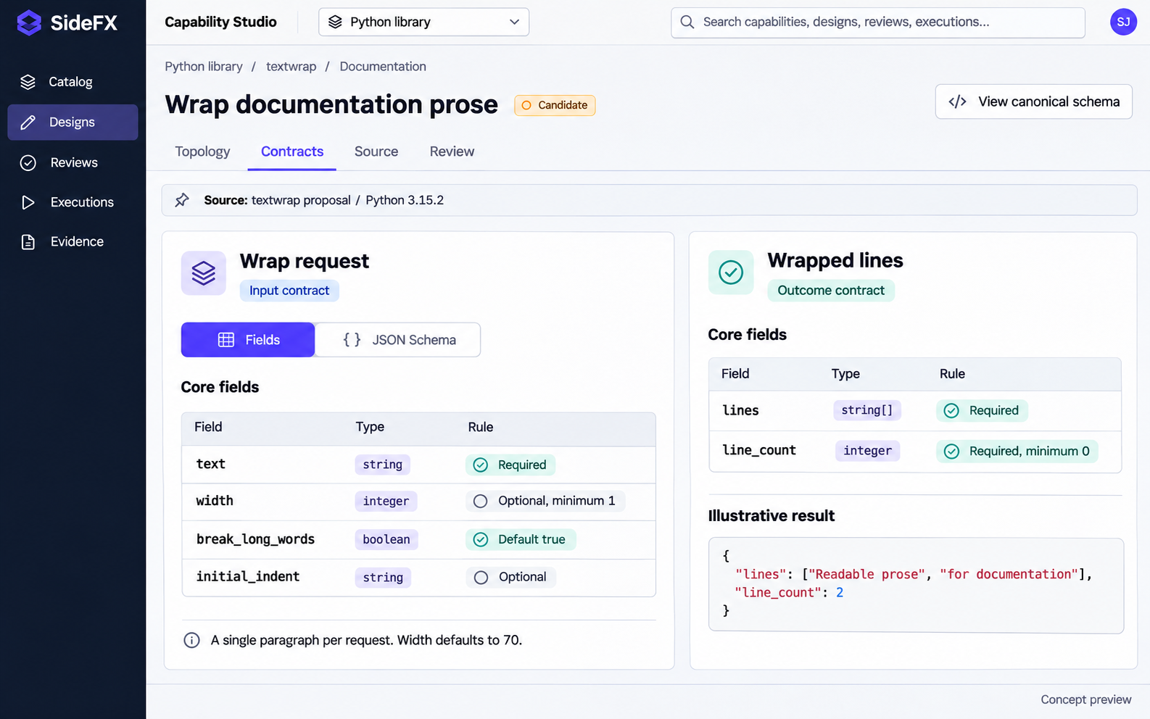
06 / CAPABILITY STUDIO
Input and
outcome
Field-level inspection makes shapes, constraints and defaults easy to understand.
Canonical schema
A readable field view and the underlying schema describe the same contract.
Product experience concept
06
Notes:
Product experience concept, not an implemented application or a record of a real run. The UI mockups are generated raster assets. Slide headings and captions are editable. Source brief: C:/Users/Sidney Jones/.codex/attachments/96e2cf0e-e6eb-4bd4-8705-577bdf3285cb/Pasted text.txt. The semantic model belongs to the estate; the UI projects it. The catalog uses the retained Python 3.15.2 documentation snapshot, not a claim about today's current Python release. Circuit structure reference: C:/lab/repos/sfx-providers/outputs/oal-minimal-continuation-deck-20261018-simulated-variants/volume-01/slide-002.svg.
Core input fields and defaults come from the retained textwrap proposal in C:/lab/ov3-workflow-authority-spec/outputs/python-library-provider-report.md. This screen intentionally shows a subset, labelled Core fields. The full schema remains available. Input text is required; width has minimum 1 and default 70. Outcome requires lines and line_count. The example output is illustrative. UI tables here are part of the concept screenshot, not a claimed editable implementation.
Visual asset: C:\lab\ov3-workflow-authority-spec\outputs\capability-studio-deck\assets\contracts.png. Generated with the built-in Image Generation tool. Brief: premium enterprise web UI with white workspace, navy navigation, indigo actions, and the supplied canonical circuit geometry where a circuit appears.

Slide 7
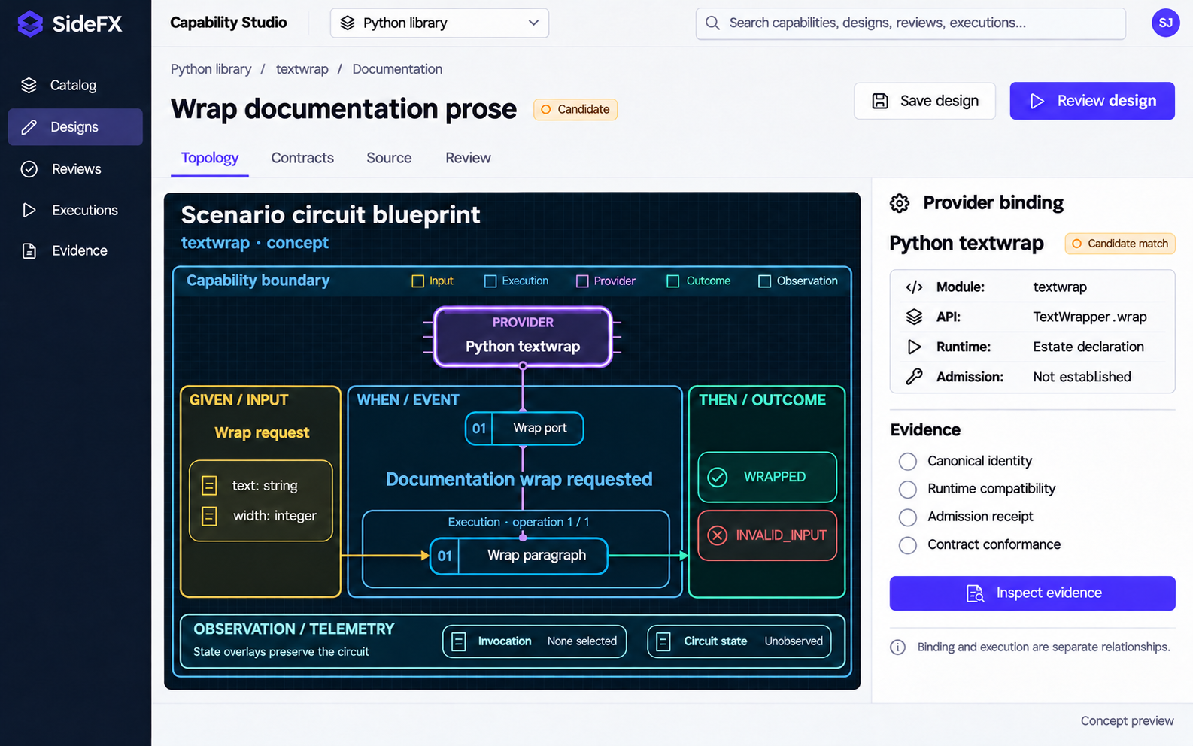
07 / CAPABILITY STUDIO
Provider
inspection
The selected provider opens its identity, runtime requirements and evidence.
Evidence is explicit
Candidate matches remain visible until the estate establishes admission.
Product experience concept
07
Notes:
Product experience concept, not an implemented application or a record of a real run. The UI mockups are generated raster assets. Slide headings and captions are editable. Source brief: C:/Users/Sidney Jones/.codex/attachments/96e2cf0e-e6eb-4bd4-8705-577bdf3285cb/Pasted text.txt. The semantic model belongs to the estate; the UI projects it. The catalog uses the retained Python 3.15.2 documentation snapshot, not a claim about today's current Python release. Circuit structure reference: C:/lab/repos/sfx-providers/outputs/oal-minimal-continuation-deck-20261018-simulated-variants/volume-01/slide-002.svg.
The provider inspector is a proposed experience. It avoids claiming a Python module is already admitted or that a runtime is available. Binding identity and execution flow are separate relations. The violet provider and numbered port remain above the blue operation flow. Evidence can include canonical identity, compatible runtime declaration, admission receipt and contract conformance.
Visual asset: C:\lab\ov3-workflow-authority-spec\outputs\capability-studio-deck\assets\provider.png. Generated with the built-in Image Generation tool. Brief: premium enterprise web UI with white workspace, navy navigation, indigo actions, and the supplied canonical circuit geometry where a circuit appears.

Slide 8
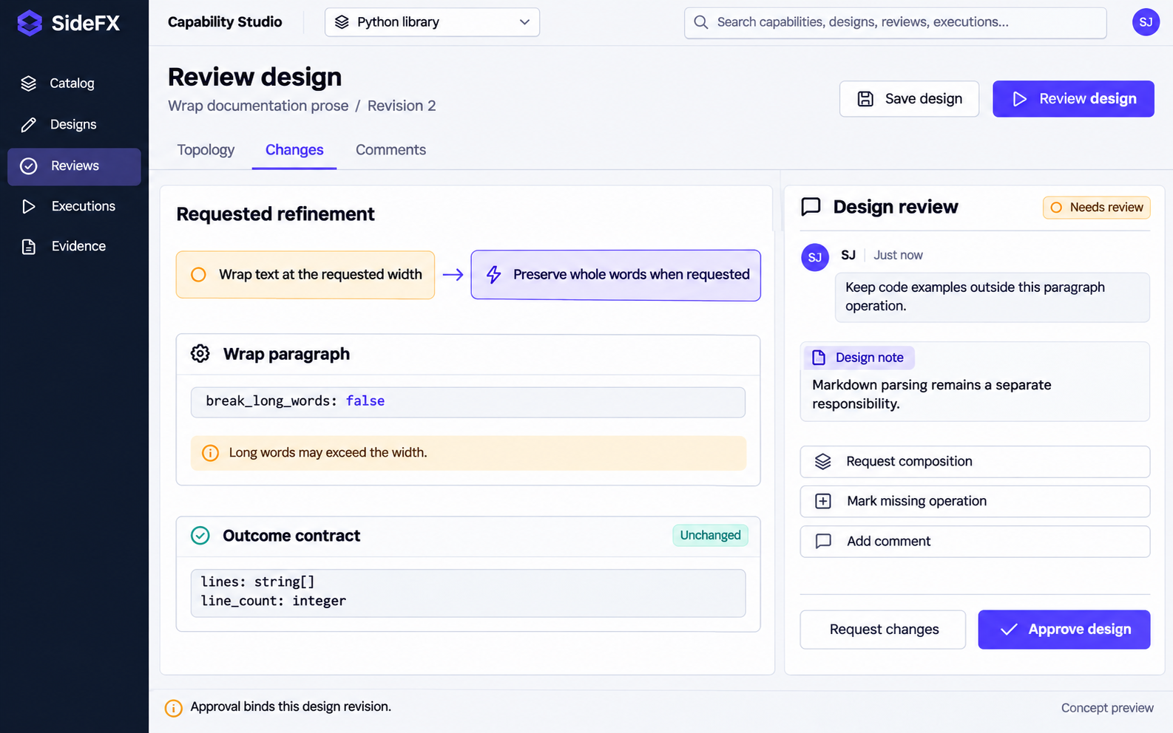
08 / CAPABILITY STUDIO
Design
review
Reviewers can annotate the proposal, request composition and identify missing operations.
Review a revision
Approval refers to the exact design that generation will consume.
Product experience concept
08
Notes:
Product experience concept, not an implemented application or a record of a real run. The UI mockups are generated raster assets. Slide headings and captions are editable. Source brief: C:/Users/Sidney Jones/.codex/attachments/96e2cf0e-e6eb-4bd4-8705-577bdf3285cb/Pasted text.txt. The semantic model belongs to the estate; the UI projects it. The catalog uses the retained Python 3.15.2 documentation snapshot, not a claim about today's current Python release. Circuit structure reference: C:/lab/repos/sfx-providers/outputs/oal-minimal-continuation-deck-20261018-simulated-variants/volume-01/slide-002.svg.
The illustrated refinement changes the word-breaking option. Long words may exceed the requested width when break_long_words is false, as recorded in the retained textwrap constraints. Code examples and Markdown parsing remain separate responsibilities. Review actions produce a new candidate revision; they do not silently mutate an admitted capability.
Visual asset: C:\lab\ov3-workflow-authority-spec\outputs\capability-studio-deck\assets\review.png. Generated with the built-in Image Generation tool. Brief: premium enterprise web UI with white workspace, navy navigation, indigo actions, and the supplied canonical circuit geometry where a circuit appears.

Slide 9
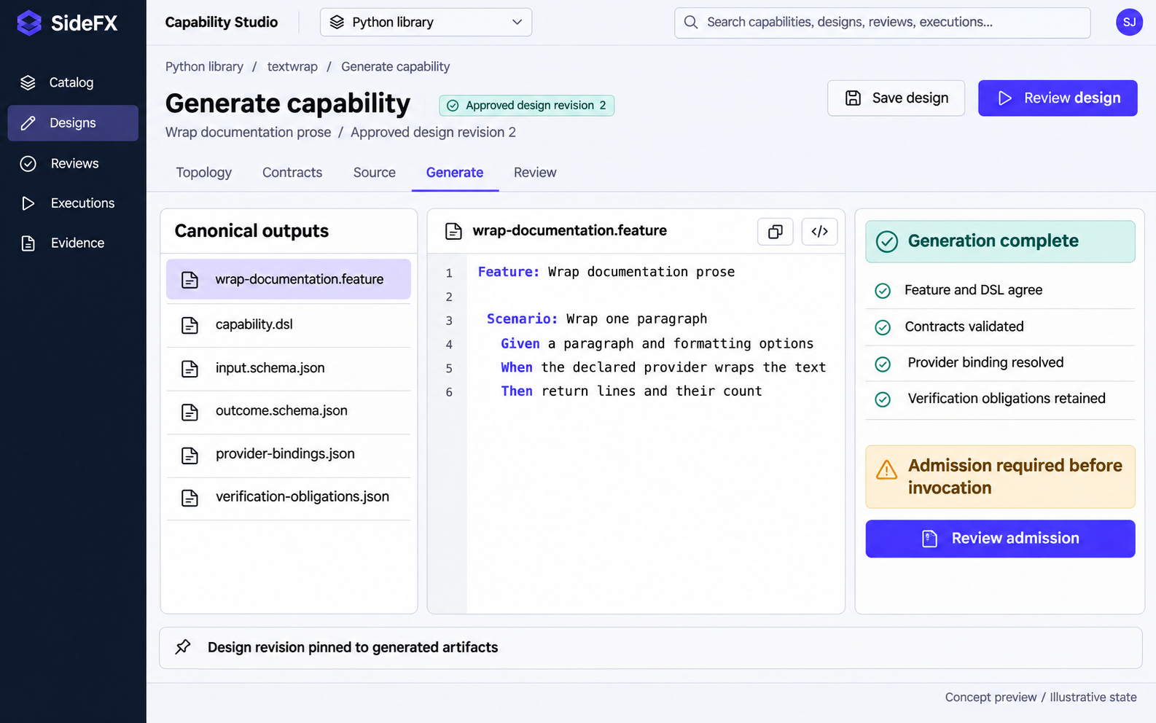
09 / CAPABILITY STUDIO
Canonical
artifacts
The reviewed topology produces the feature, DSL, contracts, bindings and verification obligations.
Generation has a result
Inspect the generated artifacts before the capability becomes invocable.
Product experience concept
09
Notes:
Product experience concept, not an implemented application or a record of a real run. The UI mockups are generated raster assets. Slide headings and captions are editable. Source brief: C:/Users/Sidney Jones/.codex/attachments/96e2cf0e-e6eb-4bd4-8705-577bdf3285cb/Pasted text.txt. The semantic model belongs to the estate; the UI projects it. The catalog uses the retained Python 3.15.2 documentation snapshot, not a claim about today's current Python release. Circuit structure reference: C:/lab/repos/sfx-providers/outputs/oal-minimal-continuation-deck-20261018-simulated-variants/volume-01/slide-002.svg.
This is the proposed generation phase. The feature remains canonical and the DSL must agree with it. The UI shows the generated artifacts and deterministic checks. Generation and admission are distinct states. Invocation becomes available only when the required admission and provider compatibility evidence succeeds. The illustrated file names and completion states are conceptual.
Visual asset: C:\lab\ov3-workflow-authority-spec\outputs\capability-studio-deck\assets\generate.png. Generated with the built-in Image Generation tool. Brief: premium enterprise web UI with white workspace, navy navigation, indigo actions, and the supplied canonical circuit geometry where a circuit appears.

Slide 10
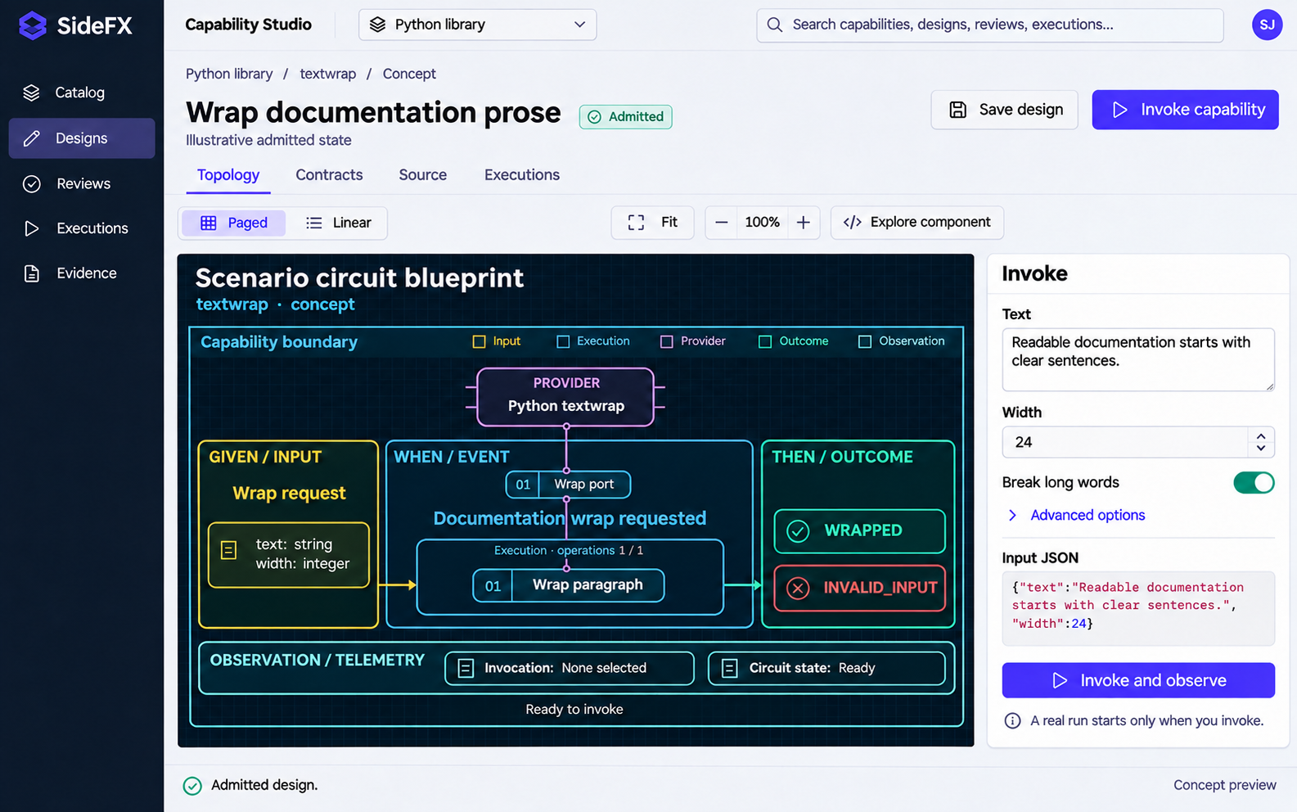
10 / CAPABILITY STUDIO
Capability
invocation
After admission, the user can supply input and start an actual run from the same workspace.
Invoke and observe
Opening the circuit reads it. The Invoke action starts execution.
Product experience concept
10
Notes:
Product experience concept, not an implemented application or a record of a real run. The UI mockups are generated raster assets. Slide headings and captions are editable. Source brief: C:/Users/Sidney Jones/.codex/attachments/96e2cf0e-e6eb-4bd4-8705-577bdf3285cb/Pasted text.txt. The semantic model belongs to the estate; the UI projects it. The catalog uses the retained Python 3.15.2 documentation snapshot, not a claim about today's current Python release. Circuit structure reference: C:/lab/repos/sfx-providers/outputs/oal-minimal-continuation-deck-20261018-simulated-variants/volume-01/slide-002.svg.
The requested future product offers contract-driven inputs synchronized with JSON. The actual API invocation returns a run identity. There is no run merely because a user opens a design or refreshes the view. This follows the thin-client boundary in C:/lab/repos/sfx-platform/AGENTS.md. The depicted admitted state is illustrative. The sample text and width 24 are used consistently in the completion example.
Visual asset: C:\lab\ov3-workflow-authority-spec\outputs\capability-studio-deck\assets\invoke.png. Generated with the built-in Image Generation tool. Brief: premium enterprise web UI with white workspace, navy navigation, indigo actions, and the supplied canonical circuit geometry where a circuit appears.

Slide 11
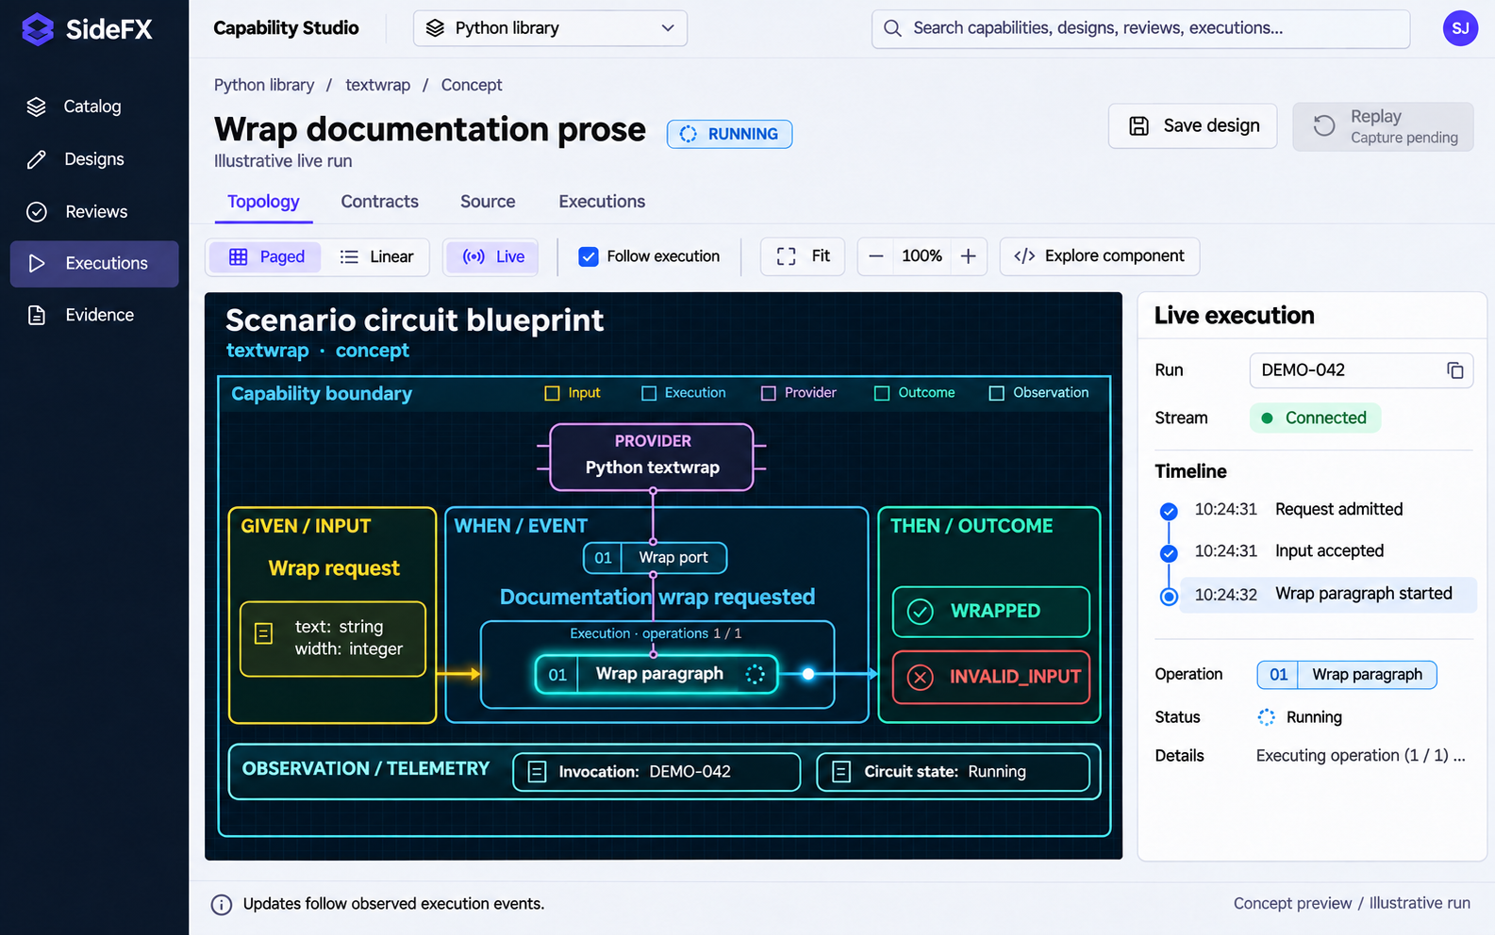
11 / CAPABILITY STUDIO
Live
execution
Observed events animate the active operation and traversed connections without changing the topology.
The run drives motion
The active cell, timeline and telemetry refer to the same invocation.
Product experience concept
11
Notes:
Product experience concept, not an implemented application or a record of a real run. The UI mockups are generated raster assets. Slide headings and captions are editable. Source brief: C:/Users/Sidney Jones/.codex/attachments/96e2cf0e-e6eb-4bd4-8705-577bdf3285cb/Pasted text.txt. The semantic model belongs to the estate; the UI projects it. The catalog uses the retained Python 3.15.2 documentation snapshot, not a claim about today's current Python release. Circuit structure reference: C:/lab/repos/sfx-providers/outputs/oal-minimal-continuation-deck-20261018-simulated-variants/volume-01/slide-002.svg.
Live execution is a required product capability. The dark circuit maintains the same topology used in preview. Status overlays can mark queued, active, completed and failed cells. Connect animation to authenticated run events with stable operation and edge identities; do not synthesize progress. The illustration freezes one active state of DEMO-042, an example run identity. The screenshot is not itself an animation or real run evidence. Existing app behavior reference: C:/lab/repos/sfx-platform/live-circuit/circuit/README.md. Host startup, session setup and graph preparation remain outside scenario playback. A fast operation should not be artificially slowed to imply live duration; use replay for inspection.
Visual asset: C:\lab\ov3-workflow-authority-spec\outputs\capability-studio-deck\assets\live.png. Generated with the built-in Image Generation tool. Brief: premium enterprise web UI with white workspace, navy navigation, indigo actions, and the supplied canonical circuit geometry where a circuit appears.

Slide 12
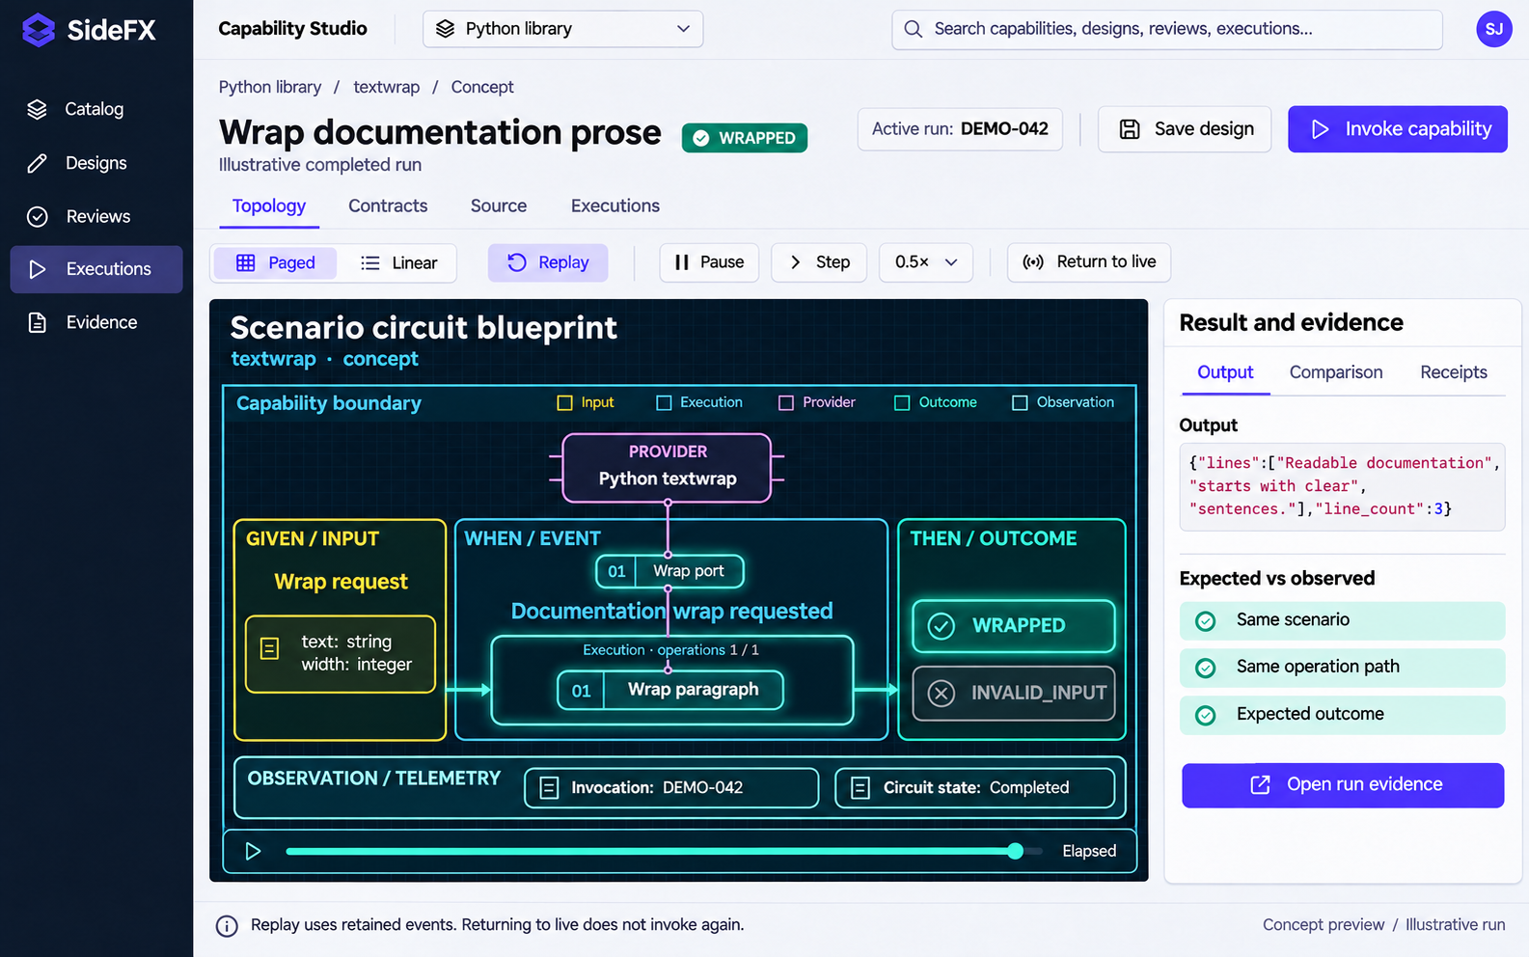
12 / CAPABILITY STUDIO
Results
and replay
The outcome, retained evidence and expected topology remain available after the run finishes.
Replay the evidence
Pause, step and change speed without invoking the capability again.
Product experience concept
12
Notes:
Product experience concept, not an implemented application or a record of a real run. The UI mockups are generated raster assets. Slide headings and captions are editable. Source brief: C:/Users/Sidney Jones/.codex/attachments/96e2cf0e-e6eb-4bd4-8705-577bdf3285cb/Pasted text.txt. The semantic model belongs to the estate; the UI projects it. The catalog uses the retained Python 3.15.2 documentation snapshot, not a claim about today's current Python release. Circuit structure reference: C:/lab/repos/sfx-providers/outputs/oal-minimal-continuation-deck-20261018-simulated-variants/volume-01/slide-002.svg.
The depicted completed run and comparison checks are illustrative. At width 24 the example paragraph wraps to Readable documentation / starts with clear / sentences., giving line_count 3. The proposed Comparison tab checks declared scenario identity, operation path, outcomes and source digests against retained testimony. Receipts identify the actual invocation. The existing app documents pause, step, speed and return-to-live controls in C:/lab/repos/sfx-platform/live-circuit/circuit/README.md. Replay and live mode must remain clearly labelled. A different outcome or missing evidence is a finding, not a successful comparison.
Visual asset: C:\lab\ov3-workflow-authority-spec\outputs\capability-studio-deck\assets\replay.png. Generated with the built-in Image Generation tool. Brief: premium enterprise web UI with white workspace, navy navigation, indigo actions, and the supplied canonical circuit geometry where a circuit appears.

Slide 13
Live execution behavior
The same circuit supports invocation, observation and replay
State | What the user sees | What drives the view
Ready | Input controls and Invoke | An admitted capability and its input contract
Running | Active operation, connection pulse and timeline | Observed events for the selected run
Completed | Output, selected outcome and receipts | Terminal evidence and retained result
Failed | Failing operation and an inspectable finding | Failure testimony with its source identity
Disconnected | Last observed state and connection warning | No invented progress while the stream is unavailable
Replay | Pause, step, speed and return to live | Retained events without another invocation
Meaning and authority stay in the estate. The browser renders their declared view.
Notes:
Product experience concept, not an implemented application or a record of a real run. The UI mockups are generated raster assets. Slide headings and captions are editable. Source brief: C:/Users/Sidney Jones/.codex/attachments/96e2cf0e-e6eb-4bd4-8705-577bdf3285cb/Pasted text.txt. The semantic model belongs to the estate; the UI projects it. The catalog uses the retained Python 3.15.2 documentation snapshot, not a claim about today's current Python release. Circuit structure reference: C:/lab/repos/sfx-providers/outputs/oal-minimal-continuation-deck-20261018-simulated-variants/volume-01/slide-002.svg.
These are proposed product acceptance behaviors, grounded in the user requirement and the documented live/replay behavior in C:/lab/repos/sfx-platform/live-circuit/circuit/README.md. They are requirements rather than claims that this new UI is deployed. Disconnection does not mean failure or cancellation. Failure paths and all declared terminal variants remain inspectable. Navigation and replay do not trigger new runs. The table is a native editable PowerPoint table.

