Slide 1



Broadening Participation in Visualization 2020
Broadening Participation in Visualization 2020
Byrd Data Visualization Laboratory
Broadening Participation in Visualization 2020
©BPBiz

Slide 2
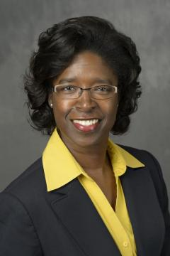
About Me
Vetria Byrd, PhD
Assistant Professor
Purdue University
Byrd Data Visualization Lab, Director
Research Interests
Pedagogy of Data Visualization
HPC Visualization: visualizing heterogeneous data, and complex data in AR/VR environments
Utilizing data visualization to advance science in the area of symptom cluster management for healthcare
Vetria Byrd
Assistant Professor
Byrd Data Visualization Lab, Director
Purdue University

Slide 3
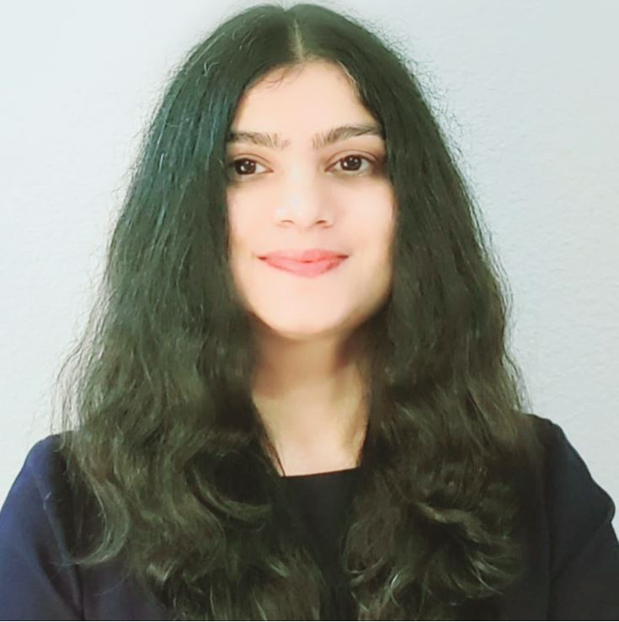
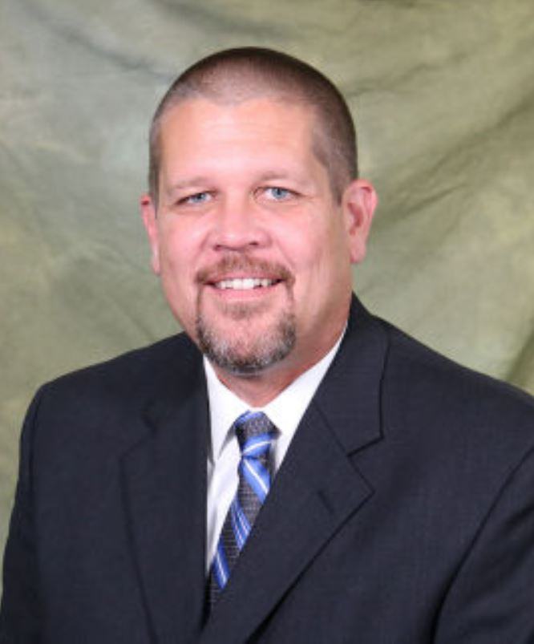
Webinar Series Organizers
Ritu Arora
Assistant Vice President of Research Computing
University of Texas at San Antonio
Vetria Byrd
Assistant Professor
Byrd Data Visualization Lab, Director
Purdue University
Brent League
Director of Research Computing Support
University of Texas at San Antonio

Slide 4
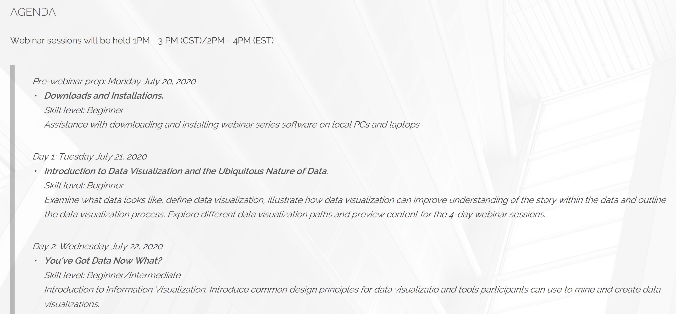
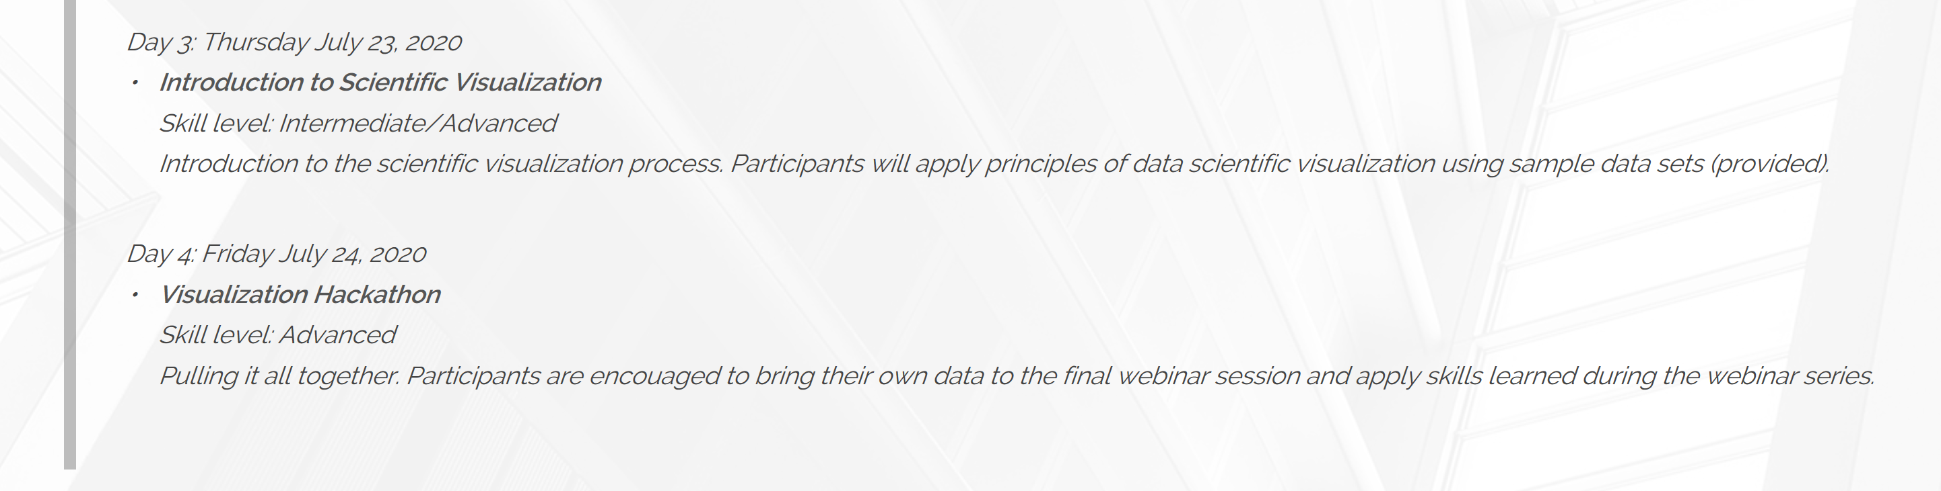

Slide 5
Webinar Agenda
Day 1: Introduction to Data Visualization and the Ubiquitous Nature of Data
Day 2: You’ve Got Data Now What?
Day 3: Introduction to Scientific Visualization
Day 4: Visualization Hackathon

Slide 6
Administrivia & Logistics
Webinar Schedule (CST Time)
1:00 PM – 1:15 PM Q&A
1:15 PM – 2:00 PM Webinar Talk
2:00 PM – 2:30 PM Hands-on
2:30 PM – 3:00 PM UTSA
Tools and Applications
Tableau (14-day Trial)
https://www.tableau.com/products/desktop/download
ParaView 5.8
https://www.paraview.org/download/

Slide 7
Webinar Website: BPViz.org
Broadening Participation in Visualization 2020
Broadening Participation in Visualization 2020
ADD URL
Byrd Data Visualization Laboratory

Slide 8
About the Webinar Series
Four-days of visualization content
To maximize your experience, there will be exercises for you to complete (to familiarize yourself with webinar tools and applications) before each webinar
Each day is stand alone; however, you are encouraged to participate in the entire series
Participants who attend the entire series will be given priority on Day 4: Visualization Hackathon and Consultation

Slide 9
Lets Get Started!
Building Data Visualization Capacity

Slide 10
Introduction to Data Visualization

