Slide 1
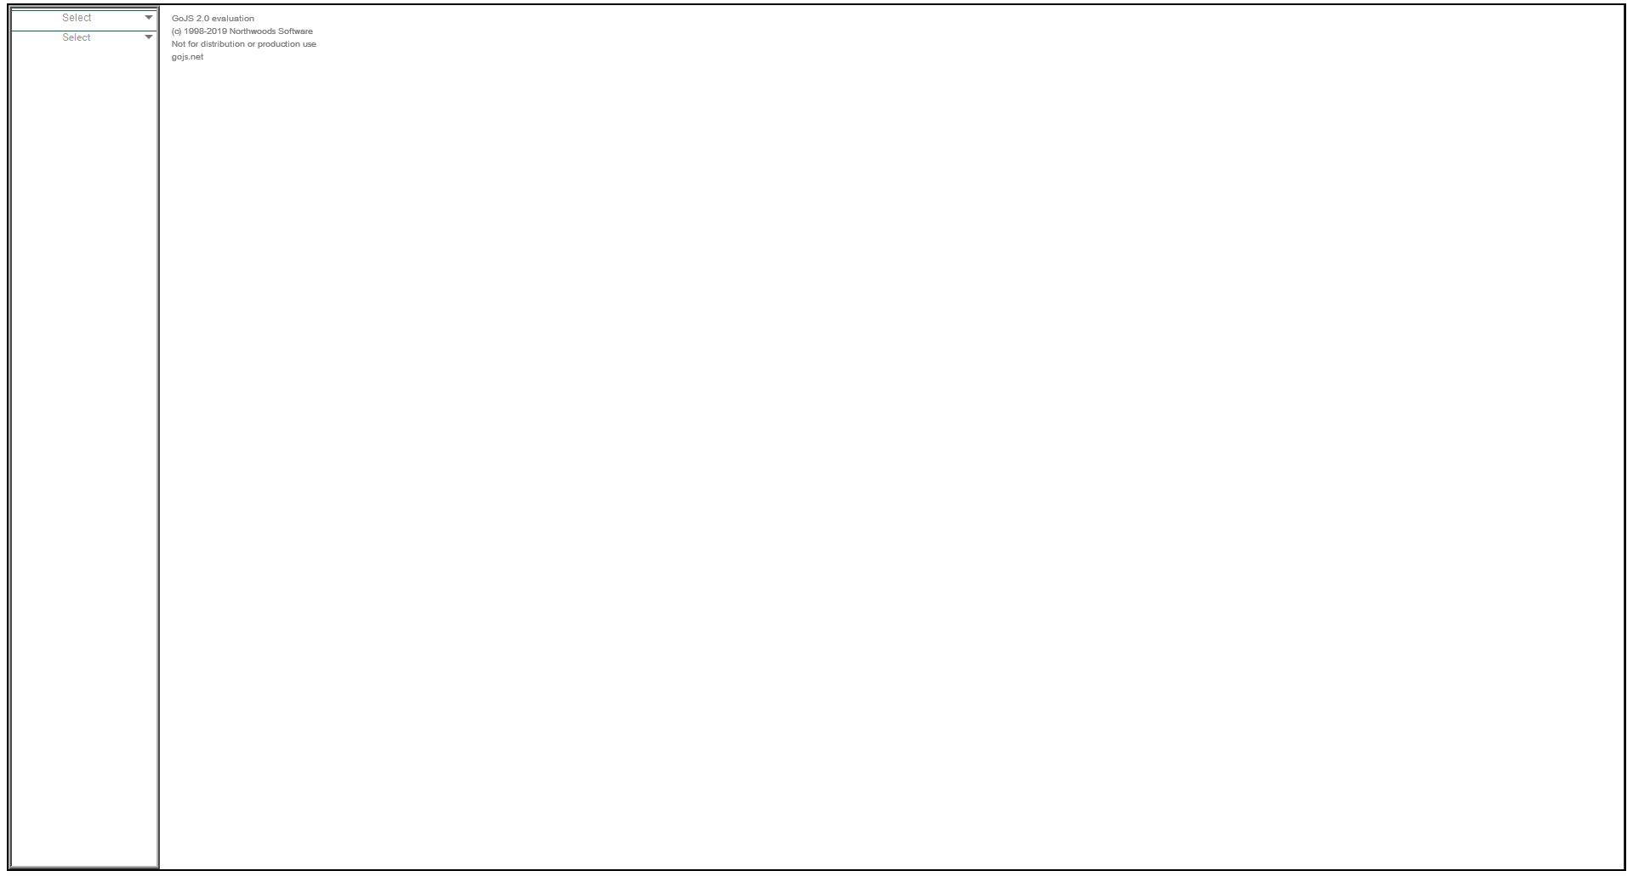


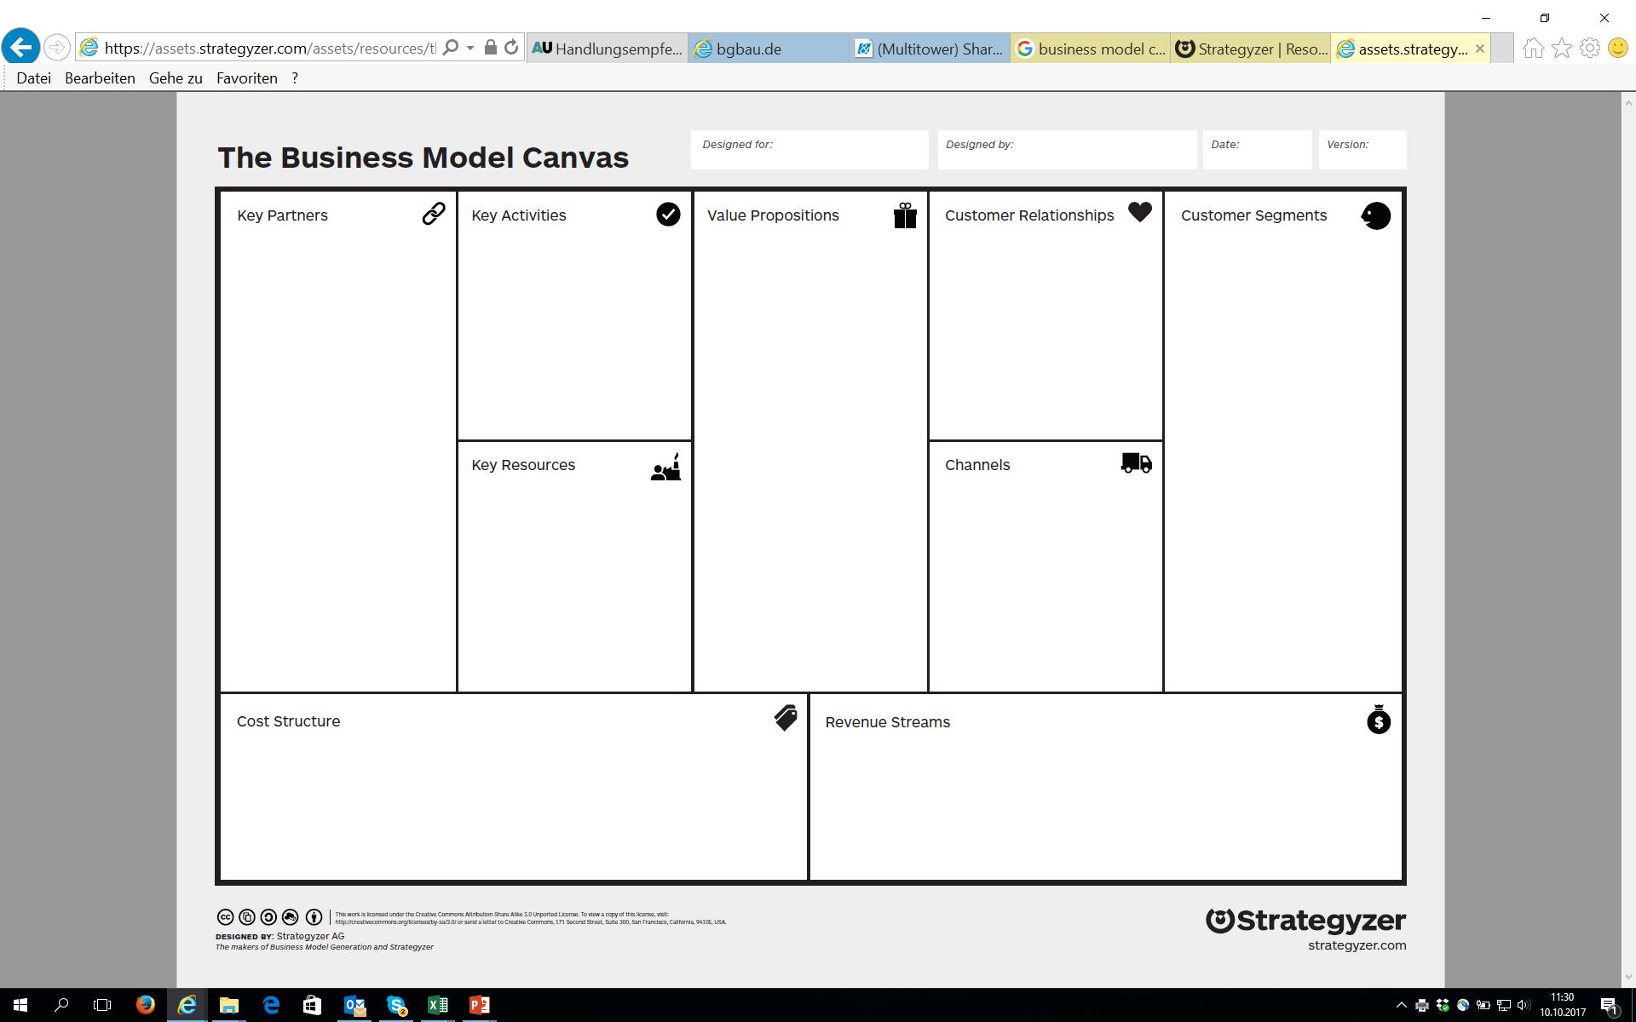
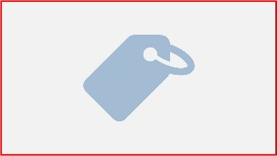
Business Model Design
Business Model Canvas
Cost Structure
Fixed Costs
Variable Costs
Salaries
Notes:
Panel-example

Slide 2

Designed for
Notes:
BMC-name, date, creator

Slide 3
Designed for
Notes:
BMC-name, date, creator

Slide 4

Designed by
Notes:
BMC-name, date, creator

Slide 5

Designed by
Notes:
BMC-name, date, creator

Slide 6

Date of Creation
Notes:
BMC-name, date, creator

Slide 7
Date of creation
Notes:
BMC-name, date, creator

Slide 8

Canvas Description
Notes:
BMC-name, date, creator

Slide 9

Canvas description
Notes:
BMC-name, date, creator

Slide 10

Notes:
Offering

Slide 11

Qualitative Values
Notes:
Offering

Slide 12
Qualitative
Values
Notes:
Offering

Slide 13
Accessibility
Notes:
Offering

Slide 14
Accessibility
Notes:
Offering

Slide 15
Mass Customization
Notes:
Offering

Slide 16
Mass
Customization
Notes:
Offering

Slide 17
Design
Notes:
Offering

Slide 18
Design
Notes:
Offering

Slide 19
Status
Notes:
Offering

Slide 20
Status
Notes:
Offering

Slide 21
Convenience
Notes:
Offering

Slide 22
Convenience
Notes:
Offering

Slide 23
Customer Co-Creation
Notes:
Offering

Slide 24
Customer
Co-Creation
Notes:
Offering

Slide 25
Newness
Notes:
Offering

Slide 26
Newness
Notes:
Offering

Slide 27

Quantitative Values
Notes:
Offering

Slide 28
Quantitative
Values
Notes:
Offering

Slide 29
Performance
Notes:
Offering

Slide 30
Performance
Notes:
Offering

Slide 31
Cost Reduction
Notes:
Offering

Slide 32
Cost Reduction
Notes:
Offering

Slide 33
Getting the Job Done
Notes:
Offering

Slide 34
Getting the Job Done
Notes:
Offering

Slide 35
Risk Reduction
Notes:
Offering

Slide 36
Risk Reduction
Notes:
Offering

Slide 37
Speed of Service
Notes:
Offering

Slide 38
Speed of Service
Notes:
Offering

Slide 39
Price
Notes:
Offering

Slide 40
Price
Notes:
Offering

Slide 41

Micro Market
Notes:
Customer Segments

Slide 42
Micro Market
Notes:
Customer Segments

Slide 43
Niche Market
Notes:
Customer Segments

Slide 44
Niche Market
Notes:
Customer Segments

Slide 45
Mass Market
Notes:
Customer Segments

Slide 46
Mass Market
Notes:
Customer Segments

Slide 47
Segmented Market
Notes:
Customer Segments

Slide 48
Segmented Market
Notes:
Customer Segments

Slide 49
Notes:
Customer Segments

Slide 50

Notes:
Customer Relationships

Slide 51

Notes:
Channels

Slide 52

Notes:
Key Partnerships

Slide 53

Notes:
Key Activities

Slide 54

Notes:
Key Ressources

Slide 55

Notes:
Revenue Streams

Slide 56

Notes:
Cost Structure – fixed Costs

Slide 57
Notes:
Cost Structure – Variable Costs

