Slide 1
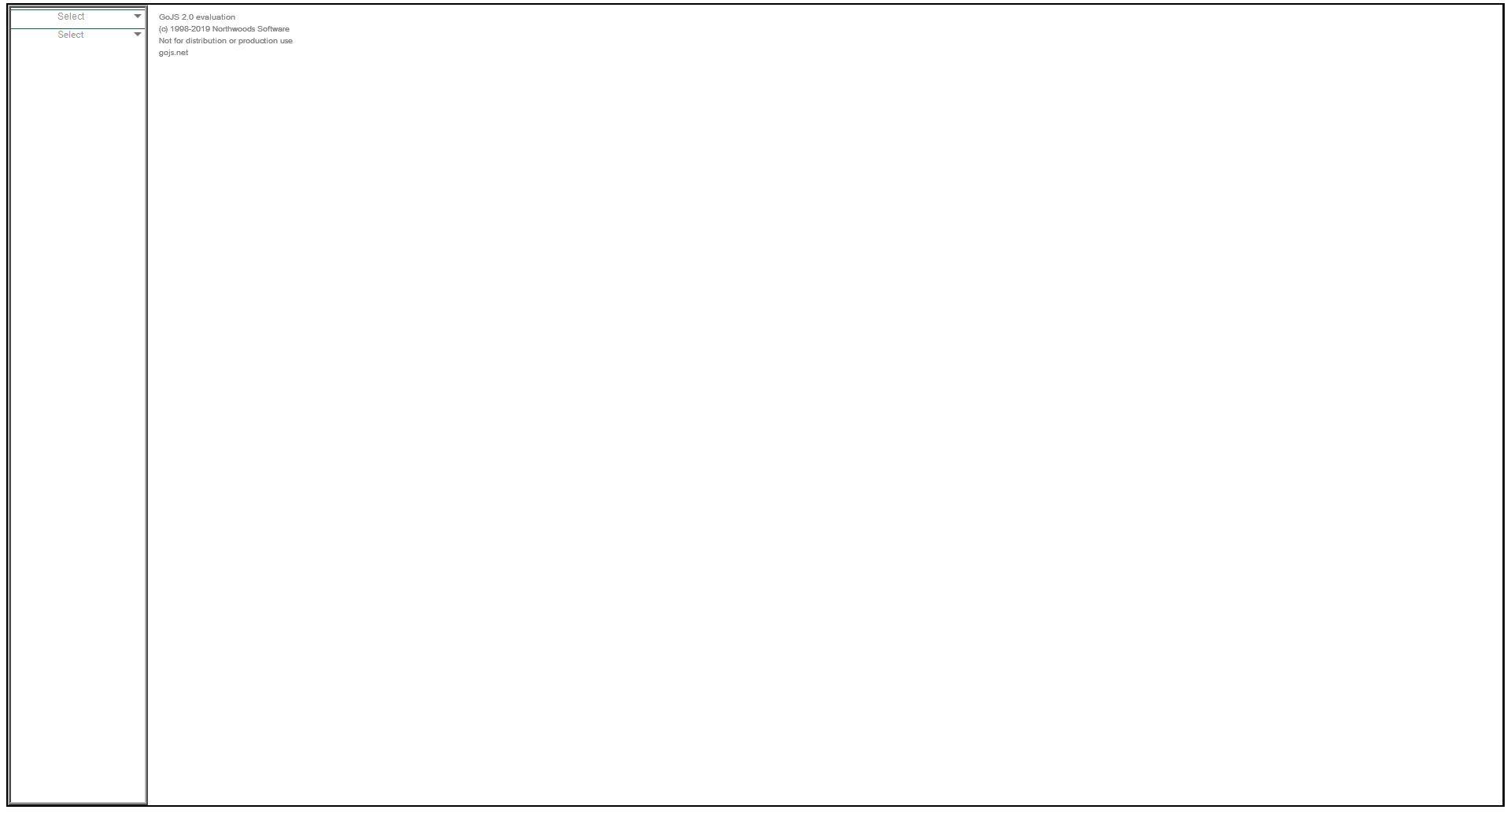


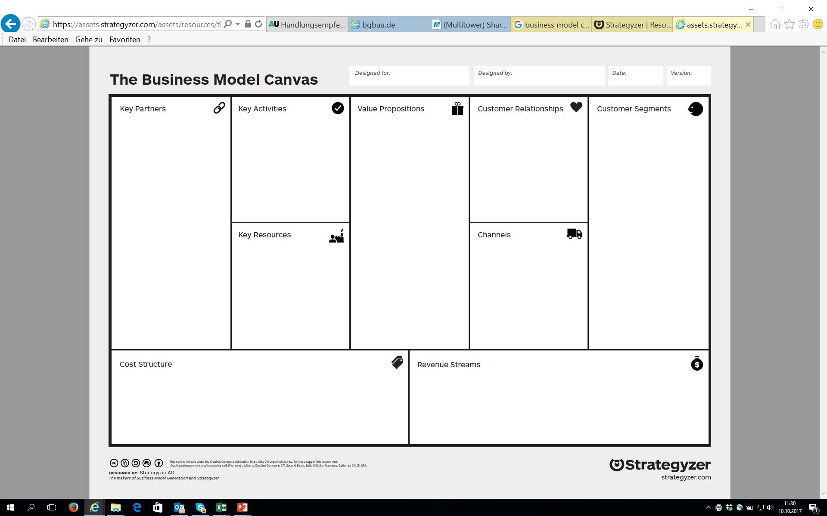
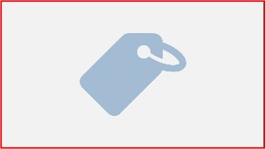
Business Model Design
Business Model Canvas
Cost Structure
Fixed Costs
Variable Costs
Salaries
Notes:
Panel-example

Slide 2

Designed for
Notes:
BMC-name, date, creator

Slide 3
Designed for
Notes:
BMC-name, date, creator

Slide 4

Designed by
Notes:
BMC-name, date, creator

Slide 5

Designed by
Notes:
BMC-name, date, creator

Slide 6

Date of Creation
Notes:
BMC-name, date, creator

Slide 7
Date of creation
Notes:
BMC-name, date, creator

Slide 8

Canvas Description
Notes:
BMC-name, date, creator

Slide 9

Canvas description
Notes:
BMC-name, date, creator

Slide 10

Notes:
Offering

Slide 11

Qualitative Values
Notes:
Offering

Slide 12
Qualitative
Values
Notes:
Offering

Slide 13
Accessibility
Notes:
Offering

Slide 14
Accessibility
Notes:
Offering

Slide 15
Mass Customization
Notes:
Offering

Slide 16
Mass
Customization
Notes:
Offering

Slide 17
Design
Notes:
Offering

Slide 18
Design
Notes:
Offering

Slide 19
Status
Notes:
Offering

Slide 20
Status
Notes:
Offering

Slide 21
Convenience
Notes:
Offering

Slide 22
Convenience
Notes:
Offering

Slide 23
Customer Co-Creation
Notes:
Offering

Slide 24
Customer
Co-Creation
Notes:
Offering

Slide 25
Newness
Notes:
Offering

Slide 26
Newness
Notes:
Offering

Slide 27

Quantitative Values
Notes:
Offering

Slide 28
Quantitative
Values
Notes:
Offering

Slide 29
Performance
Notes:
Offering

Slide 30
Performance
Notes:
Offering

Slide 31
Cost Reduction
Notes:
Offering

Slide 32
Cost Reduction
Notes:
Offering

Slide 33
Getting the Job Done
Notes:
Offering

Slide 34
Getting the Job Done
Notes:
Offering

Slide 35
Risk Reduction
Notes:
Offering

Slide 36
Risk Reduction
Notes:
Offering

Slide 37
Speed of Service
Notes:
Offering

Slide 38
Speed of Service
Notes:
Offering

Slide 39
Price
Notes:
Offering

Slide 40
Price
Notes:
Offering

Slide 41

Micro Market
Notes:
Customer Segments

Slide 42
Micro Market
Notes:
Customer Segments

Slide 43

Niche Market
Notes:
Customer Segments

Slide 44
Niche Market
Notes:
Customer Segments

Slide 45

Mass Market
Notes:
Customer Segments

Slide 46
Mass Market
Notes:
Customer Segments

Slide 47

Segmented Market
Notes:
Customer Segments

Slide 48
Segmented Market
Notes:
Customer Segments

Slide 49

Notes:
Customer Segments

Slide 50

Notes:
Customer Relationships

Slide 51
Human Interactions
Notes:
Customer Relationships

Slide 52
Human Interactions
Notes:
Customer Relationships

Slide 53
Communities
Notes:
Customer Relationships

Slide 54
Communities
Notes:
Customer Relationships

Slide 55
Co-Creation w/ People
Notes:
Customer Relationships

Slide 56
Co-Creation
w/ People
Notes:
Customer Relationships

Slide 57
Dedicated Personal Assistance
Notes:
Customer Relationships

Slide 58
Dedicated Per-sonal Assistance
Notes:
Customer Relationships

Slide 59
Personal Assistance
Notes:
Customer Relationships

Slide 60
Personal Assistance
Notes:
Customer Relationships

Slide 61

Non-Human Interactions
Notes:
Customer Relationships

Slide 62
Non-Human Interactions
Notes:
Customer Relationships

Slide 63
Automated Service
Notes:
Customer Relationships

Slide 64
Automated Service
Notes:
Customer Relationships

Slide 65
Co-Creation w/ Bot
Notes:
Customer Relationships

Slide 66
Co-Creation
w/ Bot
Notes:
Customer Relationships

Slide 67
Self-Service
Notes:
Customer Relationships

Slide 68
Self-Service
Notes:
Customer Relationships

Slide 69

Notes:
Channels

Slide 70

Own Channels
Notes:
Channels

Slide 71
Own Channels
Notes:
Channels

Slide 72
Web Sale
Notes:
Channels

Slide 73
Web Sale
Notes:
Channels

Slide 74
Sales Force
Notes:
Channels

Slide 75
Sales Force
Notes:
Channels

Slide 76
Own Stores
Notes:
Channels

Slide 77
Own Stores
Notes:
Channels

Slide 78
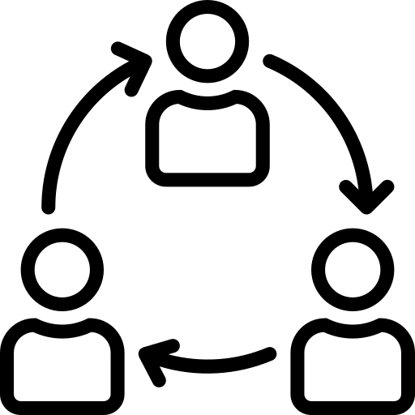
Partner Channels
Notes:
Channels

Slide 79
Partner Channels
Notes:
Channels

Slide 80
Wholesaler
Notes:
Channels

Slide 81
Wholesaler
Notes:
Channels

Slide 82
Partner Store
Notes:
Channels

Slide 83
Partner Store
Notes:
Channels

Slide 84

Notes:
Key Partnerships

Slide 85

Government
Notes:
Key Partnerships

Slide 86
Government
Notes:
Key Partnerships

Slide 87

Academic Institute
Notes:
Key Partnerships

Slide 88
Academic Institute
Notes:
Key Partnerships

Slide 89

Business Partner
Notes:
Key Partnerships

Slide 90
Business Partner
Notes:
Key Partnerships

Slide 91

Individual
Notes:
Key Partnerships

Slide 92
Individual
Notes:
Key Partnerships

Slide 93

Notes:
Key Activities

Slide 94

Support Process
Notes:
Key Activities

Slide 95
Support Process
Notes:
Key Activities

Slide 96
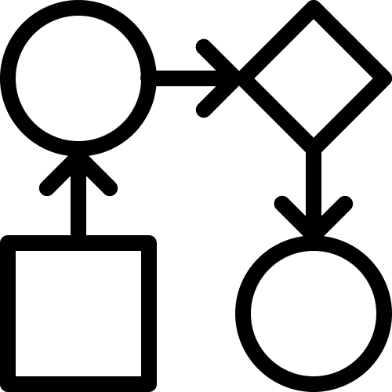
Core Process
Notes:
Key Activities

Slide 97
Core Process
Notes:
Key Activities

Slide 98

Notes:
Key Ressources

Slide 99

Financial Resource
Notes:
Key Ressources

Slide 100
Financial Resource
Notes:
Key Ressources

Slide 101

Human Resource
Notes:
Key Ressources

Slide 102
Human Resource
Notes:
Key Ressources

Slide 103

Intellectual Resource
Notes:
Key Ressources

Slide 104
Intellectual Resource
Notes:
Key Ressources

Slide 105

Physical Resource
Notes:
Key Ressources

Slide 106
Physical Resource
Notes:
Key Ressources

Slide 107

Notes:
Revenue Streams

Slide 108

Fee-based Revenues
Notes:
Revenue Streams

Slide 109
Fee-based Revenues
Notes:
Revenue Streams

Slide 110
Usage Fee
Notes:
Revenue Streams

Slide 111
Usage Fee
Notes:
Revenue Streams

Slide 112
Subscription Fee
Notes:
Revenue Streams

Slide 113
Subscription Fee
Notes:
Revenue Streams

Slide 114
Brokerage Fee
Notes:
Revenue Streams

Slide 115
Brokerage Fee
Notes:
Revenue Streams

Slide 116
Lending, Renting, Leasing
Notes:
Revenue Streams

Slide 117
Lending, Renting, Leasing
Notes:
Revenue Streams

Slide 118
Advertising
Notes:
Revenue Streams

Slide 119
Advertising
Notes:
Revenue Streams

Slide 120
Licensing
Notes:
Revenue Streams

Slide 121
Licensing
Notes:
Revenue Streams

Slide 122
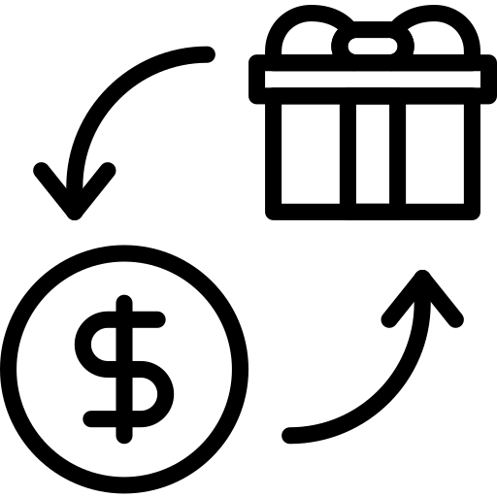
Asset Sale
Notes:
Revenue Streams

Slide 123
Asset Sale
Notes:
Revenue Streams

Slide 124

Fixed Cost
Notes:
Cost Structure – fixed Costs

Slide 125
Fixed Cost
Notes:
Cost Structure – fixed Costs

Slide 126

Variable Cost
Notes:
Cost Structure – fixed Costs

Slide 127
Variable Cost
Notes:
Cost Structure – fixed Costs

Slide 128
Micro Market
Notes:
Customer Segments

Slide 129
Micro Market
Notes:
Customer Segments

Slide 130
Niche Market
Notes:
Customer Segments

Slide 131
Niche Market
Notes:
Customer Segments

Slide 132
Mass Market
Notes:
Customer Segments

Slide 133
Mass Market
Notes:
Customer Segments

Slide 134
Segmented Market
Notes:
Customer Segments

Slide 135
Segmented Market
Notes:
Customer Segments

Slide 136

Notes:
Cost Structure – fixed Costs

Slide 137
Notes:
Cost Structure – Variable Costs

