Slide 1
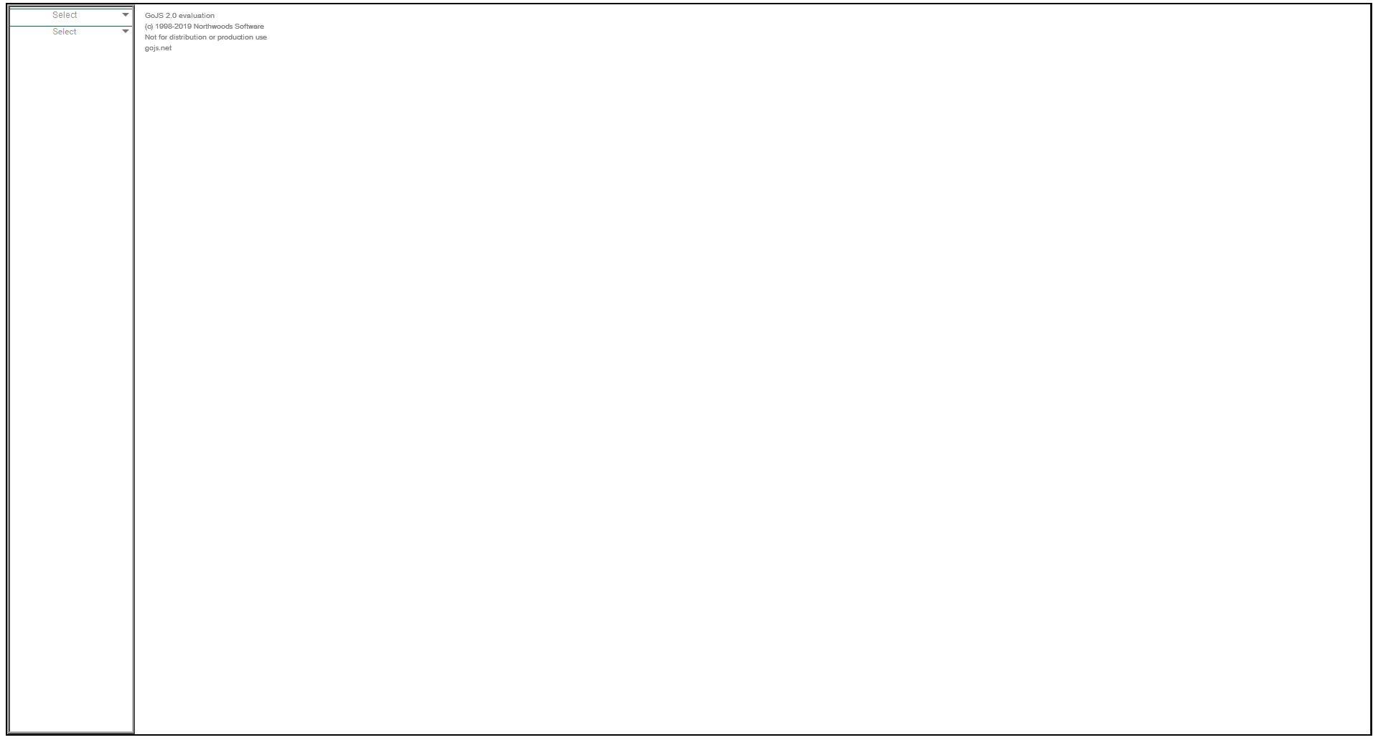


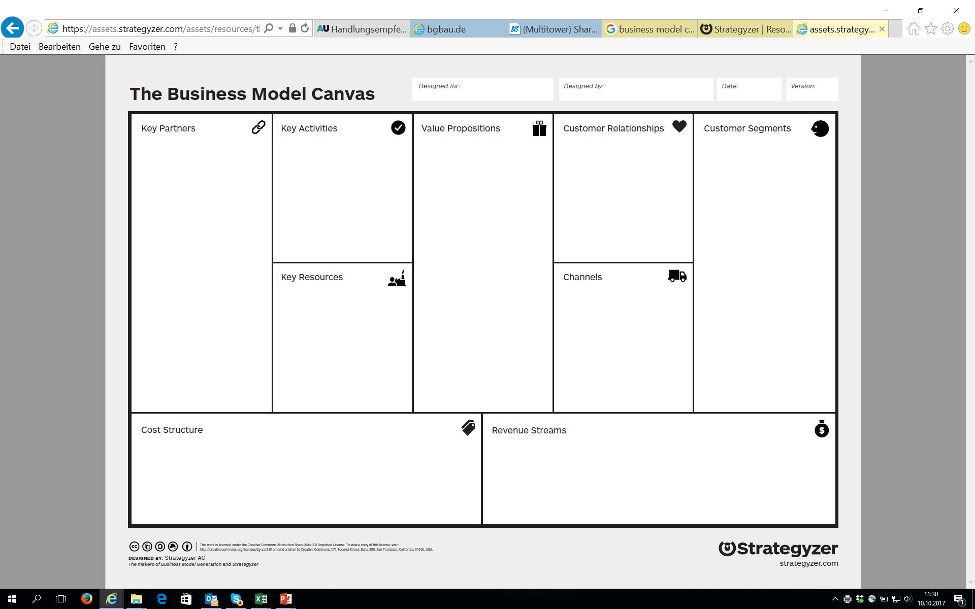
Business Model Design
Business Model Canvas
Cost Structure
Fixed Costs
Variable Costs
Salaries
Notes:
Panel-example

Slide 2

Notes:
Offering

Slide 3

Notes:
Customer Segments

Slide 4

Notes:
Customer Relationships

Slide 5

Notes:
Channels

Slide 6

Notes:
Key Partnerships

Slide 7

Notes:
Key Activities

Slide 8

Notes:
Key Ressources

Slide 9

Notes:
Revenue Streams

Slide 10

Notes:
Cost Structure – fixed Costs

Slide 11
Notes:
Cost Structure – Variable Costs

