Slide 1

Modeling probability distributions using VQCs
In cooperation with SIEMENS

Slide 2
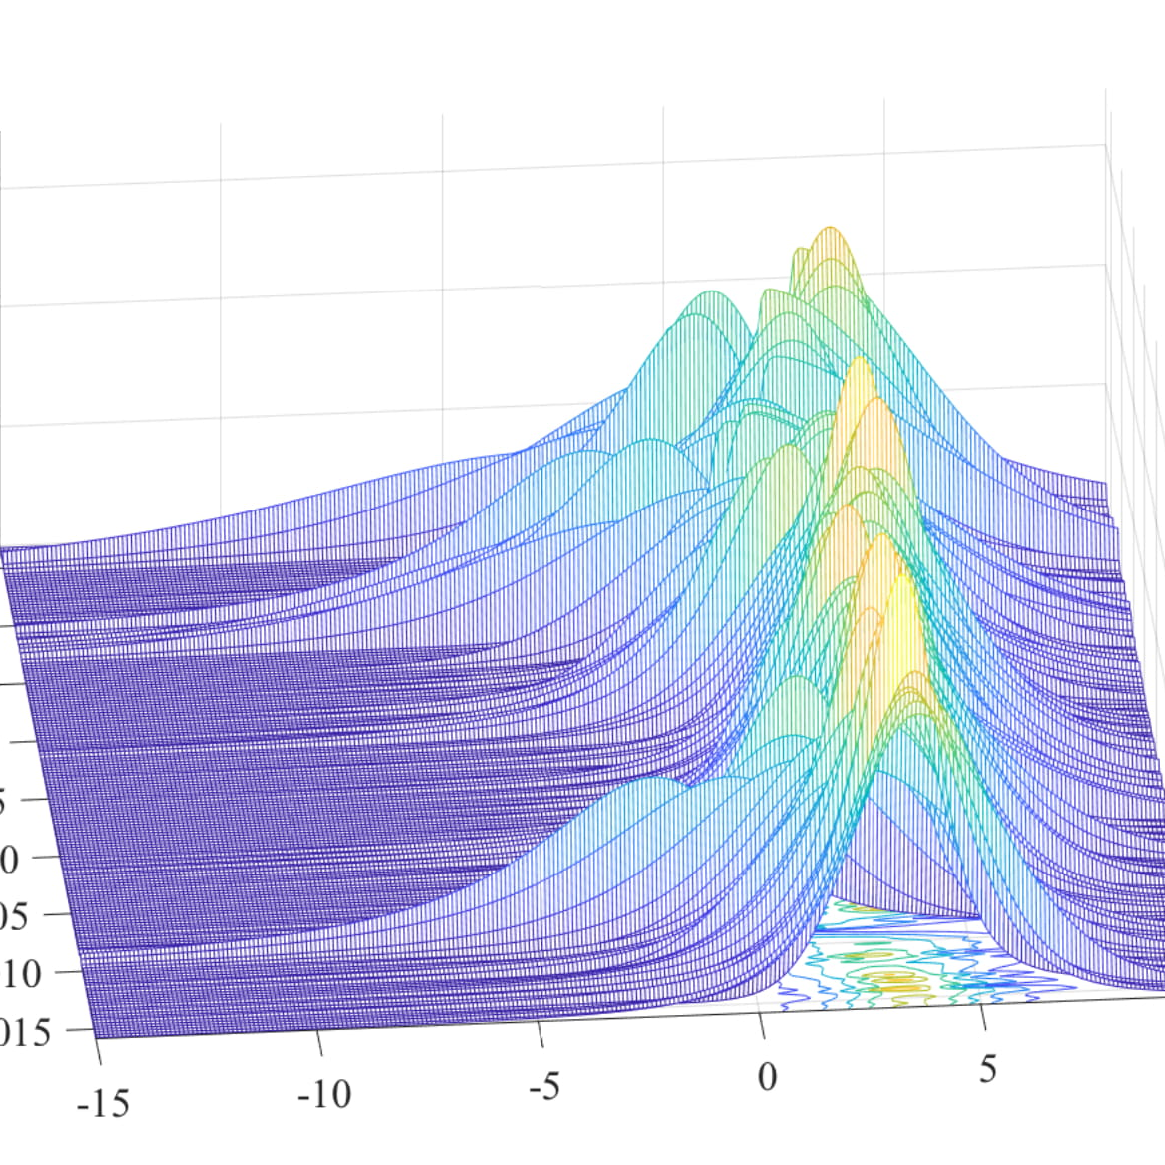
End Goal
Predict the output of a technical plant as a wind turbine with highest possible accuracy
Train our circuit with known data (x= 0 to t) so that it can then predict the outcome for values > t (t+1, t+2, …)

Slide 3

Theoretical concepts
VQCs
Data Reuploading
Fourier Series

Slide 4
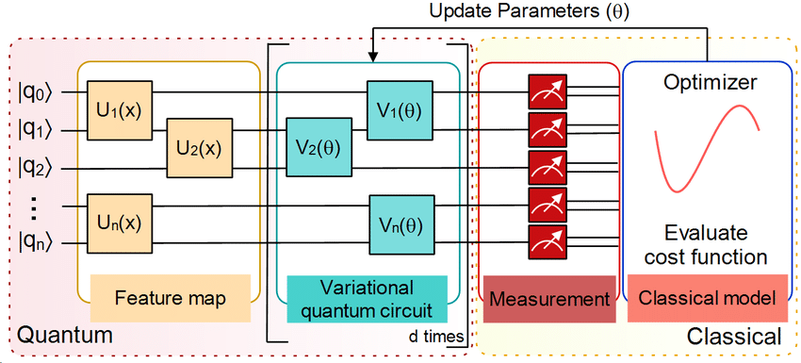
VQCs
Consist of 3 main parts:
Feature map → responsible for encoding the data into Quantum states
The actual circuit → computes the data based on parameters
Optimizer → compares the result from the circuit, compares it to the expected result and optimizes the parameters using a cost function

Slide 5
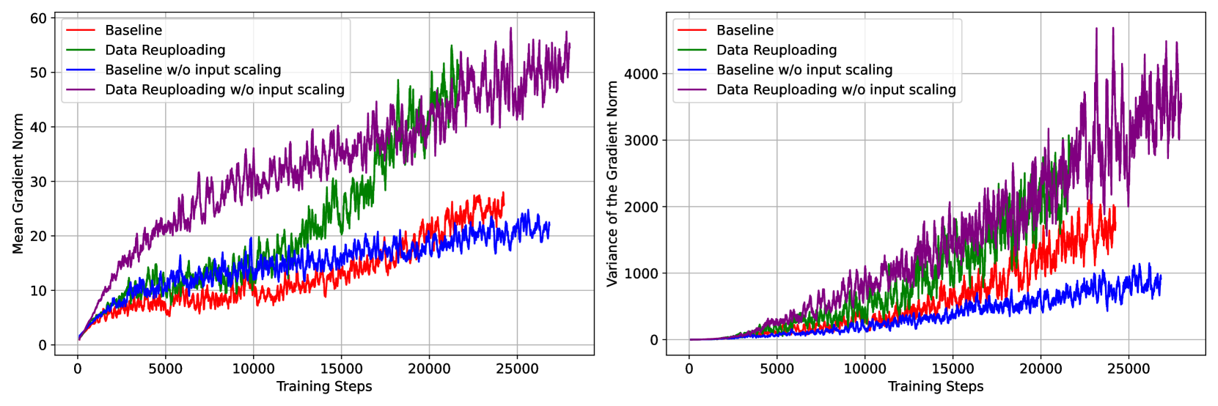
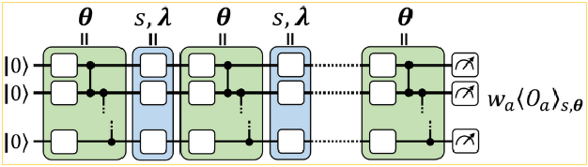
Data Reuploading (WIP)
What? → Encode classical data multiple times into the quantum cirquit
Why? → Prevention of data loss / faulty data after processing in the quantum circuit (No cloning)
https://pennylane.ai/qml/demos/tutorial_data_reuploading_classifier/

Slide 6
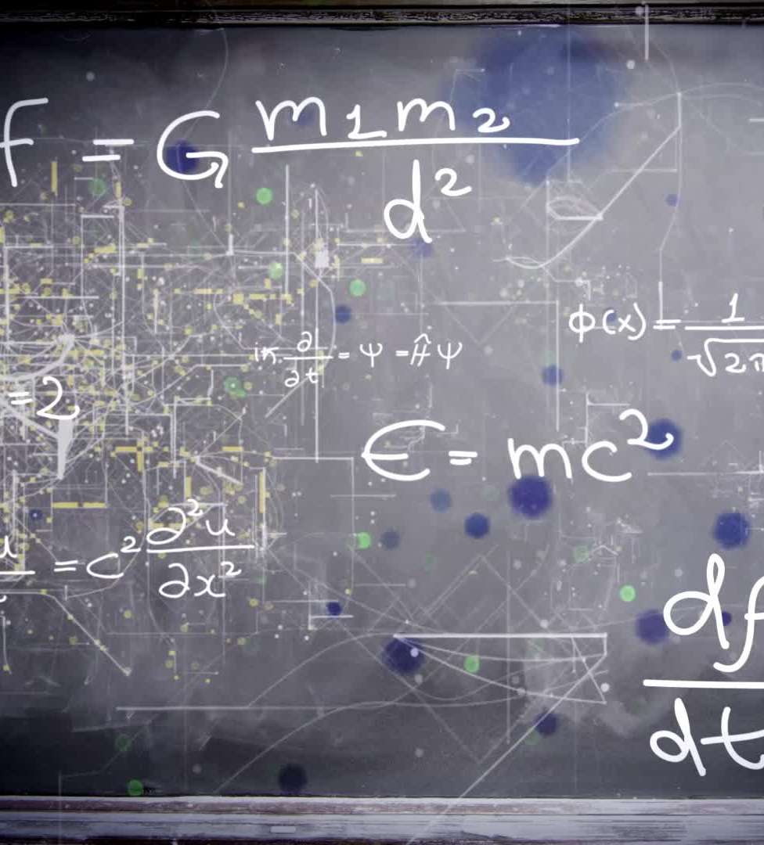
Fourier Series (WIP)
What? → Modeling complex periodical functions on the basis of sine and cosine functions
Why → Most probability distributions – especially the one in our usecase – are more complex than a simple sine function. In order to model such functions we need Furier series

Slide 7
Multiple Layers in the circuit
Enables us to model more complex funcitions
Increases approximation accuracy for our training data
With too many layers the circuit learns the training Data too well and can no longer generalize for new, unknown Data ➔ Overfitting

Slide 8

Implementing the Algorithm

Slide 9
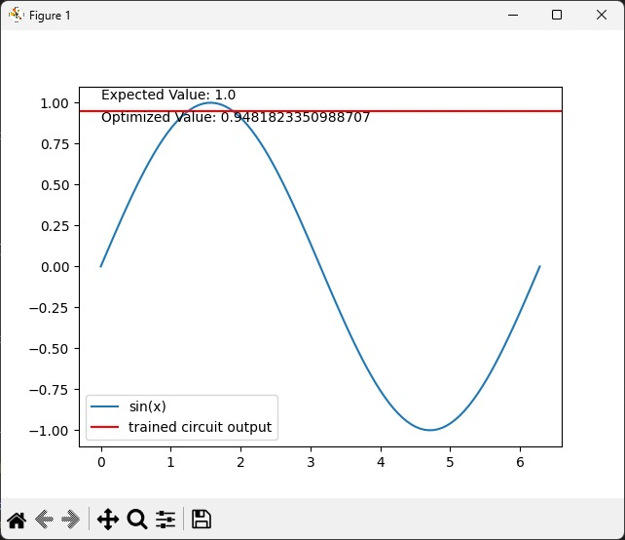
First Approach – No Input
Data encoding: None
Ansatz: Single Qbit rotations only with multiple layers
Optimization: Gradient Descend
Outcome: Parameters are trained to give the output for one x only

Slide 10
Introduce Data encoding

