Slide 1
1. Detect Threats
Threats are Detected
Sprint 1 – Build and Test Detection
SIEM Detects Threat
2. Automate Responses
Process is Automatically Executed
Sprint 2 – Build and Test Automation
Script is Executed
3. Automatically Isolate Threats
Threats are Left Isolated
Sprint 3 - Test Automated Threat Response
SDN Controller Isolates Infected Host

Slide 2
Literature Review
Summary of Information
Network Access Controls
Virus Propagation Methods
Automation Process
OpenDaylight SDN Controller
SIEM Controls
Automation Script on SIEM
EICAR File
AlienVault OSSIM
Macro-Virus
Polymorphic
Shellcode
Email attachment
Execution of code or files
Elevated privileges
Execution of another application
Shellcode reference to C&C server
Replicates via shell script
HIDS
NIDS
Anomaly detection
Threat intelligence feeds
Machine Learning algorithms
Logging
Security zones/policies
NIPS
Role Based Access Control
Unified Threat Management
Anti-Virus
Can detect
Can isolate with
Implement
Detect
Respond
1
2
3

Slide 3
Gateway
SDN Controller
SIEM
OpenFlow
Front-End
Visualisation Engine
Front-End
APIs
Log Collector
Control Plane
Database
vSRX Firewall 1
vSRX Firewall 2
OvS 1
OvS 3
OvS 4
Host 1 – Ubuntu Container
Host 3 – Ubuntu Container
Host 4 – Ubuntu Container
Host 5 – Ubuntu Container
OSSIM HIDS Agent
OSSIM HIDS Agent
OSSIM HIDS Agent
OSSIM HIDS Agent
Host 2 – Ubuntu Container
OSSIM HIDS Agent

Slide 4
SIEM Automated Response
Software-Defined Network:
Automated Threat Response
Threat Detection
SDN Controller
SIEM
OpenFlow
Front-End
Gateway
Visualisation Engine
Front-End
APIs
Log Collector
Control Plane
Database
vSRX Firewall 1
vSRX Firewall 2
OvS 1
OvS 2
OvS 3
OvS 4
Host 1 – Ubuntu Container
Host 2 – Ubuntu Container
Host 3 – Ubuntu Container
Host 4 – Ubuntu Container
OSSIM HIDS Agent
OSSIM HIDS Agent
OSSIM HIDS Agent
OSSIM HIDS Agent

Slide 5
SIEM Automated Response
Software-Defined Network:
OpenDaylight SDN Controller
Automated Threat Response
OpenFlow
Front-End
Gateway
APIs
Control Plane
AlienVault OSSIM SIEM
Visualisation Engine
Front-End
Log Collector
Database
vSRX Firewall
vSRX Firewall
Ubuntu
Ubuntu
Ubuntu
Ubuntu
OSSIM Agent 1
OSSIM Agent 1
OSSIM Agent 1
OSSIM Agent 1
Virus

Slide 6
Branch Office Network Architecture
Private data Centre
Other Branches
Internet & Public Clouds
MPLS Circuits
VPNs
EBGP Peerings to ISP
Protocols and Standards
Cluster Link / VRRP
MCLAG / RTG
VLANs / 802.1q and 802.1x
Gateway
Gateway
802.11ac / 802.11ad / 802.11ax
Optional 3rd tier for scalability, redundancy and aggregation
Router/Firewall
Router/Firewall
Router/Firewall
Router/Firewall
Router/Firewall
Router/Firewall
Router/Firewall
Router/Firewall
Switch
Switch
Switch
Switch
Switch
Switch
WAP
WAP
WAP
WAP
User
User
User
User
User
User
User
User
User
User
User
User
User
User

Slide 7
SDN Concepts:
Controller controls, switches send.
Gateway
SDN Controller
OpenFlow
Front-End
APIs
Control Plane
vSRX Firewall 1
vSRX Firewall 2
OvS 1
OvS 2
OvS 3
OvS 4
The SDN controller centrally decides where network traffic goes and tells the Open vSwitches where to send it. This is called “routing” the traffic.
Host 1 – Ubuntu Container
The switches listen to the controller and send data to the location specified by the controller. This is called “forwarding” the traffic.
OSSIM HIDS Agent
Routing Information Base (RIB):
Open vSwitch database (OVSDB)
Makes/sends changes
Receives/applies changes
Forwarding Information Base (FIB):
Open vSwitch database (OVSDB)
OpenFlow protocol
OVSDB configuration changes
OVSDB
Controller tells switches: “remove entries to and from 10.10.9.2”
OVSDB
Destination | Gateway | Interface
10.10.9.2/32 | 10.10.9.1 | eth0
192.168.1.175 /24 | 10.10.9.1 | eth0
0.0.0.0/0 | 10.10.9.1 | eth0
Destination | Gateway | Interface
10.10.9.2/32 | 10.10.9.1 | eth0
192.168.1.175 /24 | 10.10.9.1 | eth0
0.0.0.0/0 | 10.10.9.1 | eth0

Slide 8
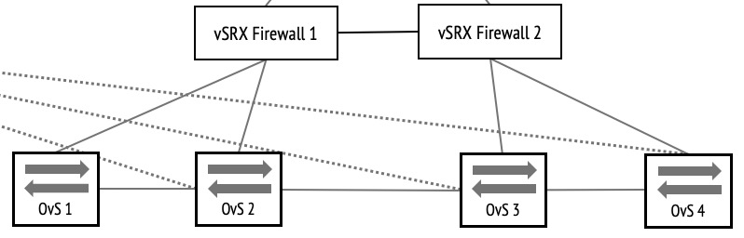
The process of pushing
Configuration to OpenDaylight:
User
Configuration
Front-end and User-Interface
OpenDaylight
Back-end
1
Success/Fail
2
3
Configuration
Database
Open vSwitch Nodes
Operational
Database
Does syntax check out?
Applies config to nodes
Has config been applied to nodes?
Yes/No
Fail/Success
Yes
Applies config to nodes
Back-end error
Success

Slide 9
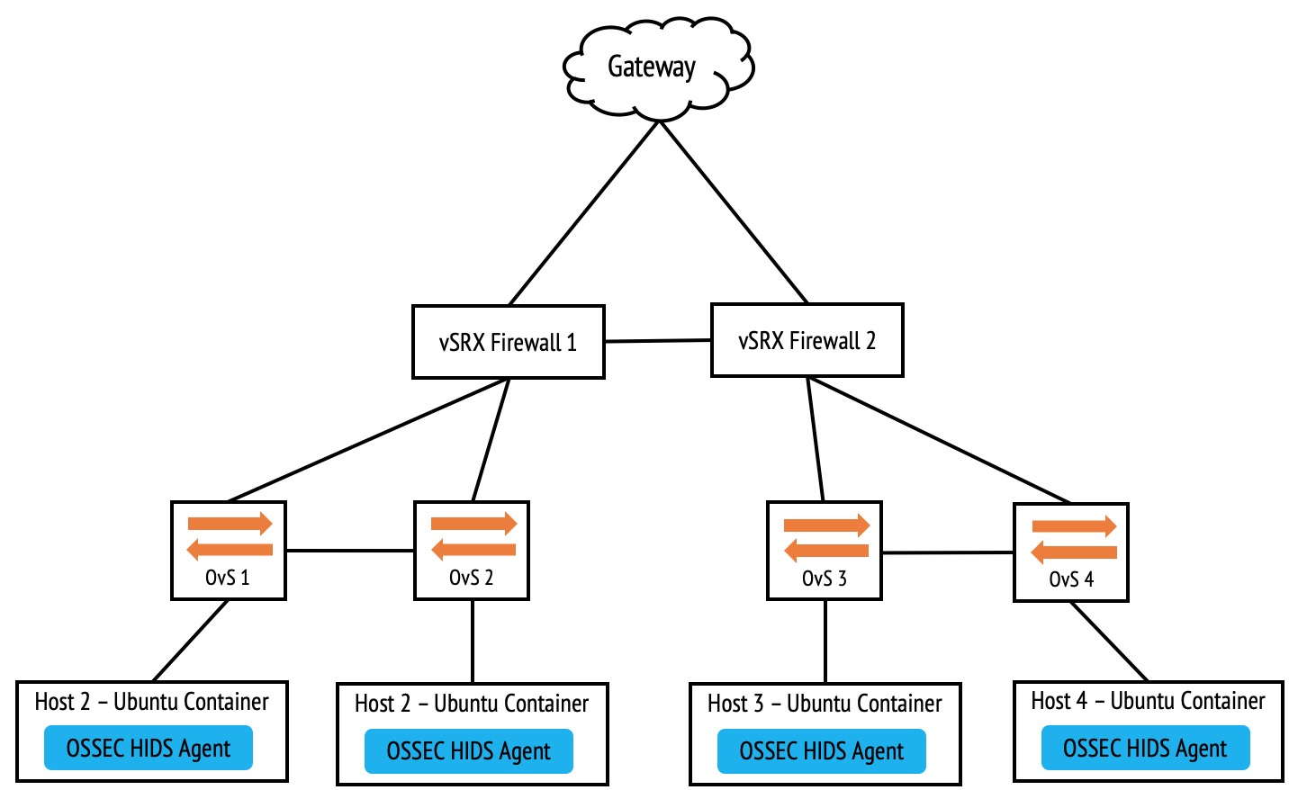
Incident Response Process:
1. Preparation and Configuration
2. Threat Detection
3. Incident Response
4. Incident Analysis
5. Security Strategy Updates
Incident Analysis
Cloud
Incident Response
Threat Detection
Web UI
SIEM
SIEM Rules and Configuration
Ubuntu
User Activity Daemon
Correlation Engine
Virus
Reporting Daemon
Detection Algorithms
Snort Agent 1
RBAC
Events and Alarms
Log Retention Daemon
Log Analysis
Database
Log Aggregator
Network Node Logs
End-host Logs
Security Device Logs
Servers
Applications
Listening Agent
Log Collector
Host OS

Slide 10
SIEM Functions
Incident Analysis
Incident Response
Threat Detection
Web UI
SIEM
SIEM Rules and Configuration
User Activity Daemon
Correlation Engine
Reporting Daemon
Detection Algorithms
RBAC
Events and Alarms
Log Retention Daemon
Log Analysis
Database
Log Aggregator
Listening Agent
Log Collector
Host OS

Slide 11
1
2
3
4
Method of SIEM threat detection
SIEM ingests data and correlates to IOCs
IOCs and threats are visualised on the SIEM dashboard for SOC teams
The SIEM hands off to the SOC team. SOC engineers respond to the threat
Incident Analysis
Incident Response
Threat Detection
Web UI
SIEM
IOCs
Events and Alarms
Threats
SIEM Rules and Configuration
Security Incident
Hand-off to Admin
User Activity Daemon
Correlation Engine
Host-based IDS/IPS
Network-based IDS/IPS
Anomaly Detection
Treat Intelligence Feeds
Sandboxes
Reporting Daemon
Detection Algorithms
RBAC
Events and Alarms
Log Retention Daemon
Log Analysis
Database
Log Aggregator
Listening Agent
Log Collector
Host OS

Slide 12
Time To Detect Security Threats
MTTD Cyber-Attack (Days)
Detecting threats in 0 days:
79% of SIEM users
19% within Hours
40% within Minutes
20 % within Seconds

Slide 13
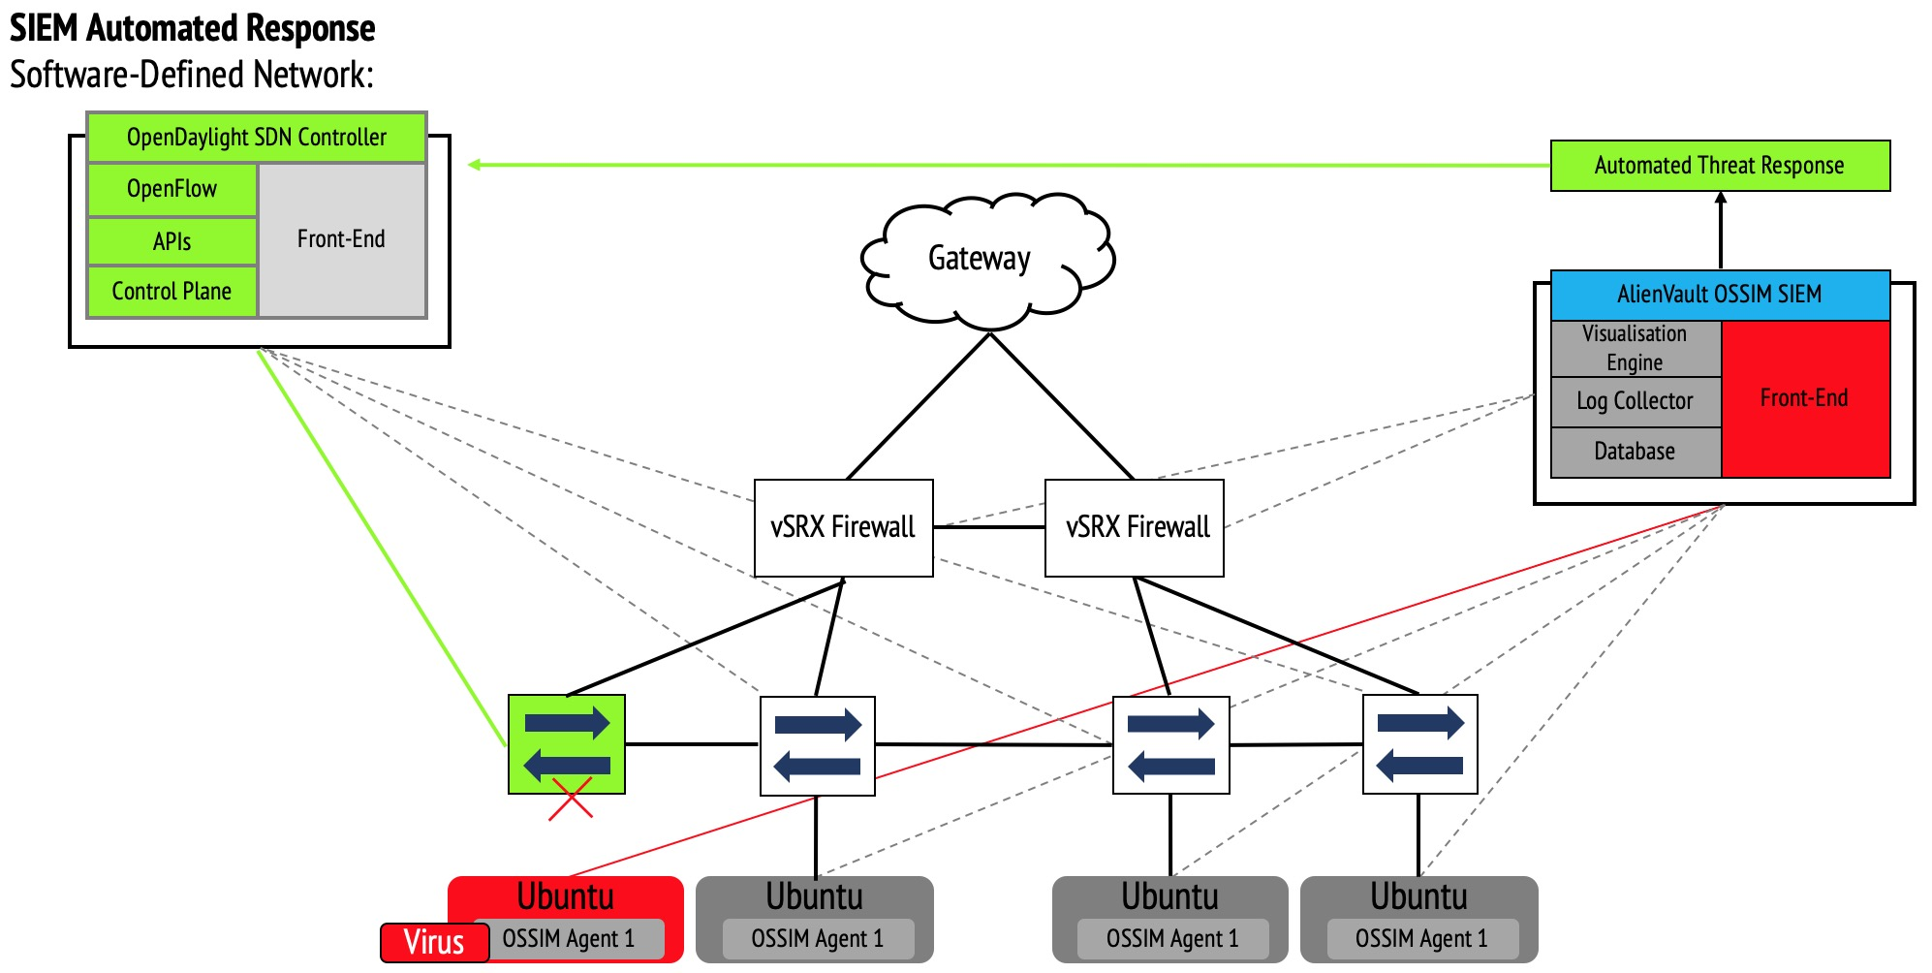
Cloud
Cloud
Home Router
Server Gigabit Ethernet Port 1
Server Gigabit Ethernet Port 1
VMware Ethernet Bridge
GNS3 Ethernet Bridge
VMWare Ethernet Bridge
SIEM
Visualisation Engine
Front-End
GNS3 Environment
Log Collector
GNS3 Compute VM
Database
VMware Workstation 15
VMware Workstation 15
Physical Server - Windows 10 Host-OS

Slide 14
SIEM Popularity Number of Mentions

Slide 15
Project Methodology:
HIDS
NIDS
Anomaly Detection
OTX
Step 1
Step 2
Step 3
Step 4
Sprint 1:
Building and configuring the SIEM.
Testing SIEM threat detection mechanisms.
Design
Deploy
Configure
Test
Review
Managing ODL Flows
Scripting
Step 5
Step 6
Sprint 2:
Deploying ODL and managing flows.
Building scripts to block flows from a SIEM event.
Testing script functionality.
Challenging.
Achievable.
Step 7
Step 8
Step 9
Step 10
Sprint 3:
Testing SIEM threat detection mechanisms. Testing automated script functionality.
Testing automated threat isolation via ODL.
Simple.
HIDS
NIDS
Anomaly Detection
OTX

Slide 16
Project Methodology:
Difficult
Challenging
Easy
Sprint 1: Detect Threats
HIDS
NIDS
+ Deploy and configure AlienVault
+ Test HIDS threat detection
+ Test NIDS threat detection
Step 1
Step 2
Sprint 2: Automate Responses
Deploying OpenDaylight
Scripting
+ Deploy and configure OpenDaylight
+ Create scripts to block flows by OpenDaylight
+ Script testing
Step 3
Step 4
Sprint 3: Automatically Isolate Threats
+ Test SIEM threat detection mechanisms
+ Test automated script execution
+ Test automated isolation via OpenDaylight
HIDS
NIDS
Step 5
Step 6

Slide 17
Unsuitable configuration
Loss of Container Data
Probability
AlienVault Error
OpenDaylight Error
Script / Runtime
Software Incompatibility
10
20
40
60
80
100
Level of Impact

Slide 18
Feasibility Test:
Sprint 1, Step 1 (HIDS)
EICAR file
1
Gateway
3
Incident Analysis
Threat Detection
vSRX Firewall 1
vSRX Firewall 2
Web UI
AlienVault Instance
SIEM Rules and Configuration
User Activity Daemon
Correlation Engine
Reporting Daemon
Detection Algorithms
OvS 1
OvS 2
OvS 3
OvS 4
RBAC
Events and Alarms
Log Retention Daemon
Log Analysis
2
Database
Log Aggregator
Host 1 – Ubuntu Container
Host 2 – Ubuntu Container
Host 3 – Ubuntu Container
Host 4 – Ubuntu Container
Listening Agent
Log Collector
AlienVault HIDS Agent
AlienVault HIDS Agent
AlienVault HIDS Agent
AlienVault HIDS Agent
Host OS
1
2
3
EICAR file is downloaded
AlienVault HIDS agent detects simulated threat
Security event is created on AlienVault SIEM

Slide 19
Running the Project Compute Allocations
VMWare Workstation 15
GNS3 VM
4
200GB
10GB
Physical Server
Available Resources
4x 256MB Hosts
40GB
1GB
4x 256MB Leaves
8GB
1GB
Storage: 460GB
vCPUs: 6
RAM: 14GB
2x Spines
40GB
4GB
1x OpenDaylight
50GB
4GB
VMWare Workstation 15
AlienVault
2
100GB
4GB

Slide 20
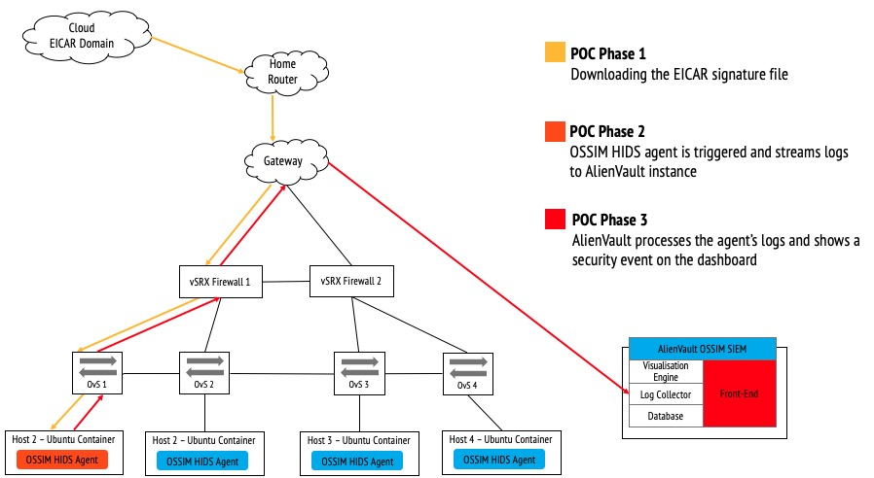
Data Collection Sprint 1
Format: Number of security events from SIEM user-interface.
Type: Quantitative
Success Metric (Successful): Event will show.
Success Metric (Failed): Event will not show.
Method of storage: Screen Recording and subsequent screenshots (on laptop and timer)
1
3
2
1
2
3
EICAR file is downloaded
AlienVault HIDS agent detects simulated threat
Security event is created on AlienVault SIEM

Slide 21
OpenDaylight SDN Controller
1
OpenFlow
Front-End
Manual Execution of Script
APIs
Gateway
Control Plane
AlienVault OSSIM SIEM
2
Visualisation Engine
Front-End
Log Collector
Database
vSRX Firewall
vSRX Firewall
3
Ubuntu Host 4
Ubuntu Host 5
OSSIM Agent 4
OSSIM Agent51
Ubuntu Host 1
Ubuntu Host 2
Ubuntu Host 3
HIDS Agent 1
HIDS Agent 2
HIDS Agent 3

Slide 22
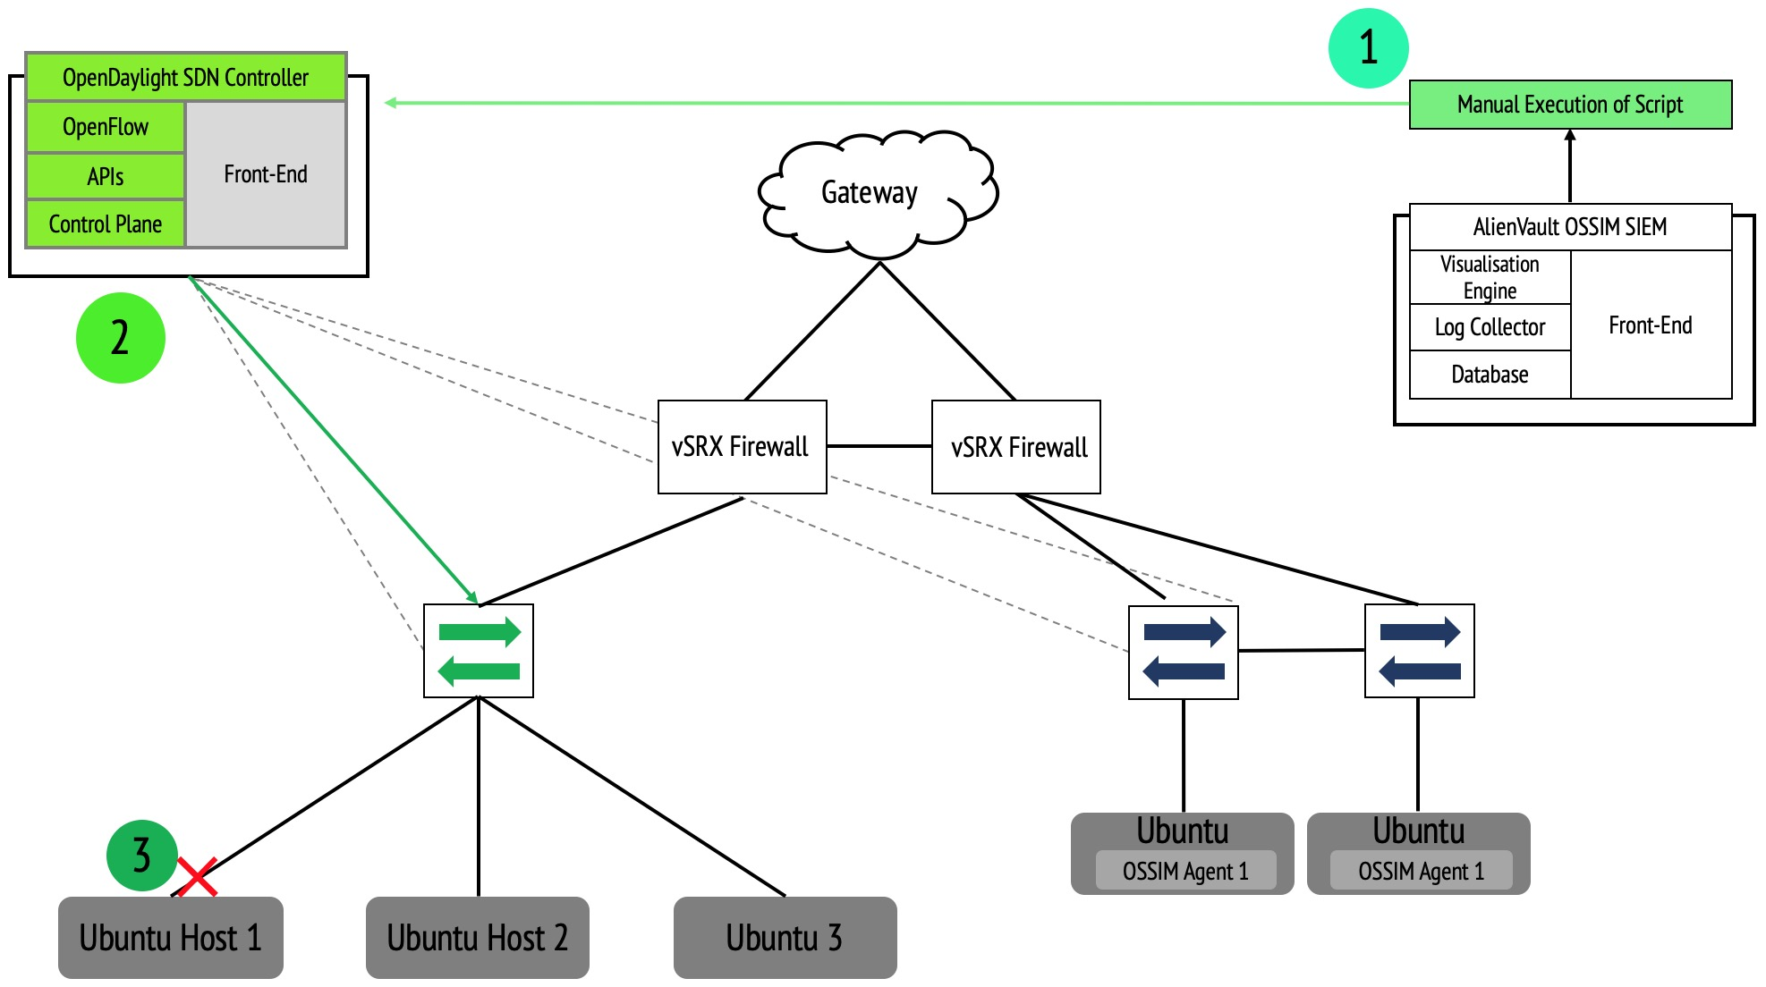
Data Collection Sprint 2
Format: Host terminal output
Type: Quantitative
Success Metric (Successful): 0 bytes returned from OvS Gateway
Success Metric (Failed): 64 Bytes returned from OvS Gateway
Method of storage: Screen Recording and subsequent screenshots (on laptop and timer)
1
2
3
Script is manually executed
Flows are removed from OpenDaylight OVSDB
Flows are removed from Open vSwitch OVSDB

Slide 23
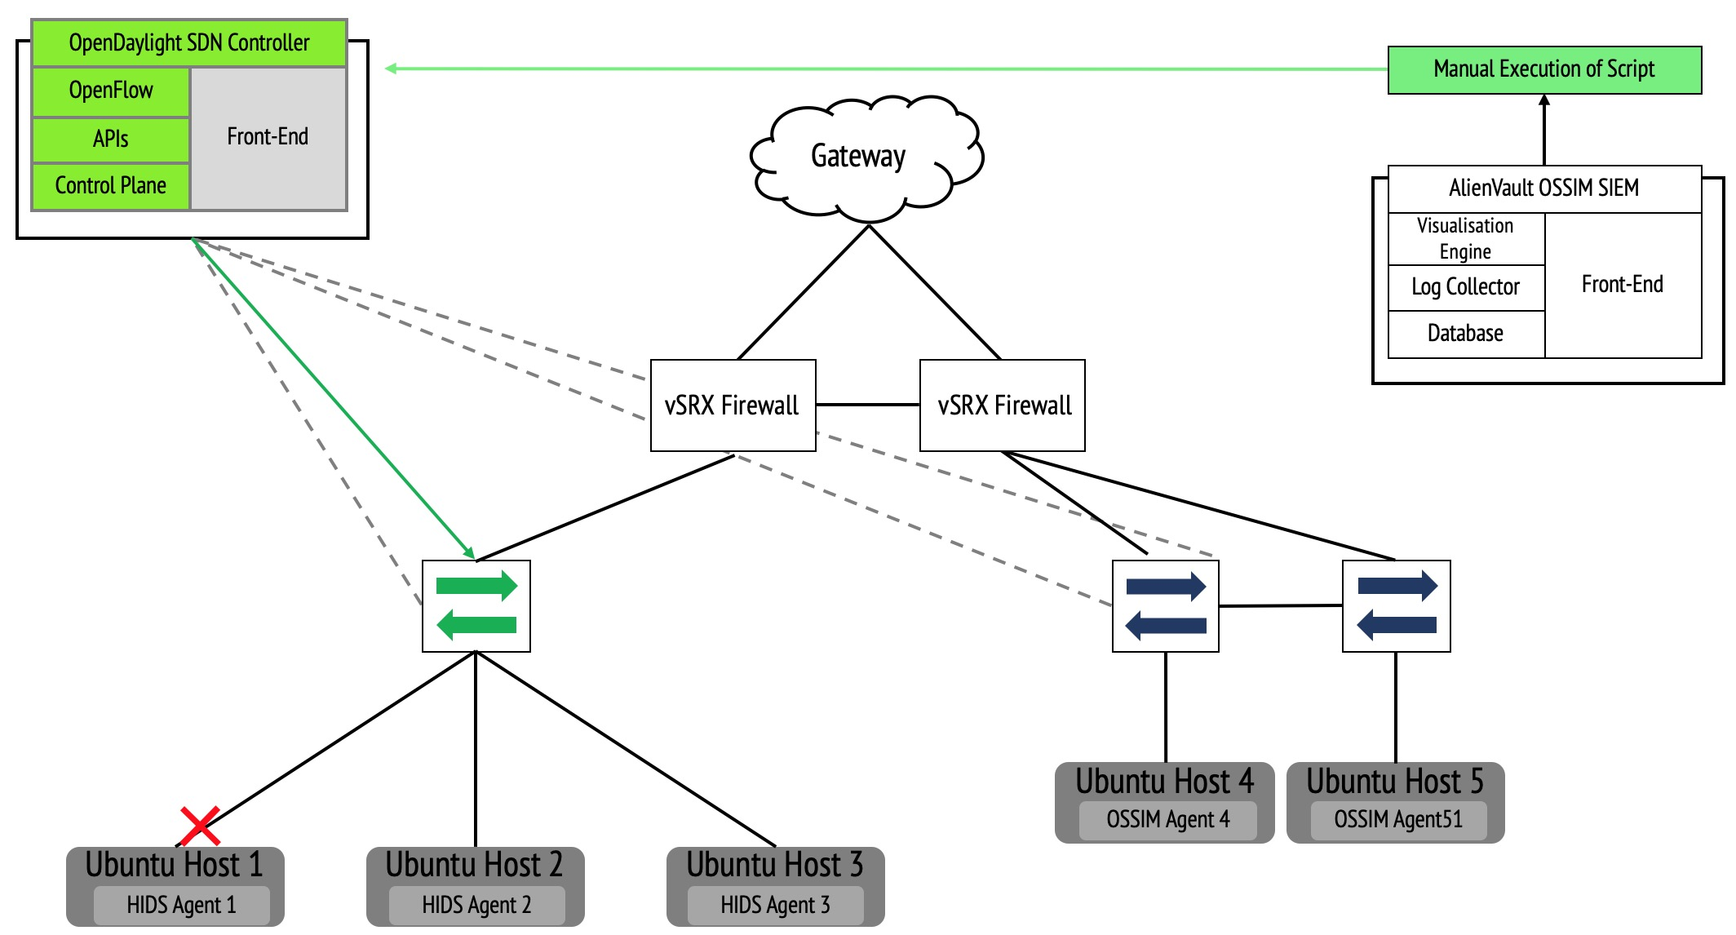
Data Collection Sprint 3
3
Format: Host terminal output
Type: Quantitative
Success Metric (Successful): 0 bytes returned from OvS Gateway
Success Metric (Failed): 64 Bytes returned from OvS GW
Method of storage: Screen Recording and subsequent screenshots (on laptop and timer)
4
2
5
1
1
EICAR simulated threat is detected
2
New security event is created on AlienVault SIEM
3
Script is automatically executed
4
Flows are removed from OpenDaylight OVSDB
5
Flows are removed from Open vSwitch OVSDB

Slide 24
Step 2
Step 6
Step 6
Bridge_1
Bridge_1
Bridge_1
vSRX
192.168.1.133
vSRX
192.168.1.133
vSRX
192.168.1.133
>
srcNAT
>
srcNAT
>
srcNAT
10.10.2.1
10.10.9.10
10.10.8.1
10.10.2.2
Software bug:
No connection through OvSM
OvS
OvSM
Flow lookup on ODL
Host 1
10.10.8.2
10.10.9.1
ACTION=NORMAL
10.10.9.1
Host 1
10.10.9.2
10.10.9.1
10.10.9.2
10.10.9.3
OvSM
Flow lookup on ODL
Host 1
Host 2
Host 3
ACTION=NORMAL
10.10.9.2
10.10.9.3
Host 2
Host 3

Slide 25
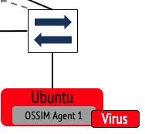
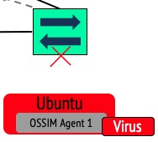
Traditional NIST IR process – Admin takes assets offline
Time is spent chasing threats
1. Preparation
4. Post-Incident
Activity
2. Detection
and
Analysis
Goal is to take the host offline
3. Containment,
Eradication and
Recovery
Use Cases for Steps 5/6 – Admin takes assets online
Time is spent eradicating threats
1. Preparation
Goal is to take the host online
4. Post-Incident
Activity
2. Detection,
Analysis and
Containment
3. Eradication
and
Recovery

Slide 26
Sprint 1
Number of Security Events per EICAR File Download
Number of Security Events

Slide 28
Seconds Before EICAR File Download
Seconds After EICAR File Download

Slide 29
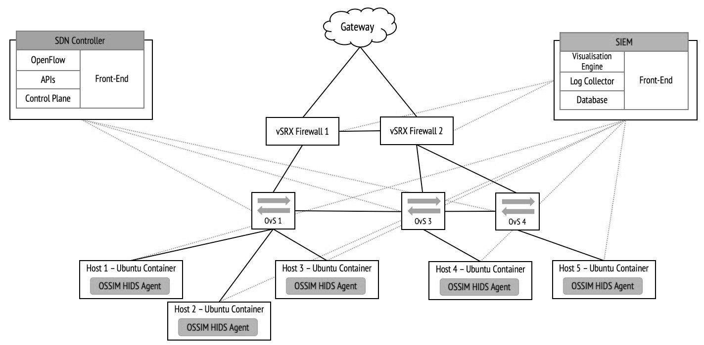
EICAR File
1
2
3
Sprint 1 data collected
No. of Security Events
Sprint 2 data collected
No. of Bytes Returned from Script Execution
Sprint 3 data collected
No. of Bytes Returned from EICAR File Download

Slide 30
Parsing variables into a script
Isolating One Threat
Isolating Many Threats
AlienVault Detects Threat
AlienVault Detects Threat
AlienVault Executes Script
AlienVault Executes Script
Isolation Script
Isolation Script
Configuration_applied_to_all_ nodes {
Opendaylight_inventory_all_nodes; }
Match_on_IP_addresses {
$SRC_IP & $DST_IP; }
Action {
order=0;
drop; }
Configuration_applied to_one_node {
node_id; }
Match_on_IP_or_MAC_address {
Fixed_IP_or_MAC_address; }
Action {
order=0;
drop; }
OvS
OvS
drop
drop
drop
Host 1
Host 2
Host 3
Host 1
Host 2
Host 3
Virus
Virus
Virus
Fixed to one host
Flexible between any hosts

Slide 31
Branch Office Network Architecture
Other Branches
Private data Centre
Internet & Public Clouds
Virus
MPLS Circuits
VPNs
EBGP Peerings to ISP
Gateway
Gateway
Network 2:
Virus is automatically isolated
Network 1:
Virus Propagates
DMZ
Router/Firewall
Router/Firewall
Router/Firewall
Router/Firewall
SIEM
SDN Controller
Switch
Switch
Switch
Switch
Switch
Switch
WAP
WAP
WAP
WAP
eth1
eth3
User
eth2
User
User
User
User
User
User
User
User
User
User
User
User
User
Virus has infected the system
Key:
Isolated system
System is safe for now

Slide 32
Isolating Threats in SDN Production Environments
Virus
Virus has infected the system
Key:
Isolated system
PE
System is safe for now
CE
vFirewall
CE
DMZ
SIEM
SDN Controller
vFirewall
vRouter
vRouter
vRouter
App instance 1
App instance 2
App instance 3
Container 3
vSwitch 7
vSwitch 8
vSwitch 9
Container 1
vSwitch 3
Container 7
Container 9
vSwitch 1
vSwitch 2
Container 2
Container 4
Container 6
Container 8
Container 5
vSwitch 4
vSwitch 5
vSwitch 6
Virus
Virus
Virus
Virus
PaaS System
PaaS System
PaaS System
IaaS System (server 1)
IaaS System (server 2)
IaaS System (server 3)
Network 1
Virus propagates and service becomes unavailable
Network 2
No virus
Network 3
Virus is automatically isolated.
service remains available to users.

