Slide 1
CSE PharmaSol Software Suite
Make-It-Wright Hackathon - 2023
Reese Hatfield, Ryan Miller, Braden Pennie, Kalen Tullis

Slide 2
DSCSA Single Purchase Order w/o Aggregation
Pharmaceutical company Cloud Pharma must comply with the DSCSA standards for electronic product tracing.
This includes in-depth data collection throughout the product's lifetime.
The EPCIS standard needs to be used for the events within this product

Slide 3
The CSE PharmaSol Software Suite A user-friendly supply chain management solution
Company
End user
Accessibility and Ease of Use
Ensuring product environment stability
Tracking every step of the way
Industry Standards!
Customer Safety
Regulatory Compliance
Brand Security
Notes:
https://journals.lww.com/journalpatientsafety/Fulltext/2013/09000/A_New,_Evidence_based_Estimate_of_Patient_Harms.2.aspx (Statistic) James, John

Slide 4
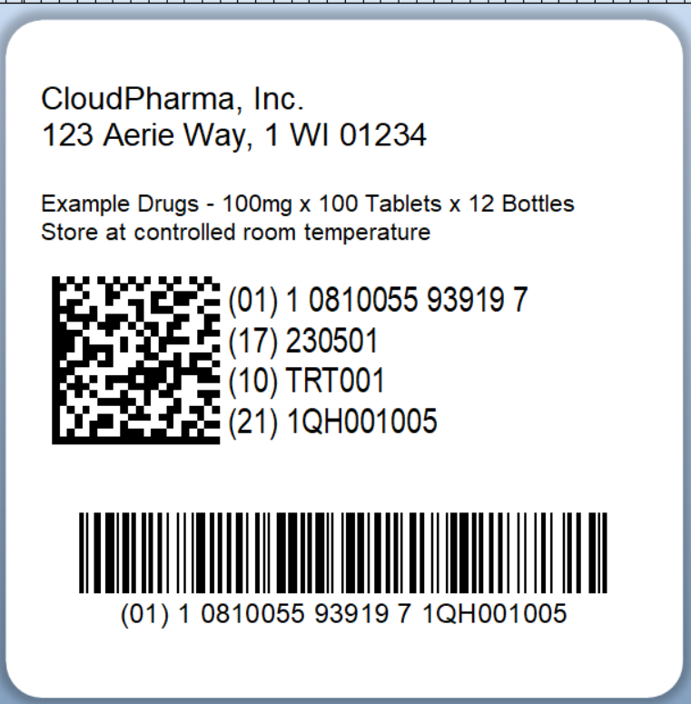

Standards and Technology
GS1 & DSCSA Regulations
EPCIS / FreEPCIS
BarTender
Python
Java Swing

Slide 5
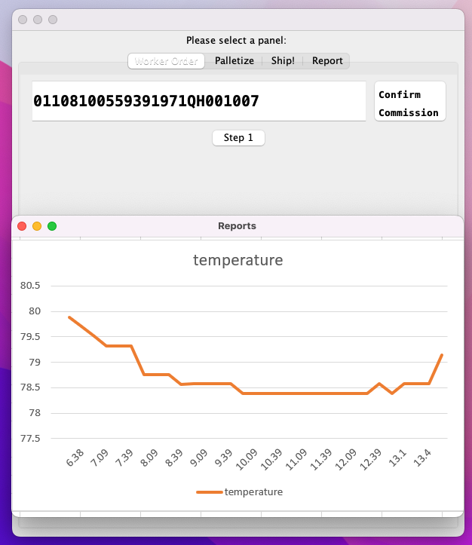
Workflow App
Package Tracking application from manufacturer to distributors
Generate EPCIS events at each step of the process
Consumer friendly data analysis
Visualize the entire workflow
Reduce product waste with enhanced tracking capabilities

Slide 6
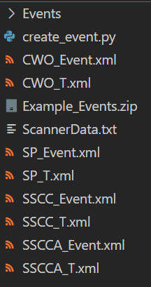
Creating EPCIS Events
After data is gathered from the app, it is “sent” off to our processing script
This script will create EPCIS Event documents utilizing event template files
These template files represent the 4 relevant events from our challenge
These events can then be sent to an EPCIS server for storage and processing

Slide 7
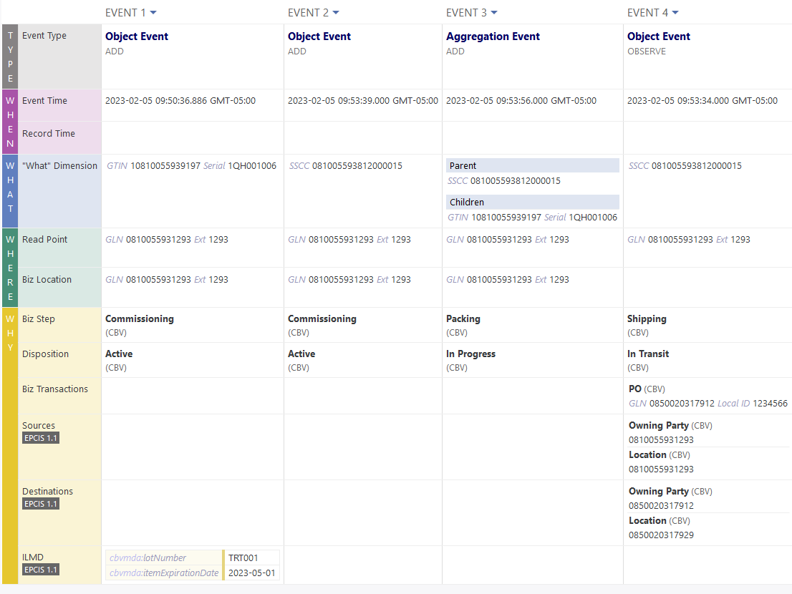

Slide 8
Improvements – Workflow App
RFID Temperature Tracking - Implemented on truck level that parses temperature intermittently and records the data.
Consumer Safety
Brand Security
Rejection Features:
Malfunction alert
Unsafe storage conditions (temp)
Expired

Slide 9
Why you should fund our project
We provide:
In-depth product tracking following EPCIS and Industry standards
Promote product security, end-user satisfaction, and safety
We have the foundations for further development and feature expansion on existing and planned ideas

Slide 10
Thank You!
Questions?

