Slide 1

D.Eco Application
Presented by Code Monkey

Slide 2
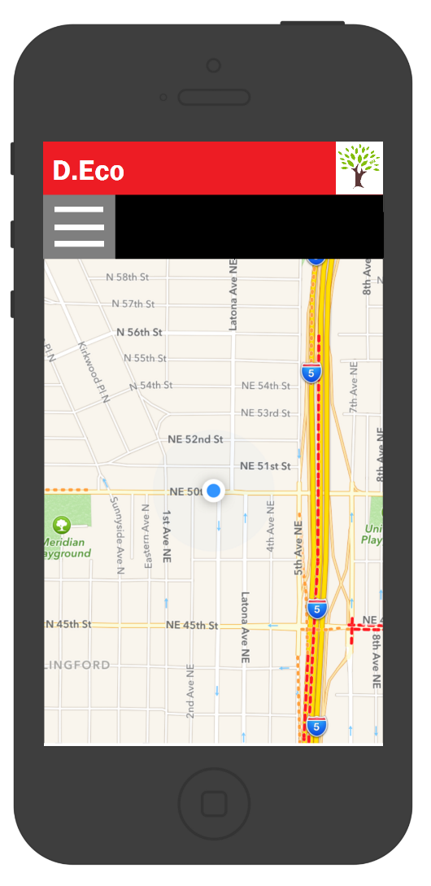
System Inception
Use Case Model
Risk Analysis
Technology Plan
Effort Estimate
System Architecture
Code Monkey
April 5, 2017

Slide 3
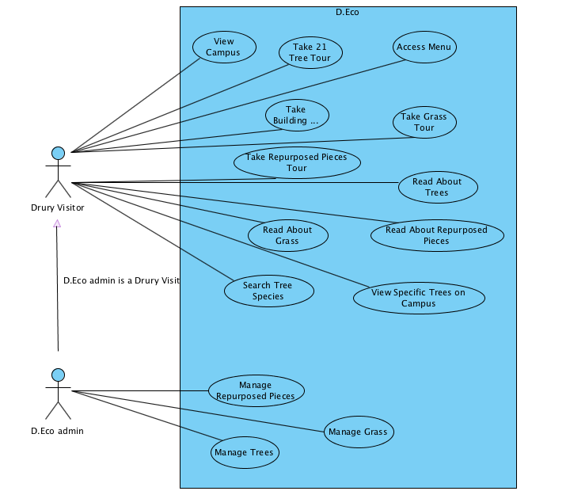
Use Case Model
Code Monkey
April 5, 2017

Slide 4
Technology Plan
Technology | Experience Rating
Phone App Technologies
IOS | Tutorial
Android | None
Cordova | Tutorial
Windows 10 Phone | None
Map Technologies
Google Maps | Tutorial
Microsoft Bing Maps | None
Open Layers | None
OpenStreetMap | None
Code Monkey
April 5, 2017

Slide 5
Technology Plan
 | Experience Rating
Application & Web Development
Java | Small Scale
Swift | Tutorial
HTML 5 | Small Scale
Javascript | Tutorial
JQuery Mobile | Tutorial
Bootstrap Framework | Tutorial
Iconic Framework | None
Web Server Scripting
PHP | Small Scale
Microsoft ASP.NET | None
Code Monkey
April 5, 2017

Slide 6
Risk Analysis
Risk | Mitigation
No experience with IOS development | Schedule time and work through tutorials
Limited experience with app development | Schedule time and work through tutorials
Limited experience with tools (Cordova, Git, and Visual Paradigm) | Schedule time to learn about the tools and work through the tutorials
Team member conflicting schedules | Plan meetings far in advance and communication in dividing work
No experience accessing GPS in mobile | Schedule time to learn and work through tutorials
Limited information on expected product | Walkthroughs with end users
Limited time to finish product | Manage time efficiently
Code Monkey
April 5, 2017

Slide 7
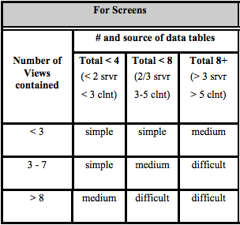
Effort Estimate
Code Monkey
April 5, 2017

Slide 8
Effort Estimate
Screen/Report | Complexity | Object Points | Notes
View Campus | 1 | 1 | Screen will be constructed by reading Drury location from the data source.
Access Menu | 1 | 1 | Simple drop down with text tabs.
Code Monkey
April 5, 2017

Slide 9
Effort Estimate Assumptions
Screen/Report | Complexity | Object Points | Notes
Take 21 Tree Tour | 2 | 2 | Screen will be constructed by Drury's location and individual location from the data source.
Subscreen
Read About Trees | 1 | 1 | Simple text with some images on screen.
Search Tree Species | 1 | 1 | Simple search bar that accesses data source.
View Specific Trees on Campus | 2 | 2 | Filter specified tree request from search bar, and access data source.
Code Monkey
April 5, 2017

Slide 10
Effort Estimate Assumptions
Screen/Report | Complexity | Object Points | Notes
Take Building Tour | 2 | 2 | Screen will be constructed by Drury's location and individual location from data source.
Subscreen
Read About Repurposed Pieces | 1 | 1 | Simple text with some images on screen.
Code Monkey
April 5, 2017

Slide 11
Effort Estimate Assumptions
Screen/Report | Complexity | Object Points | Notes
Take Grass Tour | 2 | 2 | Screen Will be constructed by Drury's location and individual location from data source with grass location.
Subscreen
Read About Grasses | 1 | 1 | Simple text with some images on screen.
Code Monkey
April 5, 2017

Slide 12
Effort Estimate Assumptions
Screen/Report | Complexity | Object Points | Notes
Take Repurposed Pieces Tour | 2 | 2 | Screen will be constructed by Drury's location and individual location from data source with repurposed pieces location.
Subscreen
Read About Repurposed Pieces | 1 | 1 | Simple text with some images on the screen.
Code Monkey
April 5, 2017

Slide 13
Effort Estimate Assumptions
Screen/Report | Complexity | Object Points | Notes
Manage Repurposed Pieces | 1 | 1 | Simple screen and access to the database.
Manage Grass | 1 | 1 | Simple screen and access to the database.
Manage Trees | 1 | 1 | Simple screen and access to the database.
Screen Total |  | 20 | Total object points for screen.
Code Monkey
April 5, 2017

Slide 14
Effort Estimate Assumptions
Screen/Report | Complexity | Object Points | Notes
3GL Modules
Map Modules | 5@10 | 50 | Module requiring scripting against a map API.
GPS Tour | 5@10 | 50 | Module to find individual location with GPS.
Server Modules | 4@10 | 40 | Data server for all 4 Map Modules.
3GL Total |  | 140 | Total object points for 3GL Module.
Total Object Points |  | 160 | Total object points for the project.
Code Monkey
April 5, 2017

Slide 15
Effort Estimate
Productivity (PROD)
PROD estimate is normal (10)
PROD = 160 NOP / 16 person months
PM = 4hr x 1 week x 4 weeks
Justification: students
Some code reuse is anticipated so adjusted effort = NOP
NOP = (160 Obj pts x (100-0.1)) / 100 = 159.8
Effort Estimate in person months (PM) (PM = 16)
Effort(PM) = 159/10 = 15.9 person months
Code Monkey
April 5, 2017

Slide 16
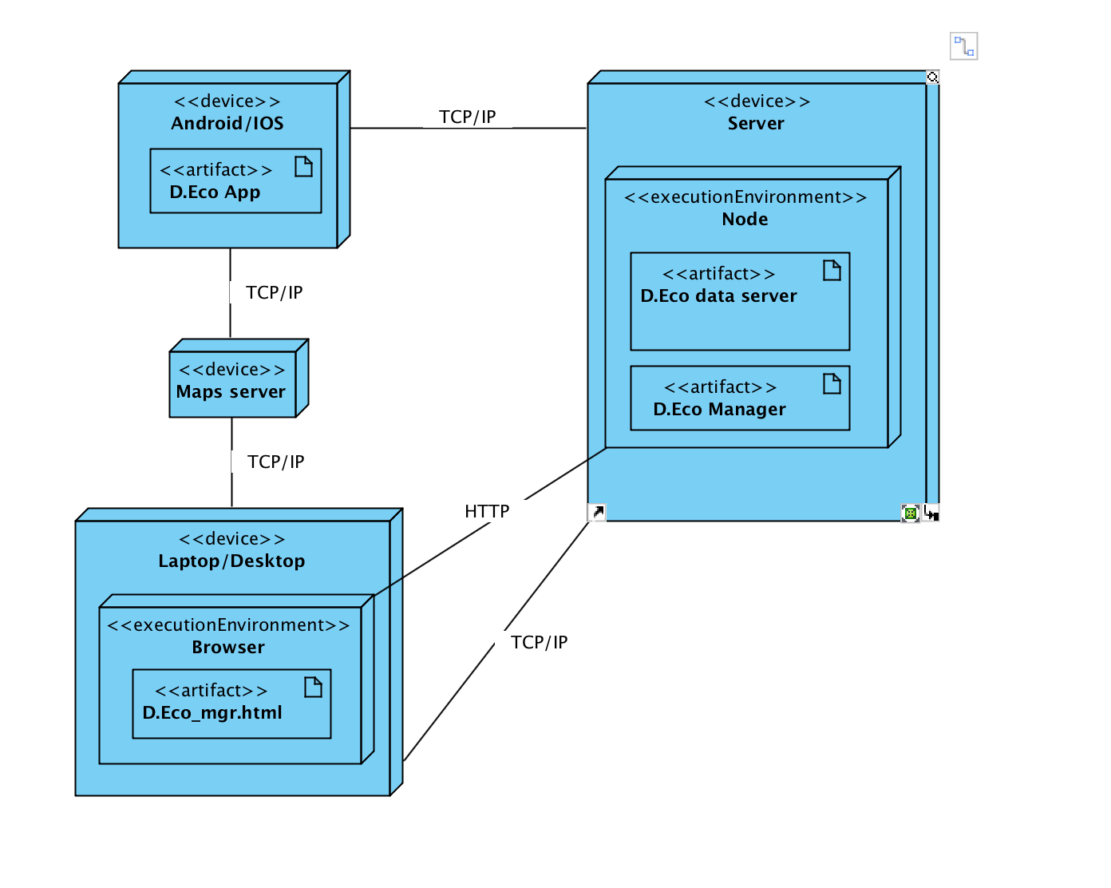
Initial Architecture
Code Monkey
April 5, 2017

Slide 17
Security Risk
Penetration attacks
Denial of service
Man in the middle attack
SQL injection
Penetration attacks
Code Monkey
April 5, 2017

Slide 18
Plan – Sprint 1
What | Who | When
Requirements (Update Use Case) | Bijan | April 7, 2017
Analysis (Update cost, risk & effort estimate) | Kylie, Cyler, Cory | April 21, 2017
Design (Platforms & Architecture) | Fisal, Morgan | April 21, 2017
Code Monkey
April 5, 2017

