Slide 1

D.Eco Application
Presented by Code Monkey

Slide 2
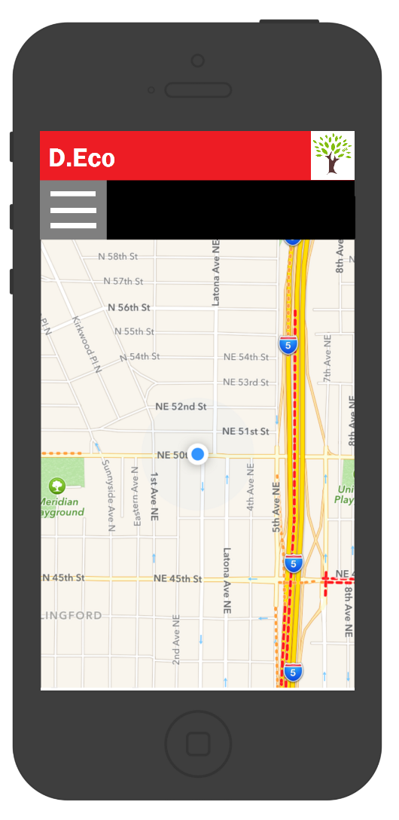
System Inception
Use Case Model
Risk Analysis
Technology Plan
Effort Estimate
System Architecture

Slide 3
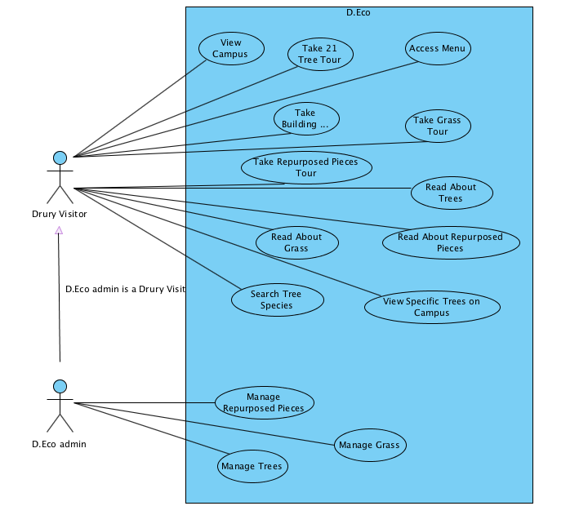
Use Case Model

Slide 4
Technology Plan
Technology | Experience Rating
Phone App Technologies
IOS | Tutorial
Android | None
Cordova | Tutorial
Windows 10 Phone | None
Map Technologies
Google Maps | Tutorial
Microsoft Bing Maps | None
Open Layers | None
OpenStreetMap | None

Slide 5
Technology Plan
 | Experience Rating
Application & Web Development
Java | Small Scale
Swift | Tutorial
HTML 5 | Small Scale
Javascript | Tutorial
JQuery Mobile | Tutorial
Bootstrap Framework | Tutorial
Iconic Framework | None
Web Server Scripting
PHP | Small Scale
Microsoft ASP.NET | None

Slide 6
Risk Analysis
Risk | Mitigation
No experience with IOS development | Schedule time and work through tutorials
Limited experience with app development | Schedule time and work through tutorials
Limited experience with tools (Cordova, Git, and Visual Paradigm) | Schedule time to learn about the tools and work through the tutorials
Team member conflicting schedules | Plan meetings far in advance and communication in dividing work
No experience accessing GPS in mobile | Schedule time to learn and work through tutorials
Limited information on expected product | Walkthroughs with end users
Limited time to finish product | Manage time efficiently

Slide 7
Effort Estimate
Screen/Report | Complexity | Object Points | Notes
View Campus | 1 | 1 | Screen will be constructed by reading Drury location from the data source.
Access Menu | 1 | 1 | Simple drop down with text tabs.

Slide 8
Effort Estimate Assumptions
Screen/Report | Complexity | Object Points | Notes
Take 21 Tree Tour | 2 | 2 | Screen will be constructed by Drury's location and individual location from the data source.
Subscreen
Read About Trees | 1 | 1 | Simple text with some images on screen.
Search Tree Species | 1 | 1 | Simple search bar that accesses data source.
View Specific Trees on Campus | 2 | 2 | Filter specified tree request from search bar, and access data source.

Slide 9
Screen/Report | Complexity | Object Points | Notes
Take Building Tour | 2 | 2 | Screen will be constructed by Drury's location and individual location from data source.
Subscreen
Read About Repurposed Pieces | 1 | 1 | Simple text with some images on screen.

Slide 10
Screen/Report | Complexity | Object Points | Notes
Take Grass Tour | 2 | 2 | Screen Will be constructed by Drury's location and individual location from data source with grass location.
Subscreen
Read About Grasses | 1 | 1 | Simple text with some images on screen.

Slide 11
Screen/Report | Complexity | Object Points | Notes
Take Repurposed Pieces Tour | 2 | 2 | Screen will be constructed by Drury's location and individual location from data source with repurposed pieces location.
Subscreen
Read About Repurposed Pieces | 1 | 1 | Simple text with some images on the screen.

Slide 12
Screen/Report | Complexity | Object Points | Notes
Manage Repurposed Pieces | 1 | 1 | Simple screen and access to the database.
Manage Grass | 1 | 1 | Simple screen and access to the database.
Manage Trees | 1 | 1 | Simple screen and access to the database.
Screen Total |  | 20 | Total object points for screen.

Slide 13
Screen/Report | Complexity | Object Points | Notes
3GL Modules
Map Modules | 5@10 | 50 | Module requiring scripting against a map API.
GPS Tour | 5@10 | 50 | Module to find individual location with GPS.
Server Modules | 4@10 | 40 | Data server for all 4 Map Modules.
3GL Total |  | 140 | Total object points for 3GL Module.
Total Object Points |  | 160 | Total object points for the project.

Slide 14
Effort Estimate
Productivity (PROD)
PROD estimate is very low (5)
PROD = 160 NOP / 32 person months
PM = 8hr x 1 week x 4 weeks
Justification: students
Some code reuse is anticipated so adjusted effort = NOP
NOP = (160 Obj pts x (100-0.1)) / 100 = 159.8
Effort Estimate in person months (PM) (PM = 32)
Effort(PM) = 159/5 = 31.8 person months

Slide 15
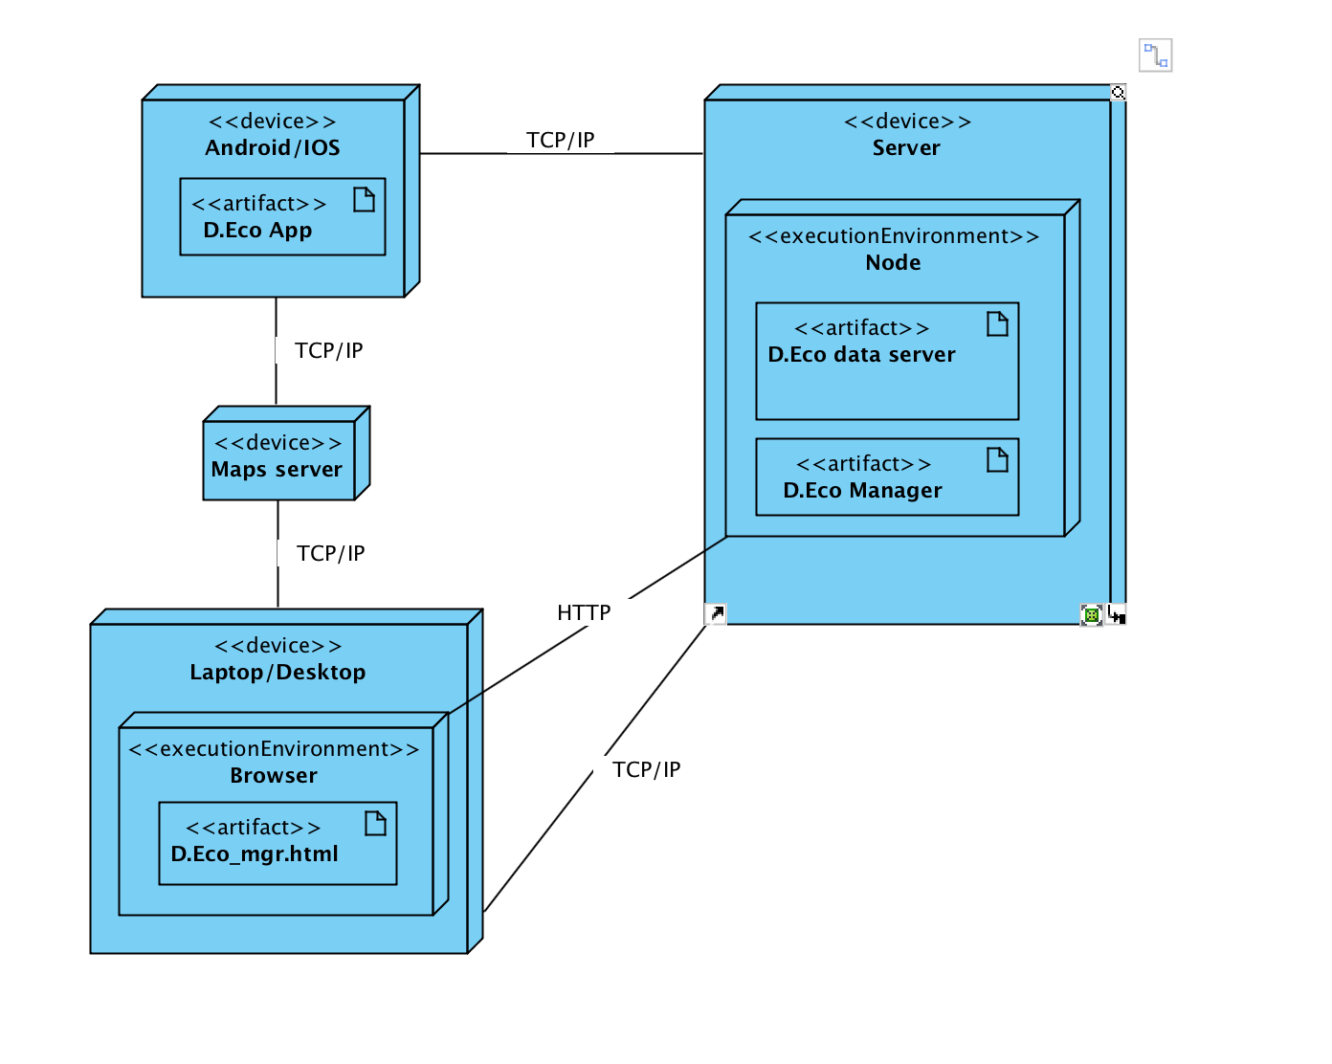
Initial Architecture

