Slide 1

Basic Details of the Team and Problem Statement
Ministry/Organization Name/Student Innovation: AICTE
PS Code: 1465
Problem Statement Title: Unified portal for developing a model curriculum for all AICTE approved institutes.
Team Name: 405 Found1
Team Leader Name: Ruchita Vilas Saindane
Institute Code (AISHE): C-8977
Institute Name: Shram Sadhna Bombay Trust Collage of Engineering And Technology, Bambhori, Jalgaon.
Theme Name: Miscellaneous

Slide 2
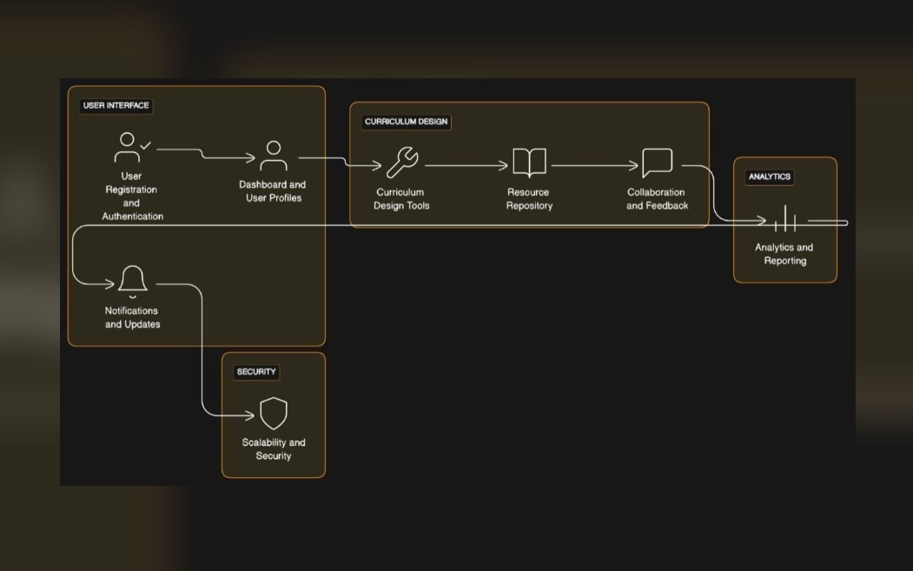



Idea/Approach Details
System Architecture:
Add process flow chart or simulated image of prototype or any relevant image related to your idea
Idea/Solution/Prototype:
Effortless Curriculum Development: Our portal simplifies curriculum development. Developers choose templates, enter data, and watch it auto-populate. Editing is easy, creating complete subject syllabi.
Dynamic Collaboration: Beyond syllabi storage, it's a dynamic platform for collaboration and best practices. Ensuring curricula align with industry standards and global trends.
Educator Support: We provide resources, tools, and insights for engaging, current curricula that match emerging trends.
Technology Stack:
Front-end:
Back-end:
Database:

Slide 3
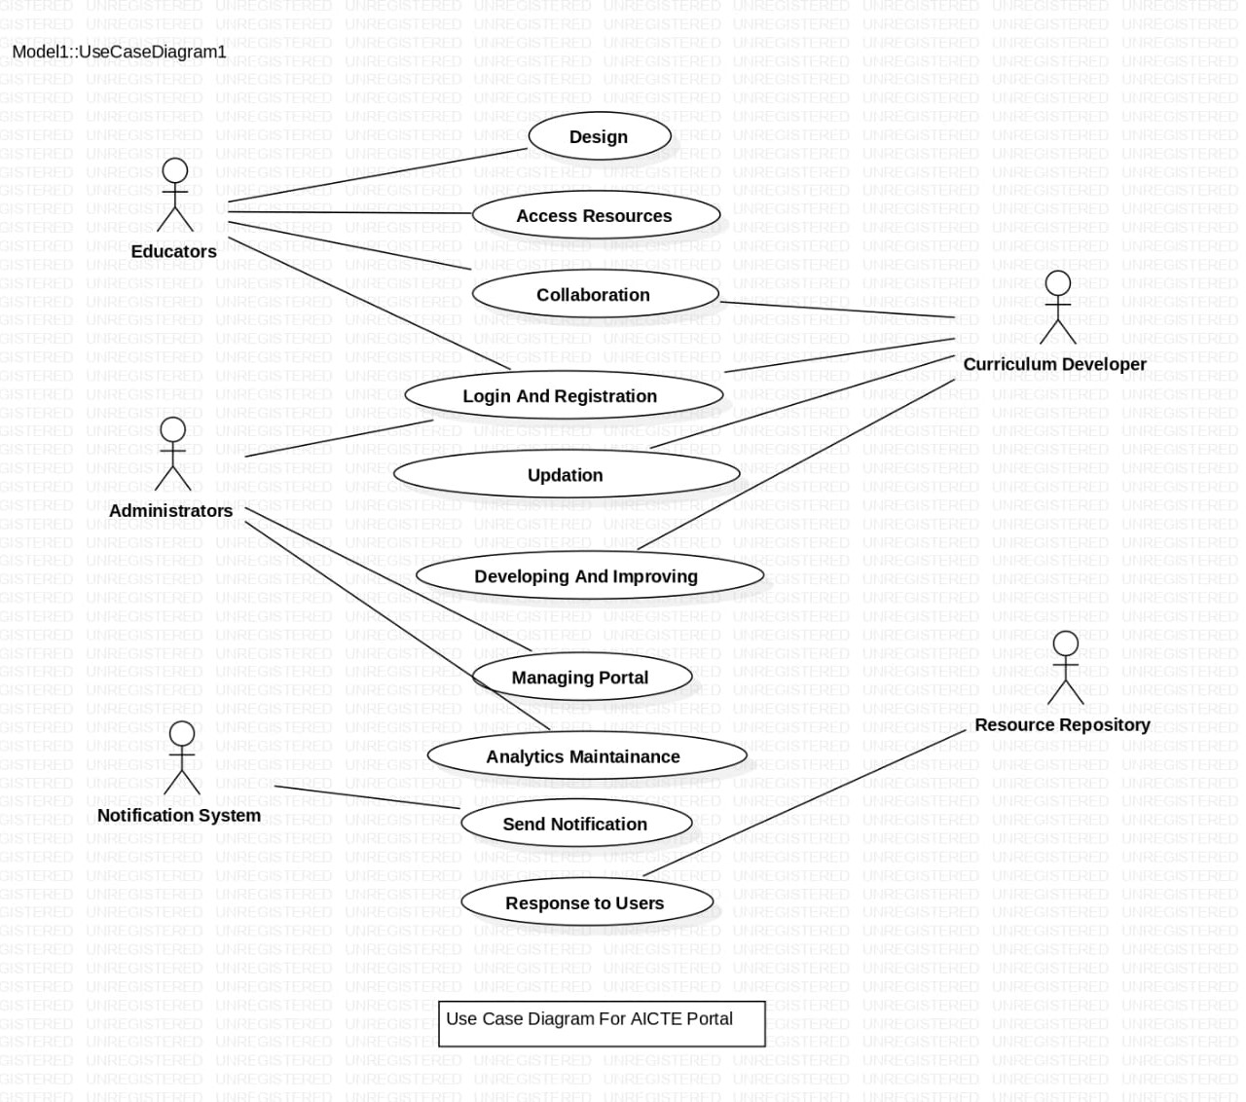
Idea/Approach Details
Use Cases:
Dependencies/Show stoppers:
Scope creep
Technical challenges
Lack of data
Flow-Map of Portal:
https://app.flowmapp.com/share/projects/6dedd153-0868-4218-a9ca-769faa401b4f/sitemap/505a231e-7234-4a22-a42e-9aea99b907ce
GitHub link:
https://github.com/BPratikVinod/CurriculumDesignPortal

Slide 4
Team Member Details
Team Leader Name: Ruchita Vilas Saindane
Branch : BE Stream : Information Technology Year : IV
Team Member 1 Name: Jayshree Shravan Bichave
Branch : BE Stream : Information Technology Year : IV
Team Member 2 Name: Ashwini Sunil Patil
Branch : BE Stream : Information Technology Year : IV
Team Member 3 Name: Ankita Nitin Warule
Branch : BE Stream : Computer Science Year : III
Team Member 4 Name: Pratik Vinod Bari
Branch : BE Stream : Information Technology Year : IV
Team Member 5 Name: Vijay Sahebrao Patil
Branch : BE Stream : Information Technology Year : IV
Team Mentor 1 Name: Dr. Dinesh D. Puri
Category : Academic Expertise : ML Domain Experience (in years): 6
Team Mentor 2 Name: Mr. Sarkar H. Rajput
Category : Academic Expertise : ML Domain Experience (in years): 6

