Slide 1
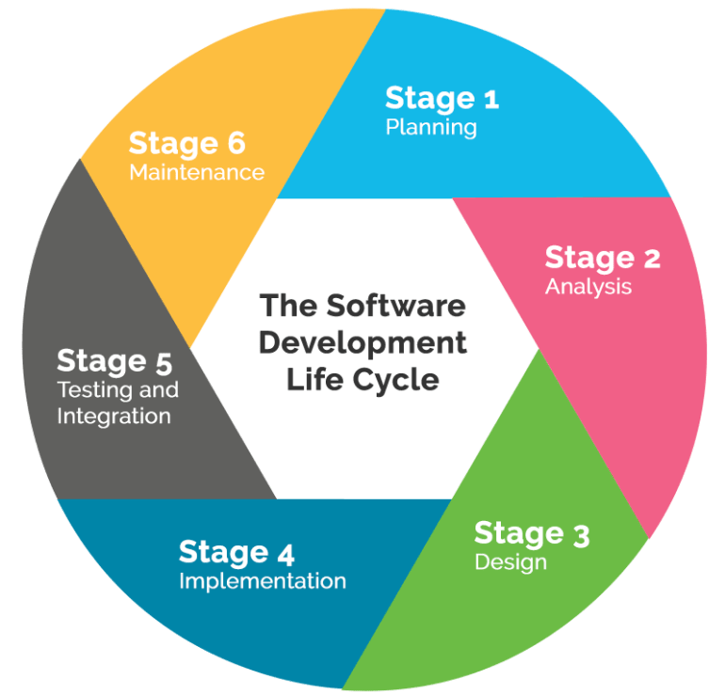
Git And GitHub Help Teams Maintain Their Projects Throughout The Development Lifecycle
Git is a version control system that allows teams to track a projects entire history.
New functionality can be added to the project without causing damage to the existing code base.
GitHub is a website hosting service that stores Git projects.
Provides a visual representation of the project’s history.
Teams can identify project issues, assign responsibilities, and communicate tasks on GitHub.
Combining the version control capabilities of Git with the hosting services of GitHub, teams can better maintain each step in the development lifecycle of their software projects.
Typical software development lifecycle.
Image source:
https://triniinxisle.com/2018/04/20/software-development-baking-what-do-they-have-in-common/

