Slide 1
Git And GitHub
Git and GitHub Help Teams Maintain Their Projects Throughout the Development Lifecycle

Slide 2
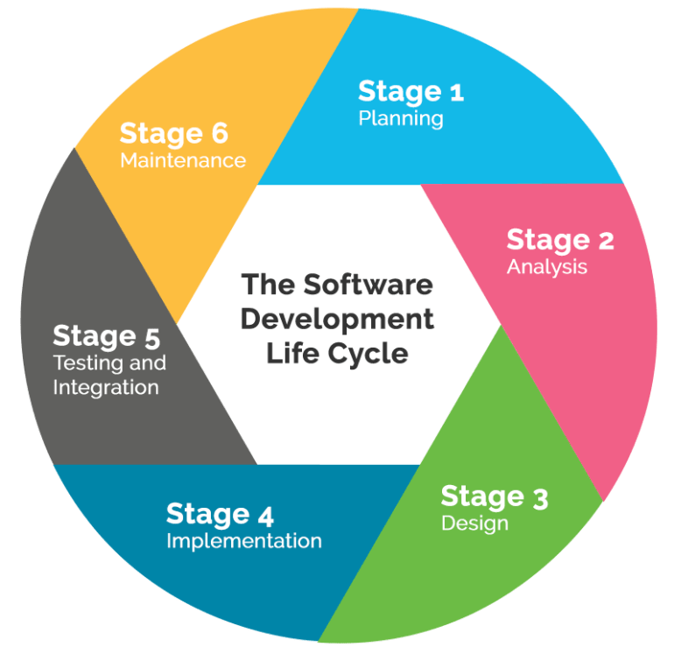
Software Development Lifecycle
Monitoring each stage in the development lifecycle helps teams maintain their software projects.
Image source:
https://triniinxisle.com/2018/04/20/software-development-baking-what-do-they-have-in-common/

Slide 3
Git
Version control system (VCS)
Tracks projects entire history
VCS capabilities of Git allows a project to be reverted to a previous stage of development.
Changes to project files can be made without altering original code base.
Branching
A branch is separate from the main project.
New features, and testing are branched from the master so each can be tracked independently.

Slide 4
GitHub
Online hosting service for Git projects.
GitHub provides a single stream for all team members to view the project’s files.
Projects are stored into directories called repositories.
Project repository can be cloned from GitHub to a local machine.
Work on a project remotely.
Cloning creates a copy of the repository.
Through cloning, file changes can be made while maintaining the current state of the projects code base.
File changes can be made locally or on GitHub directly.
All changes made are reflected on the project’s repository on GitHub.

Slide 5
Git And GitHub Help Teams Maintain Their Projects Throughout The Development Lifecycle
Combining Git and GitHub teams can maintain each step in the development lifecycle by:
Tracking files changes throughout their project’s history.
Project files are stored in a central repository on GitHub.
Cloning or copying the current state of their project to local machines.
Team members can work on the project remotely.
Creating branches from the main copy.
Branches allow teams to add new features or testing capabilities.
Branches are independent lines of development.
Maintain the integrity of the original code base.

