Slide 1




Microservices Architecture for BQP Assignment Check
Introducing a robust microservices-based web application designed to streamline assignment management and review processes, leveraging cutting-edge technologies for secure and scalable deployment.
by VIJENDER KUMAR

Slide 2
Introducing the Lead Software Architect
Background
Skillset
Objective
Over 11 years of experience in software development, specializing in microservices and full-stack solutions.
Proficient in React, FastAPI, Docker, and cloud deployment technologies, ensuring efficient and scalable development.
Demonstrate the ability to architect and deploy scalable microservices for educational platforms.

Slide 3
Project Overview
1
Assignment Brief
2
Scope Covered
Design and implement a microservices-based web application for assignment management and review.
User authentication, content handling, comments management, and notifications.
3
Rapid Development
Developed a robust prototype in just 3 days, showcasing agile development capabilities.

Slide 4
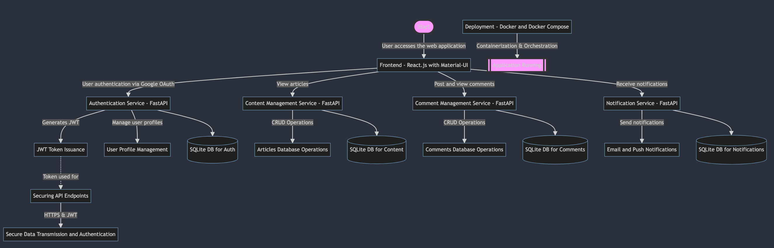
Architecture Diagram

Slide 5
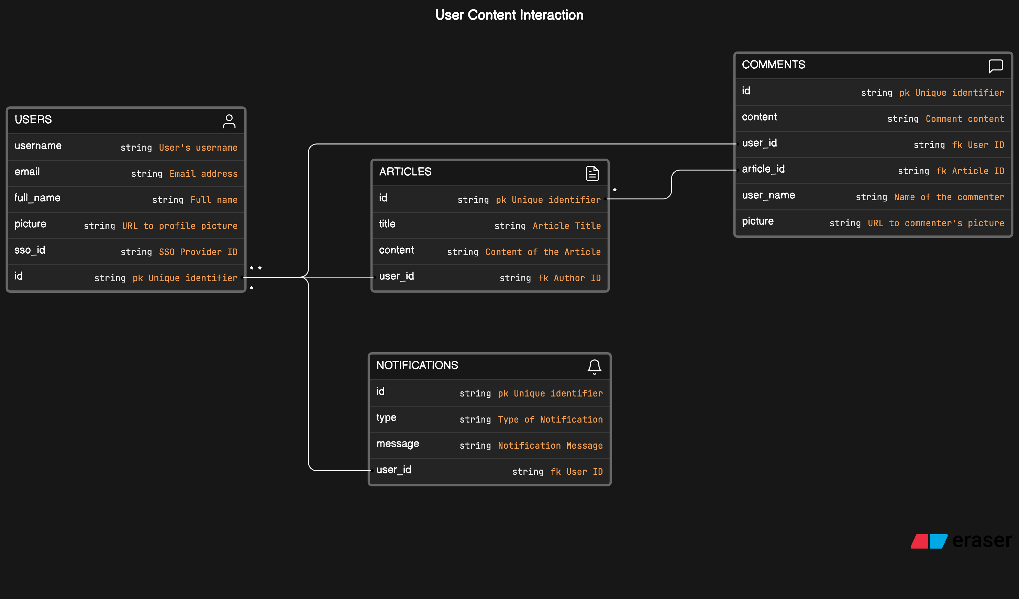
ER Diagram

Slide 6
Architectural Overview
User Authentication
1
Manages user logins and token generation using FastAPI and OAuth2.
2
Profile Management
Handles user data and privacy settings, built with FastAPI and SQLite.
Content Management
3
Manages article posting, updating, and retrieval using FastAPI and SQLite.

Slide 7
Microservices in Detail
Comment Management
Notification Service
Manages comments on articles, leveraging FastAPI and SQLite.
Sends notifications to users about interactions and updates, using FastAPI and SMTP.
Scalability and Deployment
Docker containers enable easy scaling and deployment across environments.

Slide 8



Technology Choices
FastAPI
SQLite
Docker
Rapid development and prototyping with Python's asynchronous capabilities.
Efficient data storage and management for the microservices.
Containerization for scalable and consistent deployment across environments.

Slide 9



Challenges and Solutions
Tight Timeline
Rapid prototyping and agile development enabled a 3-day turnaround.
Robust Security
Implemented OAuth2 for secure user authentication across the microservices.
Service Communication
Leveraged asynchronous programming in FastAPI to ensure efficient inter-service communication.

Slide 10
Quality Assurance and Future Enhancements
Testing Strategies
Unit and integration tests for each microservice
CI/CD Implementation
GitHub Actions for continuous integration and deployment pipelines
Future Enhancements
Multi-tenancy and license management capabilities

