Slide 1


Compiling Resource-Efficient Programs with BQSKit
Ed Younis, Mathias Weiden, Wim Lavrijsen, Costin Iancu

Slide 2
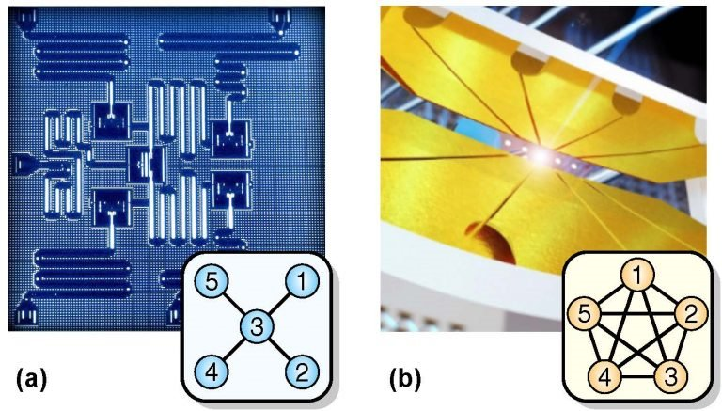
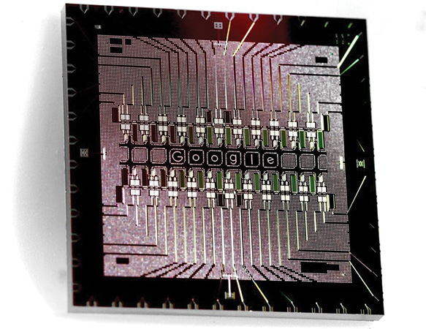
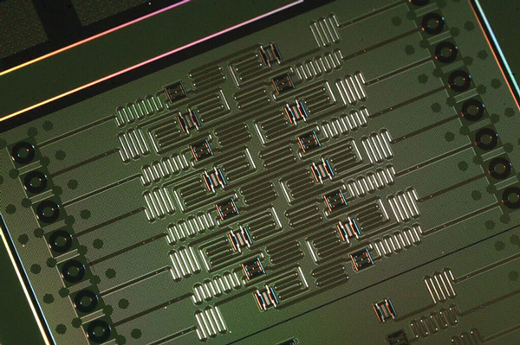
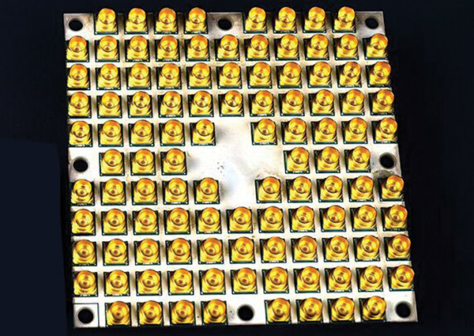
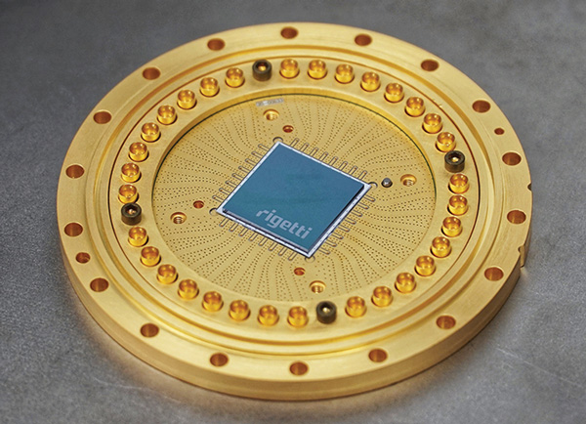
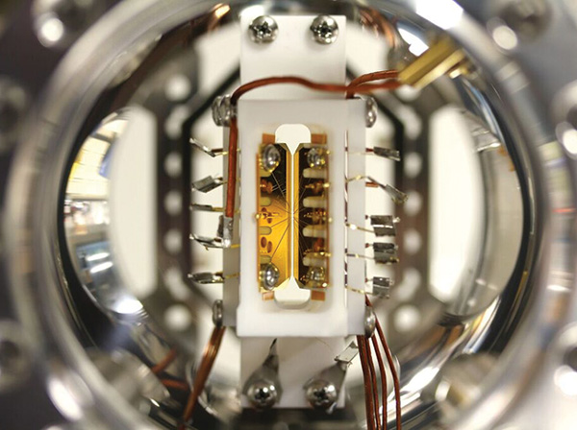
Quantum Hardware R&D is Experiencing a Boon
Extremely diverse hardware landscape
Steady stream of new gates, architectures, and constraints
Increases burden on the software stacks and compilers
Compilation has many different meanings
High Level to Circuit Program Generators
Circuit Transpilers (optimizers, constraint solving)
Control level compilation (circuit to control signals, hardware specific languages, etc)
Google IBM Intel IonQ Rigetti

Slide 3

Berkeley Quantum Synthesis Toolkit (BQSKit) [bis • kit]
Powerful and Portable Quantum Compiler Framework
Gracefully handles every gate set and architecture
Specialized pipelines for widely-used chips
Generates resource efficient circuits (width, depth, timing, etc)
Error mitigation
Enables effective algorithm and hardware design exploration
19 papers (3 IEEE QCE best papers: 2020, 2021, 2022)
300K+ downloads
LANL
Sandia
ANL
ORNL
LLNL
U Penn
U Chicago
U Kansas
U Tokyo
NCSU
Duke
CUNY
U Wisc
Quantinuum
Infleqtion
AWS
Microsoft
NVIDIA
UnitaryFund
HSBC
Users:
bqskit.lbl.gov

Slide 4

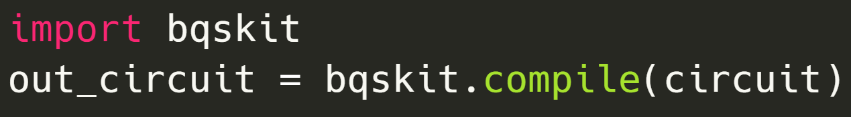
Turn-key Functionality that Works Everywhere
Python 3.8+ on Windows, Mac, Linux
(from laptop to supercomputer)
Any gate set or architecture in or out
qubits, qudits, states, many-states, unitaries, and more
(from experiment to real hardware)

Slide 5
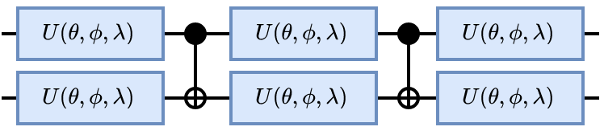
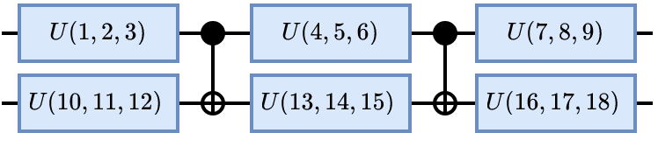


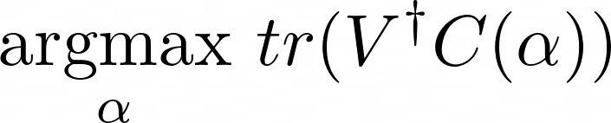
Parameterized Circuit Instantiation: A Powerful Primitive
Parameterized Circuit
Instantiated Circuit
Parameterized Circuit Instantiation
Given a parameterized quantum circuit and a target unitary , solve for

Slide 6
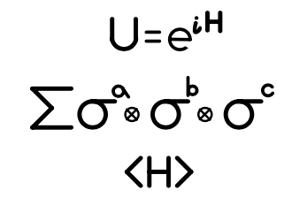
Instantiation Enables Function and Structure Separation
Instantiated Circuit
Mathematical Representations
Parameterized Circuit
Can isolate and vary circuit function and structure
Structure
Instantiated Circuit
Function

Slide 7
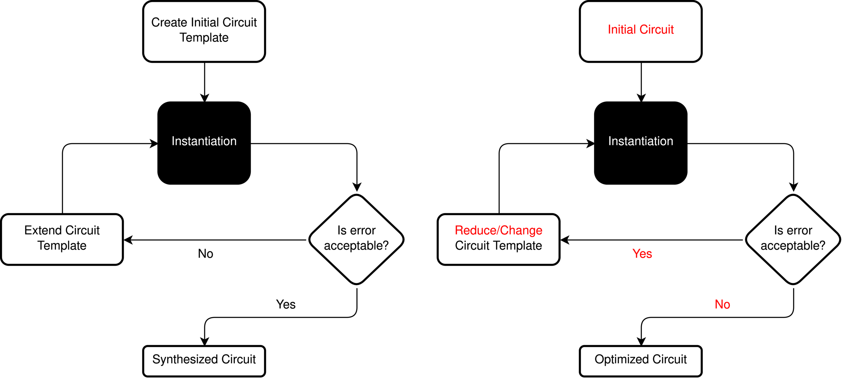
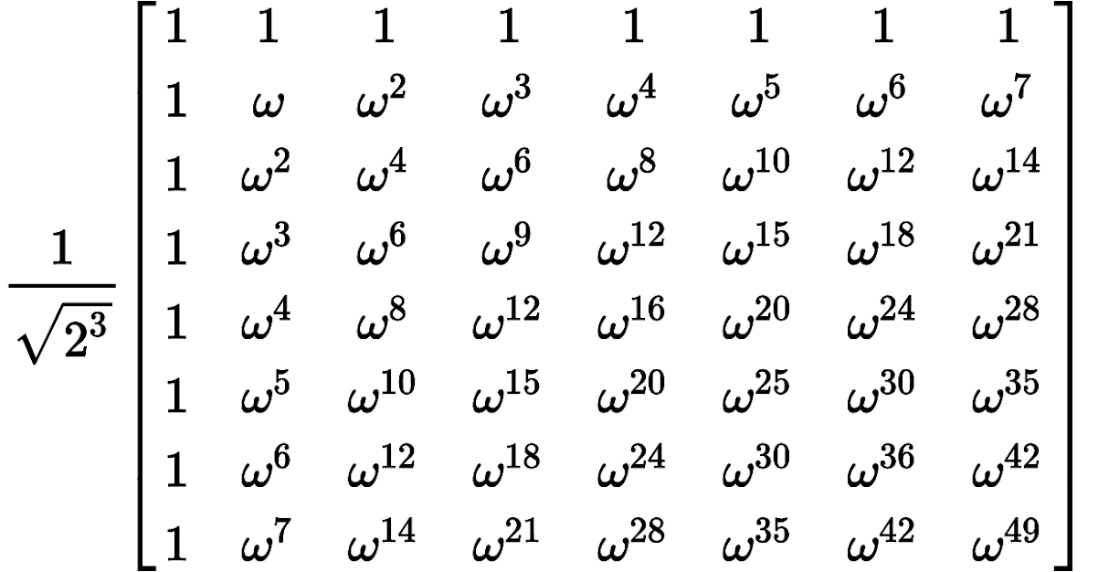
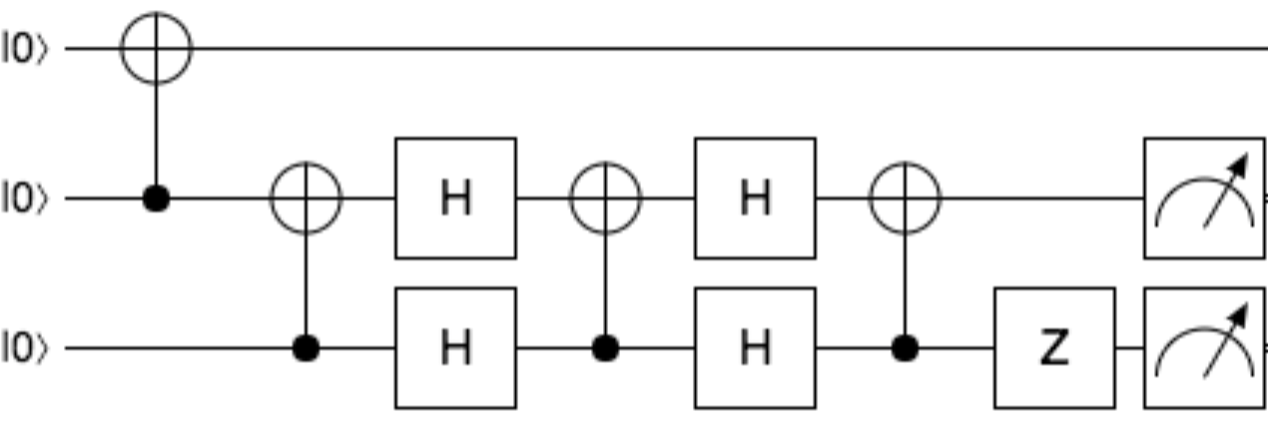
Instantiation is the Core of Bottom-Up Synthesis
Unitary
Circuit
The standard bottom-up loop is to create an initial circuit template guess then continue to instantiate and extend it until a solution is found
E. Younis et al., “QFast: Conflating Search and Numerical Optimization for Scalable Quantum Circuit Synthesis.” 2021 IEEE International Conference on Quantum Computing and Engineering (QCE). IEEE, 2021. (Best Paper Award)

Slide 8
Instantiation-Based Circuit Transformation Flow
We have found Instantiation can also be used to transform or optimize a quantum circuit. Instead of extending a circuit template like in bottom-up synthesis, we reduce or transform a circuit template and continue until it is no longer successful or necessary.
E. Younis et al., “Quantum Circuit Optimization and Transpilation via Parameterized Circuit Instantiation.” 2022 IEEE International Conference on Quantum Computing and Engineering (QCE). IEEE, 2022

Slide 9
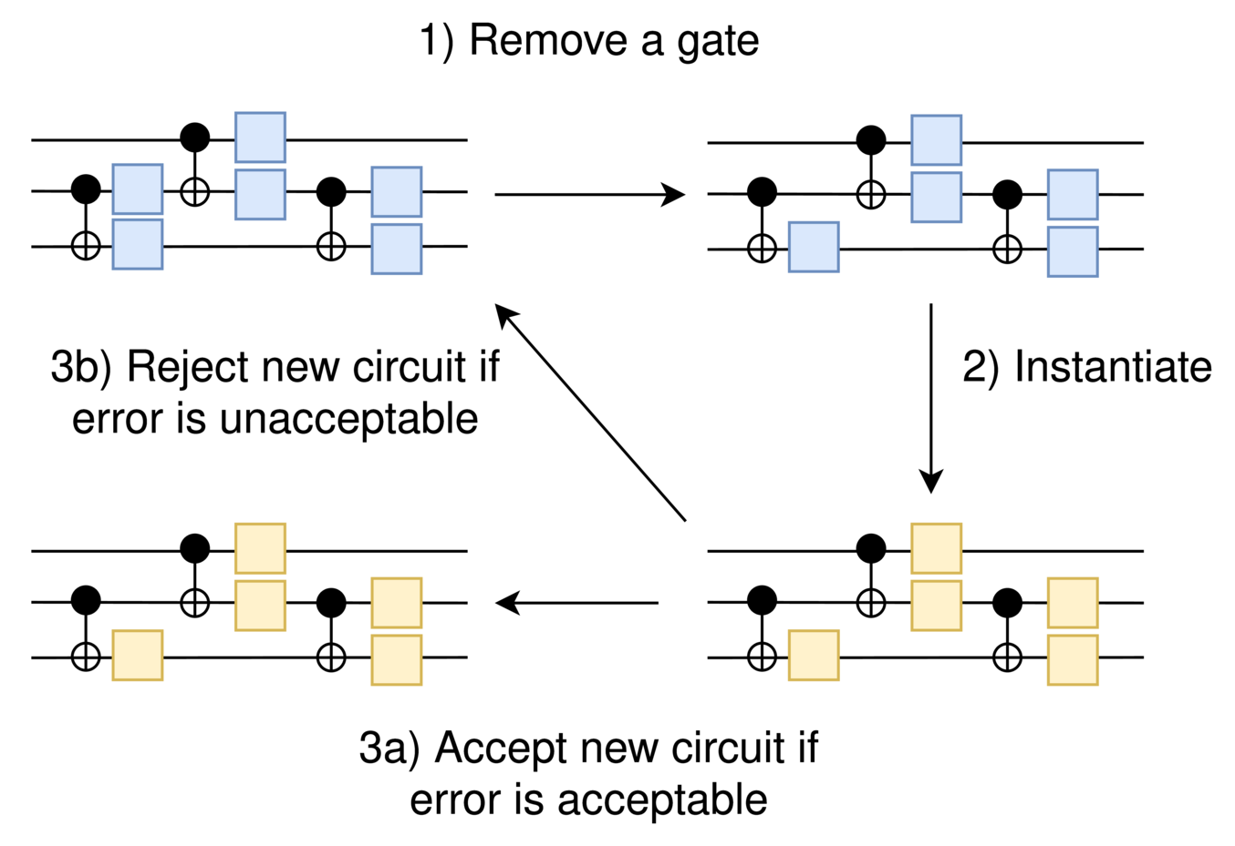
Gate Deletion is Straight Forward with Instantiation
Suboptimal circuits can have gates removed and others reinstantiated to accommodate the loss
Gate deletion + Candidate selection = Optimization algorithm
Extremely portable and flexible
Very effective due to global transformations

Slide 10
Instantiation-Based Algorithms in BQSKit
QSweep – 1 qudit, pulse-optimal
QSearch – 2-4 qudits, optimal
PAS – 3-4 qudits, better-than-optimal + post-processing
LEAP – 4-6 qudits
QFAST – 5-8 qudits
QPredict – 6-12 qudits
Retargeting
Gate Deletion
Template Substitution
Circuit Resizing
Circuit Synthesis
Instantiation
Circuit Transformation

Slide 11
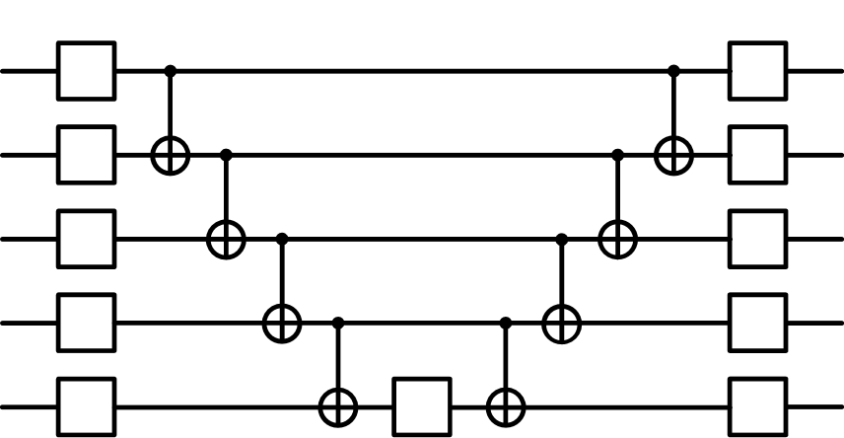
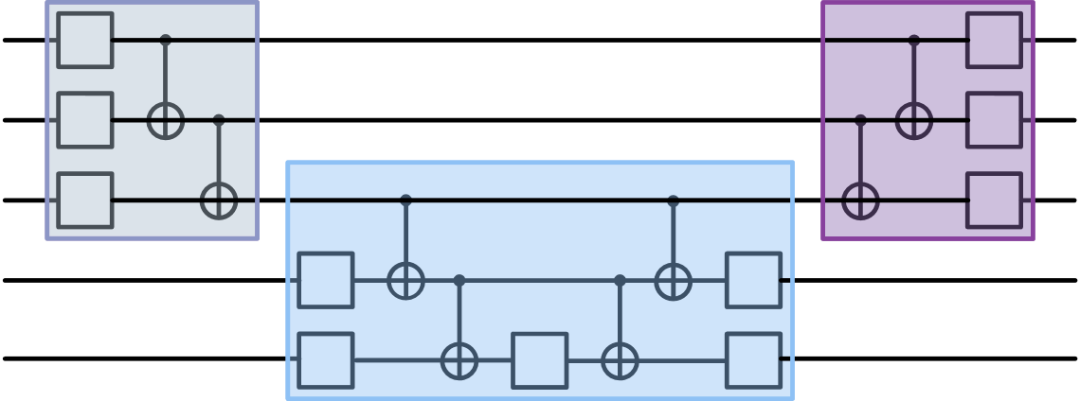
Partitioning Scales Instantiation to 1000s of qubits
Circuit on the left is partitioned into 3-qubit blocks below
Partitioning overcomes the exponential scaling of numerical instantiation
Restricts global view; can adjust block size for better performance or quality
Creates an extremely parallel workflow
X.C. Wu et al. “Reoptimization of Quantum Circuits via Hierarchical Synthesis.” 2021 IEEE International Conference on Rebooting Computing (ICRC). IEEE, 2021.

Slide 12
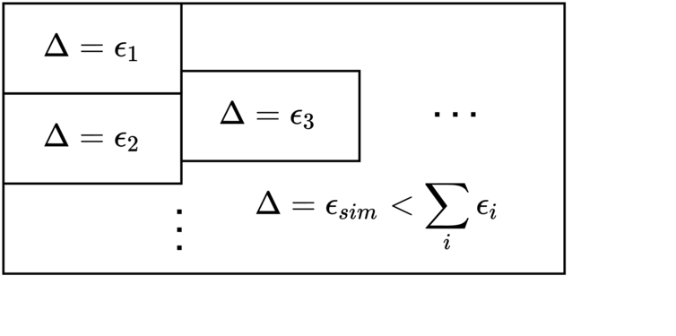
Push-button Compiler Verification
Small circuits can have their error directly calculated
Larger circuits can be first partitioned into large simulatable sections, then summing the section errors gives an upper bound on total error
Unless specified, we target 10⁻⁸ to 10⁻¹⁰ instantiation verification error, most often it is less

Slide 13
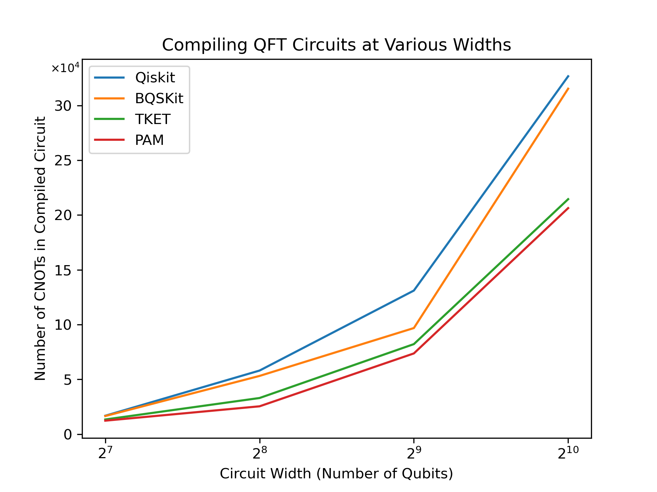
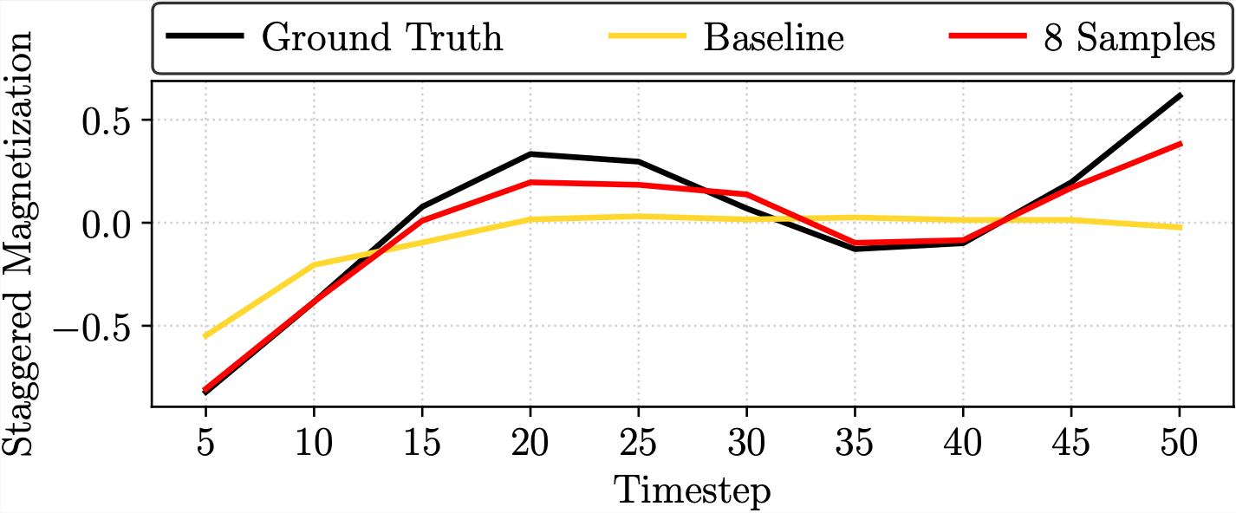
Instantiation-Based Workflows in BQSKit
Workflows
Optimization (QGO, TopAS, Gate Deletion)
Mapping/Routing (Generalized SABRE, PAM)
Approximations (QuEST)
Gate Set Retargeting
Circuit Resizing
PAM maps circuits with fewer final gates than commercial compilers
Approximations workflows better track ground truth on NISQ devices

Slide 14
Instantiation-Based Workflows in BQSKit
Workflows
Optimization (QGO, TopAS, Gate Deletion)
Mapping/Routing (Generalized SABRE, PAM)
Approximations (QuEST)
Gate Set Retargeting
Circuit Resizing
Session 1: Introduction to BQSKit Compiling (Default Workflows)
PAM maps circuits with fewer final gates than commercial compilers
Approximations workflows better track ground truth on NISQ devices

Slide 15
Instantiation-Based Workflows in BQSKit
Workflows
Optimization (QGO, TopAS, Gate Deletion)
Mapping/Routing (Generalized SABRE, PAM)
Approximations (QuEST)
Gate Set Retargeting
Circuit Resizing
Session 2:
Introduction to new bqskit-ft extension
Customizing Workflows: Deep dive for a Specific Algorithm
Session 1: Introduction to BQSKit Compiling (Default Workflows)
PAM maps circuits with fewer final gates than commercial compilers
Approximations workflows better track ground truth on NISQ devices

Slide 16

Berkeley Quantum Synthesis Toolkit Tutorial
github.com/bqskit/bqskit-tutorial

Slide 17
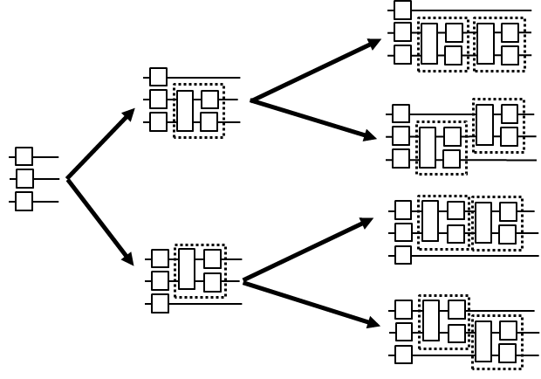
Instantiation is the Core of Bottom-Up Synthesis
QSearch is a canonical bottom-up synthesis algorithm that produces optimal circuits.
The standard bottom-up loop is to create an initial circuit template guess then continue to instantiate and extend it until a solution is found

Slide 18
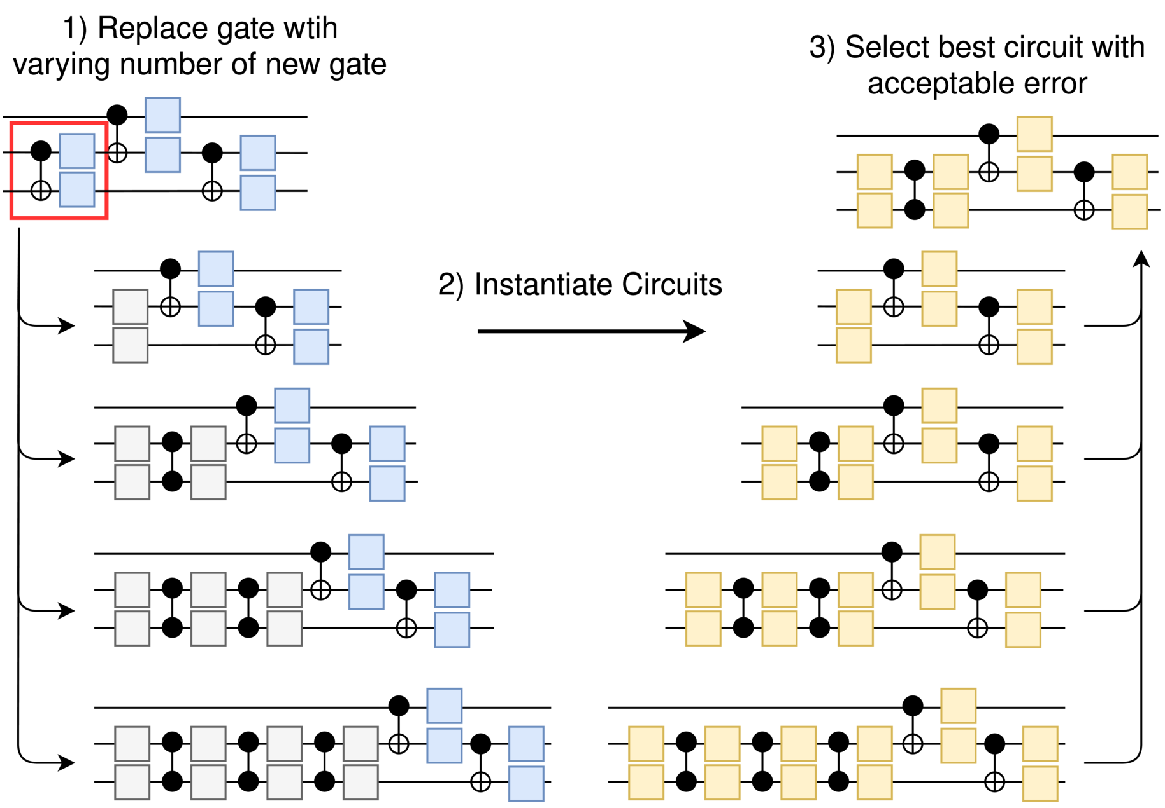
Instantiation can Retarget Circuits without Rules
Typically gate rebasing is done with fixed rules or analytic instantiation (KAK) that only consider local circuit changes
Numerical instantiation-based rebasing is more effective, portable and flexible
Works with gate sets contain multiple entangling gates

Slide 19
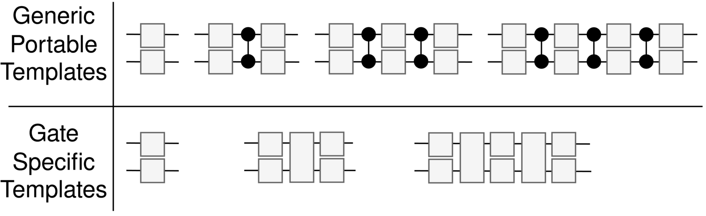
Instantiation-based Rebasing with Custom Gates
In the generic case, we use four templates with zero to three two-qubit gates. However, if we don’t need all four templates, as in the case with some gates, we can reduce the number of candidate solutions instantiated improving runtime

Slide 20
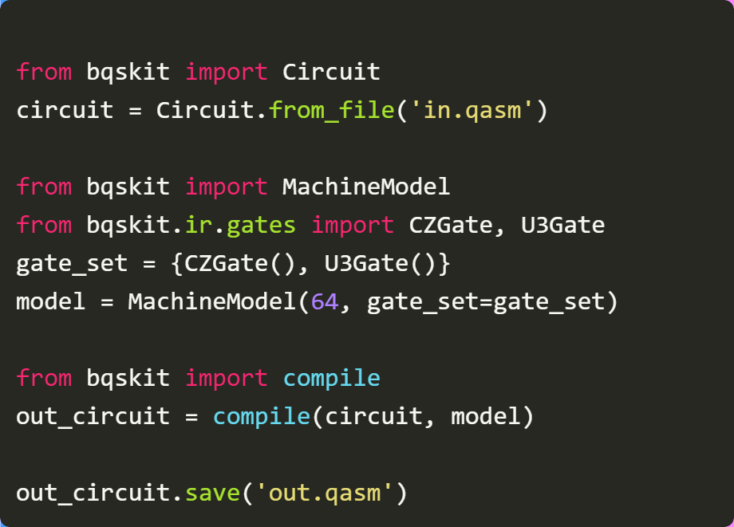
Both Algorithms are Available in BQSKit
Converting circuits from one gate set to another is extremely easy with BQSKit
No user-defined rules necessary; all gates support
Simply load a circuit, program a gate set, and compile to it.

Slide 21
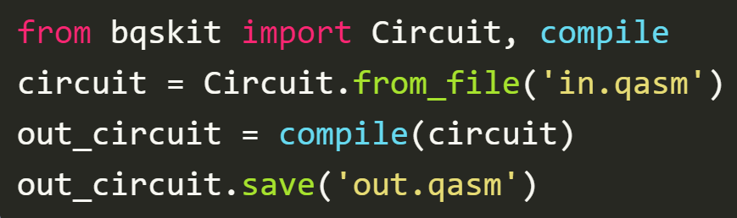
BQSKit Tutorial: Friday at 10am (TUT24)
BQSKit is a powerful and portable quantum compiler framework.
Come learn how to generate resource efficient programs with BQSKit
Tutorial on Friday at 10am
bqskit.lbl.gov

