Slide 1


Circuit Synthesis for Early Fault-Tolerant Quantum Computers
Ed Younis, Justin Kalloor, Mathias Weiden, Siyuan Niu, Costin Iancu

Slide 2
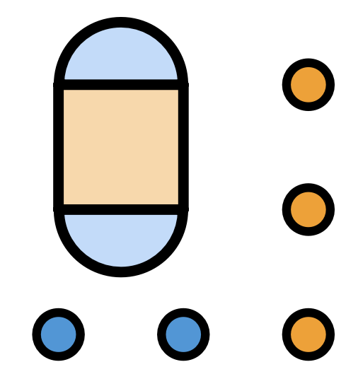
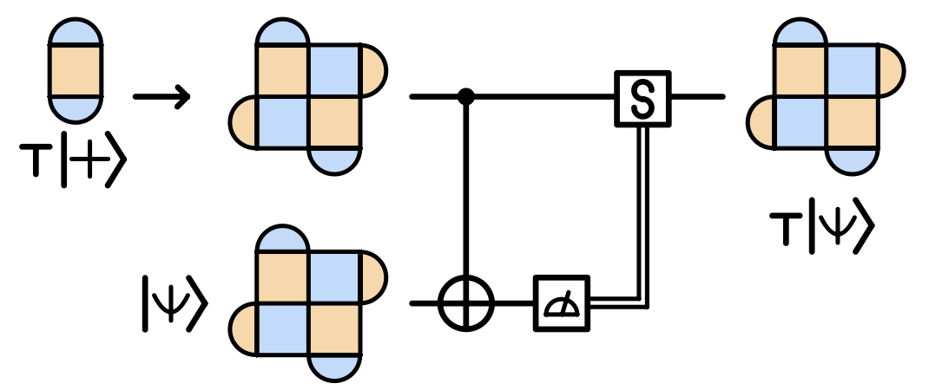
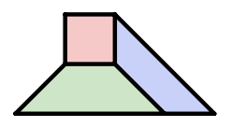
BQSKit-FT
BQSKit works very well for NISQ-style applications
Circuits contain many parameterized gates
Optimization objective is to minimize multi-qudit gates
What needs to change when considering fault-tolerant quantum computing?

Slide 3
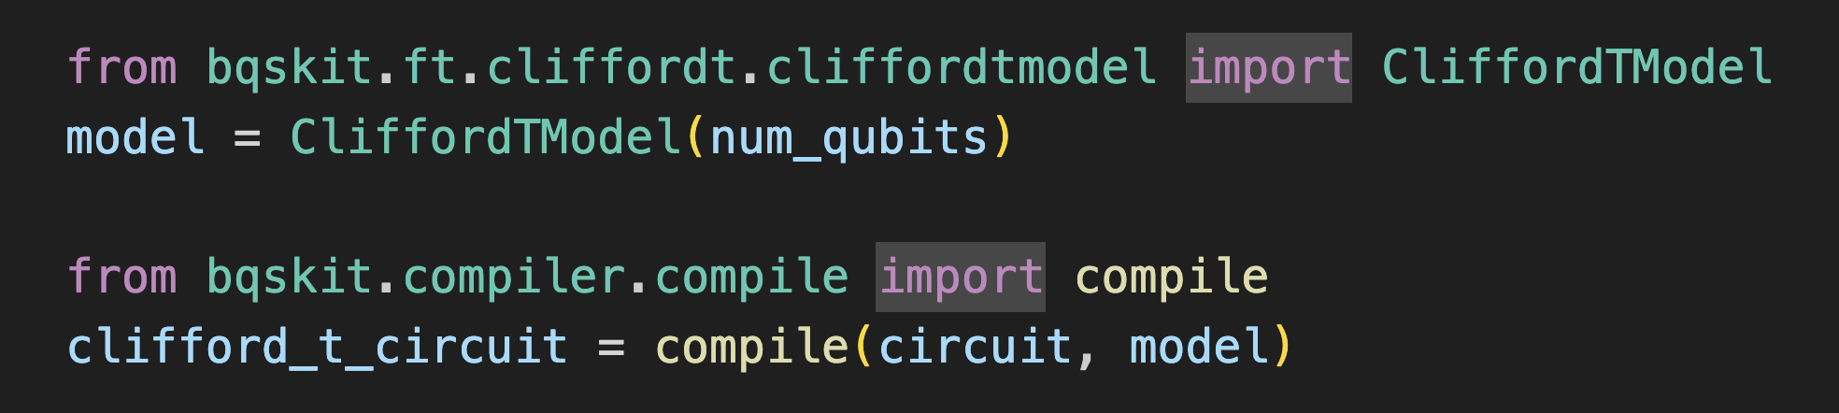
BQSKit-FT
What needs to change when considering fault-tolerant quantum computing?
Goal: let users target fault-tolerant quantum computers as easily as possible

Slide 4
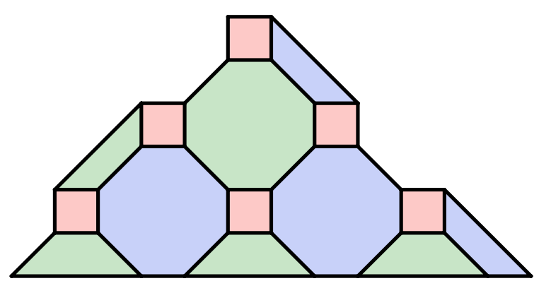
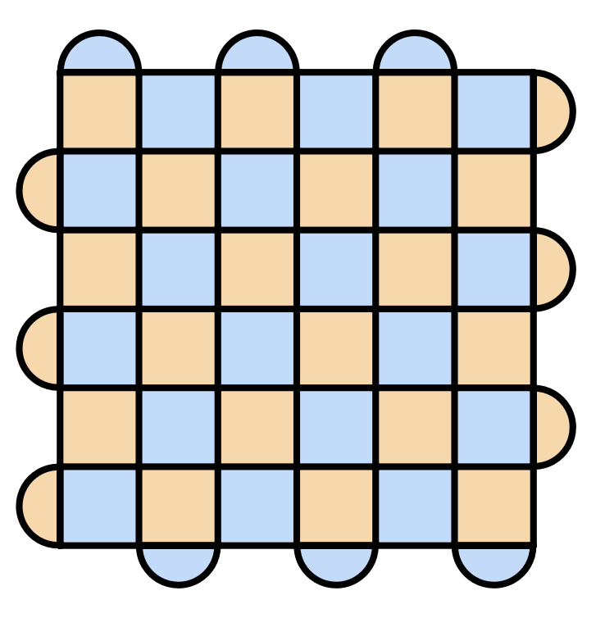
Fault-tolerant gate sets
For many codes of interest (e.g. many CSS codes like surface and color) Clifford gates are easy to implement
Transversal, fold transversal, flip transversal, etc.
Cliffords are important, but insufficient for universality
Eastin-Knill theorem: transversal (easy) gate sets are not universal
Gottesman-Knill theorem: Clifford circuits are classically simulable
A single non-Clifford gate is sufficient for universality
Solovay-Kitaev theorem: approximation with FT gate sets can be done efficiently
Color codes
Surface codes

Slide 5
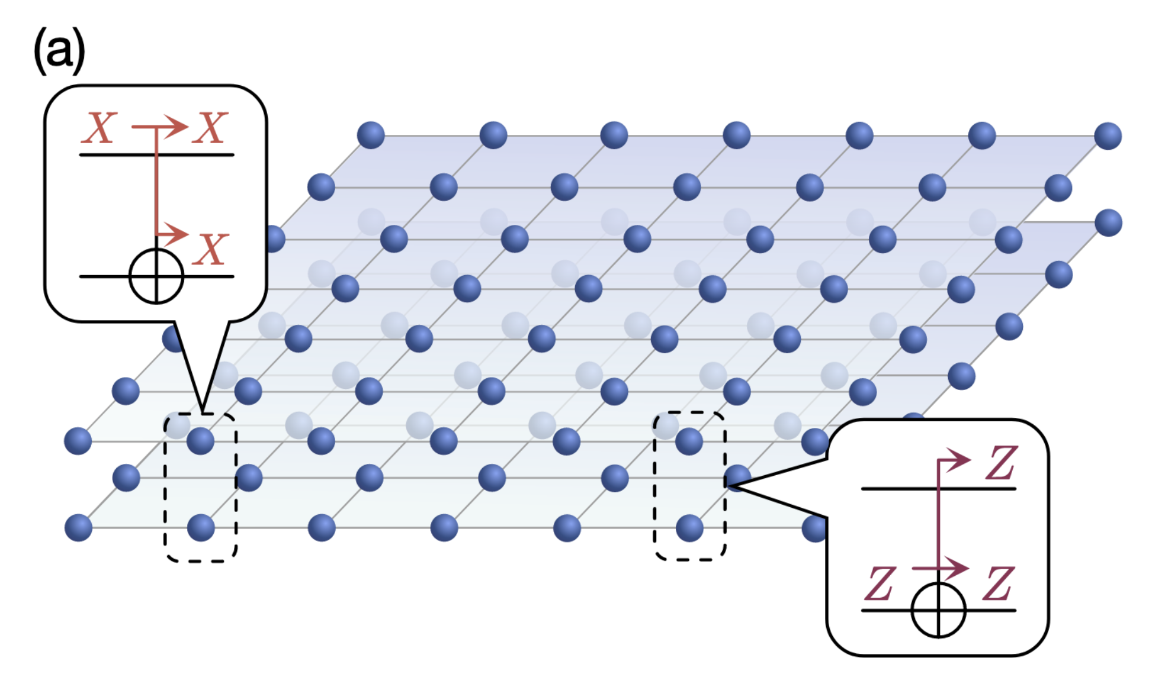
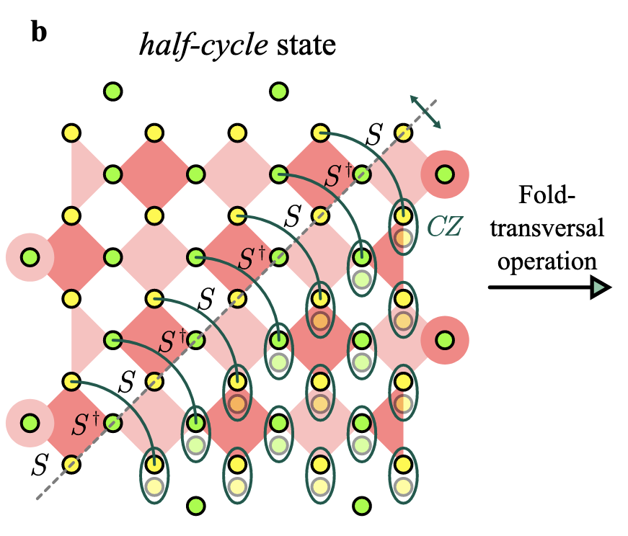
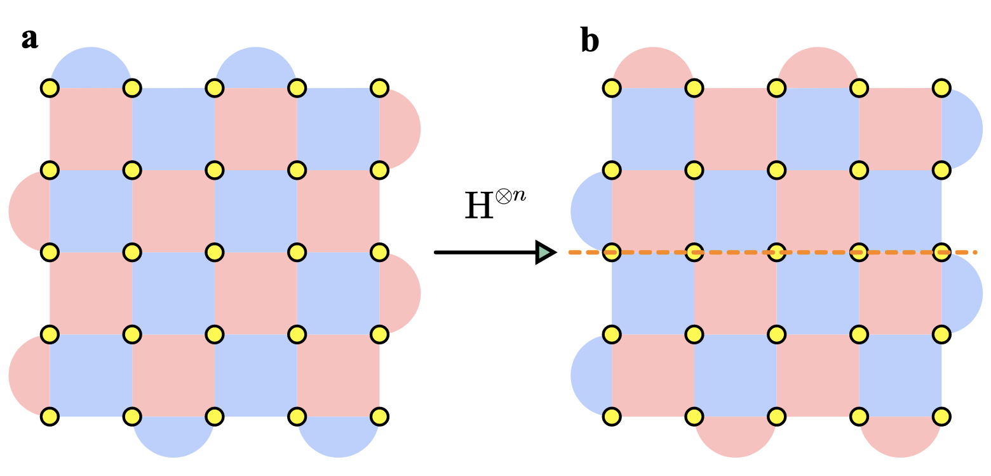

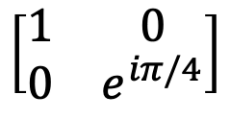

Fault-tolerant gate sets: Clifford$+T$
Clifford$+T$
CNOT
$$\left[\begin{matrix}1 & 0 \\ 0 & e^{iπ/4}\end{matrix}\right]$$
S
arxiv: 2403.03272
H
arxiv: 2412.01391
arxiv: 2412.01391
Ultimately we want circuits expressed with these gates

Slide 6
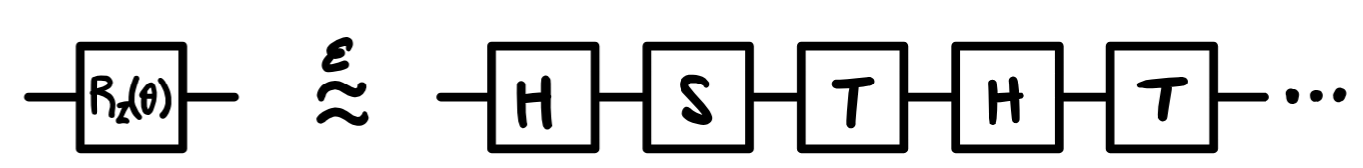

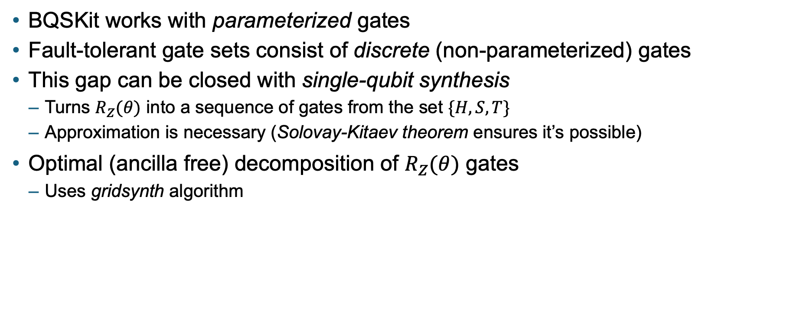



Fault-tolerant gate sets
BQSKit works with parameterized gates
Fault-tolerant gate sets consist of discrete (non-parameterized) gates
This gap can be closed with single-qubit synthesis
Turns $R_{Z}(θ)$ into a sequence of gates from the set $\{H, S, T\}$
Approximation is necessary (Solovay-Kitaev theorem ensures it’s possible)
Optimal (ancilla free) decomposition of $R_{Z}(θ)$ gates
Uses gridsynth algorithm
Assuming $ε={10}^{−3}$
H-count: $10\log{\frac{1}{ε}}≈30$
T-count: $10\log{\frac{1}{ε}}≈30$
S-count: $5\log{\frac{1}{ε}}≈15$

Slide 7


Fault-tolerant gate sets
BQSKit works with parameterized gates
Fault-tolerant gate sets consist of discrete (non-parameterized) gates
This gap can be closed with single-qubit synthesis
1. Prepare circuits in Clifford$+R_{Z}\left(θ\right)$
2. Convert $R_{Z}\left(θ\right)$ gates to Clifford$+T$

Slide 8
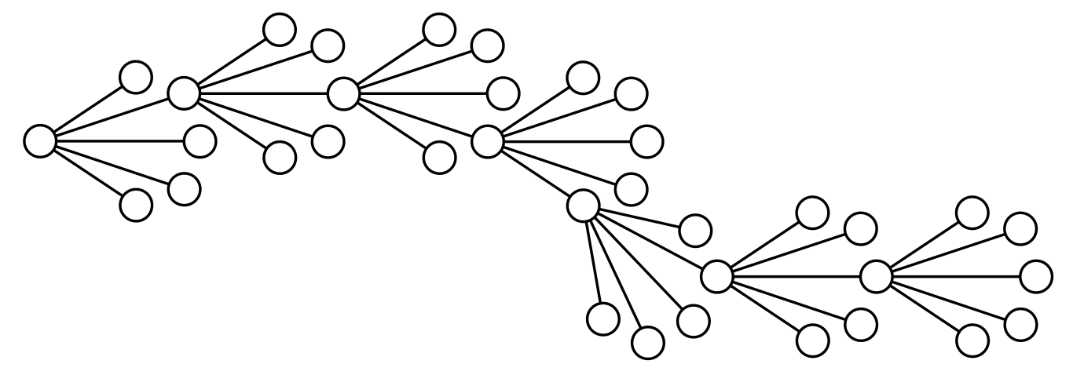
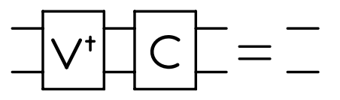
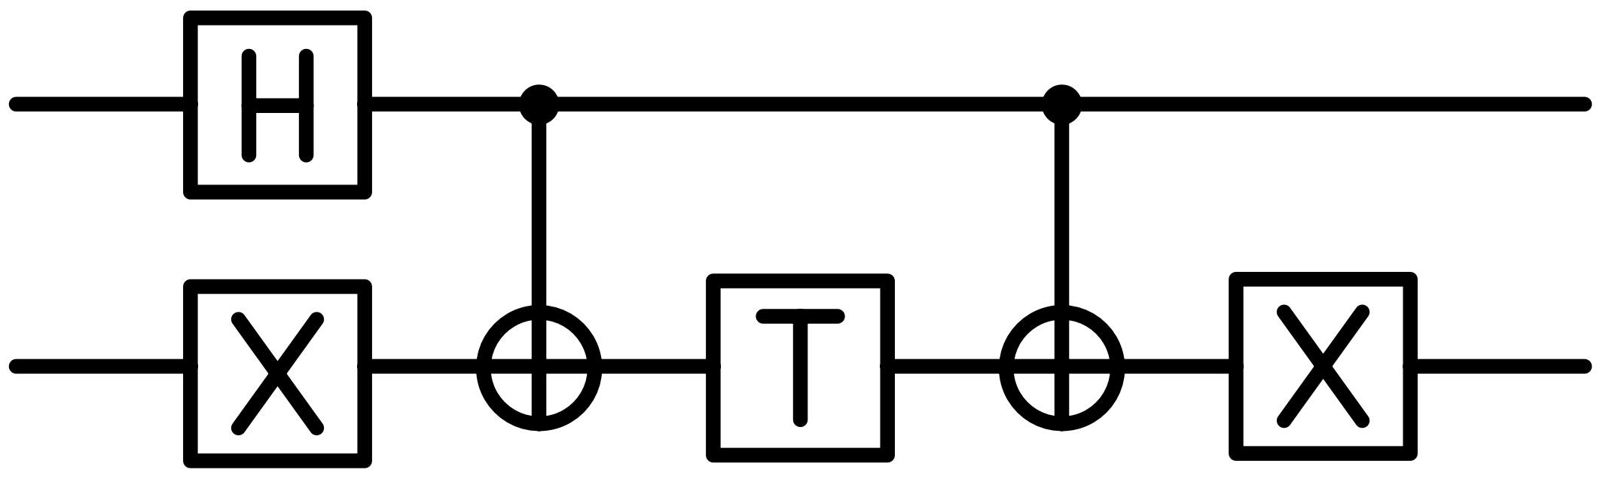
Search-based synthesis
Synthesis with discrete fault-tolerant gate sets are search-based algorithms
Search through trees of possible gate placements
This approach is highly effective for shallow unitaries
X
H
CX
T
CX
X

Slide 9

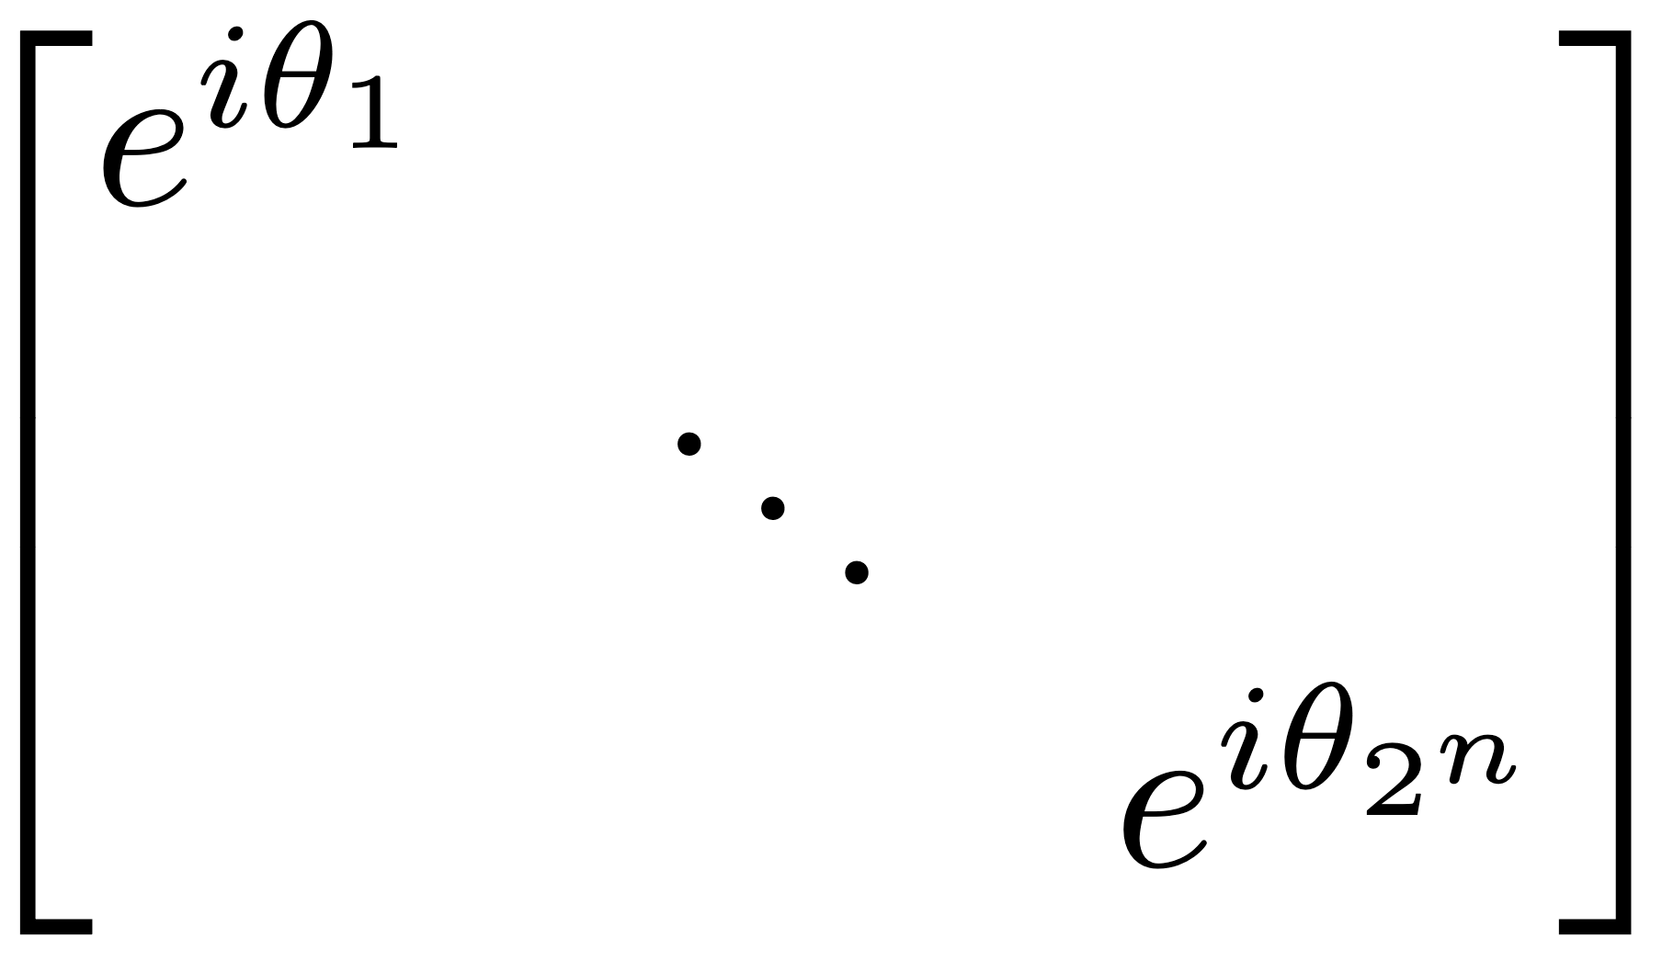

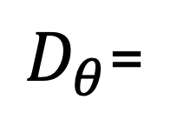
Synthesis by diagonalization
Use search-based synthesis in a double headed search
Let parameterized gates exist between the two discrete portions
Come to TP20:QSYS @ 3:00PM tomorrow to learn about some techniques we developed to do this with Machine Learning!
$D_{θ}$=
arxiv:2409.00433
n = 3
R_{Z}
R_{Z}
R_{Z}
R_{Z}
R_{Z}
R_{Z}
R_{Z}
arxiv:2504.15990

Slide 10

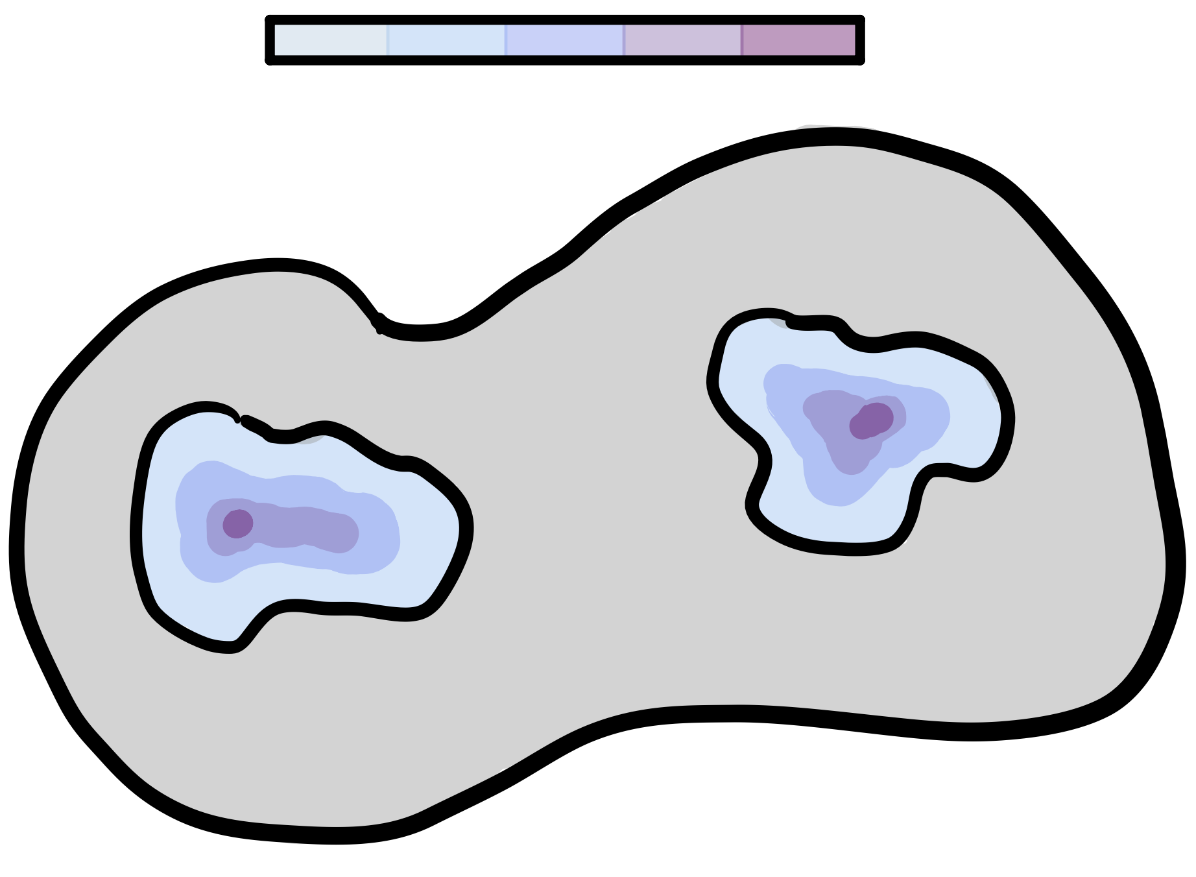
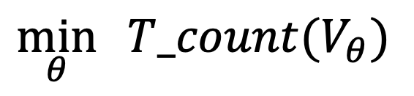
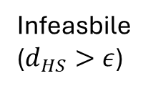

Constrained optimization (NTRO)
Keep parameterized circuits parameterized
Use constrained numerical optimization to round parameters to “friendly” values
Fits in very well with BQSKit’s IR
T-Count
High
Low
$$\min_{θ}{ T_count(V_{θ})}$$
$$s.t. d_{HS}\left(V_{θ},U\right)≤ε$$
Infeasbile
($d_{HS}>ε$)
Solution Space

Slide 11


Decomposing parameterized gates
The gridsynth algorithm is leveraged to decompose parameterized gates
1. Prepare circuits in Clifford$+R_{Z}\left(θ\right)$
2. Convert $R_{Z}\left(θ\right)$ gates to Clifford$+T$

Slide 12
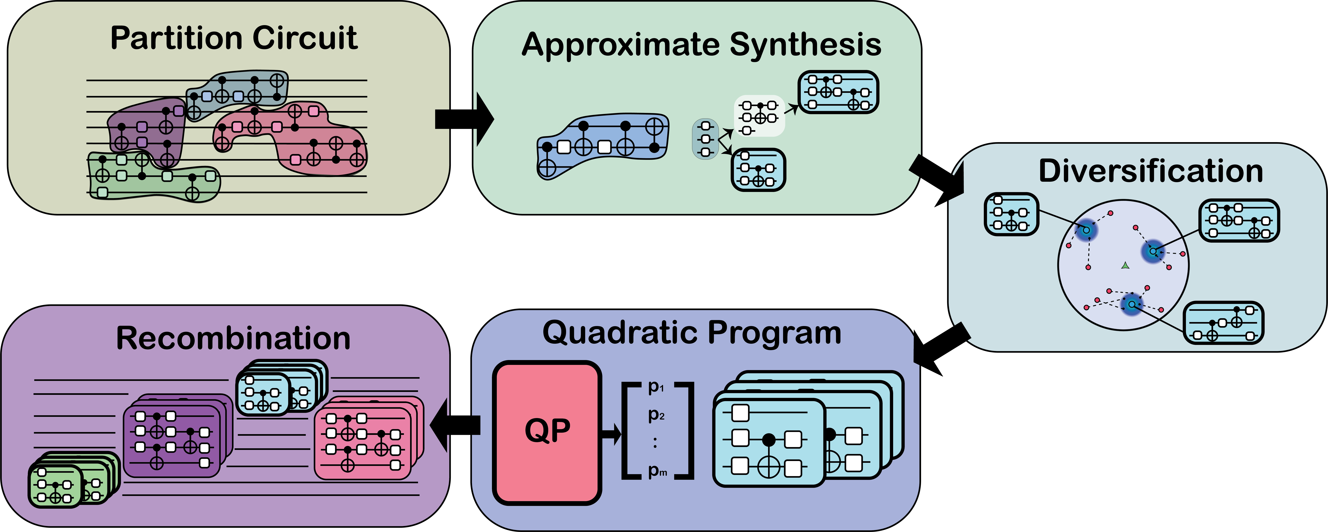
Approximate Ensembles – FT Compilation
Main Idea: By generating a convex set of approximate circuits, we can create a unital channel that quadratically scales the approximation error!
Partition circuit to scale to larger algorithms
Find minimal, further approximations using BQSKit
Expand and Diversity approximate solutions to form a convex hull around the target unitary
Recombine ensembles from each block to form a set of full circuits
Quadratic Program finds corresponding probability distribution to minimize error

Slide 13
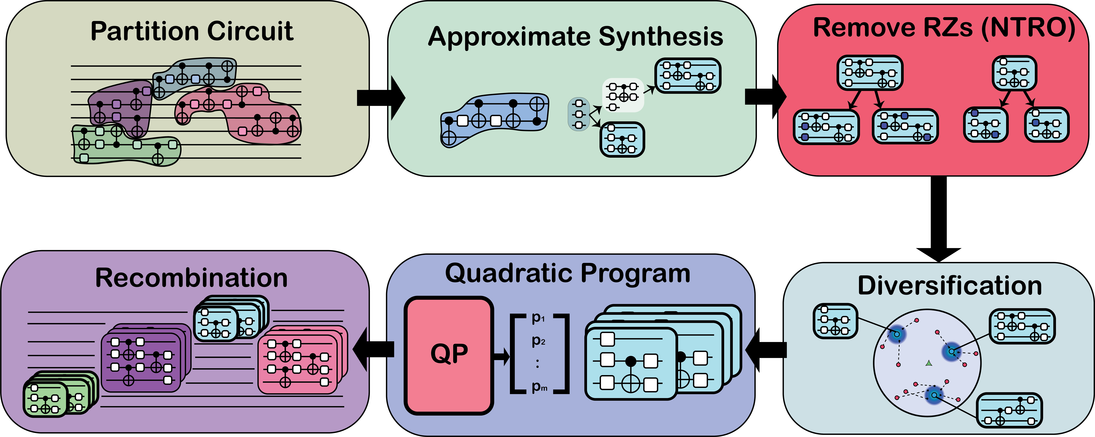

Approximate Ensembles – FT Compilation
Optimization Shift: For FT Compilation, we shift our optimization criteria to eliminate magic (T) states!
Partition circuit to scale to larger algorithms
Find minimal, further approximations using BQSKit
Fix as many RZs to multiples of $\frac{π}{4}$
Recombine ensembles from each block to form a set of full circuits
Quadratic Program finds corresponding probability distribution to minimize error
Diversify with lower precision gridsynth decompositions

Slide 14
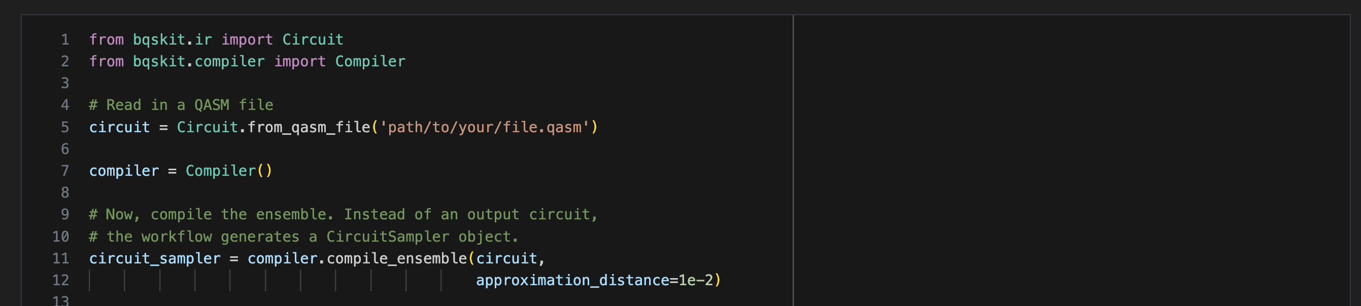
How to use with BQSKit (and BQSKit-FT) (soon to be released)
Notes:
Replace with Jupyter Notebook Demo

Slide 15
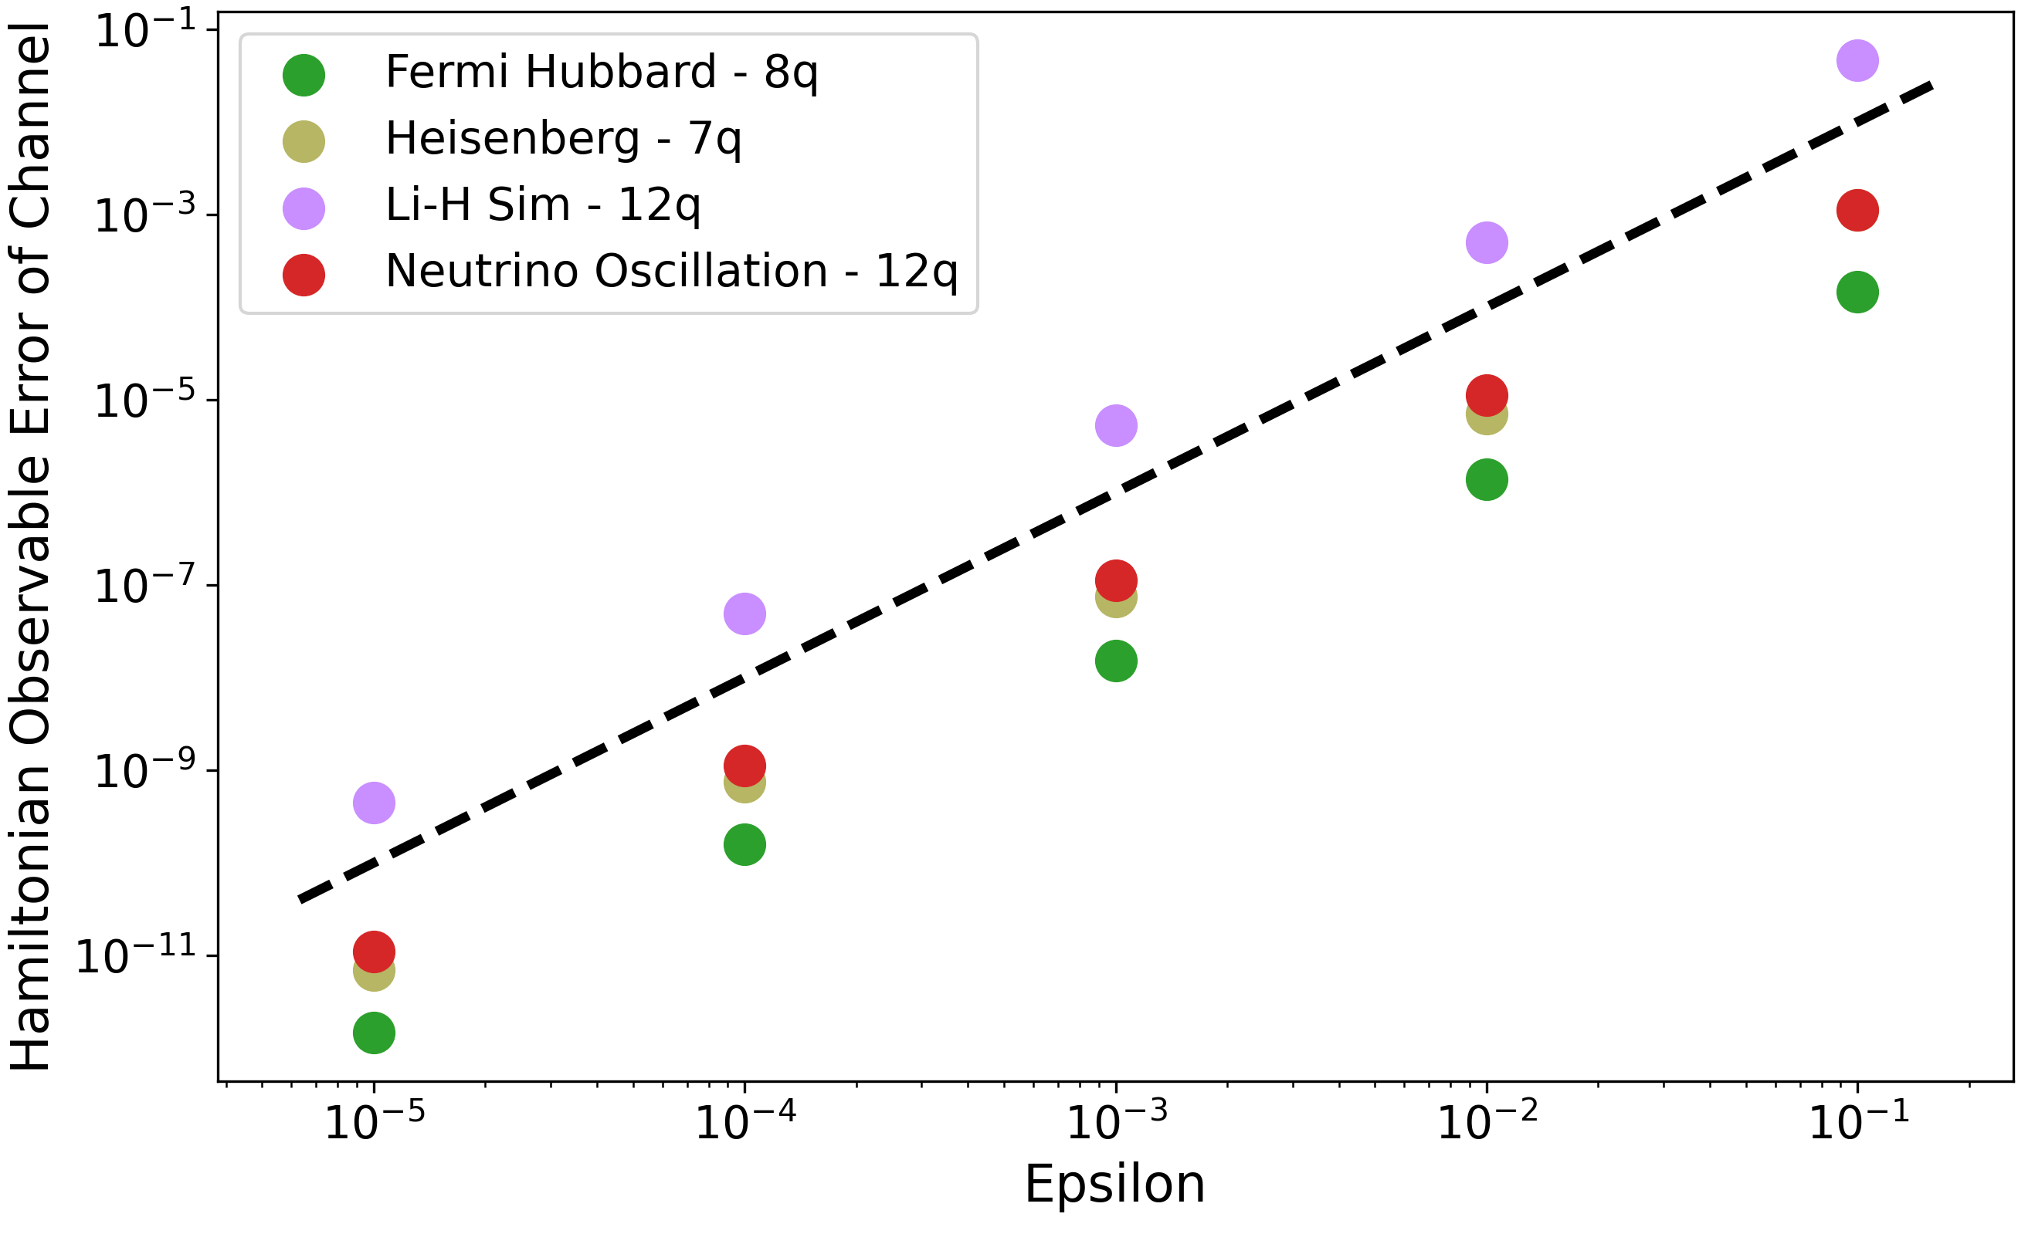
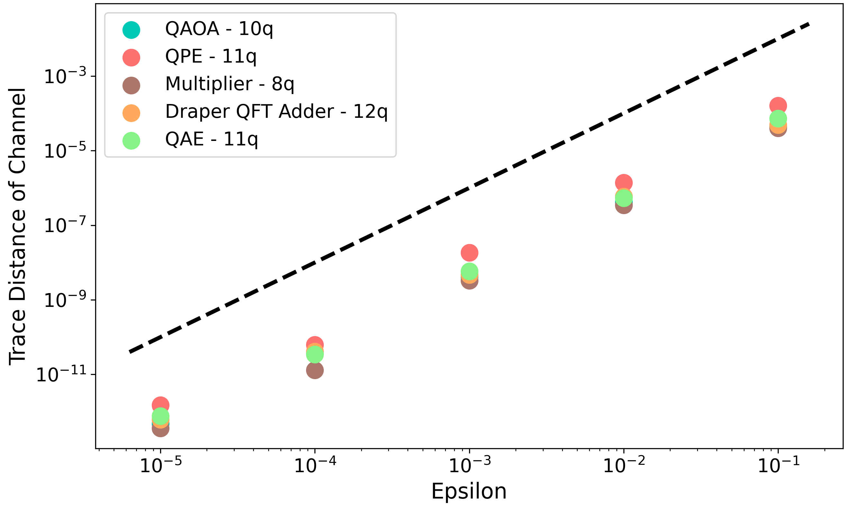
Bounding Diamond Distance
Our ensemble approach has an additional benefit: We can verifiably bound the diamond distance of the final channel
The diamond distance is equal to the worst-case trace distance over all input states
This allows us to bound distances of circuit observables
Diamond Distance is bound by the sum over partitions
Notes:
Add to Jupyter Demo

Slide 16

Berkeley Quantum Synthesis Toolkit Tutorial
github.com/bqskit/bqskit-tutorial

