Slide 1
Track & Trace + Genealogy
Manufacturing Execution System — Capability Showcase
Notes:
Opening. This is a working Manufacturing Execution System for an aluminum die-casting operation supporting automotive. Everything shown is live from the running system. Three themes: complete track & trace, on-demand reporting, and a data-integrity foundation for regulated manufacturing.

Slide 2
Track & Trace + Genealogy
Complete part lineage — every LOT, from raw casting to shipment.
Notes:
Track & Trace section. The core promise: every part carries its full lineage from raw casting through machining, assembly, and shipment.

Slide 3
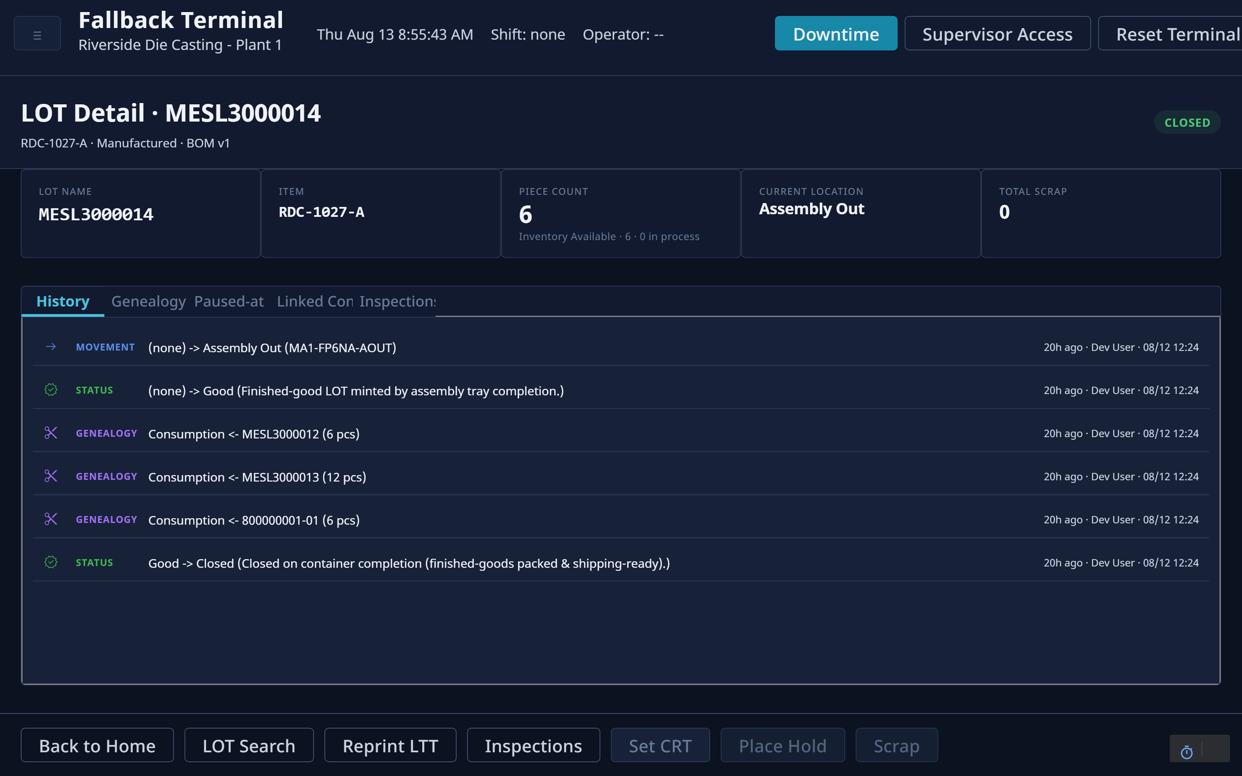
Full LOT traceability
Every LOT carries its complete production history, genealogy, as-built BOM, and quality record — one screen.
Notes:
This is a single finished-good LOT. One screen shows its whole life: every movement, status change, the components it consumed, its as-built BOM version, and its quality record. No paper, no spreadsheets.

Slide 4
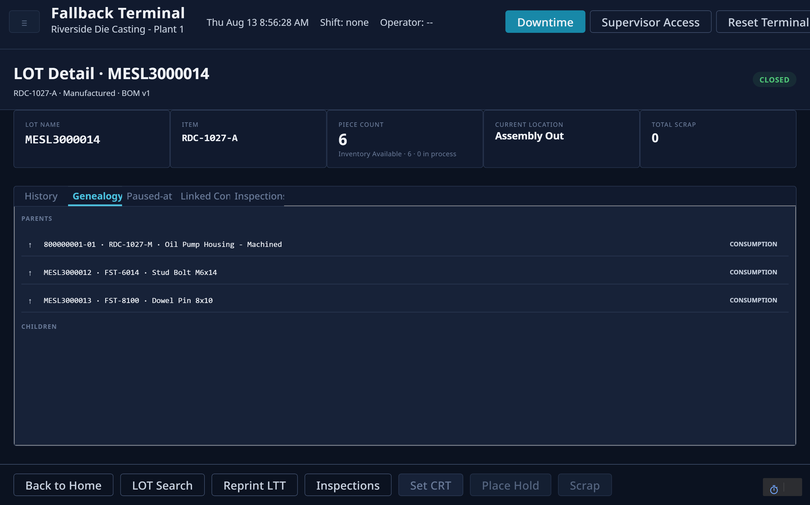
Genealogy — forward & backward lineage
Trace any finished good to the exact castings and components it consumed, and any lot forward to what it became.
Notes:
Genealogy works both directions: from a finished good down to the exact castings and components consumed, and from any raw lot forward to everything it became. This is what a full recall or containment investigation needs.

Slide 5
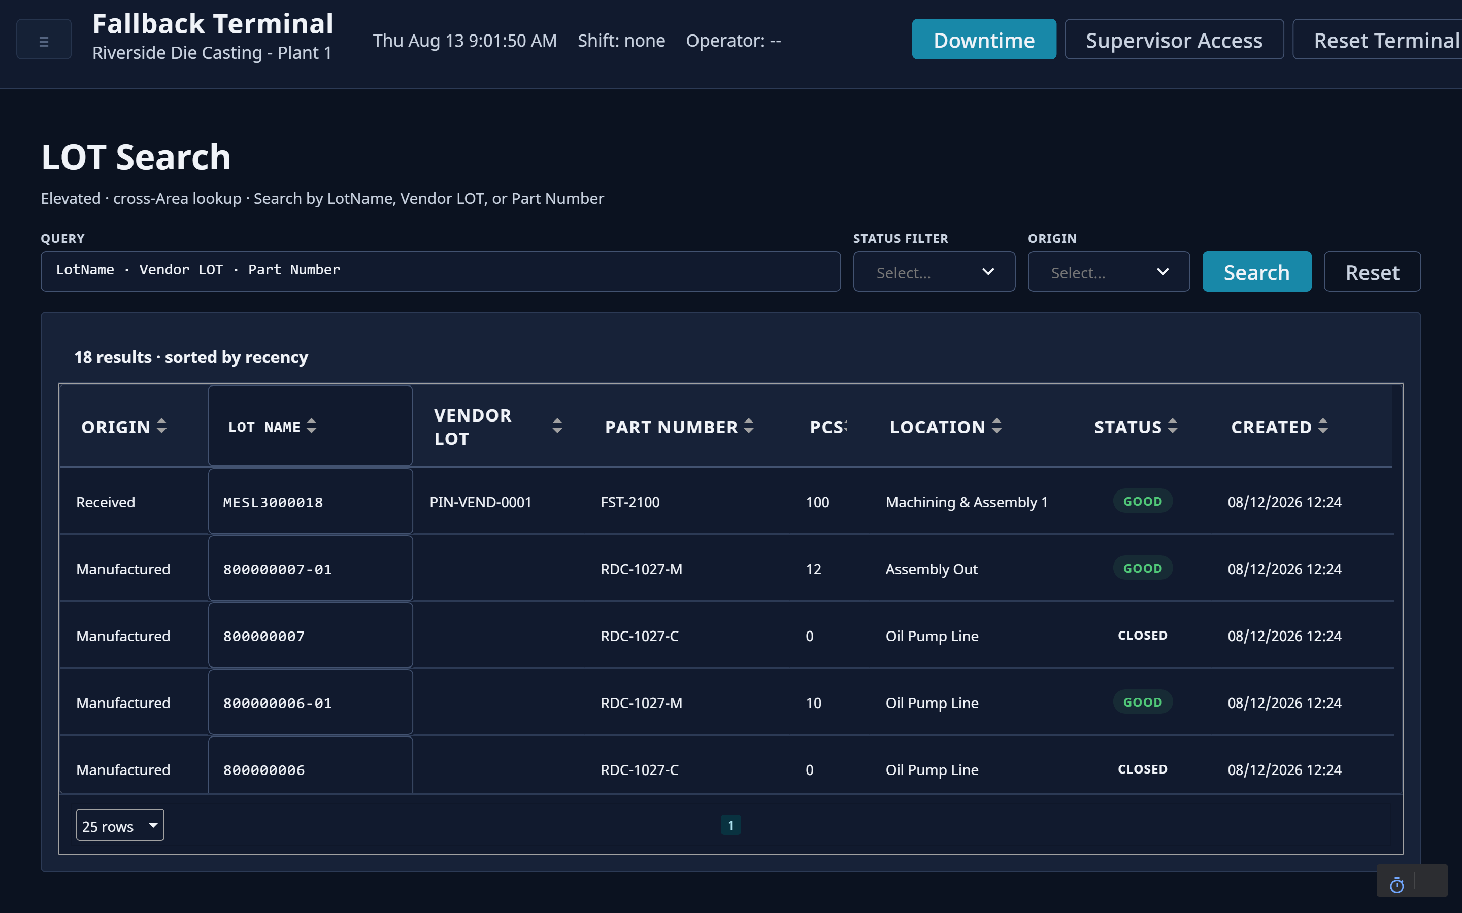
Find any part — live location & status
Search any LOT, vendor lot, or part number and see where every unit sits on the floor and its current state.
Notes:
Operators or quality find any lot instantly by lot number, vendor lot, or part number, and immediately see where every unit is on the floor and its current state.

Slide 6
Reporting
On-demand operational and traceability reporting, straight from the floor.
Notes:
Reporting section. Every report is on-demand from the floor and exports to PDF.

Slide 7
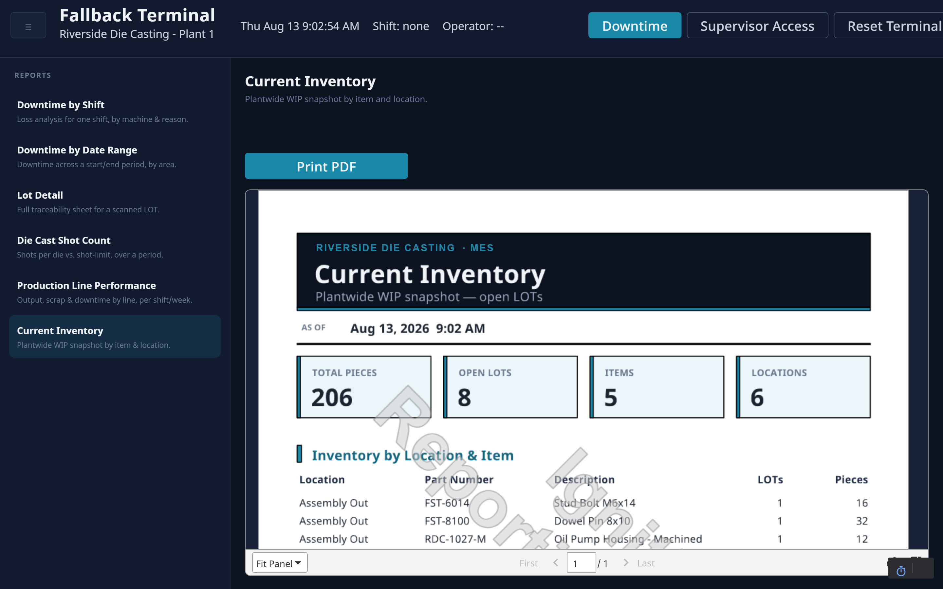
Plant-wide inventory, on demand
A live WIP snapshot by item and location — total pieces, open LOTs, and where everything is, as of this minute.
Notes:
Current inventory: a live plant-wide WIP snapshot by item and location. Total pieces, open lots, and exactly where everything sits, as of this minute.

Slide 8
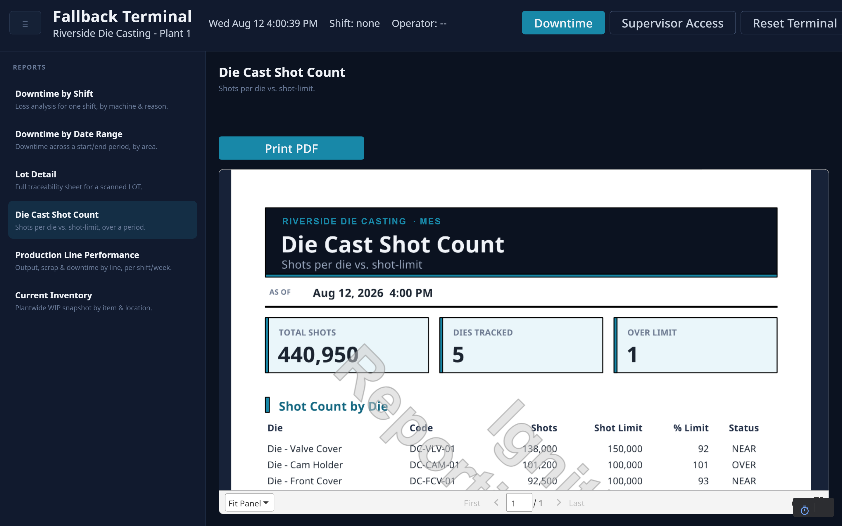
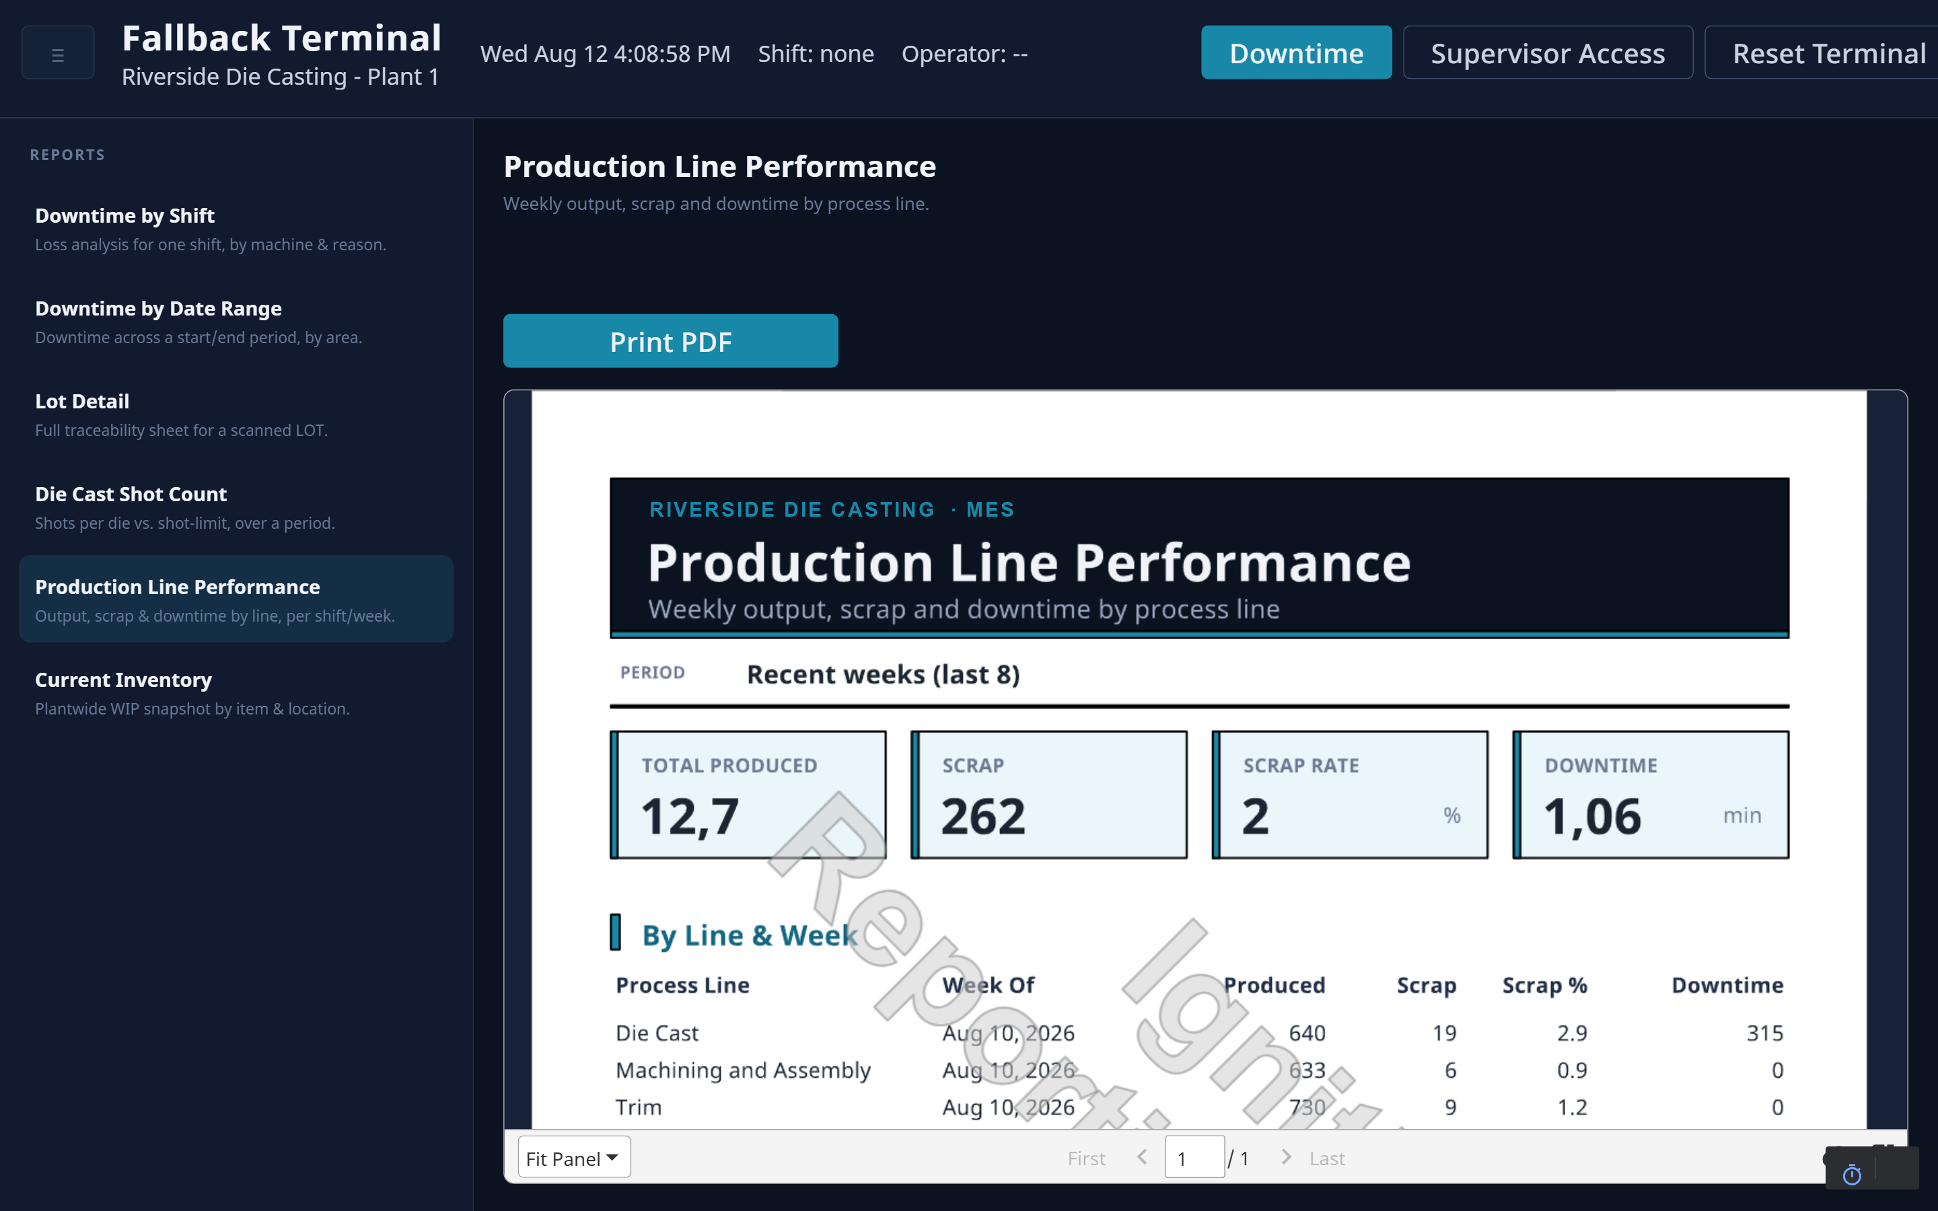
Operational reporting suite
Tooling life and line performance — shots per die vs. limit, and weekly output, scrap, and downtime by line.
Die Cast Shot Count — die life vs. limit
Production Line Performance — weekly by line
Notes:
Operational reports. Left: tooling life, shots per die against its limit with near/over-limit flags. Right: weekly production, scrap, and downtime by line for trend visibility.

Slide 9
Configuration
The entire system is operator-configurable — no code.
Notes:
Configuration section. The whole system is configured by engineers through the UI. No code, no vendor change orders.

Slide 10
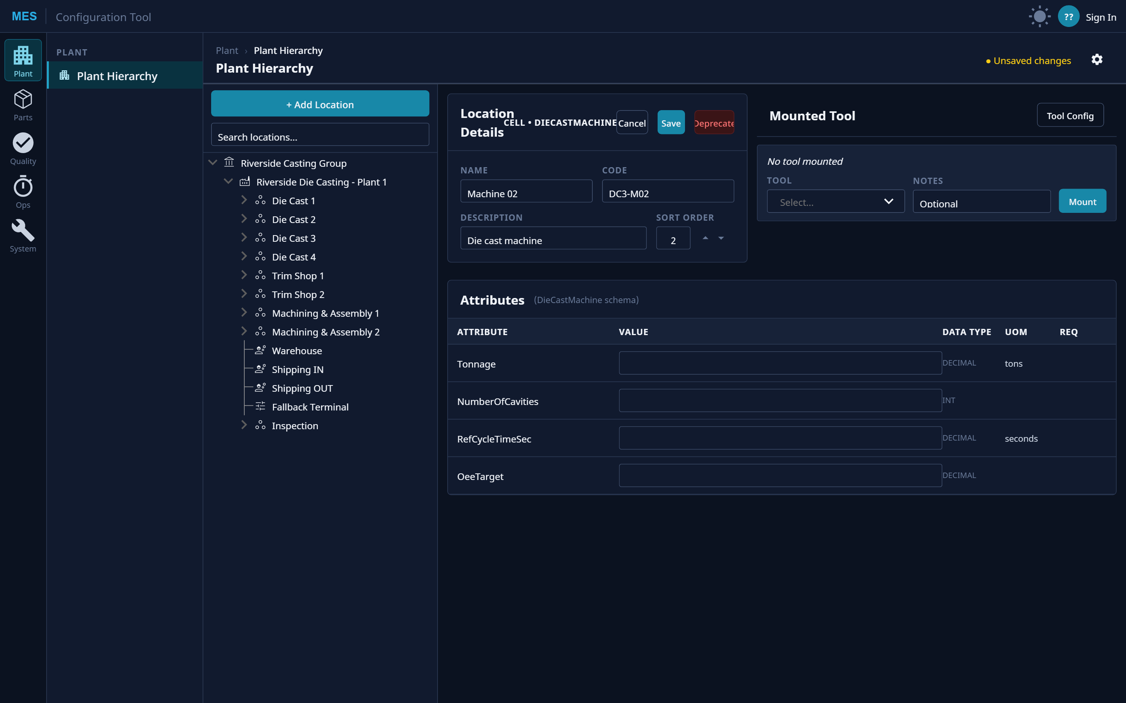
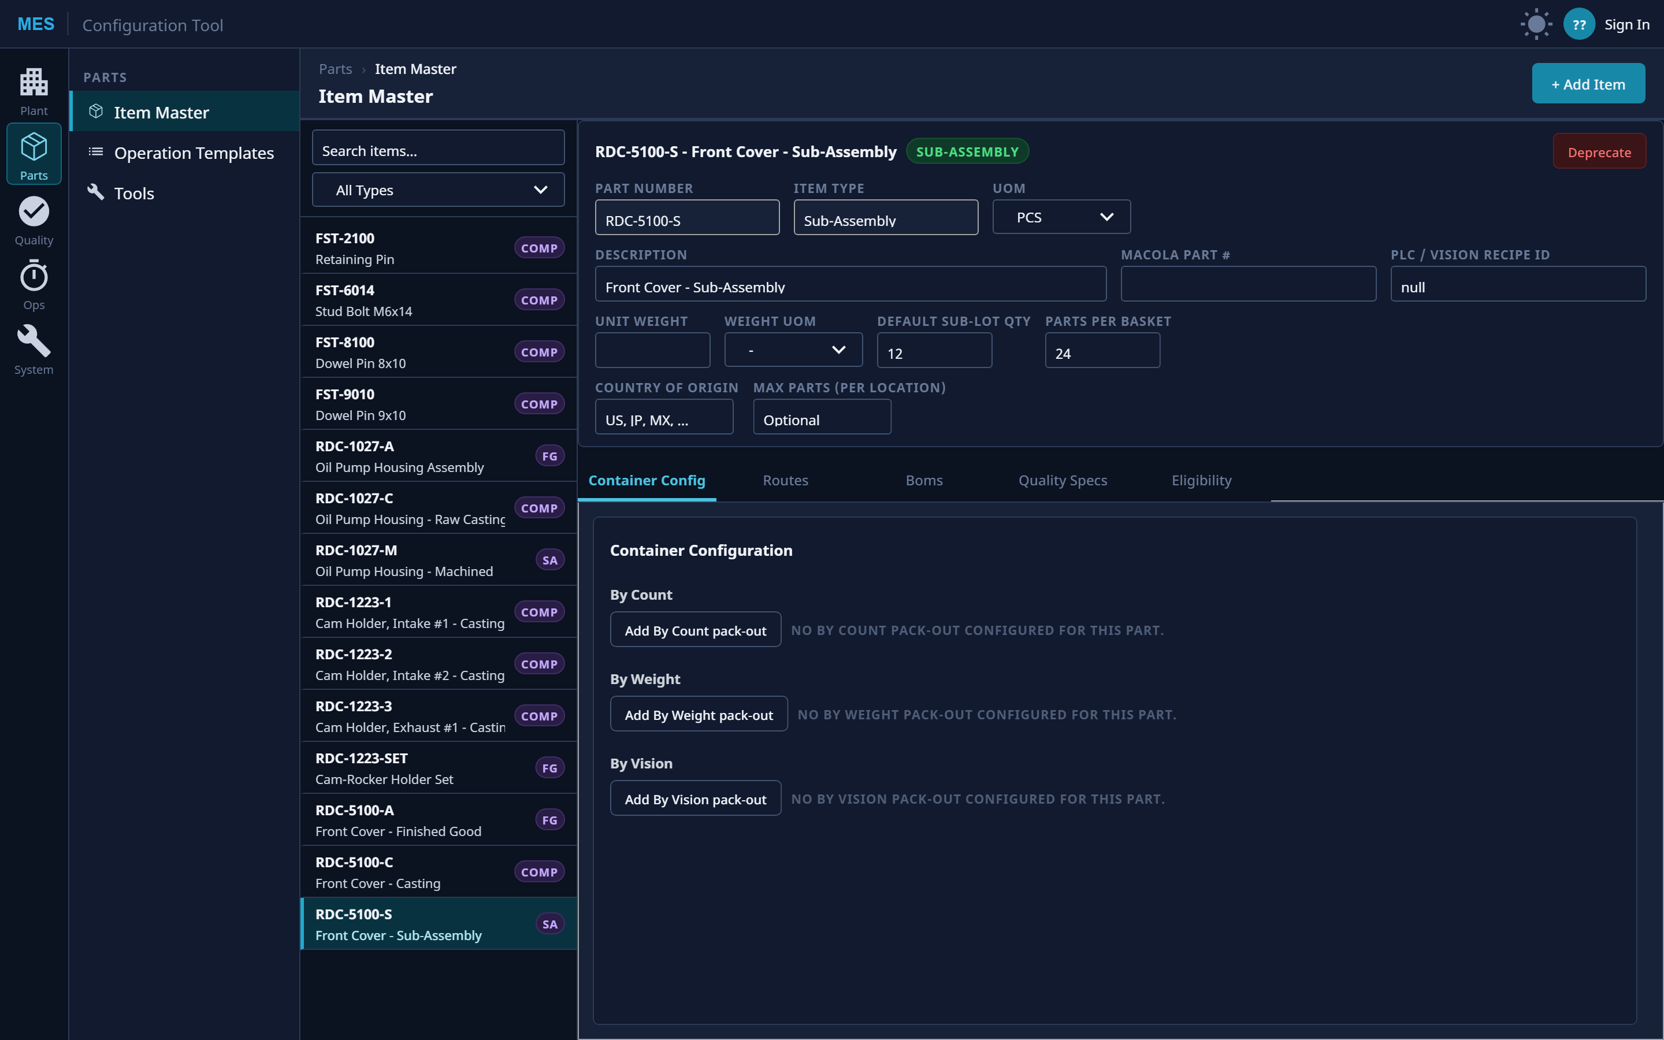
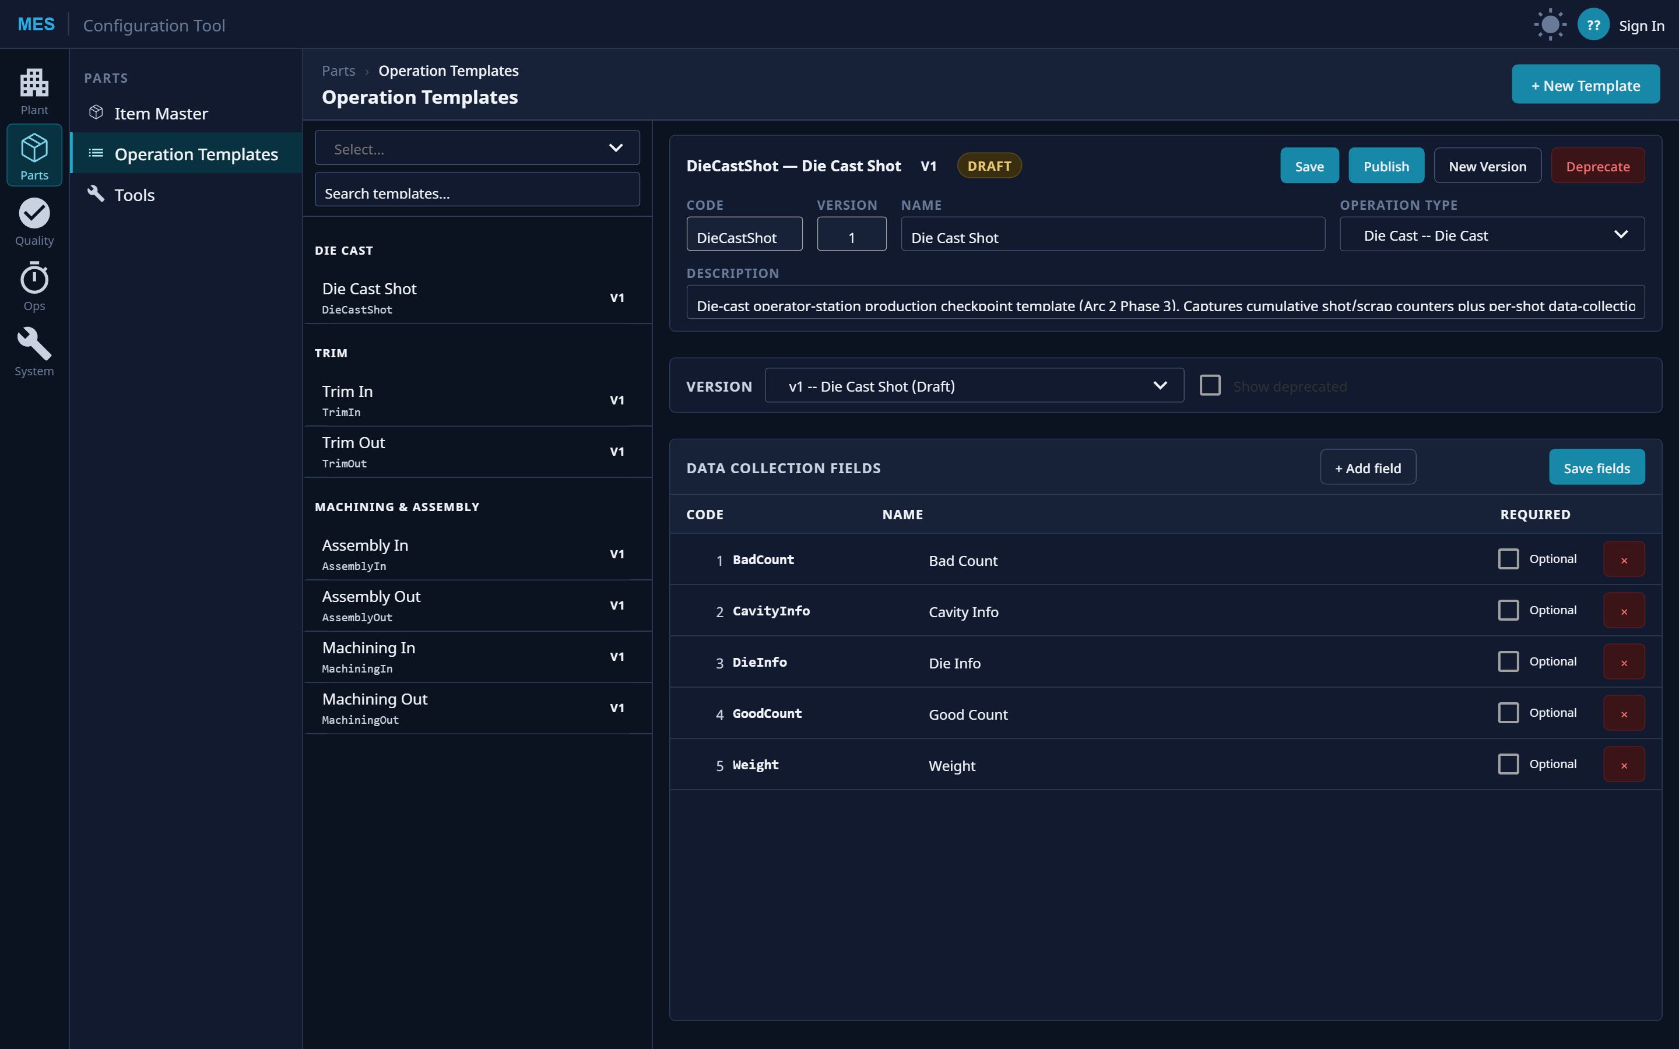
Configure the plant, parts, and processes
Model the plant hierarchy, define parts with routes / BOMs / container rules, and version every operation template.
Plant hierarchy (ISA-95)
Item master + routes / BOMs
Versioned operation templates
Notes:
Model the plant hierarchy in ISA-95 tiers, define every part with its routes, BOMs, and container rules, and version every operation template. This is why the system adapts to a new part or line without a project.

Slide 11
Built on a Data-Integrity Foundation
Architected to support the record-keeping and traceability requirements of regulated manufacturing.
Notes:
Compliance section. This matters most for regulated manufacturing. The point is not a certificate; it is that the data model is architected to support these requirements.

Slide 12
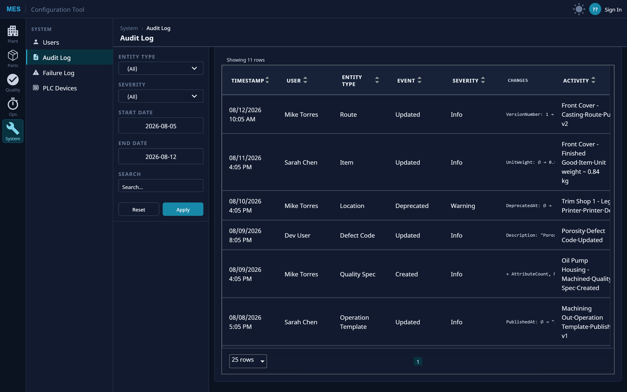
Every change, attributable and traceable
A complete, append-only audit trail — who changed what, when, with before / after values.
Append-only event log + full audit trail (who / what / when, before→after)
21 CFR Part 11 audit trail · ALCOA+
AD identity + audited per-action elevation (grant and deny recorded)
Part 11 electronic-signature-style authorization
No hard deletes — soft-delete + UTC-stamped, immutable records
Record protection & retention
Full lot genealogy + production history + as-built BOM
Device History Record traceability (ISO 13485 / 820)
Spec-driven quality + hold / nonconformance control
Nonconformance handling
Draft → Published → Deprecated version control on BOMs, routes, specs
Controlled specification revision control
Live configuration audit log — attribution, change diffs, severity.
Notes:
Every capability maps to a real requirement. Append-only audit trail with before/after values and attribution supports 21 CFR Part 11 and ALCOA+. AD-backed per-action elevation, recorded on grant and deny, is the electronic-signature-style control. No hard deletes, full genealogy, spec-driven quality, and Draft-Published-Deprecated version control round it out. On the right is the live audit log itself.

Slide 13
Track & Trace + Genealogy
Transforming Manufacturing Beyond Limits
Notes:
Close. To recap: complete genealogy, live floor visibility, instant reporting, full configurability, and a compliance-ready record foundation. Happy to go deeper on any screen.

