Slide 1
Die Cast Terminal Training
For operators and team leads - September 2026
Notes:
Welcome. Today we learn the die cast screen at the press. It keeps track of every basket we make. Part 1 is for everyone. Part 2 is for team leads.

Slide 2
WHY WE DO THIS
The ticket follows the parts
1
Every basket gets a ticket with a barcode.
2
You scan that ticket into the screen when the basket starts.
3
Honda can ask where one part came from. The ticket is how we answer.
Notes:
We are a Honda supplier. They can ask us to trace one part back to the press, the die and the shift that made it. The old paper sheets did this job. The screen does it now. A basket with no ticket scanned is a gap we cannot fill later.

Slide 3
BEFORE WE START
Words you will see
Die
Press counter
The mold in the press.
The shot number on the press.
Cavity
Shift
One spot in the die. Each one makes a part.
Your work time, such as Second Shift.
Basket
Scrap
The bin the parts drop into.
Parts we cannot use.
Ticket (LTT)
Reconcile
The barcode tag on the basket.
Settle up the numbers at the end of the shift.
Notes:
Point at a real die and a real basket while you go through these. Most people know the things, not the words on the screen.

Slide 4
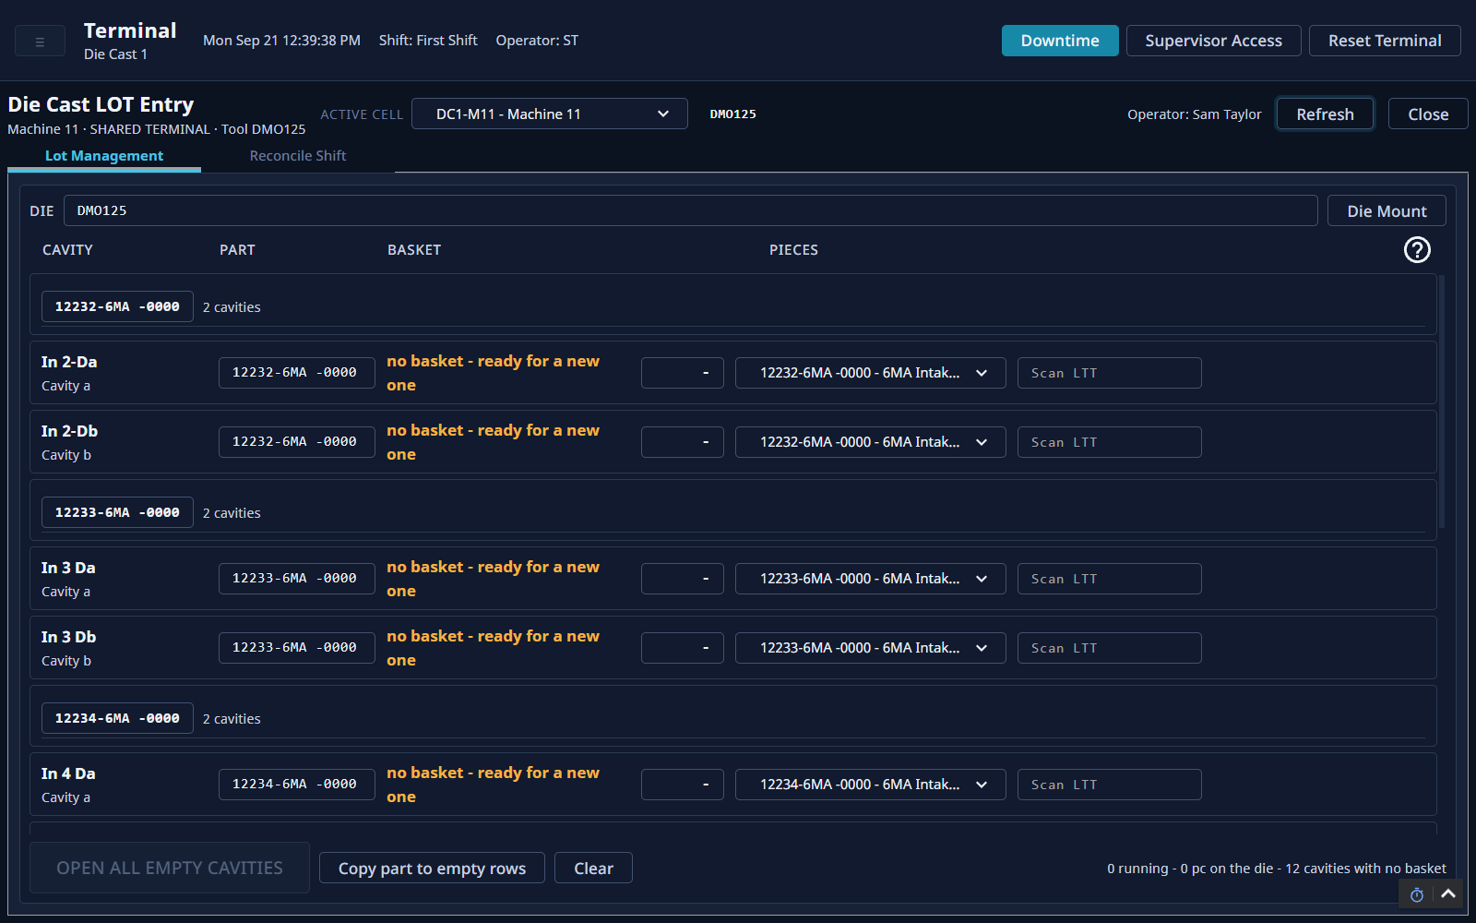
SCREEN TOUR
The Lot Management screen
A
Top bar: shift, who is signed in, Downtime
A
B
Your machine
C
B
D
C
The two tabs
E
D
The die in this machine
E
One row for each cavity
F
Open many baskets at once
F
Notes:
This is the screen you use most. Each row is one cavity of the die. Rows are grouped by the part they make. Orange words mean the cavity has no basket yet.

Slide 5
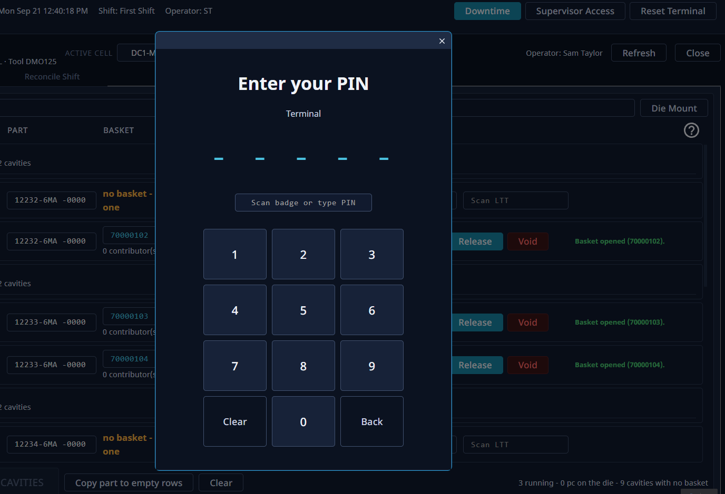
START OF SHIFT
Sign in with your PIN
1
No number pad? Tap your name here.
1
3
2
Type your five-digit PIN.
3
Check the number shows here.
2
Does your PIN start with 0? Type the 0. It counts.
Notes:
The PIN tells the screen who is working. It is not a password. Everything you do is saved under your name until someone else signs in.

Slide 6
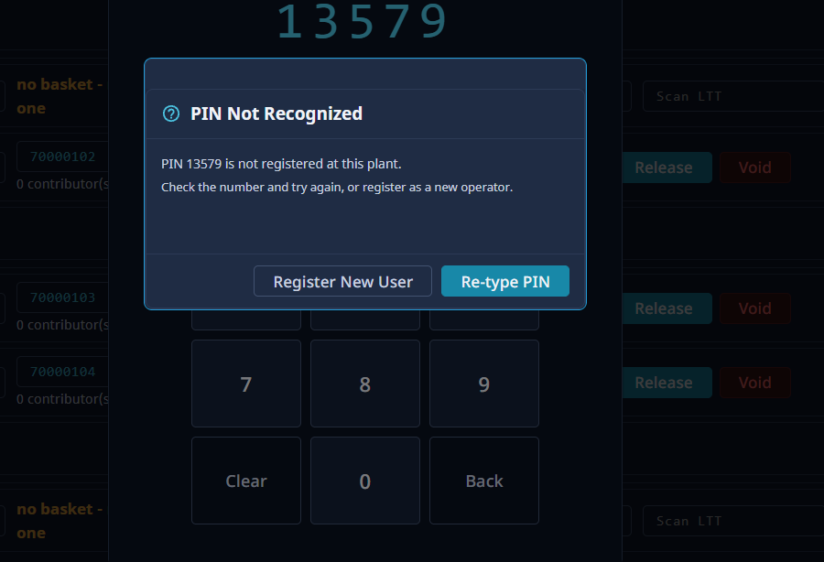
START OF SHIFT
PIN not recognized
1
Most of the time it is a typo. Tap Re-type PIN.
2
New here? Tap Register New User. Add your initials and name.
2
1
Notes:
Re-type is the big button on purpose. One wrong digit would make a second copy of you. Only register if you are new, or you were given a new PIN.

Slide 7
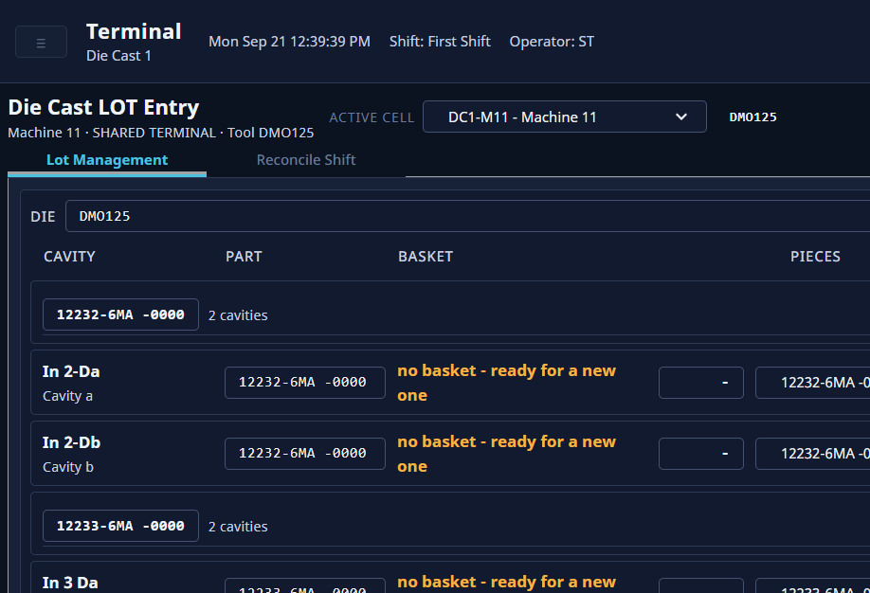
START OF SHIFT
Pick your machine and check the die
1
Tap the machine box. Pick your machine.
2
1
2
Check the die name. It must match the die in the press.
Wrong die on the screen? Stop and call your team lead.
Notes:
One terminal can run more than one machine. The screen remembers the last machine used, so always check it. If the die is wrong, every basket goes against the wrong die.

Slide 8
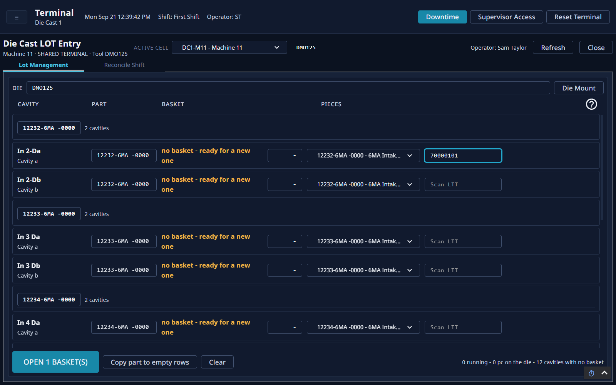
BASKETS
Open a basket
1
Find the cavity that says no basket.
2
Tap Scan LTT. Scan the ticket on the basket.
1
2
3
Tap Open 1 basket(s).
Scanning alone does not open it. You must tap the button.
3
Notes:
After the tap, the row shows the ticket number, and a green line says Basket opened. Scanned the wrong ticket? Tap Clear to empty the boxes and start again.

Slide 9
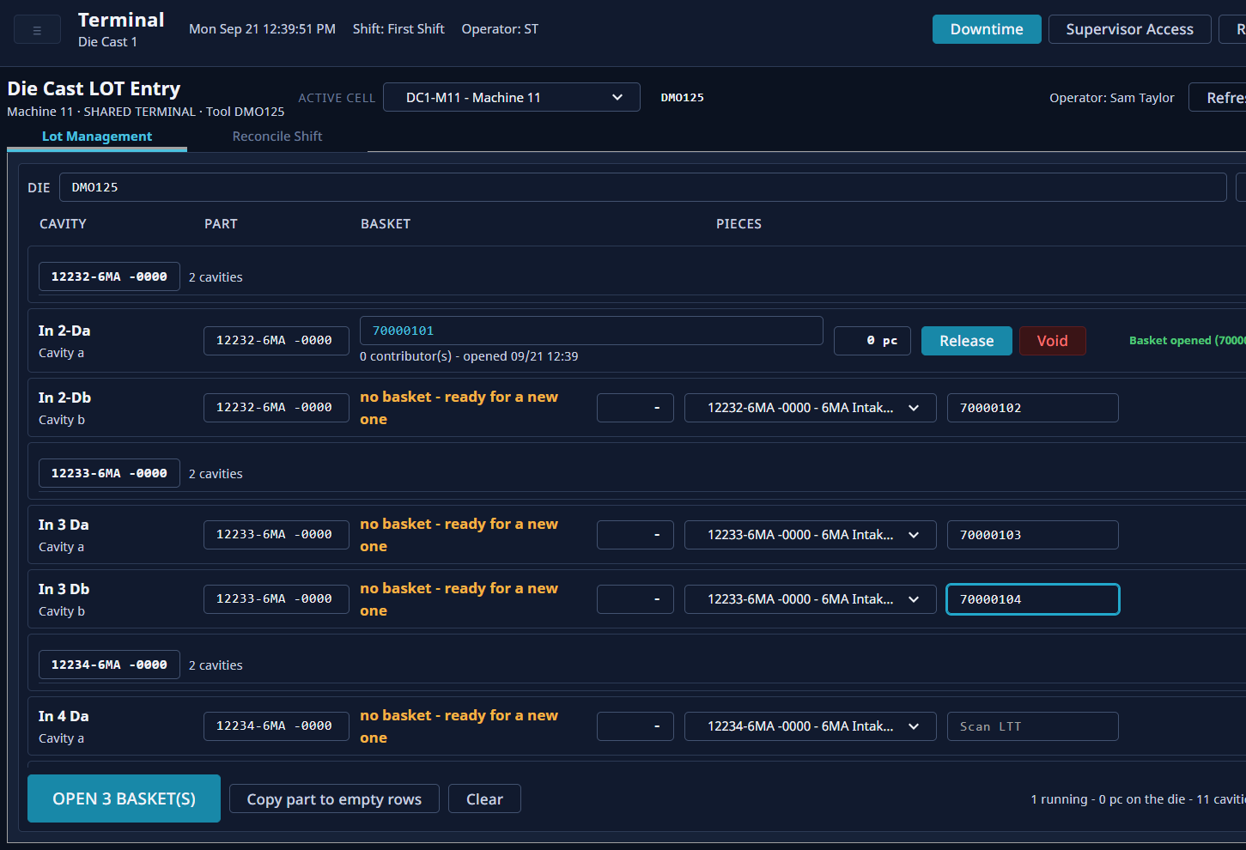
CHANGEOVER
Start many baskets at once
1
Scan a ticket into each empty row.
2
Tap the Open button. It counts your scans.
1
2
Notes:
Use this after a die change, when every cavity is empty. Scan every ticket first. Then open them all with one tap.

Slide 10
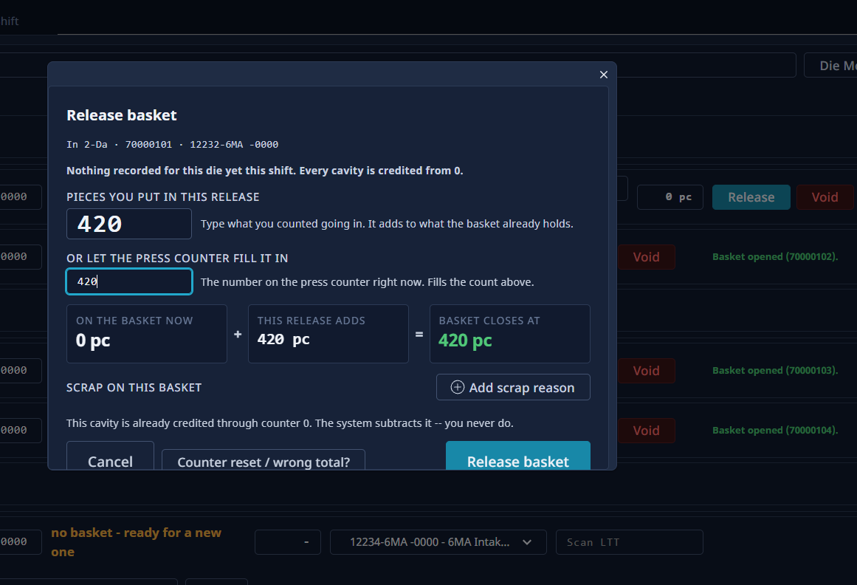
BASKETS
Release a full basket
1
Tap Release on the full basket.
2
Type the number on the press counter.
1
3
Check the three boxes. They add up for you.
2
3
4
Scrap in this basket? Tap Add scrap reason.
4
Notes:
The counter number fills in the piece count by itself. You never subtract anything. The screen does it. Did you swap the basket earlier? Use the number you wrote down then, not the number now. If your line counts pieces, type the count in the top box instead.

Slide 11
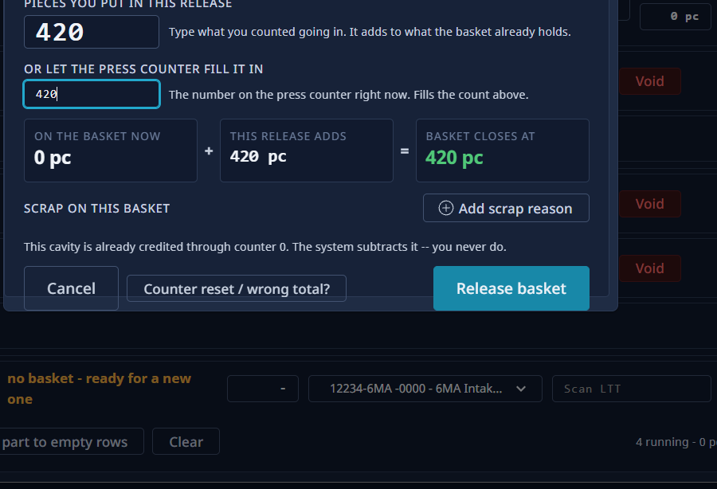
BASKETS
Release a full basket (continued)
1
Scroll down in the box. Tap Release basket.
2
Counter was reset? Tap Counter reset / wrong total? here.
2
1
Notes:
The buttons are at the bottom of the box, so scroll down to reach them. If you type no number, the screen warns you. The basket then closes at the count it already has.

Slide 12
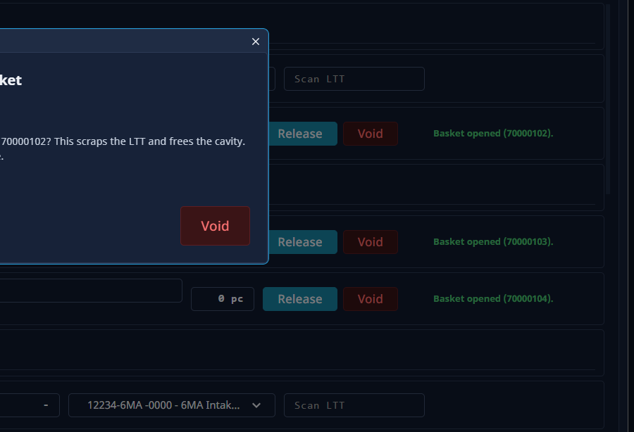
BASKETS
Void an empty basket
1
Tap Void on the basket.
2
Check the ticket number. Tap Void to confirm.
1
Only for a basket with nothing in it. It cannot be undone.
2
Notes:
Use this when a ticket was opened by mistake and no parts went in. The ticket is scrapped and the cavity is free again.

Slide 13
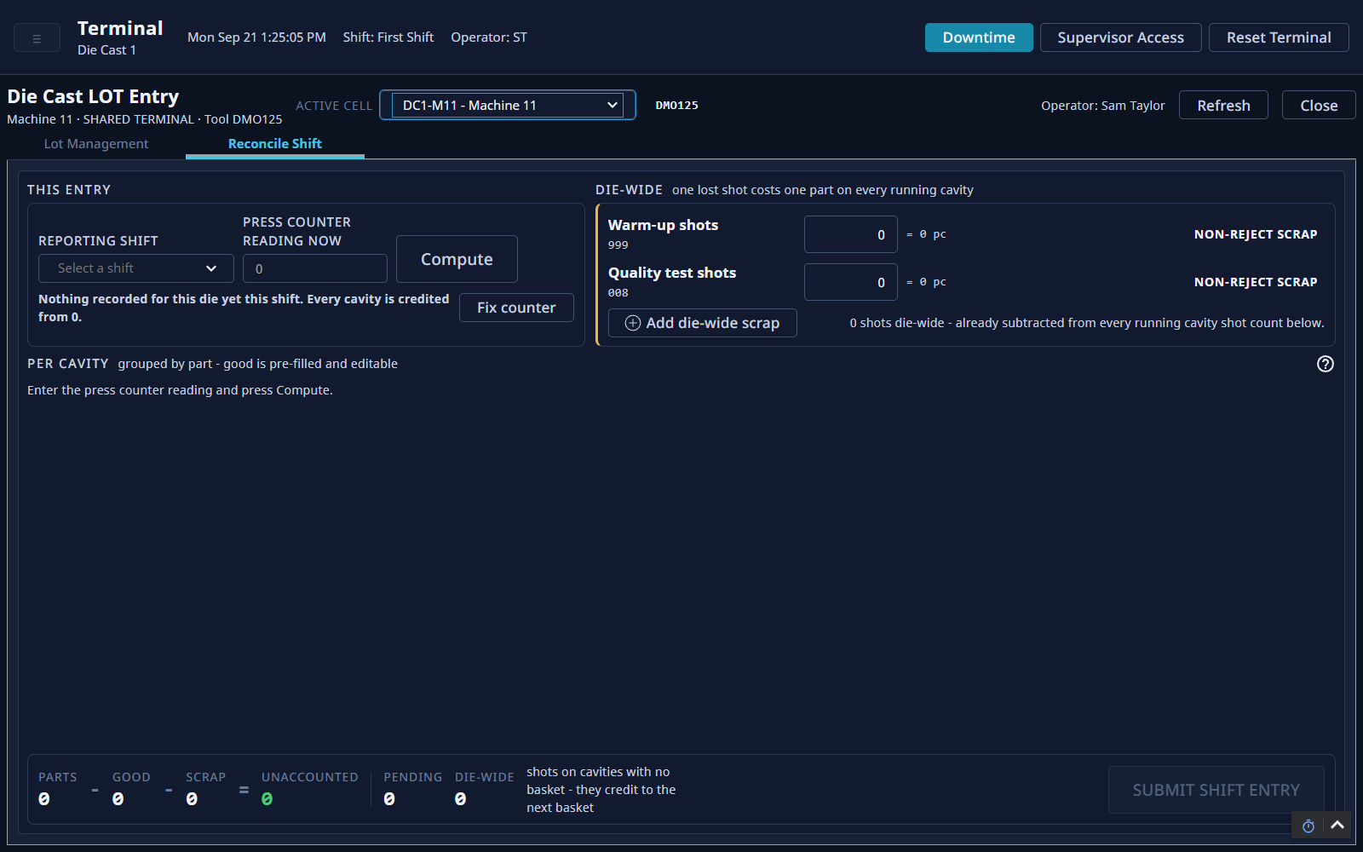
SCREEN TOUR
The Reconcile Shift screen
A
Your shift and the press counter
B
Shots lost on the whole die
A
B
C
Each cavity, after Compute
C
D
The totals, and the button to send
D
Notes:
Do this at the end of your shift, before you hand over. It settles the numbers for your die.

Slide 14
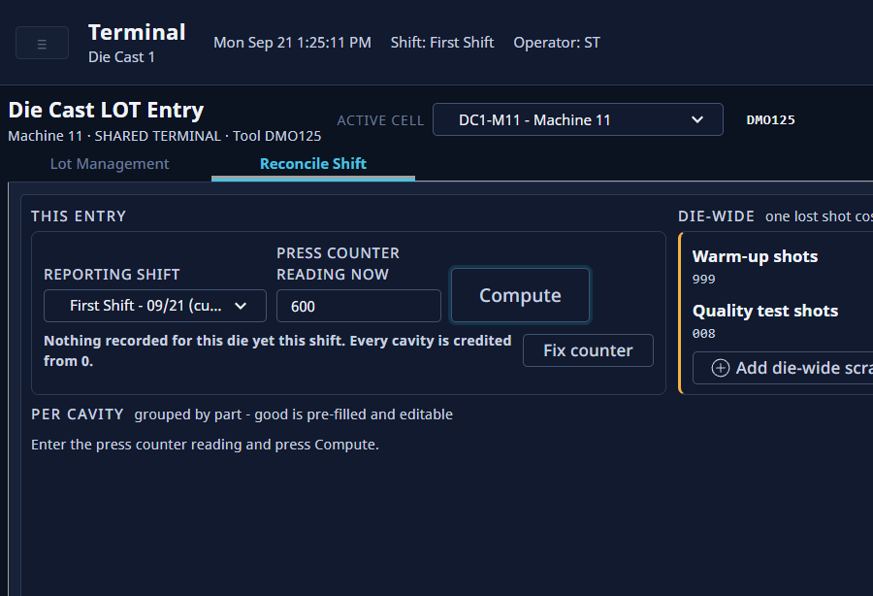
END OF SHIFT
Start the shift entry
1
Pick your shift.
2
Type the number on the press counter.
3
Tap Compute.
2
1
3
Shift just ended? The list shows the last three shifts.
Notes:
The list shows the current shift and the two before it, so you can still enter a shift that just ended. Compute fills in the table below.

Slide 15
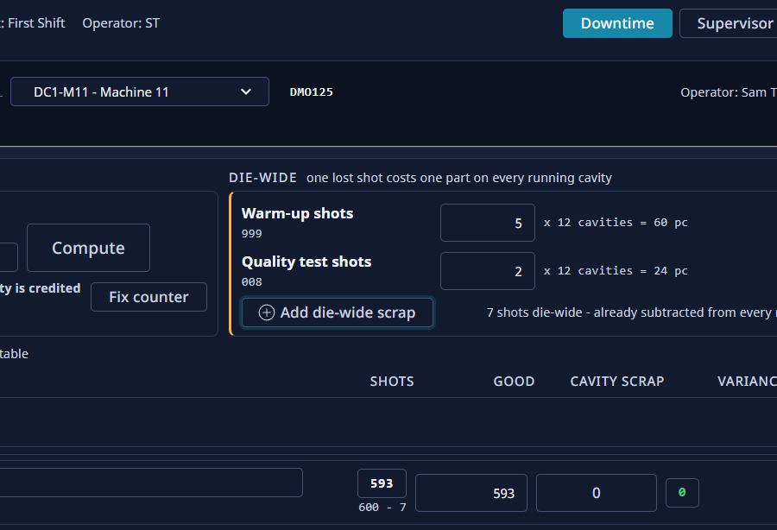
END OF SHIFT
Warm-up and test shots
1
Type the warm-up shots.
2
Type the quality test shots.
1
3
Other shots lost on the whole die? Tap Add die-wide scrap.
2
3
Type shots, not pieces. The screen does the math.
Notes:
One lost shot costs one part on every cavity. So type the number of shots. The screen multiplies by the cavities for you.

Slide 16
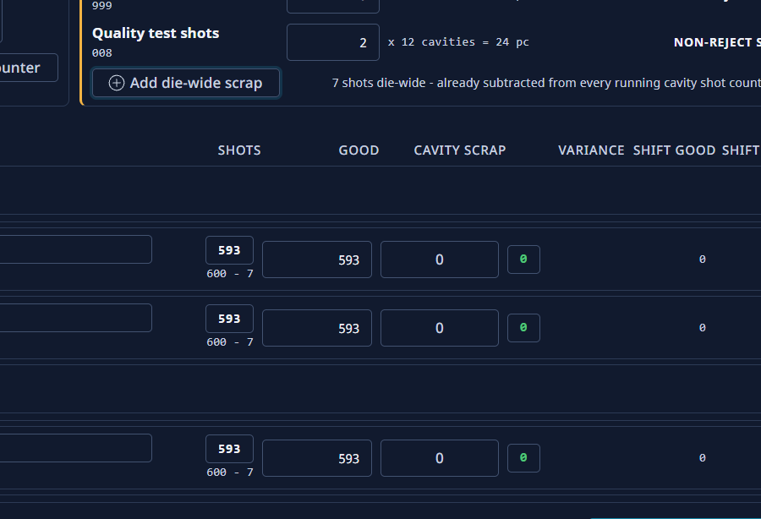
END OF SHIFT
Check Good on each cavity
1
Check the Good number. Change it if your count is different.
2
Scrap on this cavity? Tap the number under Cavity scrap.
1
2
Notes:
Good starts from the press counter, minus scrap. Once you type your own number, it stays. Lines that count baskets type a number here. Lines that read the counter can leave it.

Slide 17
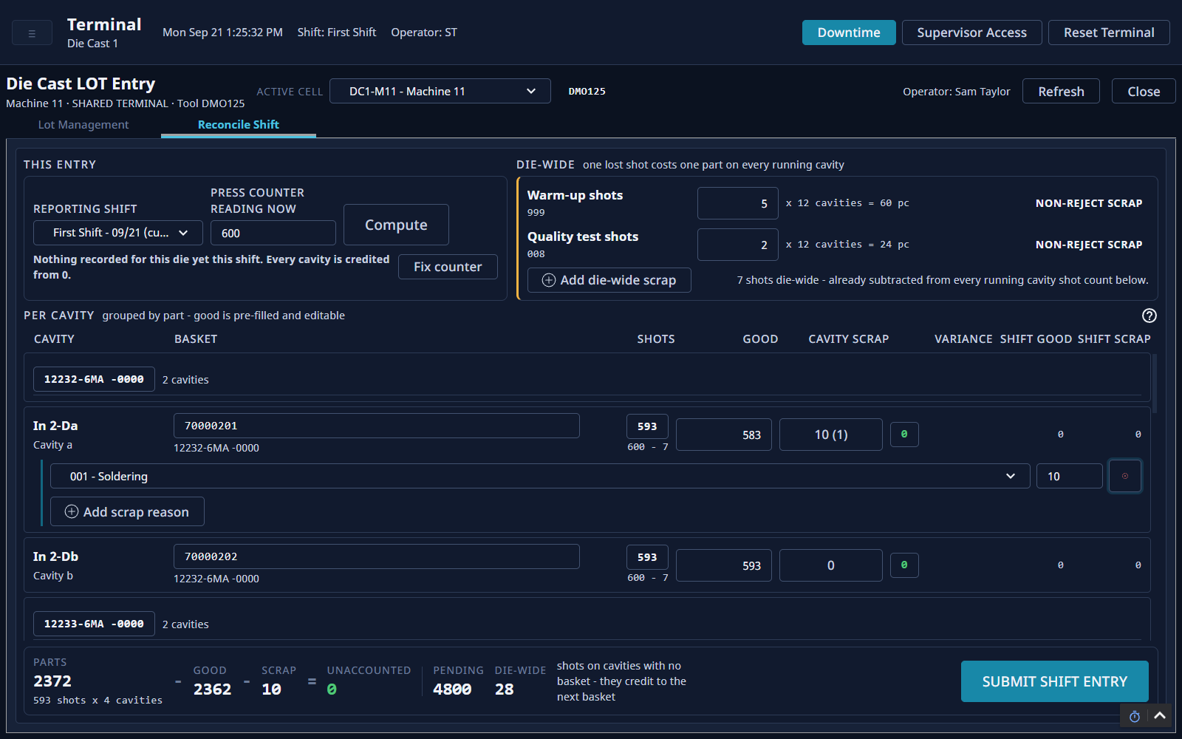
END OF SHIFT
Add scrap on a cavity
1
Pick the scrap reason.
2
Type how many.
3
More than one reason? Tap Add scrap reason.
1
2
3
Notes:
The scrap button shows the total. The number in brackets is how many reasons you added.

Slide 18
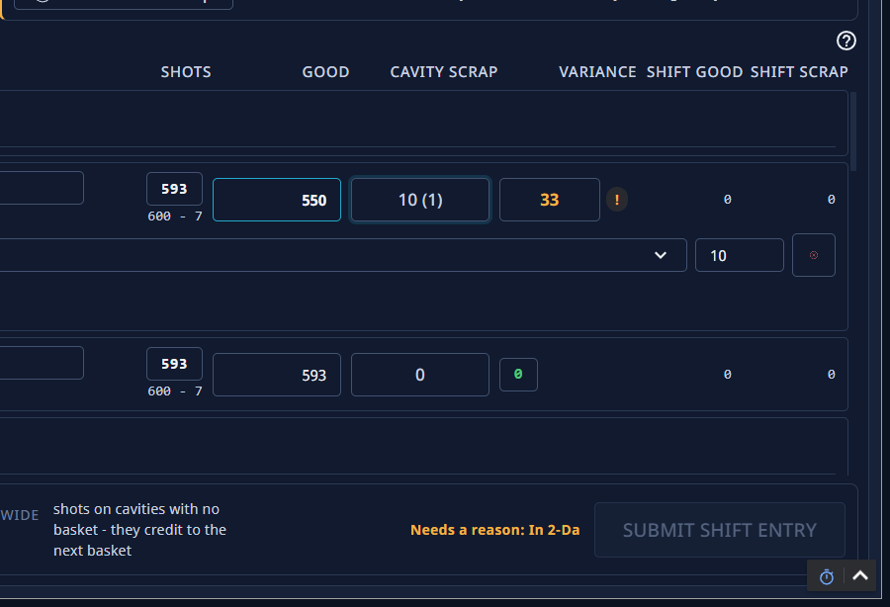
END OF SHIFT
An amber number needs a reason
1
This cavity does not add up. The number turns amber.
2
The screen names the cavity that needs a reason.
1
3
Submit shift entry stays grey until each amber number has a reason.
3
2
Notes:
Amber means shots, good and scrap do not add up. That is not an error. It just needs a reason.

Slide 19
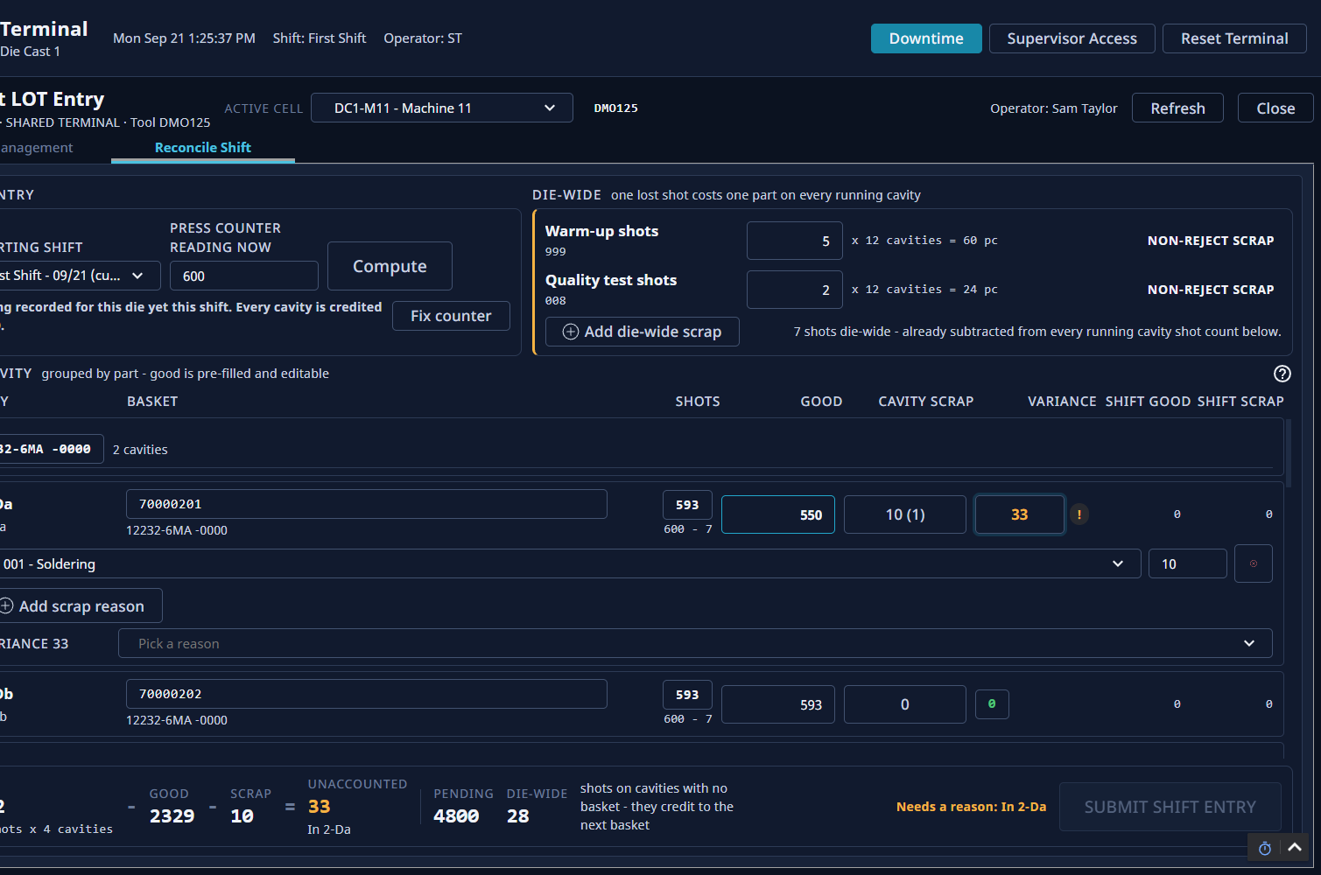
END OF SHIFT
Give a reason, then send
1
Tap the amber number.
2
Pick a reason. Not sure? Pick Unknown and add a short note.
3
Tap Submit shift entry.
1
Unknown is an honest answer. Do not guess a defect.
2
3
Notes:
Some reasons ask for a note. A short note, like found the cavity empty at 2:40, helps a lot later. Once you send it, the entry cannot be changed at the terminal. If you made a mistake, call your team lead.

Slide 20
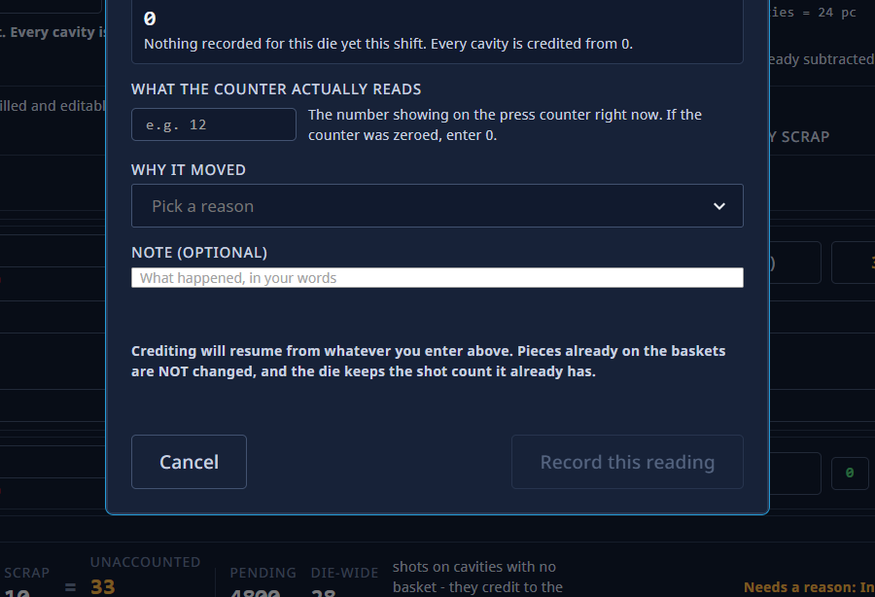
WHEN IT LOOKS WRONG
The counter was reset
1
Tap Fix counter. Type what the counter shows now.
1
Pick why it moved.
2
2
3
Add a short note if you can.
3
4
Tap Record this reading.
4
Counter was set to zero? Type 0.
Notes:
Use this when the counter was zeroed, or a wrong number went in earlier. Pieces already in the baskets do not change.

Slide 21
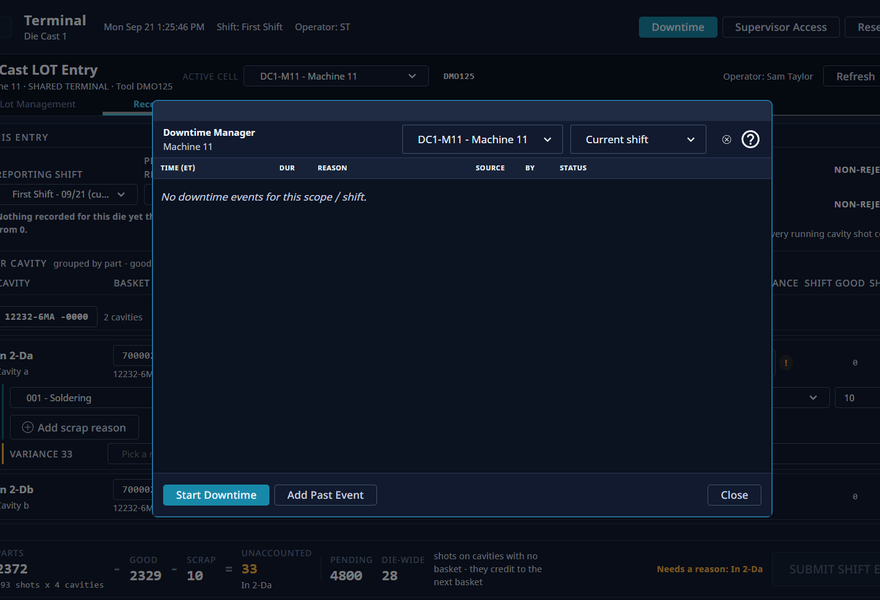
WHEN IT LOOKS WRONG
When the machine stops
1
1
Tap Downtime.
2
2
Check the machine and the shift.
3
Machine down now? Tap Start Downtime.
4
Forgot to log a stop? Tap Add Past Event.
3
4
Notes:
Every stop needs a reason. The list shows the stops for this shift. Log them as soon as you can.

Slide 22
END OF SHIFT
Hand over to the next operator
1
The next operator taps the name here.
1
2
They type their own PIN.
2
Notes:
Never keep working under someone else's PIN. The screen saves every basket under the person signed in.

Slide 23
KEEP THIS ONE
Quick reference
Every basket
End of shift
When it looks wrong
Scan the ticket into the empty row.
Press Open 1 basket(s).
When the basket is full, press Release.
Type the press counter number.
Press Release basket.
Open Reconcile Shift.
Pick your shift.
Type the press counter number.
Press Compute.
Add warm-up and test shots.
Add scrap on each cavity.
Give a reason for every amber number.
Press Submit shift entry.
Counter was reset? Press Fix counter.
Machine stopped? Press Downtime.
Die is wrong on screen? Call your team lead.
Already sent the shift entry? Call your team lead.
Notes:
Print this one slide and keep it at the press. It is the whole day on one page.

Slide 24
Part 2
For team leads
Notes:
Operators can stay for this part, but these jobs need a team lead sign-in.

Slide 25
TEAM LEAD
Supervisor Access
1
Some jobs need a team lead to sign in with their own account.
2
The sign-in lasts five minutes.
3
While it lasts, everything done here is saved under your name.
Screen pictures and step-by-step for this job come in the next version of this deck.
Notes:
Your sign-in covers the protected job you are doing. After five minutes it ends by itself.

Slide 26
TEAM LEAD
Die Mount
1
Use it when a die is changed on a press.
2
The screen must always show the die that is really in the press.
Screen pictures and step-by-step for this job come in the next version of this deck.
Notes:
If the screen shows the wrong die, every basket is saved against the wrong die.

Slide 27
TEAM LEAD
Reset Terminal
1
Use it when the screen is stuck or shows the wrong place.
Screen pictures and step-by-step for this job come in the next version of this deck.
Notes:
The steps, and when not to use it, are added with the screen pictures.

Slide 28
TEAM LEAD
The Die Cast Production screen
1
Shows good parts for this shift and the last shift.
2
Pick one area, or leave it on all of die cast.
3
One row for each press, with its die and part.
Screen pictures and step-by-step for this job come in the next version of this deck.
Notes:
This screen only reads numbers. It never changes anything. Good parts come from the shift entries operators send.

Slide 29
TEAM LEAD
Every shift
Start of shift
During the shift
End of shift
Check each press shows the right die.
Check the presses that are running have baskets open.
Fix a wrong die with Die Mount.
Watch the Die Cast Production screen.
Help with any amber number nobody can explain.
Check downtime has a reason on it.
Check every press sent its shift entry.
Compare this shift with the last one.
Pass on anything odd to the next team lead.
Notes:
A shift entry that was never sent is the one to catch. The numbers cannot be fixed at the terminal afterwards.

