Slide 1
MPP Manufacturing Execution System
Screenshots - September 2026

Slide 2
Plant model
Configuration

Slide 3
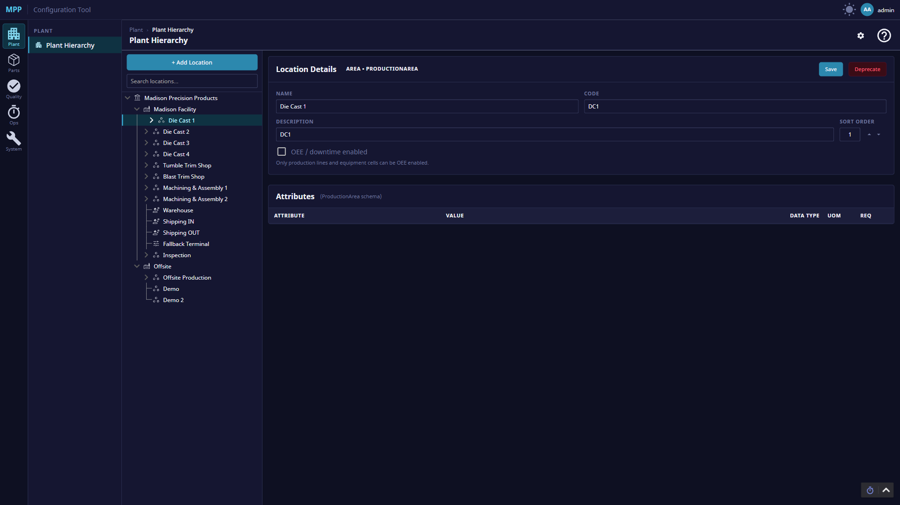
Notes:
Configuration: Plant model - Plant hierarchy

Slide 4
Parts
Configuration

Slide 5
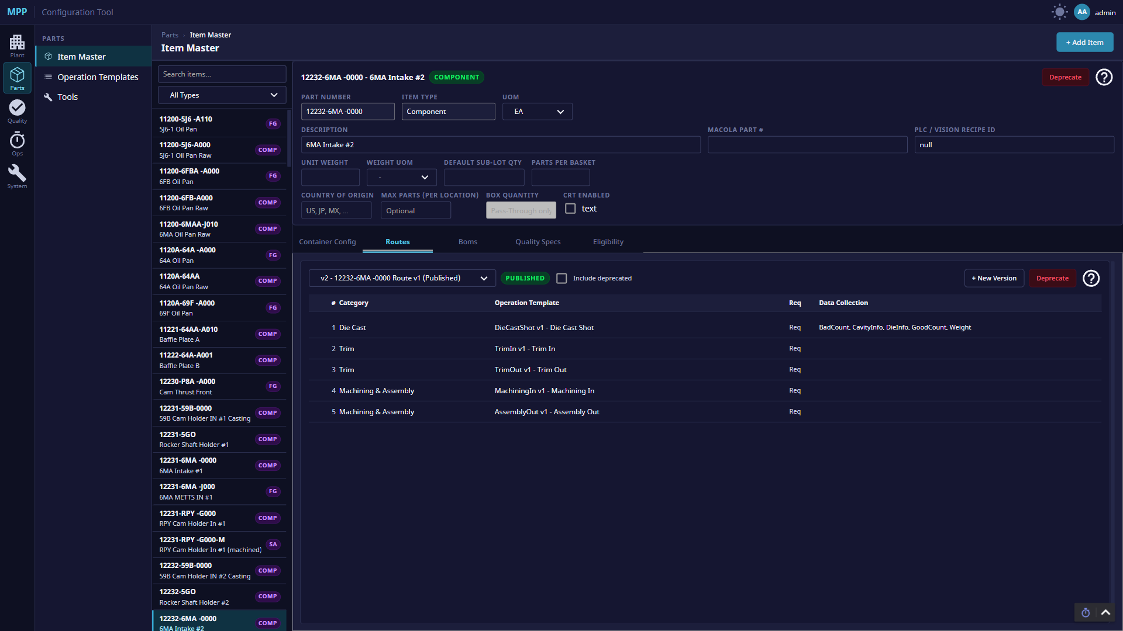
Notes:
Configuration: Parts - Item Master - routing

Slide 6
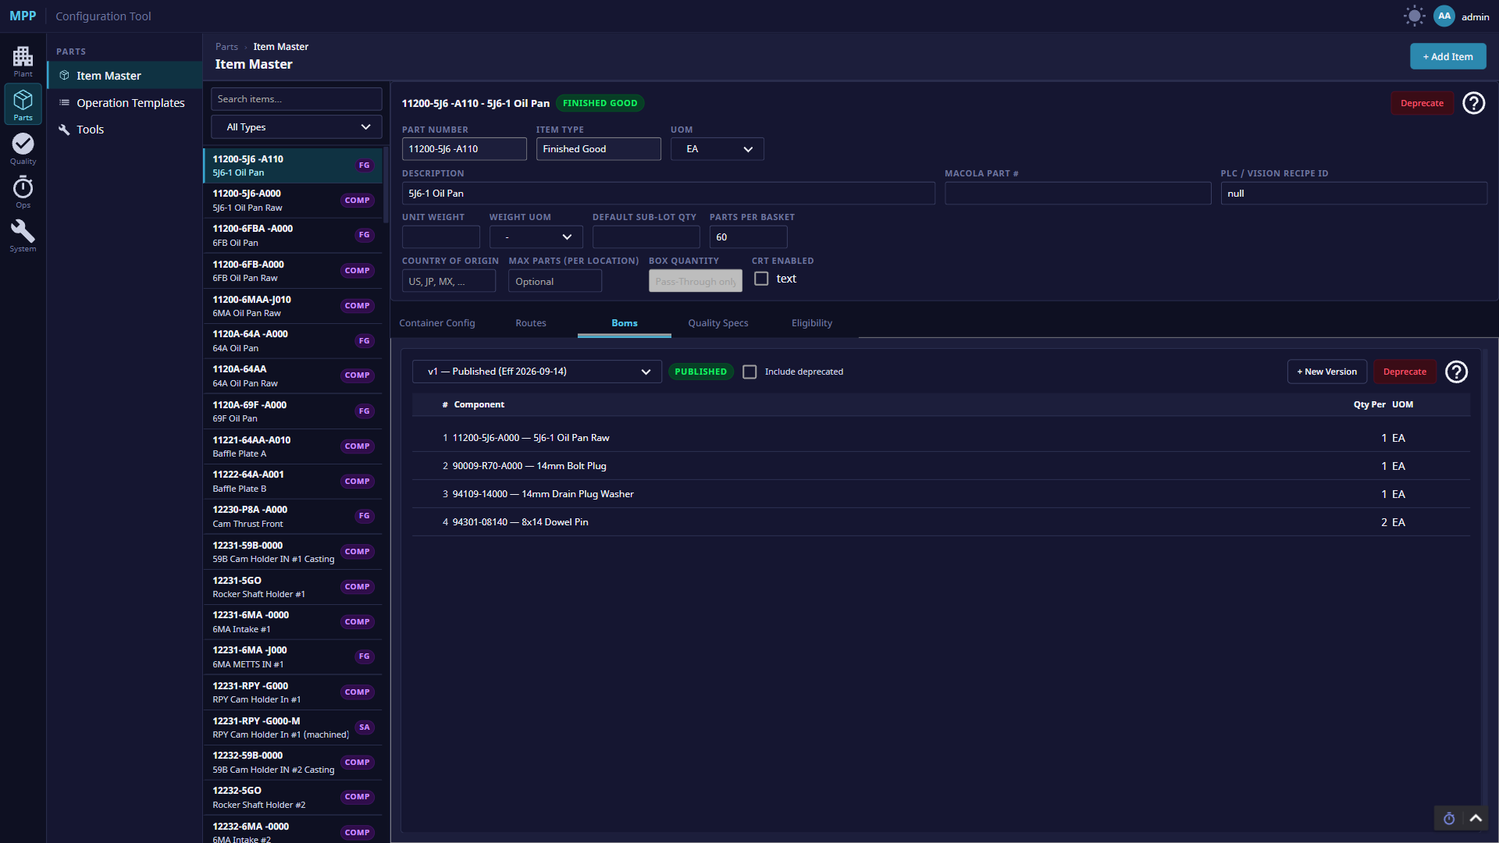
Notes:
Configuration: Parts - Item Master - bill of materials

Slide 7
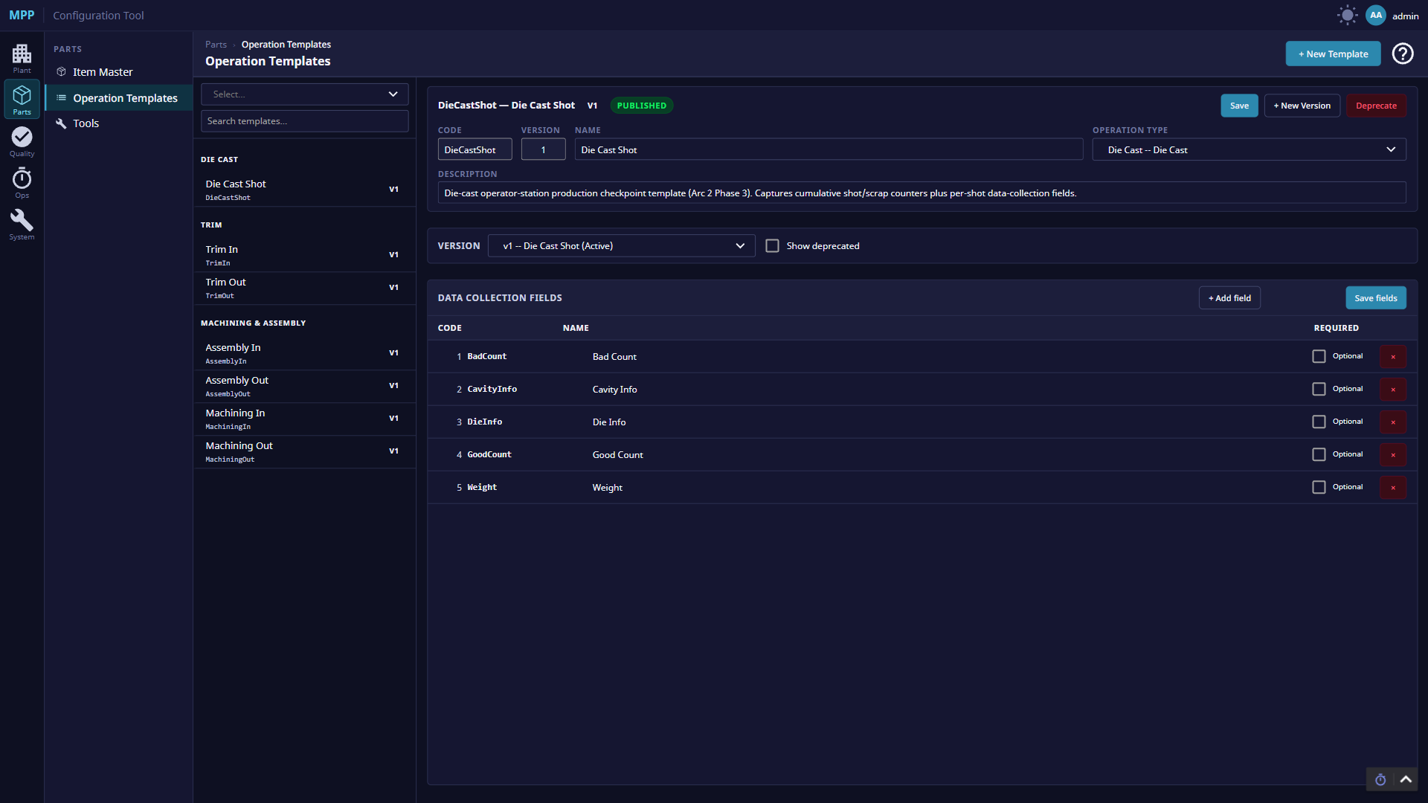
Notes:
Configuration: Parts - Operation templates

Slide 8
Dies
Configuration

Slide 9
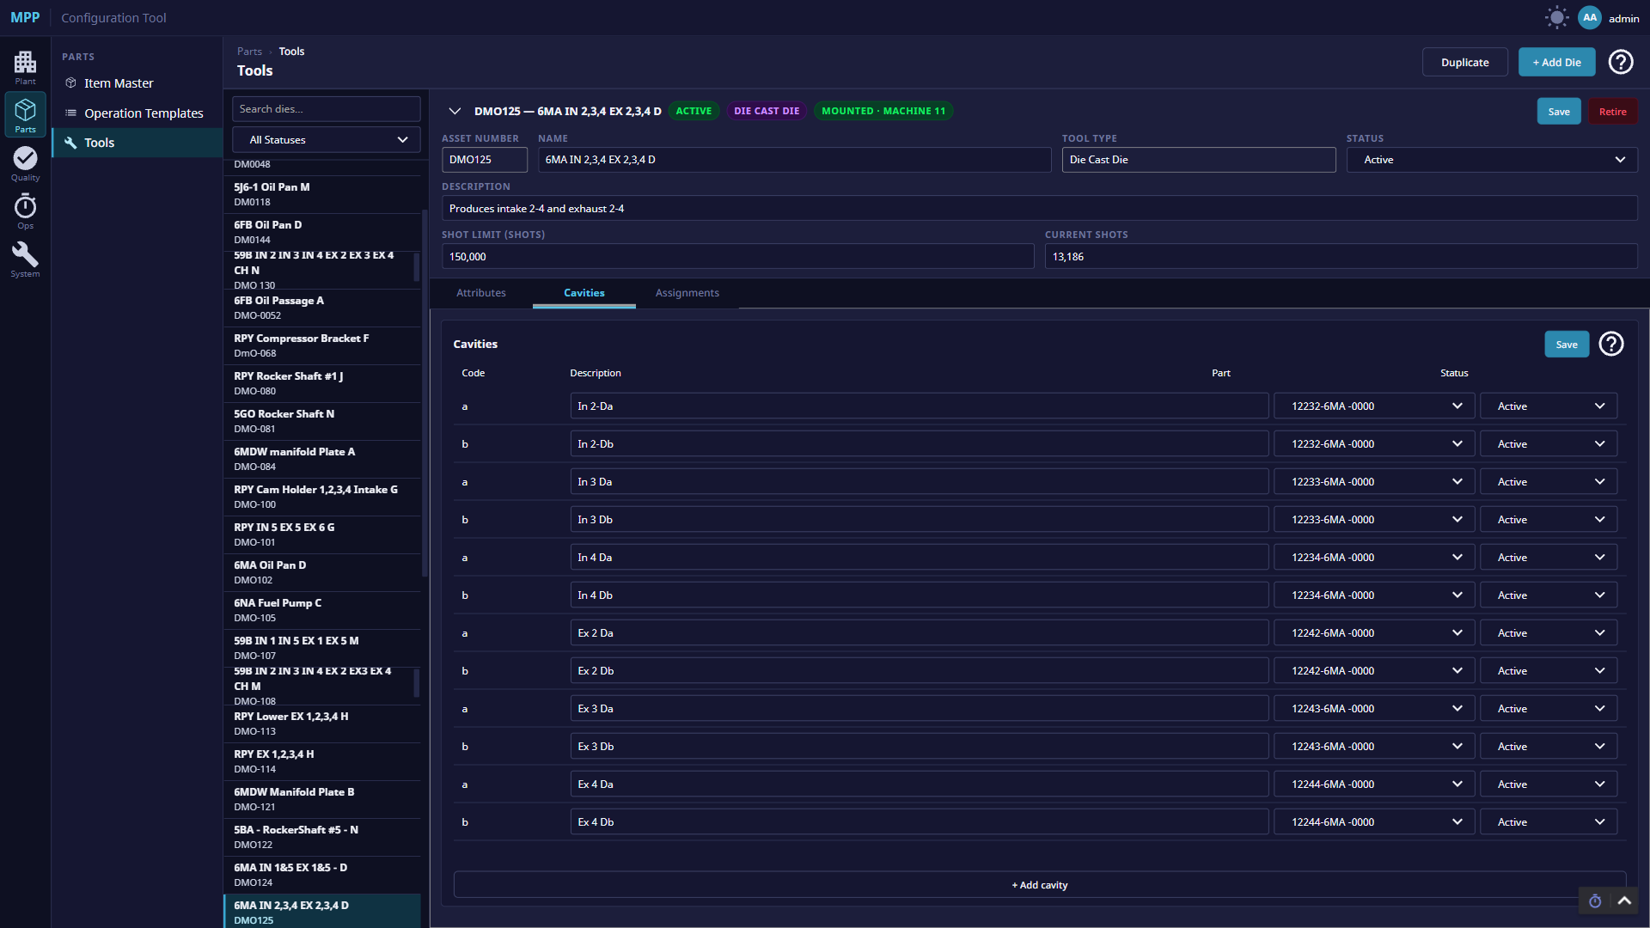
Notes:
Configuration: Dies - Dies and cavities

Slide 10
Quality and downtime
Configuration

Slide 11
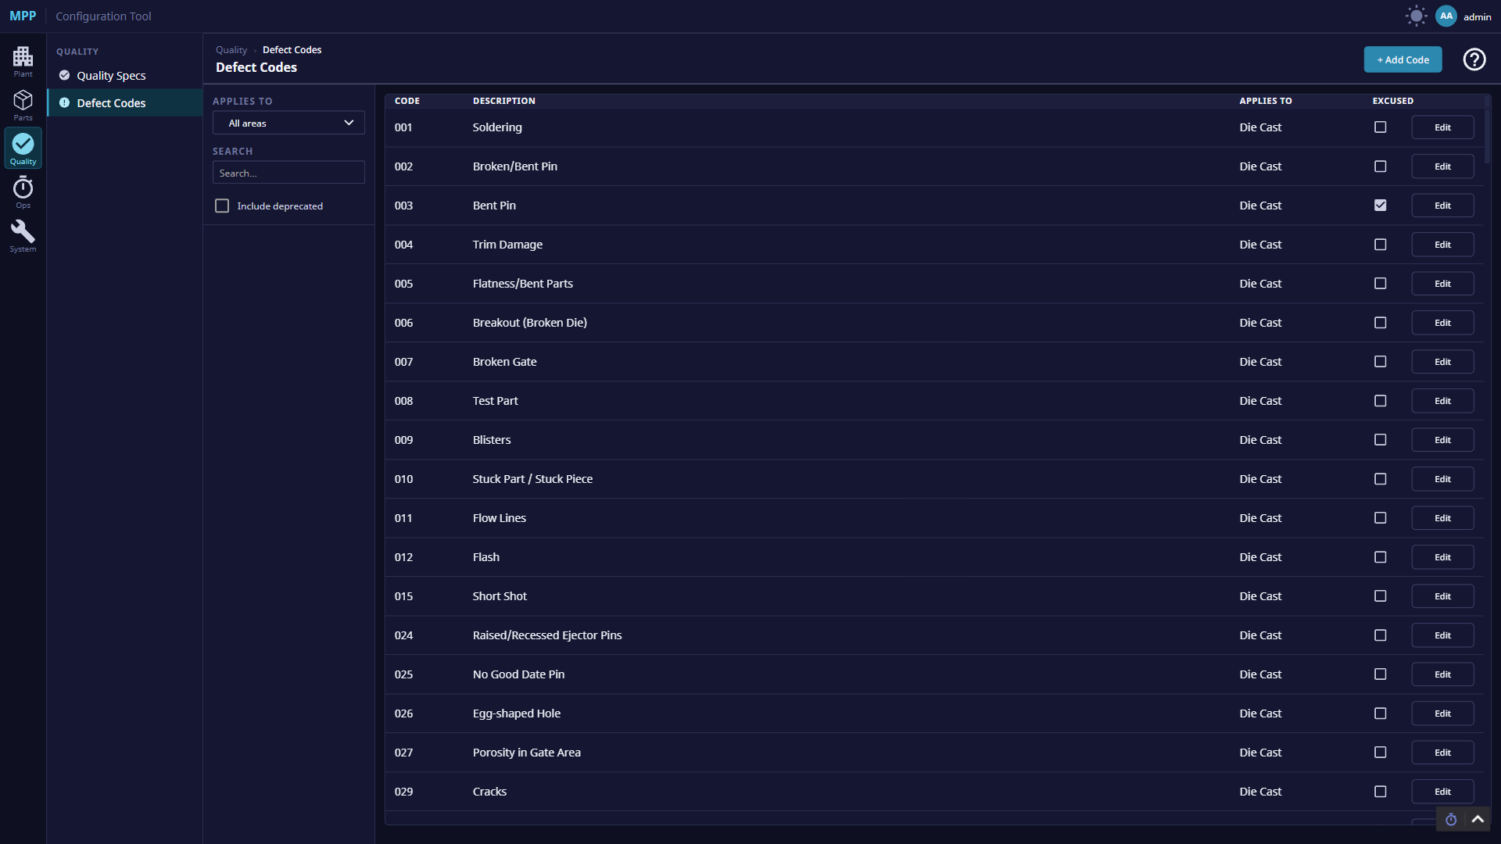
Notes:
Configuration: Quality and downtime - Defect codes

Slide 12
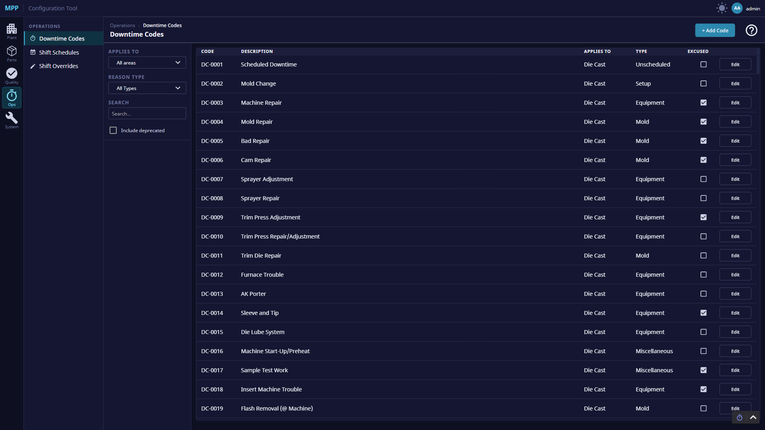
Notes:
Configuration: Quality and downtime - Downtime codes

Slide 13
Shifts
Configuration

Slide 14
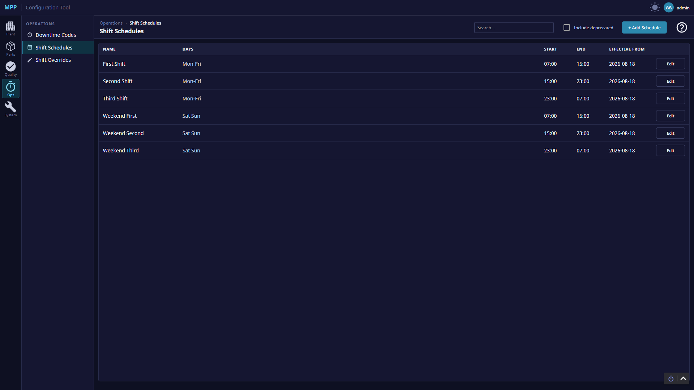
Notes:
Configuration: Shifts - Shift schedules

Slide 15
Die cast
Plant floor

Slide 16
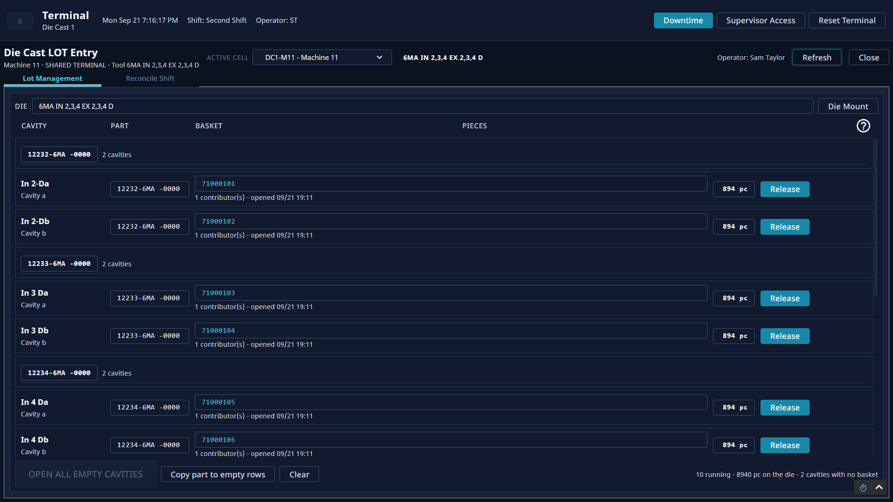
Notes:
Plant floor: Die cast - Die cast baskets, cavity by cavity

Slide 17
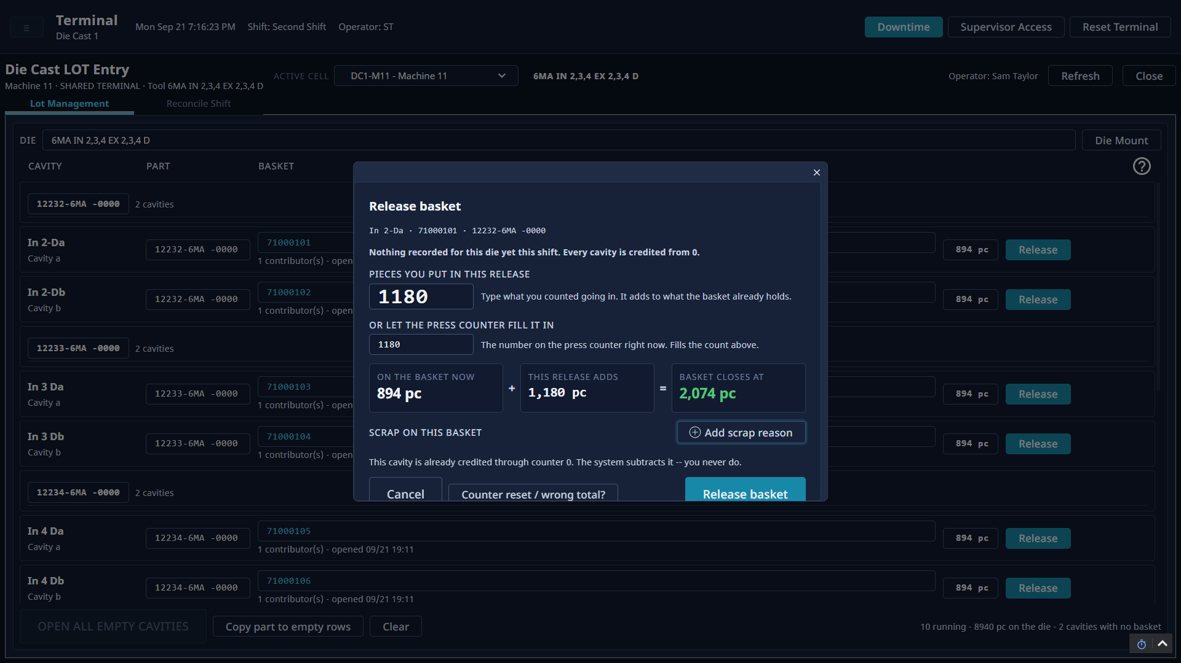
Notes:
Plant floor: Die cast - Releasing a full basket

Slide 18
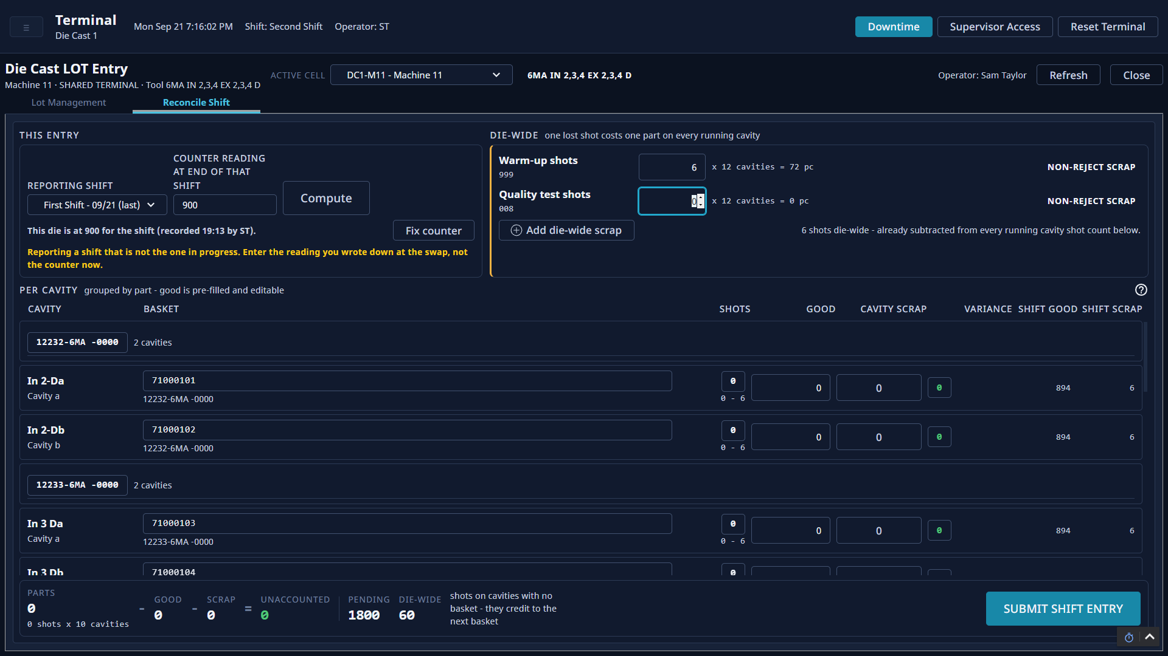
Notes:
Plant floor: Die cast - End-of-shift reconciliation

Slide 19
Downtime
Plant floor

Slide 20
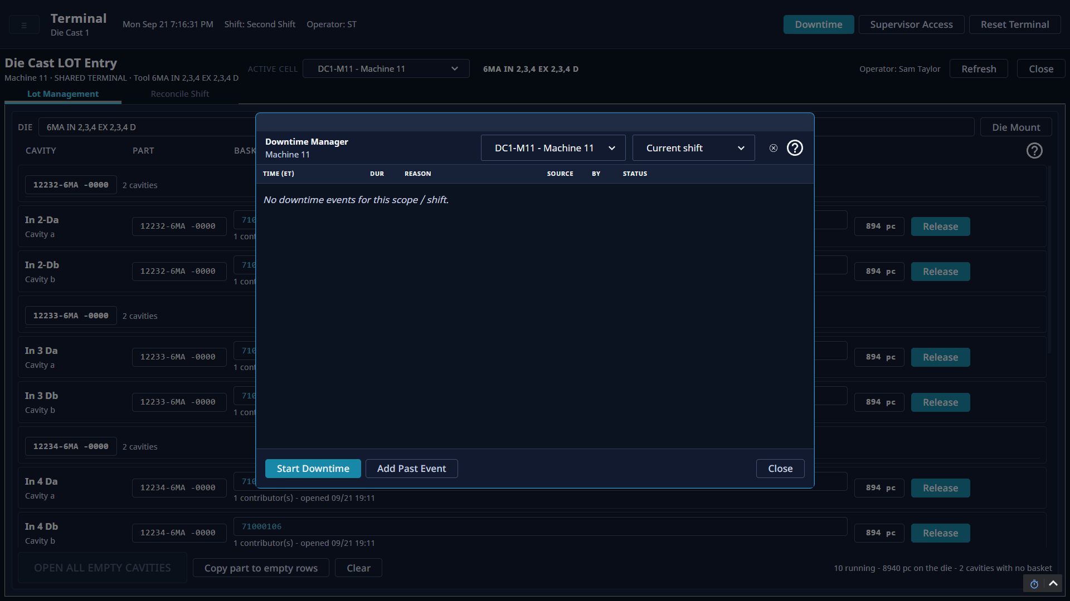
Notes:
Plant floor: Downtime - Downtime manager

Slide 21
Traceability
Plant floor

Slide 22
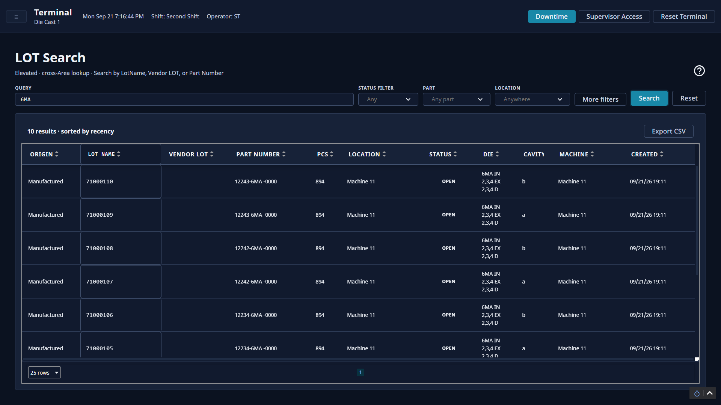
Notes:
Plant floor: Traceability - LOT search

Slide 23
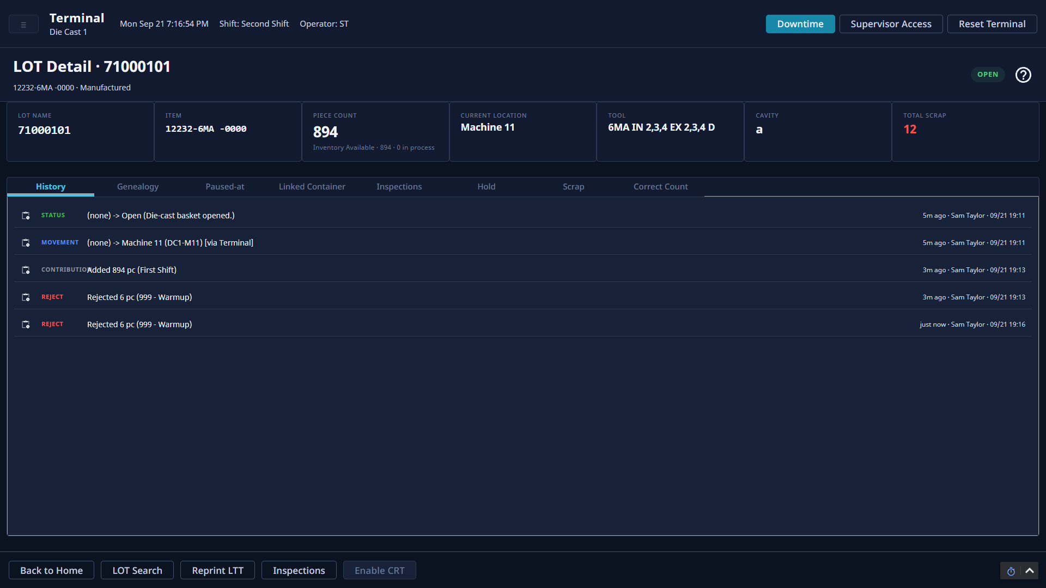
Notes:
Plant floor: Traceability - LOT detail and history

Slide 24
Reporting
Plant floor

Slide 25
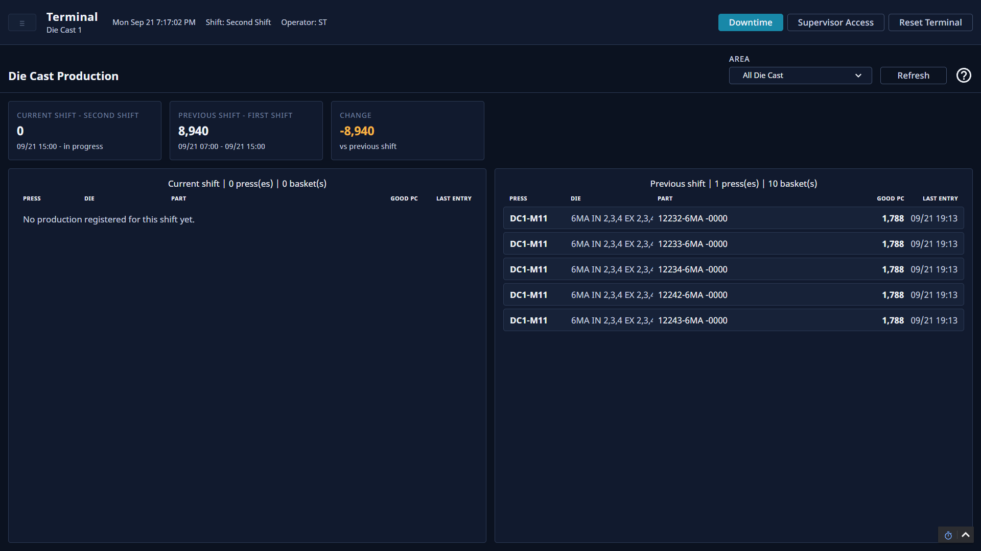
Notes:
Plant floor: Reporting - Die cast production, this shift against the last

