Slide 1
Very- Long Instruction Word (VLIW) Computer Architecture

Slide 2
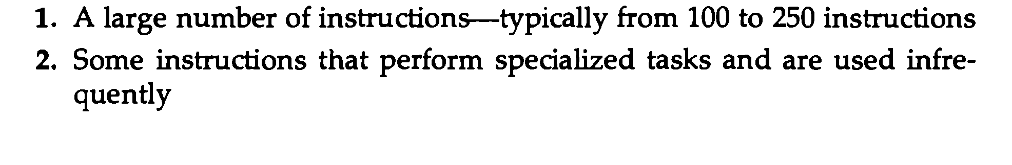
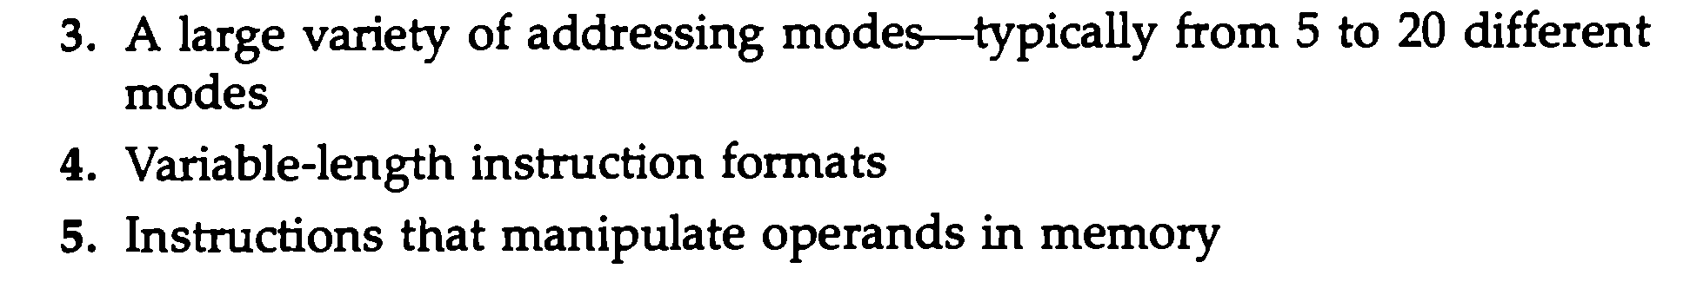
CISC Characteristics

Slide 3
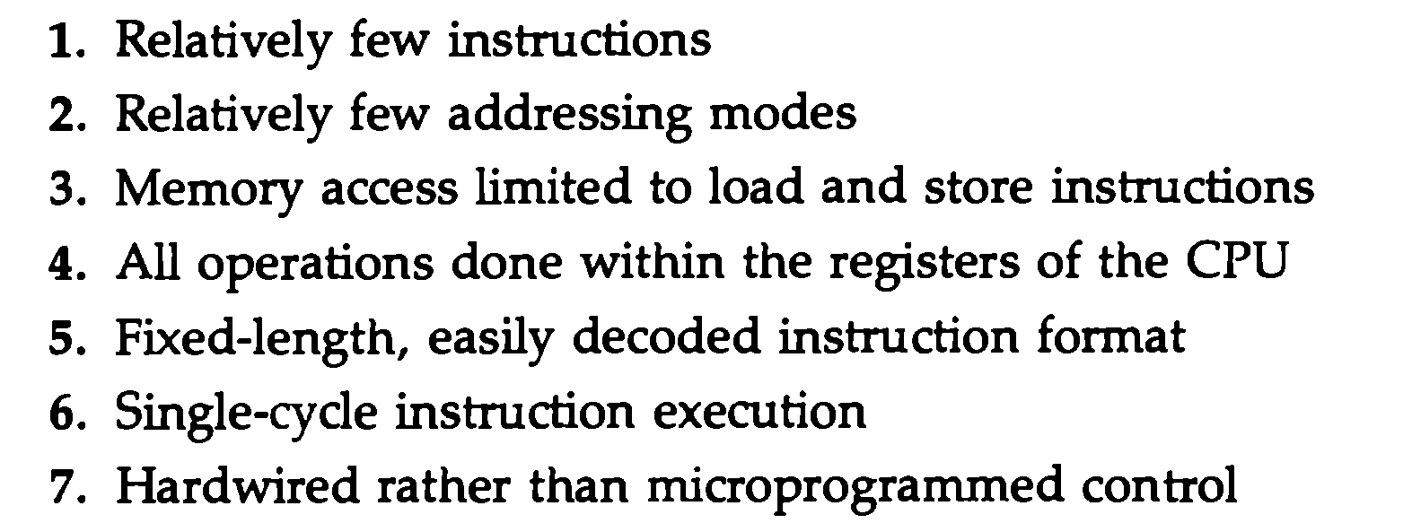
RISC Characteristics

Slide 4
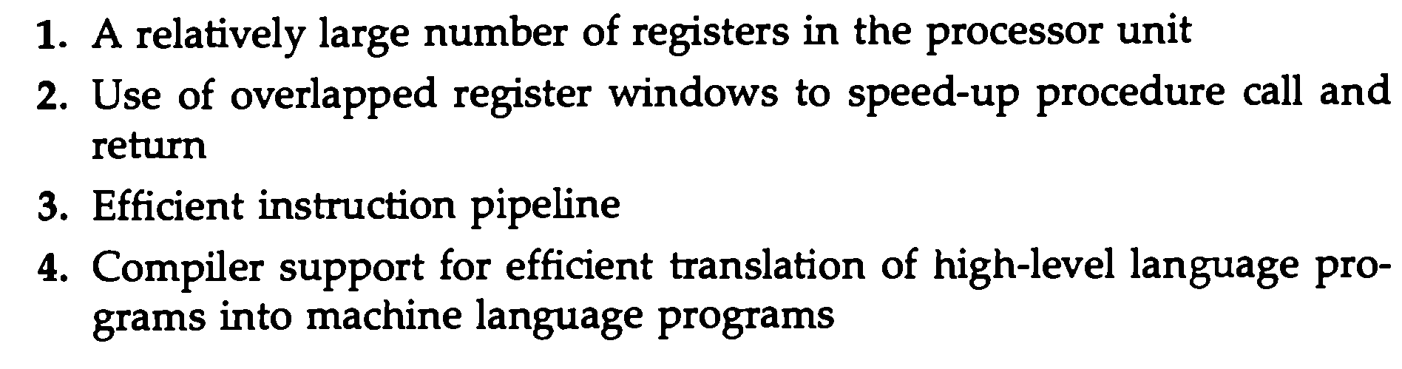
Other RISC Characteristics

Slide 5
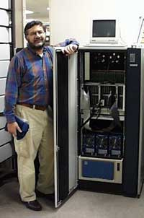
VLIW was invented
The idea of VLIW has been considered the work on trace scheduling, a method of compiling programs written in conventional languages for wide-word machines, done by Josh Fisher in 1979 at Yale laid down the foundation for VLIW technology. Now John Fisher leads HP’s VLIW compiler project.
VLIW Pioneer: HP Senior Fellow Josh Fisher beside his MultiFlow Trace VLIW machine, on display at Computer History Museum.

Slide 6
Why VLIW ?
To overcome the difficulty of finding parallelism in machine-level object code.
In a VLIW processor, multiple instructions are packed together and issued in parallel to an equal number of execution units.
The compiler (not the processor) checks that there are only independent instructions executed in parallel.

Slide 7
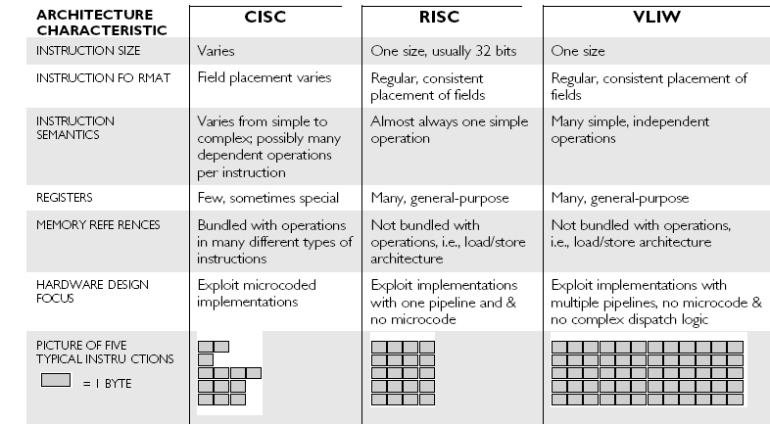
Comparison of VLIW, CISC,RISC

Slide 8
VLIW characteristics
VLIW contains multiple primitive instructions that can be executed in parallel by functional units of a processor.
The compiler packs a number of primitive, non-interdependent instructions into a very long instruction word
Since multiple instructions are packed in one instruction word, the instruction words are much larger than CISC and RISC’s.

Slide 9
The VLIW compiler
The compiler specifies the primitive instructions per VLIW instruction word.
The compiler must guarantee that the multiple primitive instructions which group together are independent so they can be executable in parallel.
Only the sequence of different VLIW words affects the outputs (e.g., blue, red, green).

Slide 10
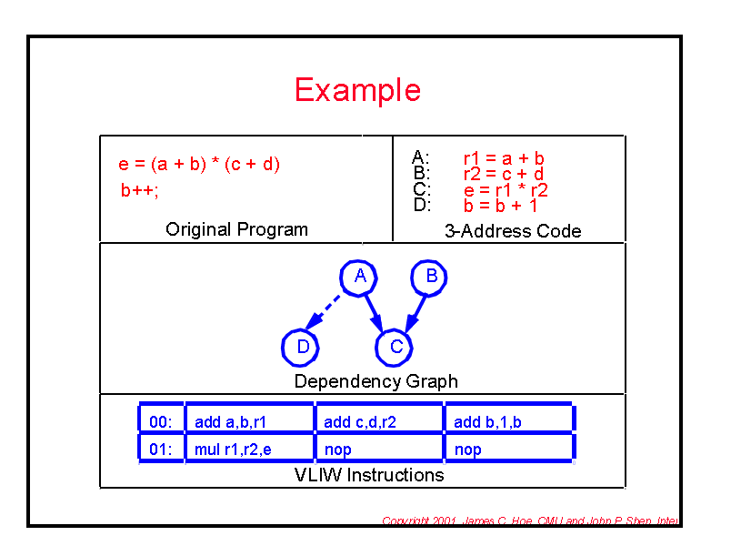
Example

Slide 11
VLIW principles
1.The compiler analyzes dependence of all instructions among sequential code, tries to extract as much parallelism as possible.
2.Based on the analysis, the compiler re-codes the piece of sequential code in VLIW instruction words.
3.Finally, the work left with VLIW hardware is only fetch the VLIWs from cache, decode them, and then dispatch the independent primitive instructions to corresponding function units and execute.

Slide 12
Implementation
To get commercial success, Itanium was invented instead of general purpose VLIW processor
A hypothetical VLIW processor architecture was invented Instead of particular implementation

Slide 13
Generating of VLIW instruction words
A hypothetical VLIW processor architecture

Slide 14
One VLIW instruction word contains maximum 8 primitive instructions.
Each time, one VLIW instruction word is fetched from cache and decoded.
After decoding, all primitive instructions in this VLIW word are issued to functional units in parallel for execution.
These primitive instructions are from the same VLIW word, so they are guaranteed to be independent.

Slide 15
SOFTWARE INSTEAD OF HARDWARE: IMPLEMENTATION ADVANTAGES OF VLIW
VLIW instructions explicitly specify several independent operations— decode the instruction and dispatch hardware that tries to reconstruct parallelism from a serial instruction stream. The processor does not need to consider whether or not the instructions are parallel.

Slide 16
Conclusion
1. The highly parallel implementation is much simpler and cheaper than its counterparts.
2. The encoding of VLIW words implies parallelism among their primitive instructions, which results in reduced hardware complexity.
3. The complier must assemble multiple primitive instructions into a single VLIW, to make sure that multiple function units are kept busy.

Slide 17
Conclusion( cont.)
4. The compiler optimizes software pipeline; by re-ordering tries to find the most parallelism in the sequential code.
5. The microprocessor performance is dependent on how the compiler produces VLIW words.

