Slide 1
FROM TWEETS TO TRADES: SENTIMENT ANALYSER FOR DIGITAL CURRENCIES USING FINE-TUNED GPT-3

Slide 2
"Are you looking for a way to stay ahead of the competition in the cryptocurrency market? We have just the solution for you."
Our sentiment analysis tool for cryptocurrencies can help you predict market trends, manage risk, and improve your social media

Slide 3
What is Sentiment Analysis?
That’s Neutral
That’s Positive
That’s Negative
Sentiment analysis is the process of analyzing and understanding the sentiment or emotion behind a piece of text or speech.

Slide 4
What’s the application in crypto market
In the context of cryptocurrencies, sentiment analysis can help you understand how people feel about a particular cryptocurrency or the cryptocurrency market as a whole.
“Overall, sentiment analysis can help investors make more informed decisions about investing in the cryptocurrency market and manage risk more effectively.”

Slide 5
Market Prediction
“Positive sentiment may indicate a bullish market, while negative sentiment may indicate a bearish market. For instance, if our sentiment analysis tool detects a high volume of positive sentiment towards Bitcoin, it may indicate that the market is trending upward."

Slide 6
Risk Dashboard
Risk Management
Reputation Management
"By identifying potential market shifts or negative sentiment towards a particular cryptocurrency, our tool can help you make informed decisions about buying, selling, or holding cryptocurrency."
“If our sentiment analysis tool detects a high volume of negative sentiment towards a particular cryptocurrency company, it may indicate that they need to take action to improve their reputation.”
Middle
Low
High

Slide 7
Benefits for retail investors
$
01
Level the playing field between retail investors and institutional investors
02
Sentiment analysis can help retail investors make better decisions and manage risk
03
Retail investors who understand the sentiment of the market can gain a competitive advantage over other investors who do not.

Slide 8
Fine Tuning GPT
1
Reduced training time and resources provide improved performance on specific tasks or domains
2
Efficient and cost-effective way to train a model allows for transfer learning from pre-trained models
3
Can handle a wide range of natural language processing tasks that provides state-of-the-art performance on many NLP benchmarks.

Slide 9
DATA
Collection
Processing
BITCOIN
PRICE FORECASTING
Time-series Regression of sentiment
NLP
Topic modelling
Sentiment analysis
using Fine-Tuned GPT

Slide 10
PRODUCT FEATURES
DATA COLLECTION
DATA PROCESSING
SENTIMENT ANALYSIS
REAL TIME PRICE FORECASTING
ACTIONABLE RESULT
WEB SCRAPING TWEETS
CLEANING PREPROCESSING TOKENIZATION
FINE-TUNED GPT3 REAL-TIME SENTIMENT
TIME-SERIES REGRESSION
Decision By user
1
2
3
4
5

Slide 12
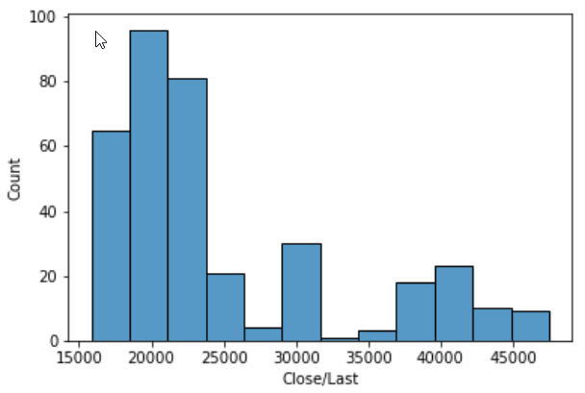
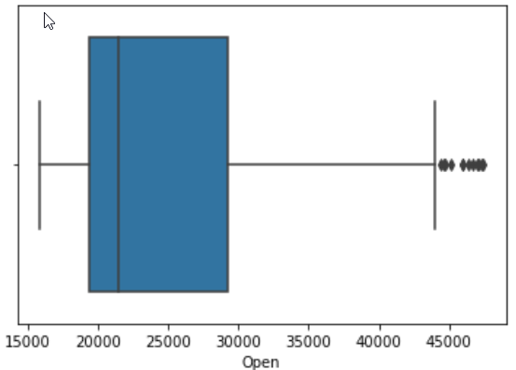
ED
Exploratory Data Analysis

Slide 13
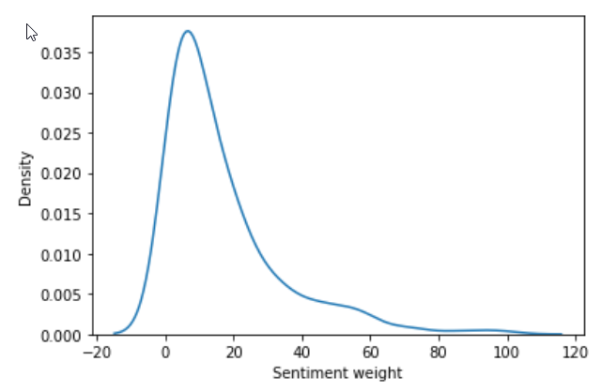
Sentiment Weightage Distribution

Slide 14
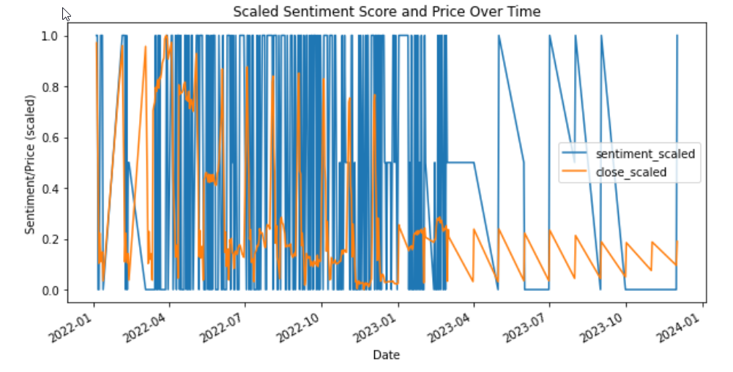

Slide 15
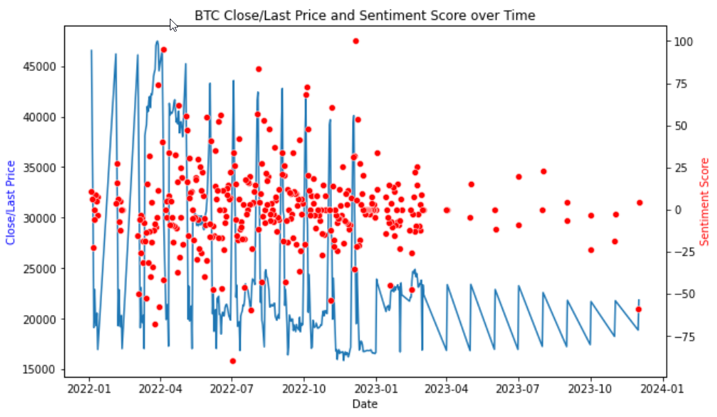

Slide 16
Conclusion
The tool can help you stay ahead of the competition by providing valuable insights into market trends, risk management, reputation management, and social media marketing
“Our sentiment analysis tool can take your cryptocurrency investments to a whole new level today”

