Slide 1



$$k$$
$$m$$
$$c$$

Slide 2
$$k$$
$$m$$
$$c$$

Slide 3



${\ddot{u}}_{f}\left(t\right)$ (output)
$ω_{n}, ζ$
${\ddot{u}}_{g}\left(t\right)$ (input)

Slide 4
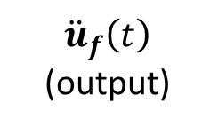


$\{ω_{i}, ζ_{i}\}$
${\ddot{u}}_{f}\left(t\right)$ (output)
${\ddot{u}}_{g}\left(t\right)$ (input)

Slide 5
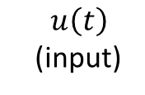





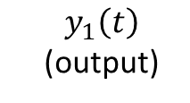

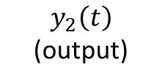
$$m_{2}$$
$y_{2}\left(t\right)$ (output)
$$c_{2}$$
$$k_{2}$$
$$m_{1}$$
$y_{1}\left(t\right)$ (output)
$$c_{1}$$
$$k_{1}$$
$u\left(t\right)$ (input)

Slide 6
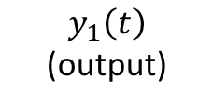

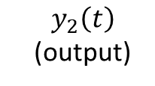

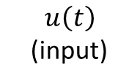


$$m_{2}$$
$y_{2}\left(t\right)$ (output)
$$k_{2}$$
$$m_{1}$$
$y_{1}\left(t\right)$ (output)
$$k_{1}$$
$u\left(t\right)$ (input)

Slide 7
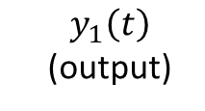

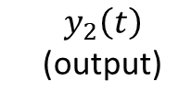

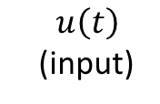


$$m_{2}$$
$y_{2}\left(t\right)$ (output)
$$k_{2}$$
$$m_{1}$$
$y_{1}\left(t\right)$ (output)
$$k_{1}$$
$u\left(t\right)$ (input)

Slide 8
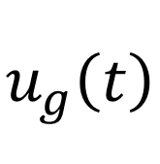


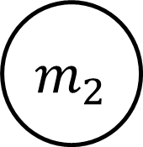

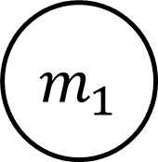
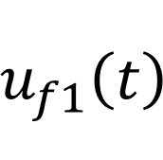
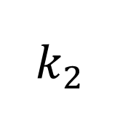
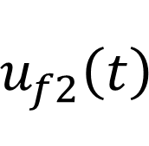
2dof
$$m_{2}$$
$$u_{f2}\left(t\right)$$
$$c_{2}$$
$$k_{2}$$
$$m_{1}$$
$$u_{f1}\left(t\right)$$
$$c_{1}$$
$$k_{1}$$
$$u_{g}\left(t\right)$$

Slide 9
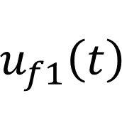
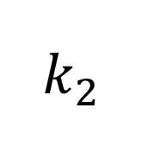
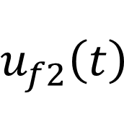
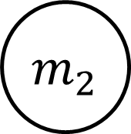
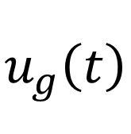

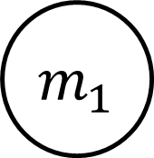
2dof
$$m_{2}$$
$$u_{f2}\left(t\right)$$
$$k_{2}$$
$$m_{1}$$
$$u_{f1}\left(t\right)$$
$$k_{1}$$
$$u_{g}\left(t\right)$$

Slide 10
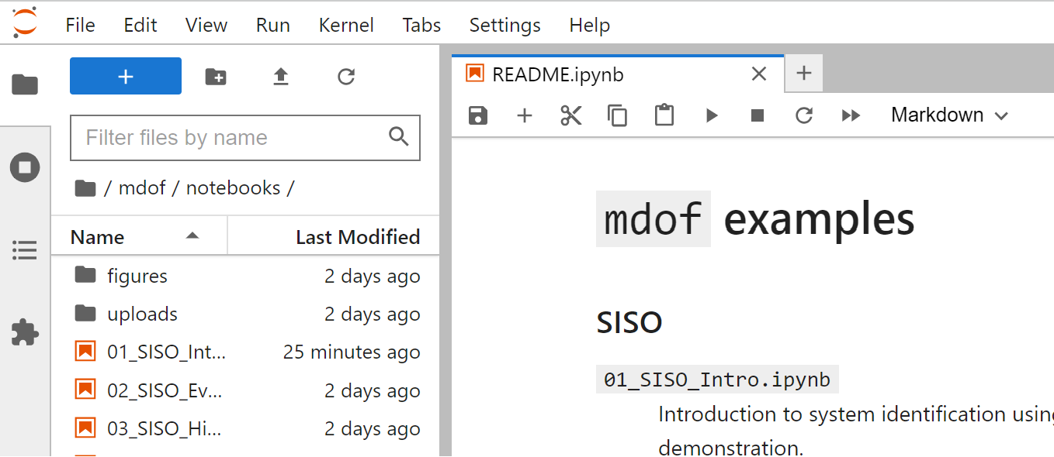

Slide 11
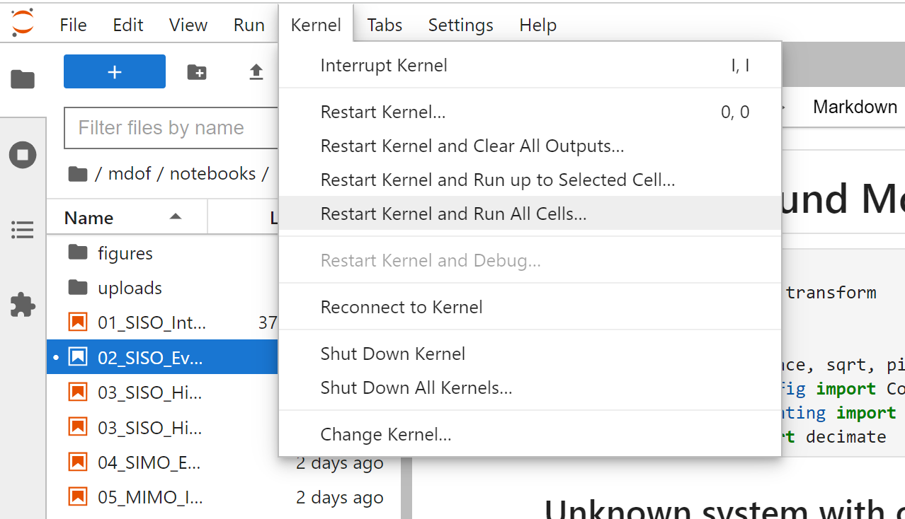

Slide 12
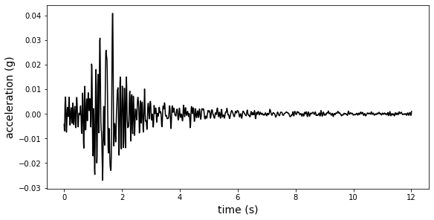
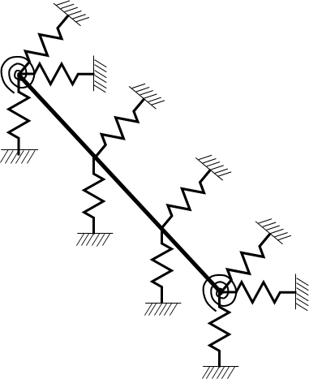
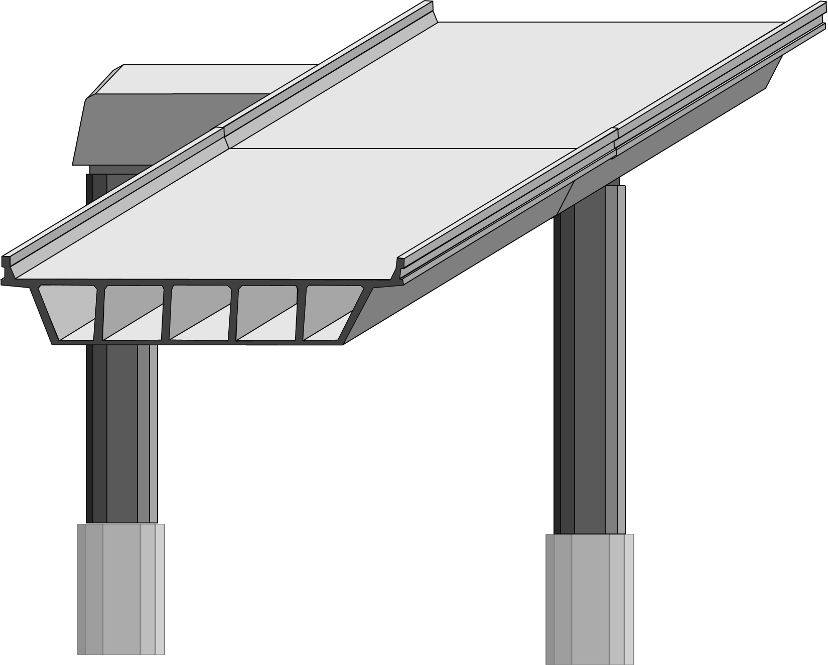
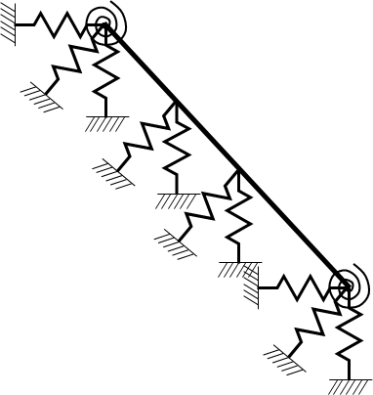
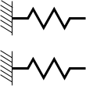
$$M\ddot{u}\left(t\right)+C\dot{u}\left(t\right)+Ku\left(t\right)=−Mι{\ddot{u}}_{g}\left(t\right)$$
$$M\ddot{u}\left(t\right)+C\dot{u}\left(t\right)+Ku\left(t\right)=−Mι{\ddot{u}}_{g}\left(t\right)$$
Type I Predictors
Type II Predictors

Slide 13
$$M\ddot{u}\left(t\right)+C\dot{u}\left(t\right)+Ku\left(t\right)=−Mι{\ddot{u}}_{g}\left(t\right)$$

Slide 14
mdof

Slide 15
