Slide 1



$$k$$
$$m$$
$$c$$

Slide 2

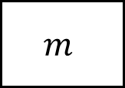

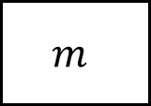
$$k$$
$$k$$
$$m$$
$$m$$
wall

Slide 3



${\ddot{u}}_{f}\left(t\right)$ (output)
$ω_{n}, ζ$
${\ddot{u}}_{g}\left(t\right)$ (input)

Slide 4
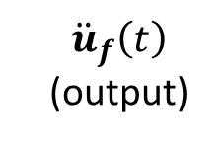


$\{ω_{i}, ζ_{i}\}$
${\ddot{u}}_{f}\left(t\right)$ (output)
${\ddot{u}}_{g}\left(t\right)$ (input)

Slide 5
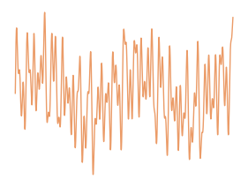
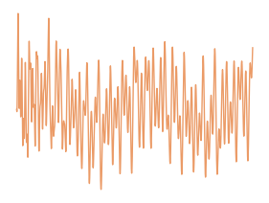

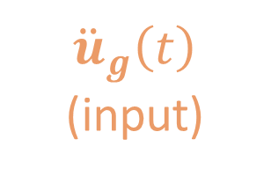
?
${\ddot{u}}_{g}\left(t\right)$ (input)
${\ddot{u}}_{f}\left(t\right)$ (output)

Slide 6


$${\ddot{u}}_{f}\left(t\right)$$
?
$${\ddot{u}}_{g}\left(t\right)$$

Slide 7
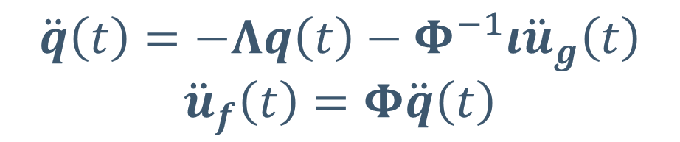


${\ddot{u}}_{g}\left(t\right)$ (input)
$$\ddot{q}\left(t\right)=−Λq\left(t\right)−Φ^{−1}ι{\ddot{u}}_{g}\left(t\right)$$
$${\ddot{u}}_{f}\left(t\right)=Φ\ddot{q}\left(t\right)$$
${\ddot{u}}_{f}\left(t\right)$ (output)

Slide 8
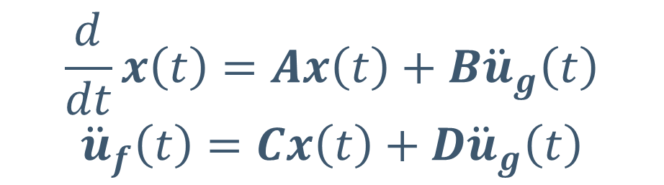
$$\frac{d}{dt}x\left(t\right)=Ax\left(t\right)+B{\ddot{u}}_{g}\left(t\right)$$
$${\ddot{u}}_{f}\left(t\right)=Cx\left(t\right)+D{\ddot{u}}_{g}\left(t\right)$$
${\ddot{u}}_{g}\left(t\right)$ (input)
${\ddot{u}}_{f}\left(t\right)$ (output)

Slide 9

${\ddot{u}}_{g}\left(t\right)$ (input)
$$\{ω_{i}, ζ_{i}\}$$
${\ddot{u}}_{f}\left(t\right)$ (output)

Slide 10

${\ddot{u}}_{g}\left(t\right)$ (input)
$$G\left(s\right)$$
${\ddot{u}}_{f}\left(t\right)$ (output)

Slide 11
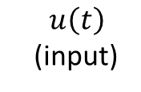





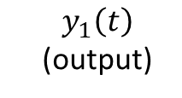

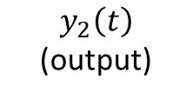
$$m_{2}$$
$y_{2}\left(t\right)$ (output)
$$c_{2}$$
$$k_{2}$$
$$m_{1}$$
$y_{1}\left(t\right)$ (output)
$$c_{1}$$
$$k_{1}$$
$u\left(t\right)$ (input)

Slide 12
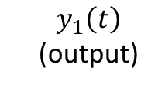

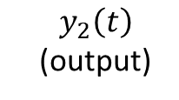

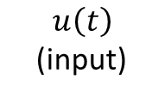


$$m_{2}$$
$y_{2}\left(t\right)$ (output)
$$k_{2}$$
$$m_{1}$$
$y_{1}\left(t\right)$ (output)
$$k_{1}$$
$u\left(t\right)$ (input)

Slide 13







$$m_{2}$$
$$y_{2}\left(t\right)$$
$$k_{2}$$
$$m_{1}$$
$$y_{1}\left(t\right)$$
$$k_{1}$$
$$u\left(t\right)$$

Slide 14
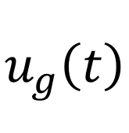


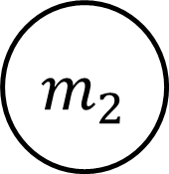

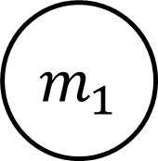
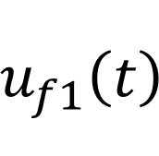
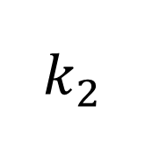
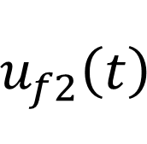
2dof
$$m_{2}$$
$$u_{f2}\left(t\right)$$
$$c_{2}$$
$$k_{2}$$
$$m_{1}$$
$$u_{f1}\left(t\right)$$
$$c_{1}$$
$$k_{1}$$
$$u_{g}\left(t\right)$$

Slide 15
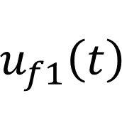
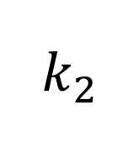
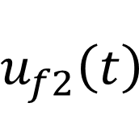
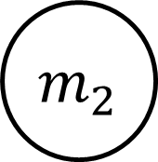
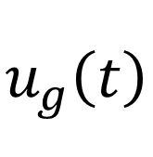

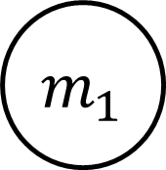
2dof
$$m_{2}$$
$$u_{f2}\left(t\right)$$
$$k_{2}$$
$$m_{1}$$
$$u_{f1}\left(t\right)$$
$$k_{1}$$
$$u_{g}\left(t\right)$$

Slide 16
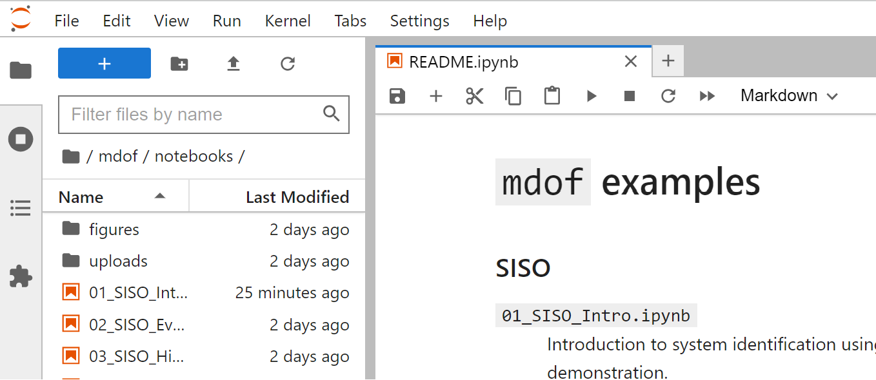

Slide 17
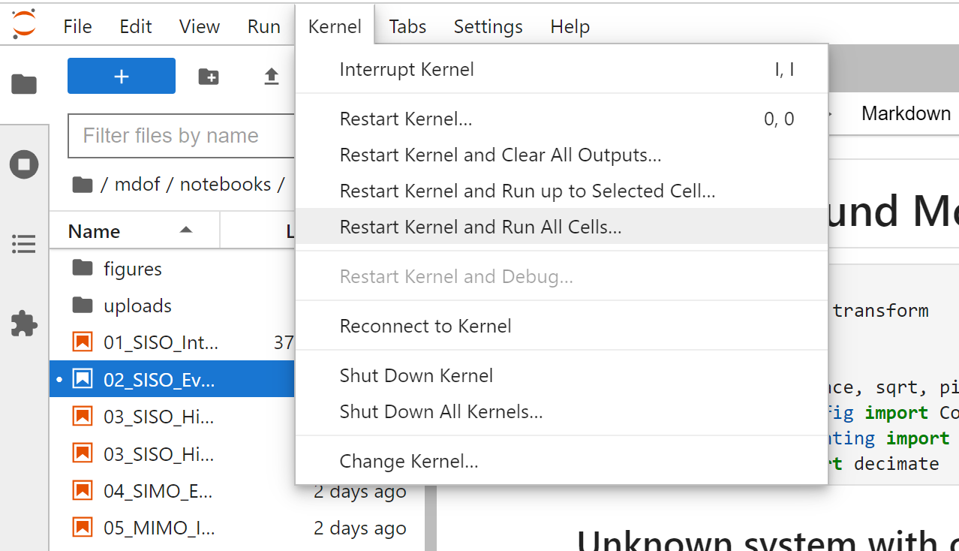

Slide 18
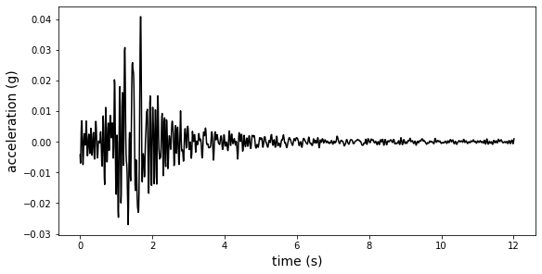
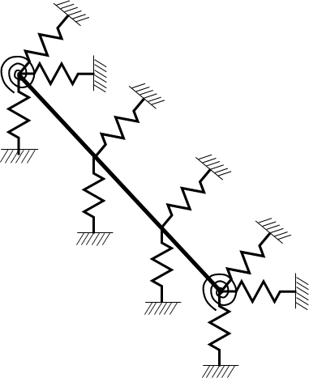
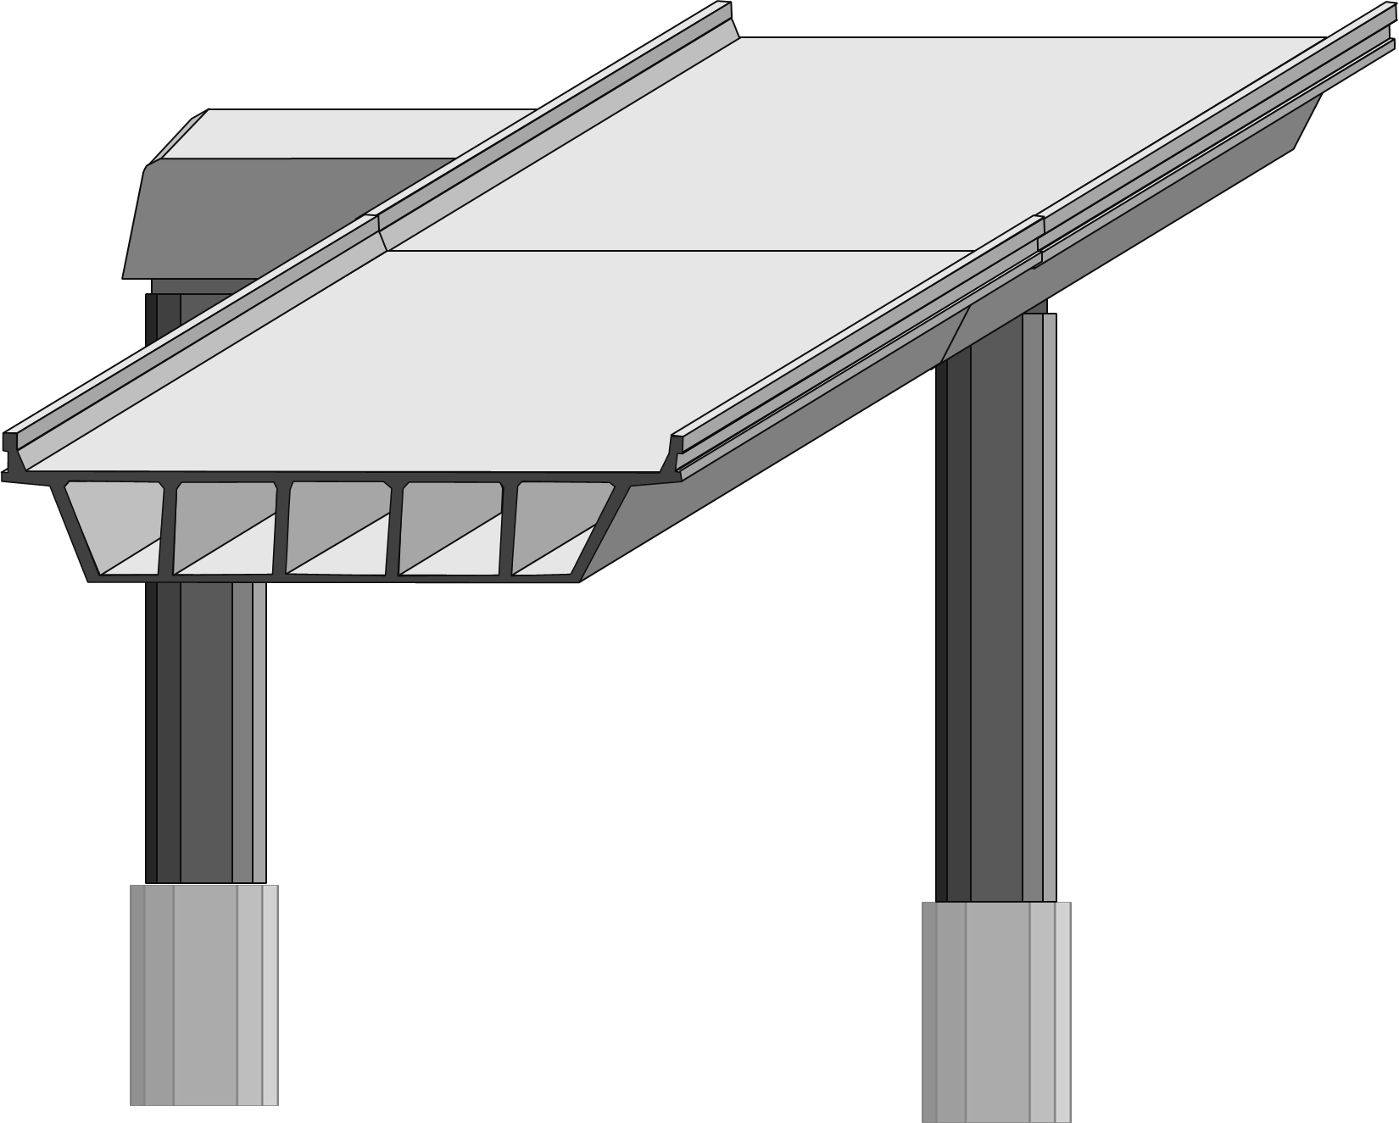
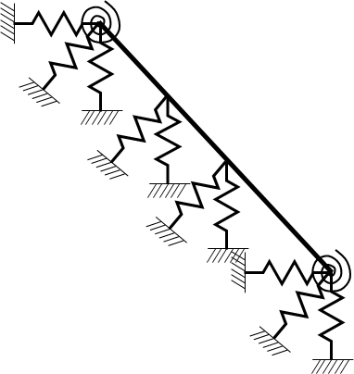
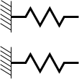
$$M\ddot{u}\left(t\right)+C\dot{u}\left(t\right)+Ku\left(t\right)=−Mι{\ddot{u}}_{g}\left(t\right)$$
$$M\ddot{u}\left(t\right)+C\dot{u}\left(t\right)+Ku\left(t\right)=−Mι{\ddot{u}}_{g}\left(t\right)$$
Type I Predictors
Type II Predictors

Slide 19
$$M\ddot{u}\left(t\right)+C\dot{u}\left(t\right)+Ku\left(t\right)=−Mι{\ddot{u}}_{g}\left(t\right)$$

Slide 20
mdof

Slide 21
