Slide 1
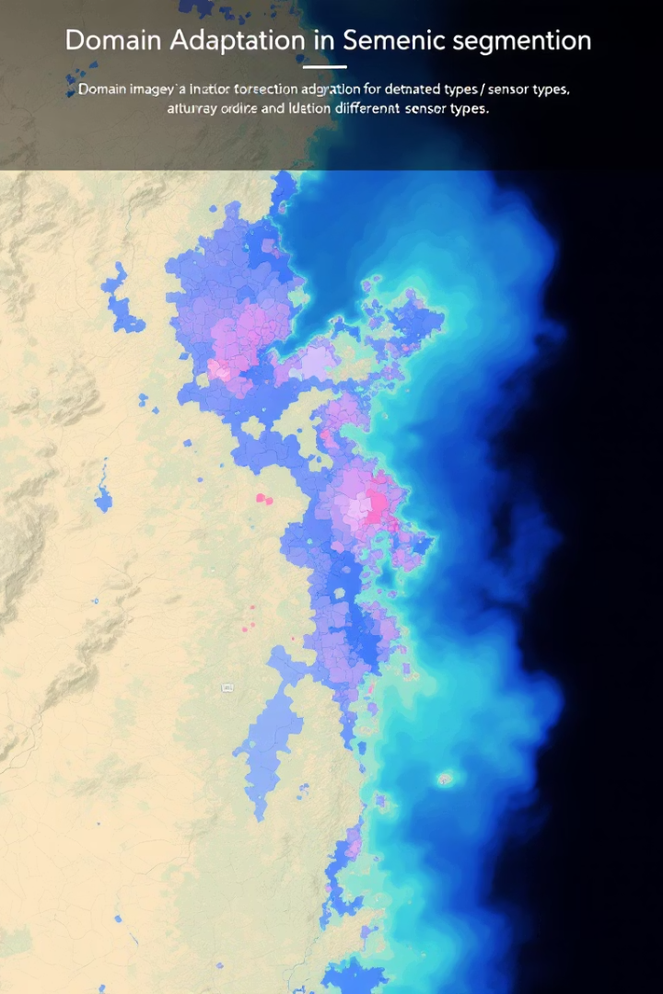
Adversarial Unsupervised Domain Adaptation for Aerial Image Segmentation AeroAdapt-GAN

Slide 2
Semantic Segmentation & Domain Adaptation
Semantic Segmentation: Label each pixel with a class.
Domain Adaptation: Adapt models to new data distributions.
Notes:
"Semantic segmentation is the task of labeling each pixel in an image with a category, such as road, building, or vegetation. However, a segmentation model trained on one dataset often struggles when applied to new, unseen data — due to differences like lighting, sensor type, or image resolution. Which we call Domain gap“
And this is where we benefit from something called:
"Domain adaptation addresses this challenge by helping the model adjust to the new domain without needing additional manual labeling. In other words, domain adaptation ensures that a segmentation model can generalize and perform well even when the input images come from different sources."

Slide 3
Real Life Applications
Satellite Image Analysis (Urban Mapping)
Autonomous Driving (Self-driving cars)
Medical Imaging (MRI & CT scans)
Industrial IoT
Notes:
helps segment buildings, roads, vegetation correctly even when the source and target satellite images are very different.
Helps correctly detect roads, pedestrians, and traffic signs in different weather and lighting conditions without retraining.
ensures that tumor segmentation models work reliably across different imaging devices and hospitals.
As for IIoT:
Factory Equipment Monitoring: segments parts of the machine (e.g., pipe, valve, motor)
Infrastructure Monitoring (Pipelines, Power Plants)
And it’s crucial to use for these application where images captured by different sensors or conditions vary a lot.

Slide 4
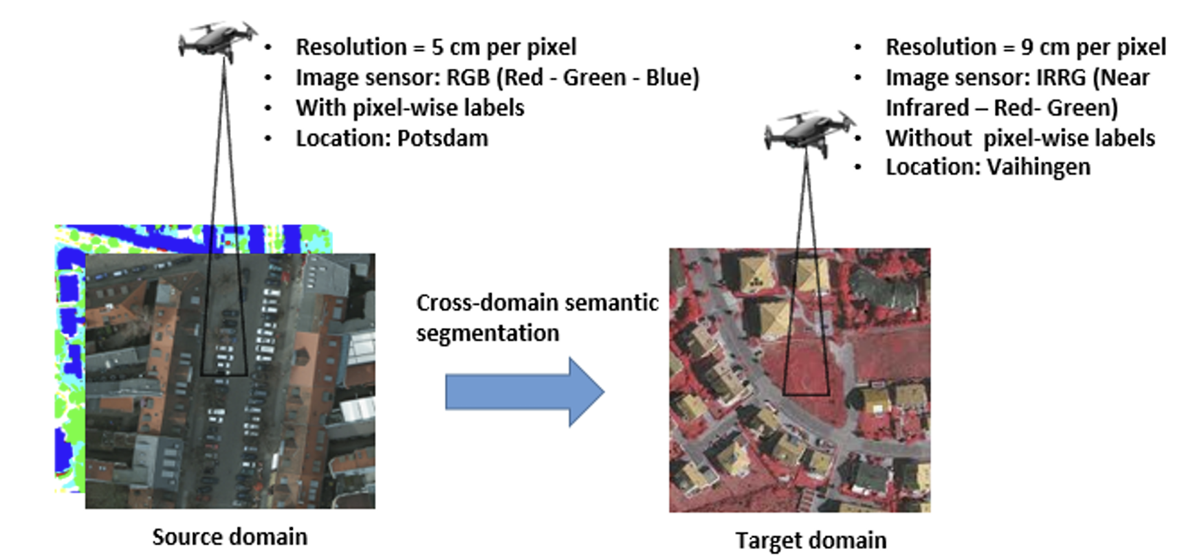
Referenced Paper Overview
Unsupervised Domain Adaptation Using Generative Adversarial Networks for Semantic Segmentation of Aerial Images [1]
Original method: CycleGAN for image translation + Segmentation model (BiSNet).
Goal: Adapt source images to target domain.
Notes:
We based our work on this research paper that used an adversarial generative network to translate images from a domain to another (from RGB to IRRG) then performed segmentation on the translated images.
shows a typical situation in which we have a trained model on a specific source domain and we want to use this model to segment another domain.

Slide 5
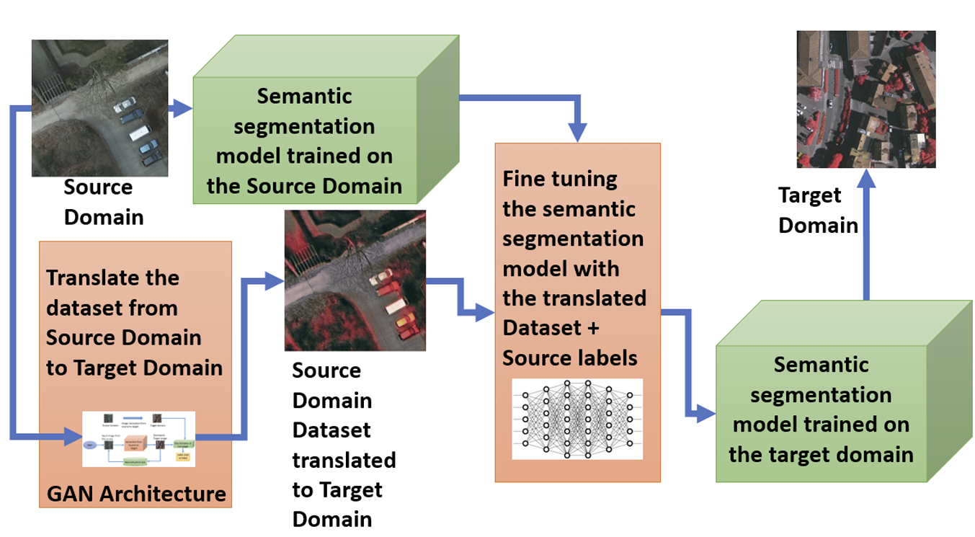
Our Proposed Implementation
Improved segmentation model.
Refined translation process.
Early stopping based on mIoU.
Notes:
We followed a similar idea but improved the pipeline by using a stronger segmentation model and refining the translation process
Mention the improvements:
DeepLabV3 + ResNet101
Early stopping using mIoU
Better CycleGAN training setup
Refined the translation process

Slide 6
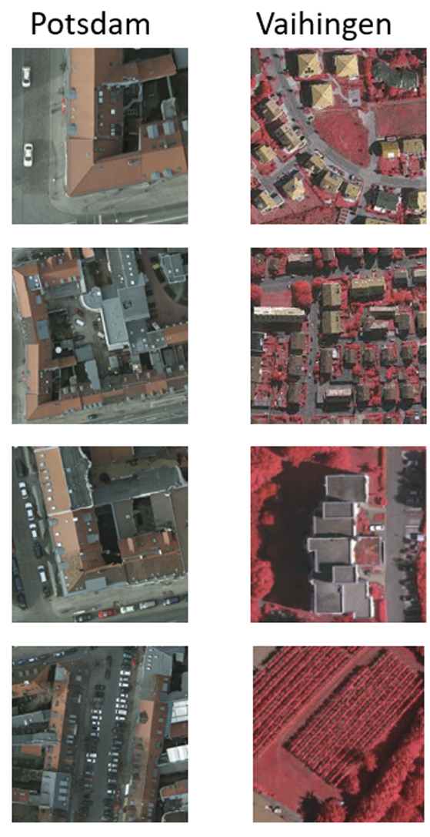
Data and preprocessing
Dataset Source: International Society for Photogrammetry and Remote Sensing (ISPRS) [2]
Contains: Potsdam (RGB), Vaihingen (IRRG).
Cropped into 512x512 patches for training efficiency.
Notes:
"We used the Potsdam and Vaihingen datasets — both aerial images but with different resolutions and sensors (RGB vs IRRG)."
"We split large tile images into 512x512 patches to make training efficient and organized the data systematically for both CycleGAN and Segmentation.“
وقولي اللي كتبته لك ذاك اليوم بالدفتر

Slide 7
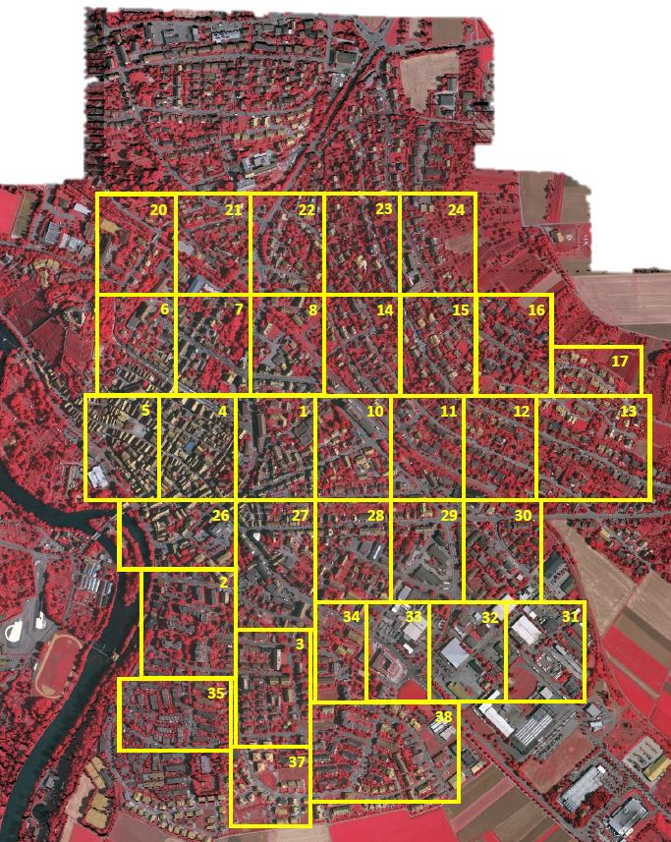
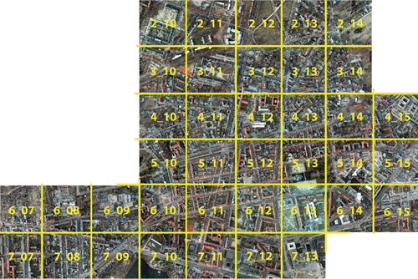
Vaihingen
(Target domain)
Potsdam
(Source domain)

Slide 8
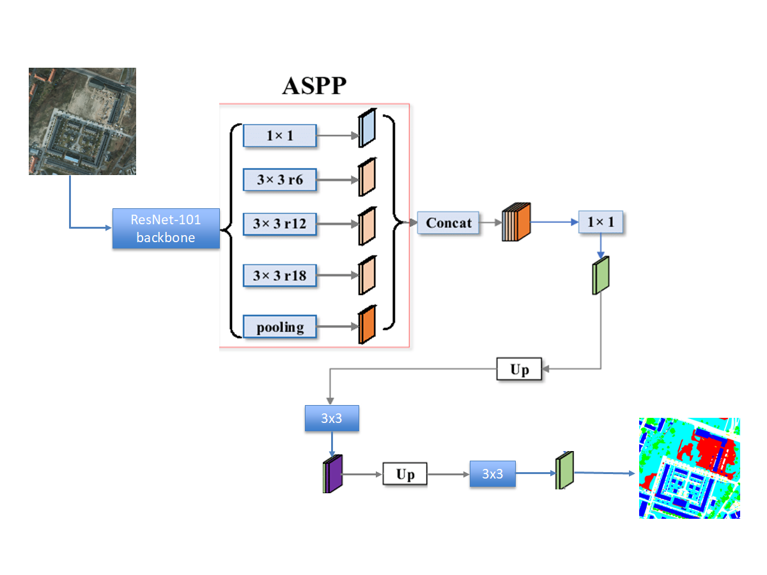
Segmentation Model
DeepLabV3 with ResNet101 backbone.
Captures multi-scale contextual information.
Notes:
We used DeepLabV3 with a ResNet101 backbone for semantic segmentation, known for capturing multi-scale context, which is very useful for complex aerial images. And the module used in deeplab for this particular process is ASPP, which "It looks at different zoom levels — local and global — to better understand what an object is and capture features, and to make more accurate segmentation decisions.“
Local information → tiny details near the pixel (e.g., the edge of a car, a window, a tree leaf)
Global context → the bigger surrounding scene (e.g., this area is part of a whole car, or part of a big building)
Concat Compare to ground truth mask (256×256 one-hot)**
↓
– Compute categorical_crossentropy loss
– Update MeanIoU_Custom metric
↓
Backpropagate gradients into the network

Slide 9
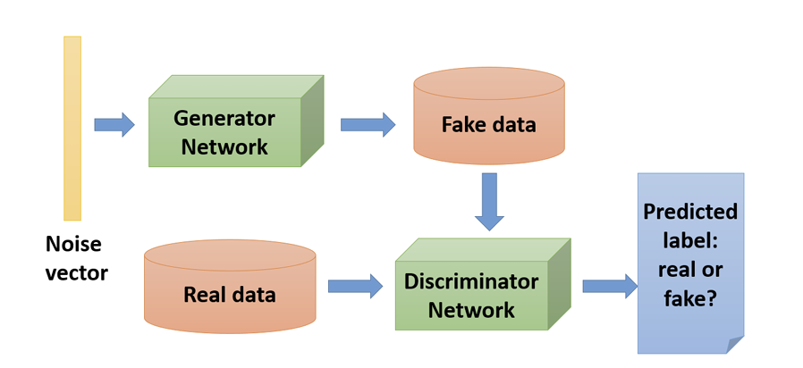
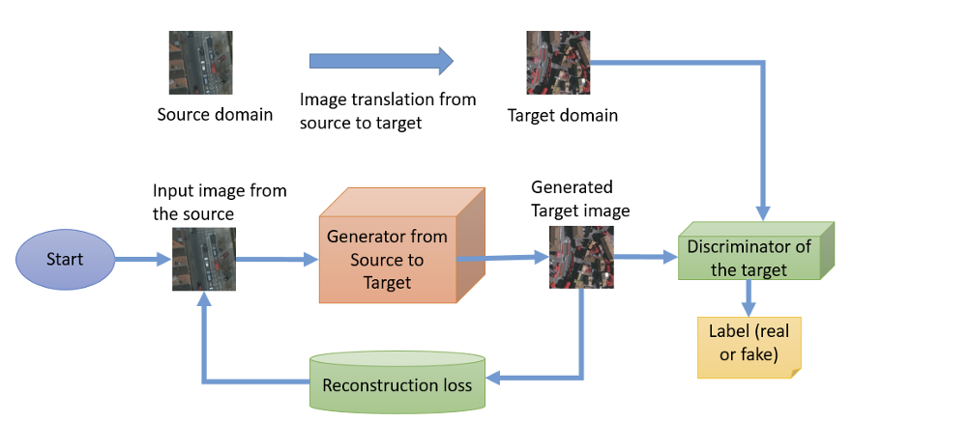
CycleGAN for Translation
CycleGAN translates images between domains.
Generator
Discriminator
Preserves structure using cycle consistency.
Notes:
"To perform domain adaptation, we used CycleGAN to translate images from Potsdam (RGB) style to Vaihingen (IRRG) style."
"CycleGAN learns to translate images in both directions while preserving structure, using two generators and two discriminators."

Slide 10
Translation and Fine-tuning
Translate Potsdam to Vaihingen style.
Fine-tune segmentation model on translated data.
Notes:
"After translation, we fine-tuned the segmentation model on the translated images. This way, the model learned the new style without needing new labels."
This step helps the model parameters to learn the patterns of the target dataset and to converge to a better recognition of image structure on the target dataset. After the fine-tuning process, the semantic segmentation model is adapted to work on the target dataset.

Slide 11
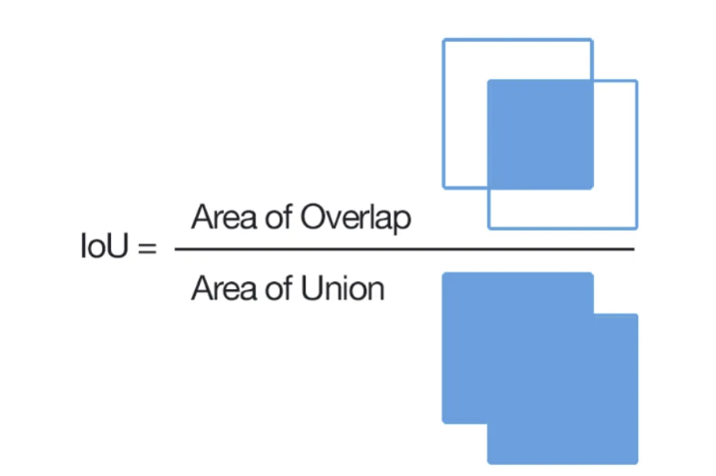
Evaluation
Metrics: Accuracy, Precision, Recall, F1-score, Mean IoU.
Focus on overall and class-specific performance.
Notes:
"We evaluated the model using key metrics like accuracy, precision, recall, F1-score, and most importantly, mean Intersection-over-Union (mIoU)."

Slide 12
Criteria | Experiment 1 | Experiment 2 | Experiment 3
Stopping | Early Stopping | No Early Stopping | Until Convergence
Generator Loss and Discriminator Accuracy | MSE (L2 loss) | Binary cross entropy (BCE) | Binary cross entropy (BCE)
Results before adaptation | Overall accuracy : 0.4281 Overall mIoU : 0.1804 | Overall accuracy : 0.3762 Overall mIoU : 0.1462 | Overall accuracy : 0.3692 Overall mIoU : 0.1596
Results after adaptation | Overall accuracy : 0.0362 Overall mIoU : 0.0194 | Overall accuracy : 0.3401 Overall mIoU : 0.0793 | Overall accuracy : 0.3882 Overall mIoU : 0.1151

Slide 13
Results
Better accuracy in segmentation model
Significantly improved over the baseline.

Slide 14
Future Work / Enhancements
Evaluate stronger backbones and networks
Multi-scale: train on varied tile size to capture fine details & larger context
Retrain to further close the domain gap.

