Slide 1

Artificial Illusion
The Art of Deepfake Technology

Slide 2
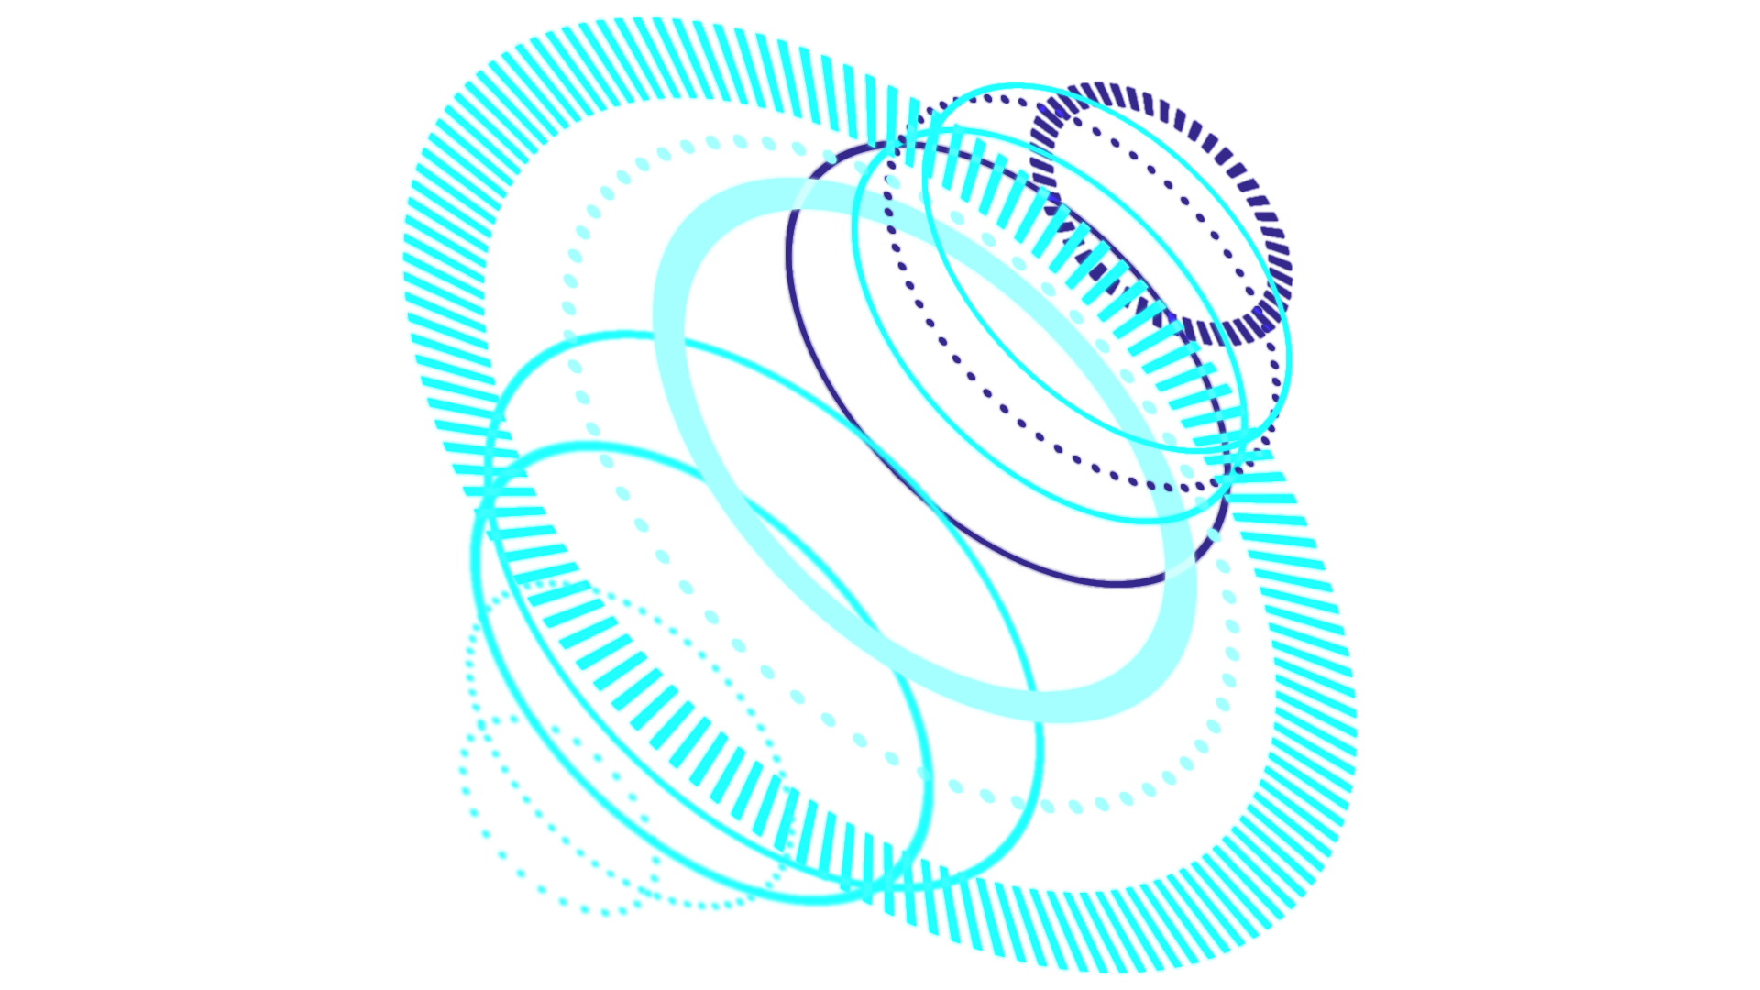
TABLE OF CONTENTS
01
Introduction
02
Implement & challenge
03
Results
04
Conclusion
What is the project about
What have we done and face
Final output and achievments

Slide 3

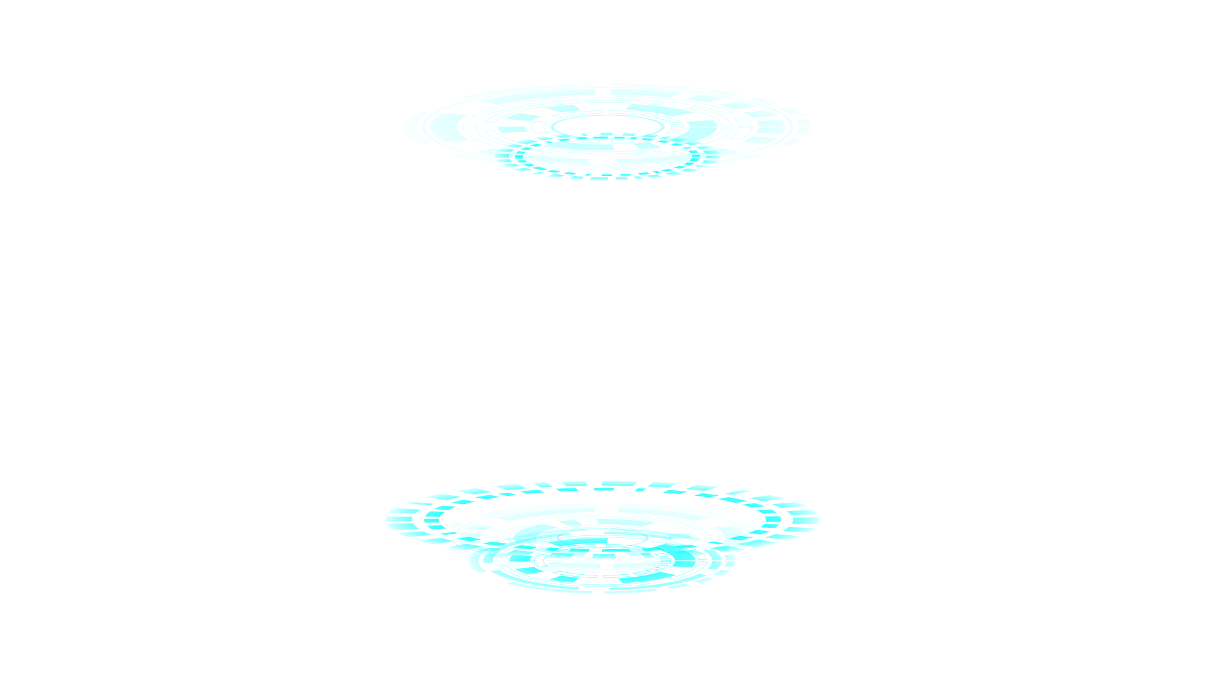
INTRODUCTION

Slide 4

Type
Deepfake
Model
MesoNet
Objectives
Enhance,Modify,Generalize

Slide 5
Limitations
Resources,Time, References
Gaps
Missing Parts in the Base-Model

Slide 6
Implemntation and Challenges

Slide 7

Implementations
Evaluation
Data Collection
Preprocessing
Training
Self-Gathered
FaceForensics++
Deep Fake Detection Challenge
Original Dataset
Loss
Accuracy
Classification Report
Confusion Matrix
Real World effectiveness
Epochs 60 – 80 ~ 100
Batches 16 – 32
Learn Rate 0.001
Decay Weight 1e-5

Slide 8
Computation Load
Incomplete Training
Unclear Output
Challenges
Took an average of 2 ~ 8 hours to preprocess videos for small dataset size
Took an average of 1 ~ 2 hours to preprocess images
The Training code was missing from the base-line
Searching for the base-line train code
The base-line output was unclear

Slide 9
Base-Dataset
Incompatible videos
Errors
Challenges
The Base-line dataset link wasn’t working
The results wasn’t that of a good compatibility to videos
Some minor and major error appear after long time of running

Slide 10
Results

Slide 11
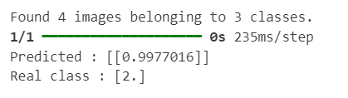
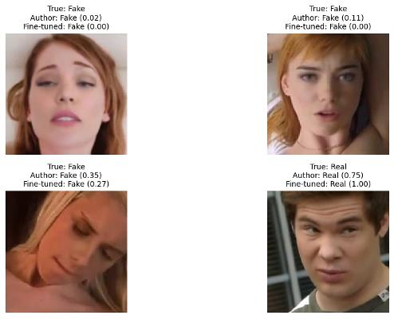
Base-line model
Refined Model
Outputs

Slide 12
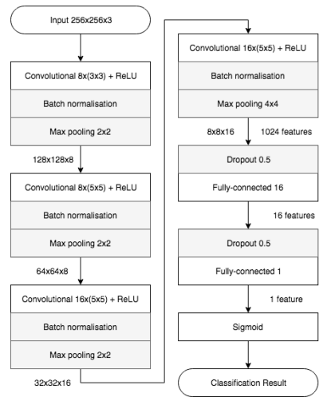
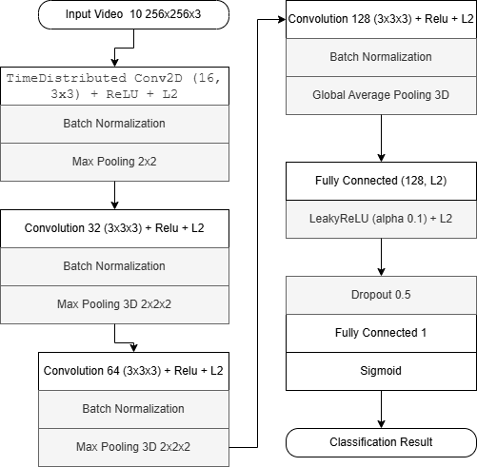
Base-line model
Refined Model
Outputs

Slide 13
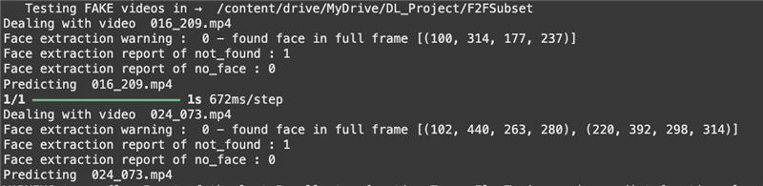
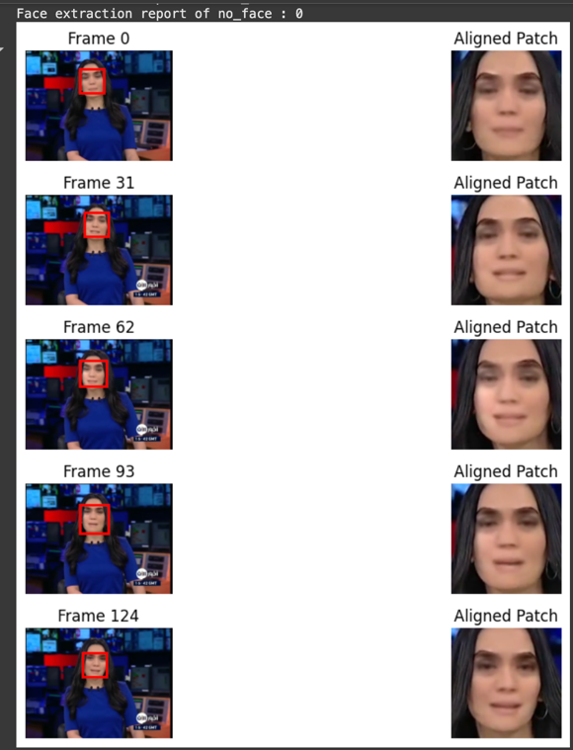
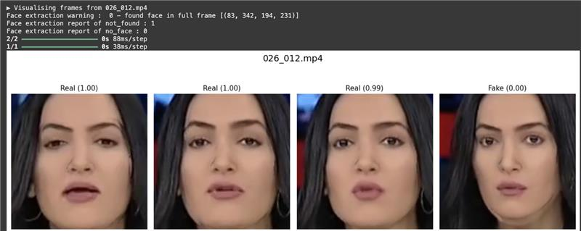
Base-line model
Refined Model
Outputs

Slide 14
Conclusion

Slide 15
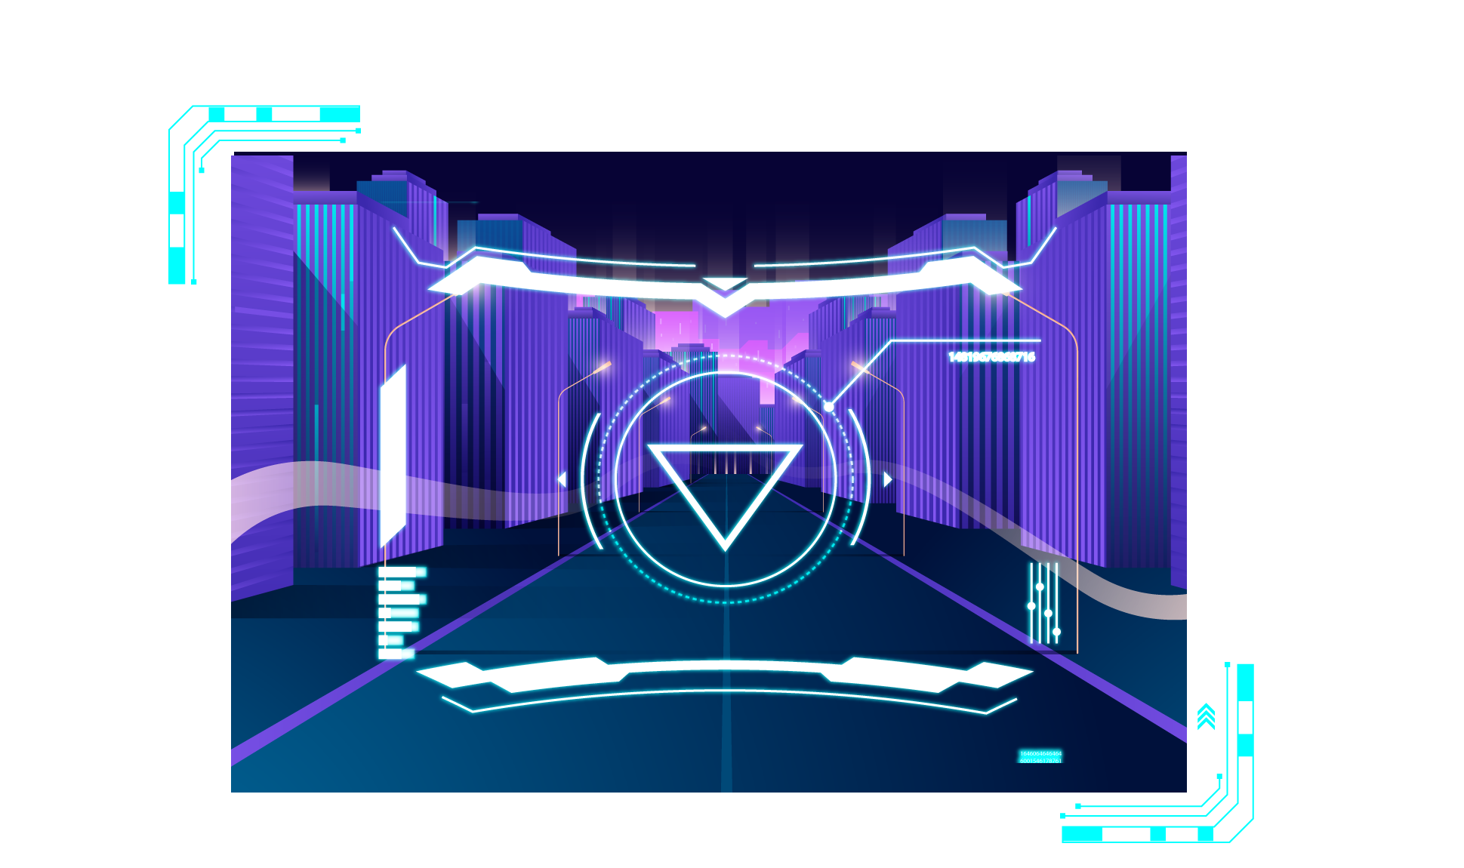
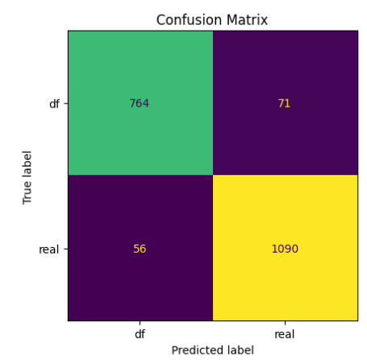
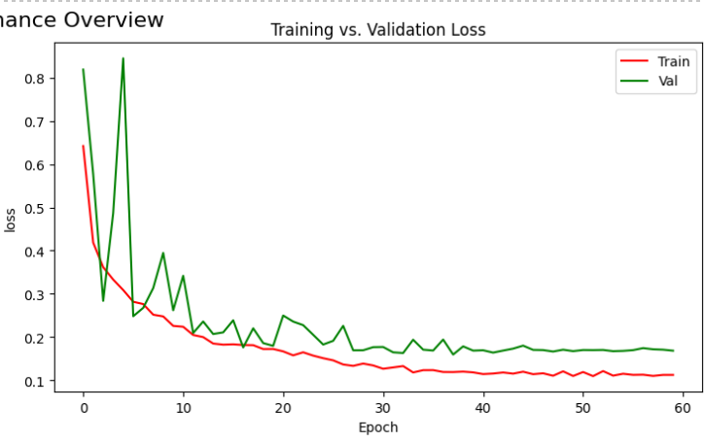
Meso-4 Refined

Slide 16
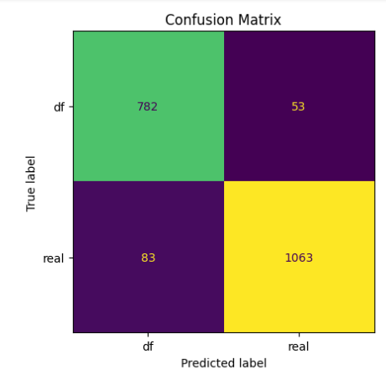
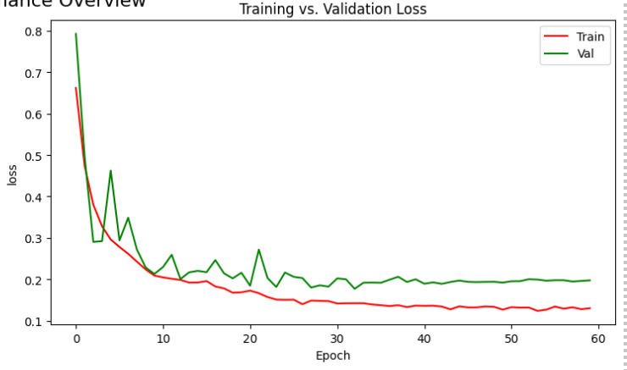
MesoInception-4 Refined

Slide 17
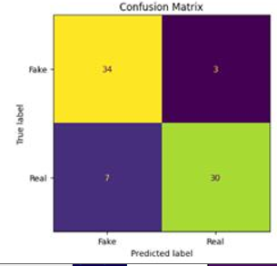
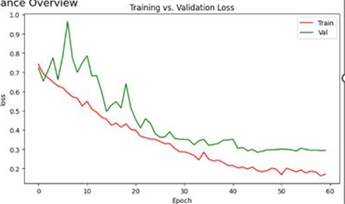
Meso-3D

Slide 18


OUR TEAM
Jawaher Alkhamis
Dhoha Almubayedh

