Slide 1
Enhanced K-Replay Model for Real World Knowledge Image Captioning
ICS 590: Spl Topics in Deep Learning
Student: Reem AlJunaid g202102170
Supervisor: Dr. Muzammil Behzad

Slide 2
Outline:
Introduction
Literature Review
Limitations
Existing Model and Challenges
Proposed Enhancements
Algorithm
Loss Function and Optimization
Datasets and Preprocessing
Performance Metrics
Experiment Setup
Results
Conclusion

Slide 3
Introduction
Image captioning combines computer vision and natural language processing to describe images.
Applications include multimedia understanding and aiding the visually impaired.
Existing models often generate generic captions lacking real-world knowledge (e.g., named entities, context).
Missing knowledge can be critical for fully understanding image content.
Rich, detailed captions can improve downstream.

Slide 4
Literature Review
🔹 Early Approaches: Encoder-Decoder
CNN + RNN models
Converted visual features into text linearly
Limited in capturing long dependencies and complex scenes
🔹 Enhancements: Attention Mechanisms
Visual Attention modules (e.g., Bottom-Up & Top-Down, AoA)
Improved focus on important image regions during captioning
🔹 Shift to Transformer-Based Models
Transformers enable parallel sequence processing.
🔹 NLP-Driven Multimodal Models
Inspired by BERT’s bidirectional attention
🔹 Vision-Language Pretraining (VLP) Models
Pretraining on large image-caption datasets
Recent SOTA: BLIP, GIT, OFA achieve top benchmark results.
Notes:
"Image captioning has evolved a lot over the years. Initially, models used CNNs to encode images and RNNs to decode captions, like in the early work by Vinyals et al. However, these models struggled with capturing complex relationships in scenes.
To address this, attention mechanisms were introduced — models like Bottom-Up and Top-Down and AoA helped focus on important regions of the image dynamically while generating captions.
Later, transformers replaced RNNs, allowing parallel processing of sequences and better handling of long-range dependencies. Meshed-Memory Transformer further improved context modeling by using memory vectors to capture relationships between different image parts.
Then, inspired by BERT in NLP, we saw the rise of Vision-Language Pretraining (VLP) models, like CLIP and OSCAR, which learned strong visual-text representations from massive datasets.
Finally, recent models like BLIP, GIT, and OFA combine visual and language understanding at scale, achieving state-of-the-art performance across multiple benchmarks."

Slide 5
Related Work
Retrieve-and-generate frameworks enrich captions using external resources
Entity-aware models integrate named entities via templates or decoder modifications
Visual recognition outputs used to guide caption generation
Contextual metadata (e.g., geolocation) incorporated for more specific descriptions
Fine-tuning Vision-Language Pre-trained (VLP) models for knowledge-informed captioning
Notes:
"Image captioning has evolved a lot over the years. Initially, models used CNNs to encode images and RNNs to decode captions, like in the early work by Vinyals et al. However, these models struggled with capturing complex relationships in scenes.
To address this, attention mechanisms were introduced — models like Bottom-Up and Top-Down and AoA helped focus on important regions of the image dynamically while generating captions.
Later, transformers replaced RNNs, allowing parallel processing of sequences and better handling of long-range dependencies. Meshed-Memory Transformer further improved context modeling by using memory vectors to capture relationships between different image parts.
Then, inspired by BERT in NLP, we saw the rise of Vision-Language Pretraining (VLP) models, like CLIP and OSCAR, which learned strong visual-text representations from massive datasets.
Finally, recent models like BLIP, GIT, and OFA combine visual and language understanding at scale, achieving state-of-the-art performance across multiple benchmarks."

Slide 6
Limitations
The current approaches for image captioning face several limitations:
Generic Captions.
Knowledge Forgetting During Fine-tuning.
Dependency on External Tools.
Knowledge Hallucination.

Slide 7
Existing Model and Challenges
🧠 Baseline: K-Replay Framework
Designed to retain real-world knowledge during VLP model fine-tuning for image captioning
Uses a replay buffer with pseudo-captions to maintain previously learned knowledge
Greedy decoding used for pseudo-captions → leads to generic, low-diversity outputs
Combines multiple loss functions (CE, know, distillation) → causes training instability
OFA backbone lacks self-attention over image patches before text fusion → may miss fine-grained visual patterns

Slide 8
Proposed Enhancements
Beam search decoding for generating diverse and accurate pseudo-captions.
Attention layers to better focus on relevant image regions.
Learning rate schedulers to stabilize training.

Slide 9
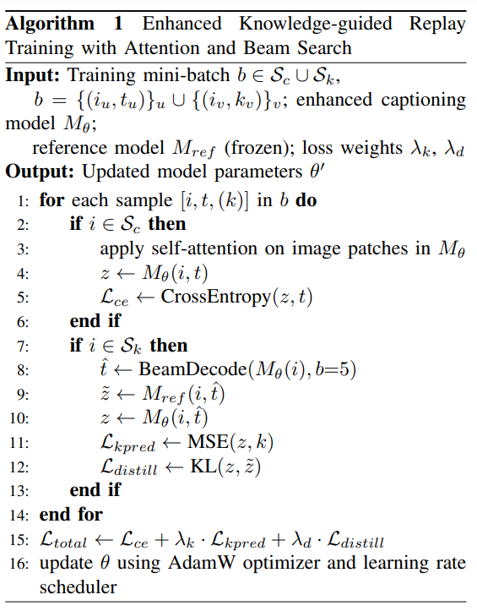
Algorithm

Slide 10





Loss Function
Vanila Finetuning VLP Loss:
Knowledge Distillation Loss:
Knowledge Prediction Loss:

Slide 11
Datasets and Preprocessing
MS-COCO
Standard image captioning dataset.
Karpathy split: 113,287 training / 5,000 validation / 5,000 test images.
Replay CC12M Subset
Over 20,000 samples curated from CC12M.
Filtered image-text pairs mentioning 122 predefined keywords.
Used as replay exemplars during training.
KnowCap
Dataset for real-world knowledge-enhanced captioning.
1,424 image-caption pairs across 240 knowledge categories, 424 validation, 1,000 testing.
Includes an “unseen” subset (520 samples, 120 new categories) to test generalization.

Slide 12
Datasets and Preprocessing
All datasets converted into pycocoevalcap standard format.
Training set:
Randomly selected 27,000 image-caption pairs from COCO.
Randomly selected 5,000 image-keyword pairs from Replay CC12M.
Combined and shuffled to form a 32,000-sample training set.
Validation set:
Used COCO validation set and KnowCap validation set.
Testing set:
Evaluated on COCO test set, full KnowCap test set, and KnowCap unseen subset

Slide 13
Performance Metrics
BLEU:
Measures n-gram precision against ground truth captions.
METEOR:
Considers stemming, synonyms, and exact matches for semantic similarity.
ROUGE:
Focuses on recall through n-gram and sequence overlap.
CIDEr:
Evaluates TF-IDF weighted n-gram similarity to human references.
Knowledge Recognition Accuracy:
Measures correct inclusion of real-world concepts using KnowCap dataset keywords.

Slide 14
Experiment Setup
Google Colab with NVIDIA A100 GPU.
OFA-Large (official PyTorch checkpoint).
Batch size: 8
Epochs: 10
Learning rate: 7e-6
Label smoothing: 0.1
Knowledge distillation temperature: T = 16
Loss weights: 1.0 for both distillation and knowledge prediction.
Best checkpoint selected based on validation performance on KnowCap dataset.

Slide 15
Results

Slide 16
Results

Slide 17
Results

Slide 18
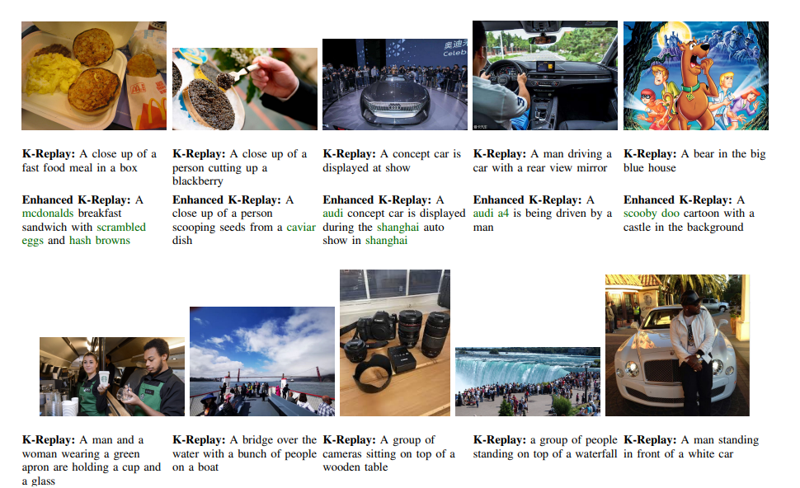
Results

Slide 19
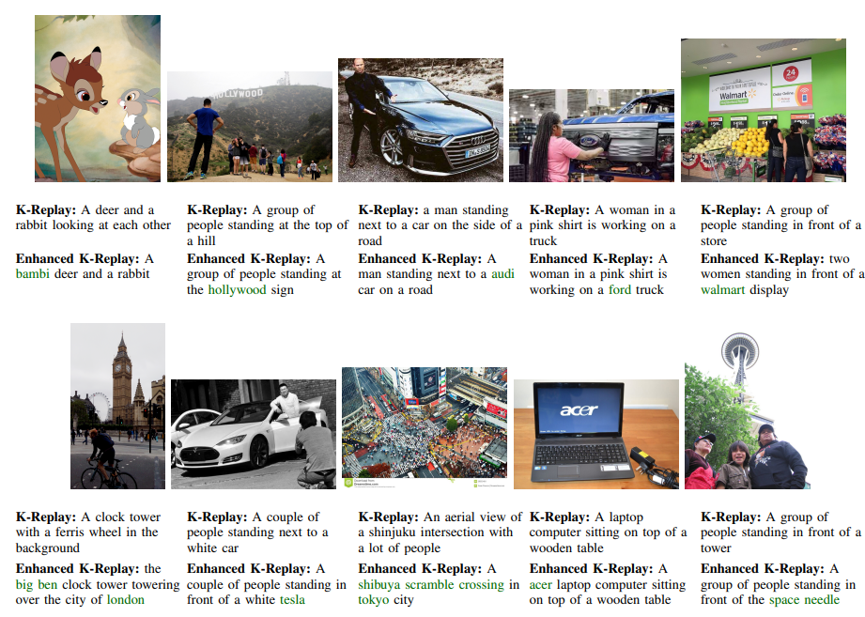
Results

Slide 20
Results

Slide 21
Conclusion
Enhanced the KnowCap framework with beam search, attention modules, and training schedulers.
Achieved better caption quality and improved knowledge recognition.
Improved generalization to unseen knowledge concepts.
Future work will explore prompt-augmented keyword generation for more relevant and focused captions.

