Slide 1
Enhanced K-Replay Model for Knowledge Image Captioning
ICS 590: Spl Topics in Deep Learning
Student: Reem AlJunaid g202102170
Supervisor: Dr. Muzammil Behzad

Slide 2
Outline:
Introduction
Literature Review
Limitations
Baseline Model and Challenges
Proposed Enhancements
Algorithm
Loss Function and Optimization
Datasets and Preprocessing
Performance Metrics
Experiment Setup
Results
Conclusion
Notes:
Assalam Alikum

Slide 3
Introduction
Image captioning combines computer vision and natural language processing to describe images.
Applications include multimedia understanding and aiding the visually impaired.
Existing models often generate generic captions lacking real-world knowledge (e.g., named entities, context).
Missing knowledge can be critical for fully understanding image content.
Rich, detailed captions can improve downstream.
Notes:
"Image captioning is the task of describing images by combining techniques from computer vision and natural language processing. It has many important applications, including improving how we understand multimedia content and supporting visually impaired people by with meaningful descriptions.
However, existing image captioning models often produce generic captions which lack the important real-world knowledge, such as contextual details or named entities like places, brands, or people. This missing information can be critical for fully understanding what’s happening in an image.
Moreover, generating rich and detailed captions doesn't just help with image understanding — it can also improve the performance of other AI systems that depend on captions, like visual question answering systems.
In this project, we aim to address these challenges by enhancing image captioning with more real-world knowledge."

Slide 4
Literature Review
🔹 Early Approaches: Encoder-Decoder
CNN + RNN models
Converted visual features into text linearly
Limited in capturing long dependencies and complex scenes
🔹 Enhancements: Attention Mechanisms
Visual Attention modules (e.g., Bottom-Up & Top-Down, AoA)
Improved focus on important image regions during captioning
🔹 Shift to Transformer-Based Models
Transformers enable parallel sequence processing.
🔹 Vision-Language Pretraining (VLP) Models
Pretraining on large image-caption datasets
Recent SOTA: BLIP, GIT, OFA achieve top benchmark results.
Notes:
"Image captioning has evolved a lot over the years.
Early Approaches: Encoder-Decoder
CNNs to encode images and RNNs to decode captions.
However, these models can not capture the complex relationships in scenes.
To address this, attention mechanisms were introduced —
models like Bottom-Up and Top-Down and AoA they helped focus on important regions of the image while generating captions.
Later, transformers replaced RNNs, to allow parallel processing of sequences and better handling of long dependencies.
Then, inspired by BERT in NLP, we saw the rise of Vision-Language Pretraining (VLP) models, like CLIP and OSCAR, which learned strong visual-text representations from massive datasets.
Finally, recent models like BLIP, GIT, and OFA combine visual and language understanding at scale, achieving state-of-the-art performance across multiple benchmarks."

Slide 5
Related Work
Retrieve-and-generate frameworks enrich captions using external resources
Entity-aware models integrate named entities via templates or decoder modifications
Visual recognition outputs used to guide caption generation
Contextual metadata (e.g., geolocation) incorporated for more specific descriptions
Fine-tuning Vision-Language Pre-trained (VLP) models for knowledge-informed captioning
Notes:
Several studies tried to enhance the captions with knowledge based on Retrieve-and-generate frameworks external resourcs. Like entity-aware models, visual recognition models, or metadata.
Other studies fine-tuned vision-language models for captioning, but they still suffer from generic bias.

Slide 6
Limitations
The current approaches for image captioning face several limitations:
Generic Captions.
Knowledge Forgetting During Fine-tuning.
Dependency on External Tools.
Knowledge Hallucination.
Notes:
Generic Captions: Most of image captioning produces safe, generic captions that lack real-world knowledge.
Knowledge Forgetting During Fine-tuning: Fine-tuning can lead to catastrophic forgetting of previously learned real-world knowledge, including named entities, and contextual details.
Dependency on External Tools: Some models rely heavily on external resources (like object detectors or metadata) to inject knowledge. These tools require additional annotation and are often not scalable or reliable.
Knowledge Hallucination: Pretrained models sometimes include incorrect or made-up information in captions due to noisy image-text pairs in their training data.

Slide 7
Baseline Model and Challenges
🧠 Baseline: K-Replay Framework
Designed to retain real-world knowledge during VLP model fine-tuning for image captioning
Uses a replay buffer with knowledge keywords to maintain previously learned knowledge.
Notes:
Our base line model take a different approach — it fine-tunes a vision-language model, in a controlled way, to reduce generic bias and hallucinations, and make the captions more informative."

Slide 8
Baseline Model and Challenges
🧠 Baseline: K-Replay Framework
It has three main parts:
(1) Vanilla finetuning the VLP model for image captioning.
(2) Knowledge prediction task on the replay data to awaken the knowledge of pretrained VLP model
(3) Knowledge distillation constraint to alleviate the knowledge hallucination caused by pre-training noise
Notes:
Our base line model take a different approach — it fine-tunes a vision-language model, in a controlled way, to reduce generic bias and hallucinations, and make the captions more informative."

Slide 9
Baseline Model and Challenges
🧠 Baseline: K-Replay Framework
Greedy decoding used for pseudo-captions → leads to generic, low-diversity outputs
Combines multiple loss functions (CE, know, distillation) → causes training instability
OFA backbone lacks self-attention over image patches before text fusion → may miss fine-grained visual patterns
Notes:
Our base line model take a different approach — it fine-tunes a vision-language model, in a controlled way, to reduce generic bias and hallucinations, and make the captions more informative."

Slide 10
Proposed Enhancements
Beam search decoding for generating diverse and accurate pseudo-captions.
Attention layers to better focus on relevant image regions.
Learning rate schedulers to stabilize training.

Slide 11
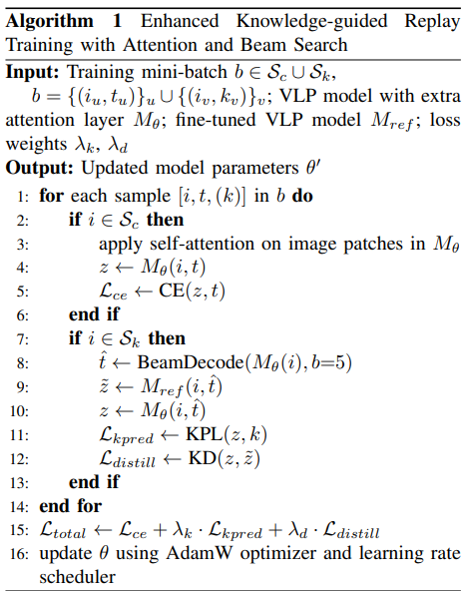
Algorithm

Slide 12





Loss Function
Vanila Finetuning VLP Loss:
Knowledge Distillation Loss:
Knowledge Prediction Loss:
Notes:
كول باك ليبلرز

Slide 13
Datasets and Preprocessing
MS-COCO
Standard image captioning dataset.
Karpathy split: 113,287 training / 5,000 validation / 5,000 test images.
Replay CC12M Subset
Over 20,000 samples curated from CC12M.
Filtered image-text pairs mentioning 122 predefined keywords.
Used as replay exemplars during training.
KnowCap
Dataset for real-world knowledge-enhanced captioning.
1,424 image-caption pairs across 240 knowledge categories, 424 validation, 1,000 testing.
Includes an “unseen” subset (520 samples, 120 new categories) to test generalization.

Slide 14
Datasets and Preprocessing
All datasets converted into pycocoeval standard format.
Training set:
Randomly selected 27,000 image-caption pairs from COCO.
Randomly selected 5,000 image-keyword pairs from Replay CC12M.
Combined and shuffled to form a 32,000-sample training set.
Validation set:
Used COCO validation set and KnowCap validation set.
Testing set:
Evaluated on COCO test set, full KnowCap test set, and KnowCap unseen subset

Slide 15
Performance Metrics
BLEU:
Measures n-gram precision against ground truth captions.
METEOR:
Considers stemming, synonyms, and exact matches for semantic similarity.
ROUGE:
Focuses on recall through n-gram and sequence overlap.
CIDEr:
Evaluates TF-IDF weighted n-gram similarity to human references.
Recognition Accuracy:
Measures the percentage of captions that correctly include valid knowledge-related keywords.

Slide 16
Experiment Setup
Google Colab with NVIDIA A100 GPU.
OFA-Large (official PyTorch checkpoint).
Batch size: 8
Learning rate: 7e-6
Label smoothing: 0.1
Knowledge distillation temperature: T = 16
Loss weights: 1.0 for both distillation and knowledge prediction.
Best checkpoint selected based on validation performance on KnowCap dataset.

Slide 17
Results

Slide 18
Results

Slide 19
Results

Slide 20
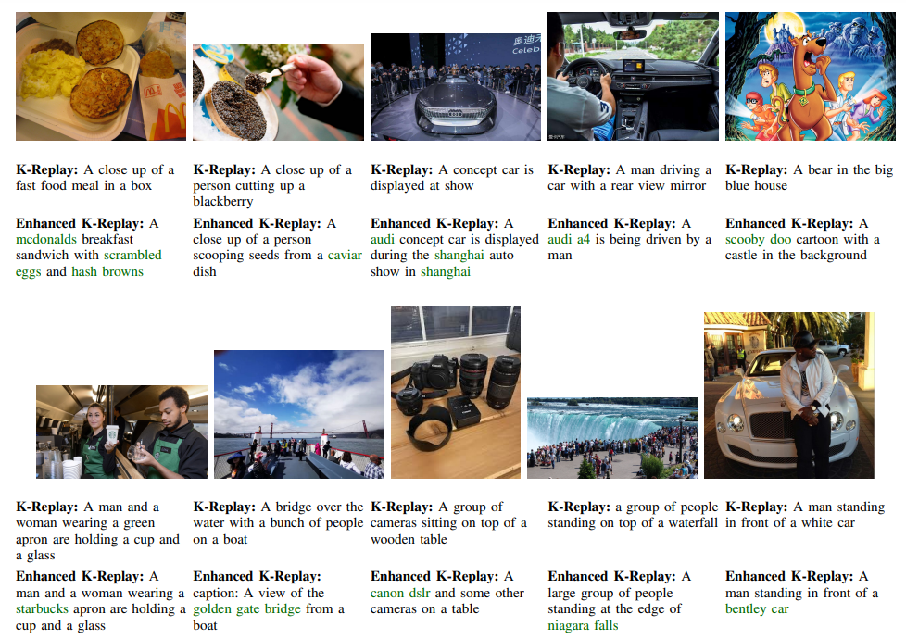
Results

Slide 21
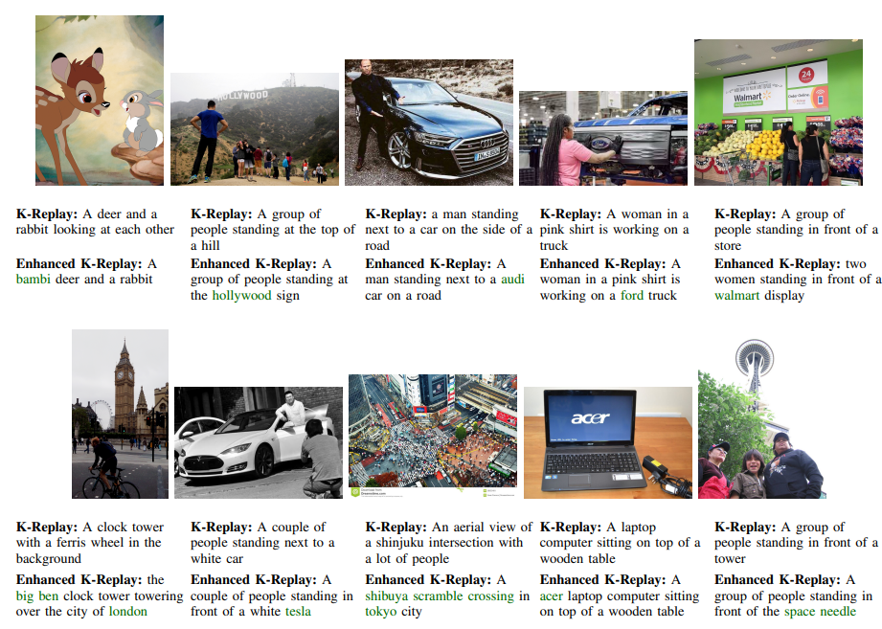
Results

Slide 22
Results
Notes:
EWC
Recall and Learn
Child tunning
Adapters

Slide 23
Conclusion
Enhanced the KnowCap framework with beam search, attention modules, and training schedulers.
Achieved better caption quality and improved knowledge recognition.
Improved generalization to unseen knowledge concepts.
Future work will explore prompt-augmented keyword generation for more relevant and focused captions.

