Slide 1
Examining the Potential of Multimodality for Vision-Language Models: EXPLORE
Saad Alghamdi - Abdulaziz Alshukri - Mohammed Alharthi

Slide 2
TABLE OF CONTENTS
01
02
03
04
INTRODUCTION
Overview
Abstract - Terminologies
Base model - Dataset
Our Work
Results
Design and Experiment Setup
You can describe the topic of the section here

Slide 3
01
INTRODUCTION

Slide 4
Abstract
This project explores enhancements to the InstructBLIP vision-language model, focusing on improved performance through instruction-based prompting and better generalization in zero-shot settings. It investigates various architectural configurations and introduces Low-Rank Adaptation (LoRA) to compress model parameters. The aim is to retain at least 70% of the original model’s performance while enabling deployment on resource-constrained devices.

Slide 5

Terminologies
Vision Language Models
(VLM)
Low-Rank Adaptation (LORA)
combines both visual recognition and language generation to perform tasks
A technique which is applied on layers of the language model to enable efficient fine tuning with fewer number of trainable parameters
Freeze/Unfreeze Model
Tokenization
A training technique where some layers of the model are kept unchanged (frozen) while others are updated (unfrozen) to speed up training or prevent overfitting
The process of converting input text into smaller units (tokens), such as words/subwords, which can be processed by the model.
Notes:
Vision Language Models (VLM): Models that combine visual understanding and language processing to perform tasks like image captioning or visual question answering.
Low-Rank Adaptation (LoRA): A method for fine-tuning large models efficiently by injecting small trainable matrices into frozen model layers, reducing the number of trainable parameters.
Freeze/Unfreeze Model: A training technique where some layers of the model are kept unchanged (frozen) while others are updated (unfrozen) to speed up training or prevent overfitting.
Tokenization: The process of converting input text into smaller units (tokens), such as words or subwords, which can be processed by the model.

Slide 6
Terminologies
Visual Question Answering (VQA)
Multimodality
The integration of multiple data types (e.g., images and text) to enhance model understanding and task performance
A task where a model answers questions about images, requiring both visual and linguistic understanding.
Notes:
Multimodality: The presence and interaction of multiple types of data (modalities), such as visual, textual, or auditory inputs, within a single model or system. In vision-language models, this typically refers to the combination of image and text modalities to achieve richer understanding

Slide 7
02
Overview

Slide 8
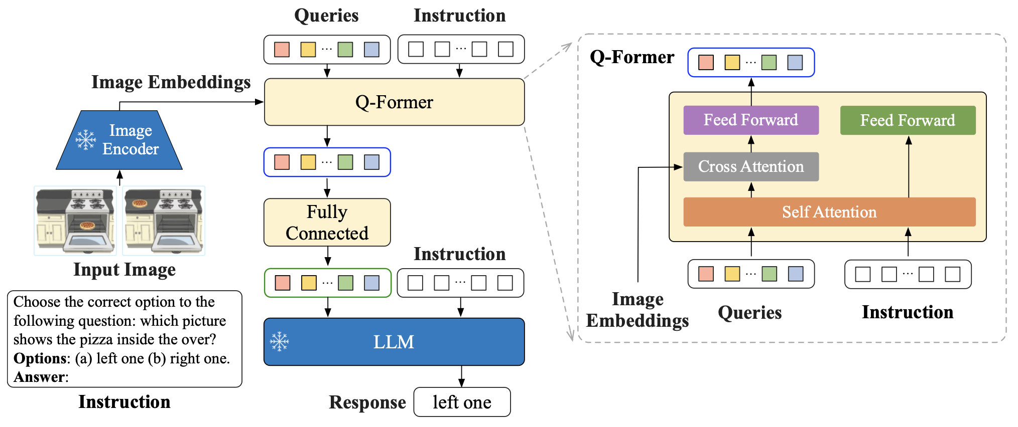
Model Architecture of InstructBLIP.
2
1
3
Notes:
Training Phases:
Pretraining: Vision-Language Learning
Q-Former learns to pull visual info from the frozen image encoder.
No instruction is used yet.
Pretraining: Soft Prompt for LLM
The output of Q-Former is used as a soft prompt to train the LLM to generate text from images.
Still no instruction.
Instruction Tuning (Final Step)
Now, instructions are added as input to the Q-Former.
The model is fine-tuned so that the Q-Former learns to extract instruction-relevant features.
The LLM receives both instruction + visual context, and is trained to output correct responses.
The vision encoder does this: it converts the image into visual embeddings — basically, numerical features that describe the content of the image.
Image → Vision Encoder → Visual Embeddings
Q-former: stands for querying transformer
The input to the Q-Former contains a set of K learnable query embeddings, which interact with the image encoder’s output through cross attention
Cross attention = This is the mechanism where each query looks at the whole image and focuses on relevant parts
Plus the Instruction
The instruction can now influence what the Q-Former chooses to extract from the image. It’s like telling the model, “focus only on what’s needed for this task
LLM:
he task-specific visual info (from Q-Former)
The instruction text
It outputs the final natural language response, like a caption or answer.

Slide 9
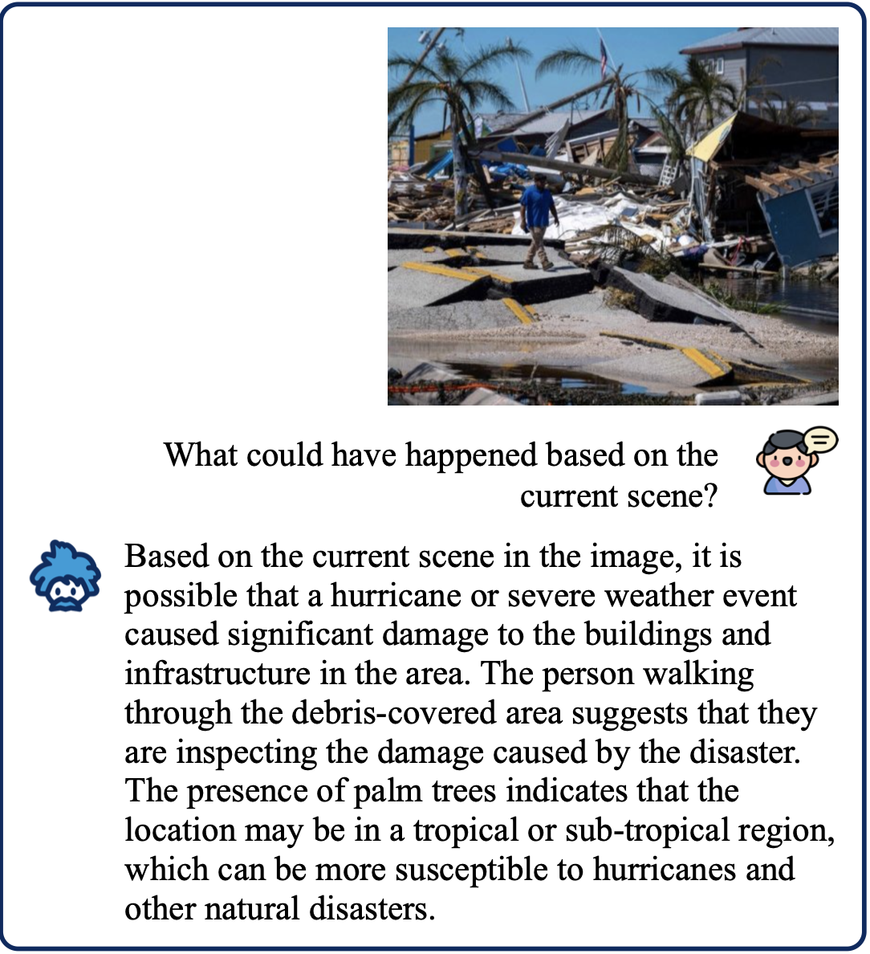
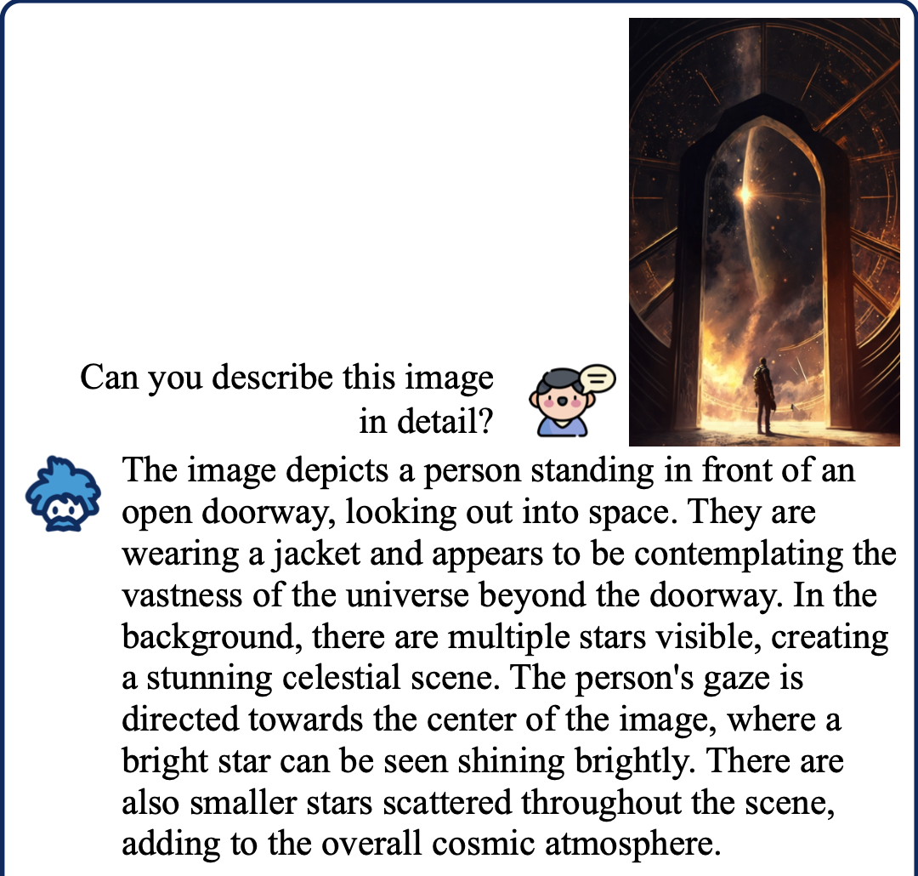
examples generated by InstructBLIP

Slide 10
Dataset
VL-RewardBench dataset :
1250 samples curated for several vision language tasks
we used 80% in (1000 example) in training and kept the remaining 20% (250 example) for testing
1 sample:
3 main components
image = sample['image']
query = sample['query']
actual_response = sample['response']
Notes:
s a comprehensive benchmark designed to evaluate vision-language generative reward models (VL-GenRMs) across visual perception, hallucination detection, and reasoning tasks.

Slide 11
03
Our Work

Slide 12
Proposed Enhancements
parameter-efficient fine-tuning technique (PEFT)
▾low-rank matrices
LoRa (Low Rank Adaptation)
Preserve model's performance
Optimize the computational efficiency
Notes:
we propose an optimized enhancement that focuses on preserving the model's performance while optimizing the computational efficiency.
This enhancement is introduced by applying LoRa (Low Rank Adaptation). LoRa is a parameter-efficient fine-tuning technique (PEFT) that works by introducing low-rank matrices to be trained instead of training the total parameters of the model

Slide 13
Language Complexity
Loss Function
Cross-Entropy Loss
Probabilistic Nature
Notes:
In our implementation, Probabilistic Nature
we have chosen cross-entropy to be used as the main training loss to handle the language complexity. The probabilistic nature of the cross-entropy loss makes it a good choice to check
In our implementation, we use cross-entropy loss as the primary training objective to handle the complexity of natural language generation.
Its probabilistic nature makes it well-suited for comparing the model’s predicted token distributions against the ground truth responses during instruction tuning.

Slide 14
Experiment Setup
10 experiments
Experiments 1 - 4
fine-tuning with reduced model architecture configurations and different LoRa parameters
Experiments 5 - 8
increasing the model configurations and model size with different LoRa parameters
Experiment 9 - 10
default model configurations with different LoRa setups

Slide 15
04
Results
You can enter a subtitle here if you need it

Slide 16
Evaluation Metrics
cross-entropy loss
ROUGE metrics
Using cross-entropy loss to align predicted text with ground truth during instruction tuning.
To evaluate the text-generation quality
CLIP score
MME benchmark
Evaluating the alignment between text and visual content
The MME benchmark is standard framework to compare the different models and configurations in multimodalities task

Slide 17
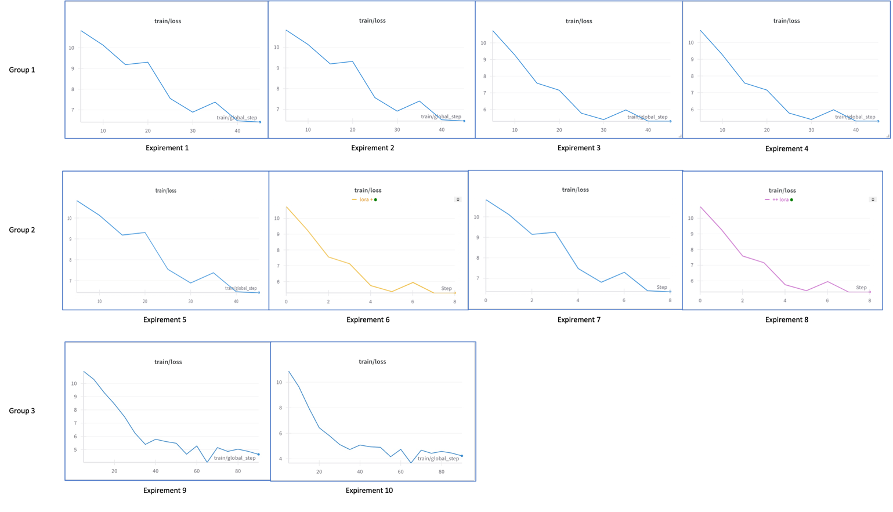
Training Loss

Slide 18
Performance Results
Experiment | Configuration Description | Test Loss | ROUGE-1 | ROUGE-2 | ROUGE-L | CLIP Score | MME Overall
1 | Medium model | Default LoRA | 5.674 | 0.2285 | 0.1039 | 0.1924 | 0.2657 | 1315.15
2 | Small model | Default LoRA | 5.7099 | 0.2282 | 0.1037 | 0.1928 | 0.2663 | 1339.66
3 | Medium model | Enhanced LoRA | 3.2433 | 0.2292 | 0.1057 | 0.1956 | 0.2647 | 1321.87
4 | Small model | Enhanced LoRA | 3.2548 | 0.2282 | 0.1044 | 0.1932 | 0.2638 | 1323.35
5 | large model | Default LoRA | 5.8116 | 0.2209 | 0.0971 | 0.1818 | 0.2644 | 1339.66
6 | large model | Enhanced LoRA | 3.2817 | 0.2198 | 0.0960 | 0.1813 | 0.2619 | 1322.58
7 | Extra-Large model | Default LoRA | 5.6749 | 0.2171 | 0.0955 | 0.1788 | 0.2652 | 1332.86
8 | Extra-Large model | Enhanced LoRA | 3.2839 | 0.2184 | 0.0966 | 0.1808 | 0.2616 | 1323.60
9 | Default model | Default LoRA | Extended training | 4.8339 | 0.1434 | 0.0463 | 0.0935 | 0.2671 | 1294.84
10 | Default model | Enhanced LoRA | Extended training | 4.5713 | 0.1193 | 0.0315 | 0.0794 | 0.2528 | 1262.80

Slide 19
impact of different LoRa parameter settings
Model Size | Standard LoRA Test Loss | Enhanced LoRA Test Loss | Improvement (%)
Small (Exp 2 vs. 4) | 5.7099 | 3.2548 | 43.0%
Medium (Exp 1 vs. 3) | 5.6740 | 3.2433 | 42.8%
large (Exp 5 vs. 6) | 5.8116 | 3.2817 | 43.5%
Extra-large (Exp 7 vs. 8) | 5.6749 | 3.2839 | 42.1%
default Extended (Exp 9 vs. 10) | 4.8339 | 4.5713 | 5.4%
$$Improvement \left(\%\right)= \frac{Standard Loss−Enhanced Loss}{Standard Loss}∗100$$

Slide 20
REFERENCES
Dai, W., Li, J., Li, D., Tiong, A. M. H., Zhao, J., Wang, W., Li, B., Fung, P., & Hoi, S. (2023). InstructBLIP: Towards General-purpose Vision-Language Models with Instruction Tuning. arXiv. https://doi.org/10.48550/arXiv.2305.06500AUTHOR (YEAR). Title of publication. Publisher.
Li, L., Wei, Y., Xie, Z., Yang, X., Song, Y., Wang, P., An, C., Liu, T., Li, S., Lin, B. Y., Kong, L., & Liu, Q. (2024). VL-RewardBench: A Challenging Benchmark for Vision-Language Generative Reward Models. arXiv. https://huggingface.co/datasets/MMInstruction/VL-RewardBench AUTHOR (YEAR). Title of publication. Publisher.

Slide 21
Thank you!

