Slide 1
PG-Attention: Prompt-Guided Attention Adapter for Multi-View Few-Shot Medical Anomaly Detection
Alhanoof Alhunief
Supervised by Dr. Muzammil Behzad

Slide 2
Medical anomaly detection is critical for early diagnosis.
Few-shot learning settings are challenging.
Traditional models require large labeled datasets.
Motivation

Slide 3
Vision-Language Models like CLIP show promise.
MVFA-AD improves anomaly detection but has:
Generic prompts.
Simple MLP adapters.
Problem Statement

Slide 4
Introduce domain-specific prompt engineering. ( medical imaging ).
Proposed Solution:
PG-Attention
Integrate Adapter-with-Attention (AWA) modules inside the vision encoder.

Slide 5
Craft medically meaningful, domain-specific prompts
Use modality-specific and pathology-specific terms.
Example (Brain MRI):
Normal: "An MRI image of a healthy brain without tumors."
Abnormal: "An MRI image showing a malignant brain tumor."
Prompt Engineering

Slide 6
AWA module structure:
Lightweight Multi-Head Self-Attention (MHSA).
Followed by MLP bottleneck layers.
Benefits:
Capture spatial dependencies between image patches.
Model subtle anomalies spread across regions.
Adapter-with-Attention (AWA)

Slide 7
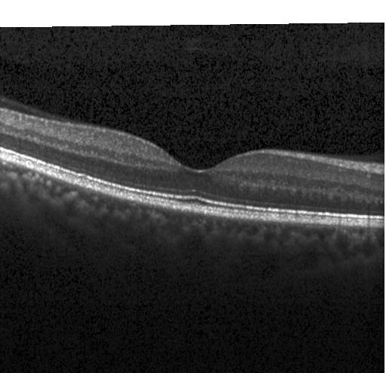
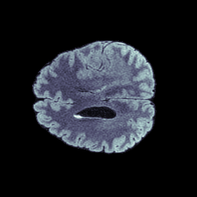
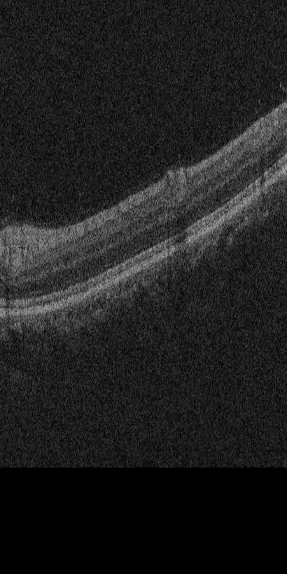
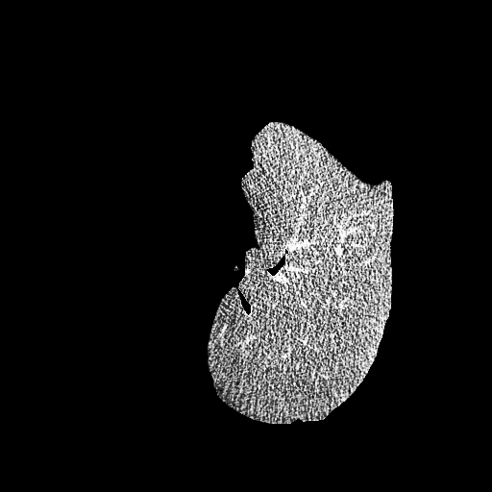
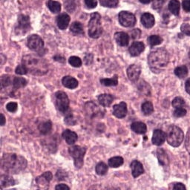
Datasets
BraTS (Brain MRI)
LiTS (Liver CT)
RESC (Retina Fundus)
OCT2017 (Retina OCT)
CRCHisto (Histopathology)

Slide 8
Few-shot learning: 4 labeled images per class.
Loss functions:
Binary Cross-Entropy (BCE) for classification.
Dice Loss and Focal Loss for segmentation.
Training Strategy

Slide 9
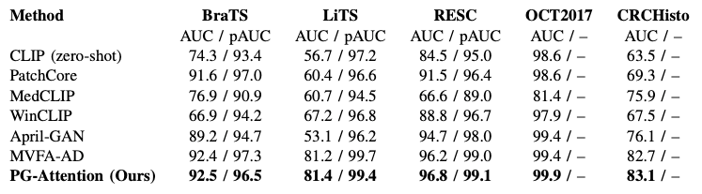
Few-shot (k=4) comparison of anomaly detection performance across five medical datasets. We report image-level AUC / pixel-level AUC (pAUC) where applicable.
Experimental Results

Slide 10
Empirical results demonstrate that PG-Attention consistently achieves comparable or better results than prior state-of-the-art methods, especially in modalities where spatial context and semantic precision are critical.
Future directions:
Semi-supervised learning.
Active learning with prompts.
3D volumetric scans and multi-modal data.
Conclusion and
Future Work

Slide 11
Thank You
Alhanoof Alhunief

