Slide 1
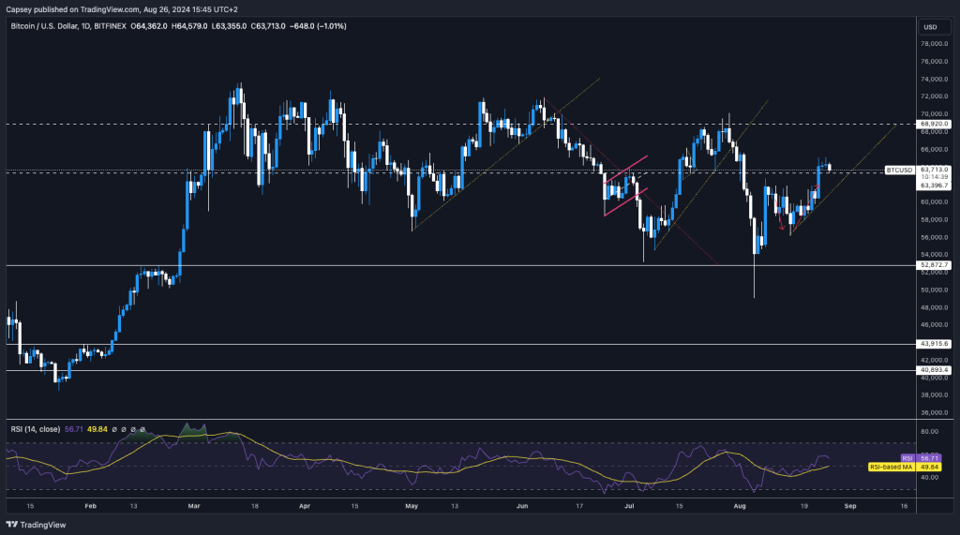

Experimental Study of Deep Learning
Models for Short-Term Crypto Price Forecasting
A Comparative Analysis of Neural Architectures for Bitcoin and Ethereum Prediction
Waseem Mohamad (Student ID: g202401140)
King Fahd University of Petroleum and Minerals
Supervised by: Dr. Muzammil Behzad

Slide 2



Introduction: Cryptocurrency Market Characteristics
Market Features
Forecasting Challenges
Extreme Volatility - Daily swings exceeding 10% common
Nonlinearity - Complex price patterns
Data accessibility - Limited public data
Regime shifts - Sudden market changes
24/7 Trading - Continuous global markets
Decentralized - No central authority
Behavioral Factors
Sentiment-driven - News & social media impact
Herding behavior - Group decision-making
Speculative nature - High risk/reward
Noise vs. Signal - Difficulty extracting patterns

Slide 3






Problem Statement & Objectives
Research Problem
Central Question
How can deep learning models be designed, trained, and evaluated to forecast short-term cryptocurrency price movements using only publicly accessible datasets?
Research Objectives
Construct reproducible multimodal dataset combining price history, technical indicators, news, and search trends
Compare performance across multiple target formulations (regression, direction classification, local extrema)
Implement and evaluate diverse DL architectures (MLP, LSTM, CNN-LSTM, Transformer)
Assess how model complexity affects predictive stability during high volatility periods

Slide 4




Literature Review: Evolution of Forecasting Techniques
Methodological Evolution
Classical Models
ML Approaches
Deep Learning
• ARIMA, GARCH, VAR
• Linear relationships
• Limited with volatility
• SVM, Random Forest
• Nonlinear patterns
• Feature engineering
• LSTM, CNN, Transformers
• Temporal dependencies
• Multimodal integration
Limitations in Existing Research
Data Accessibility - Reliance on proprietary APIs (Twitter, Reddit)
Model Instability - Poor performance during market shocks
Target Formulation - Focus on regression vs. classification
Reproducibility - Limited open-source implementations

Slide 5





Methodology: Data Sources & Feature Engineering
Publicly Accessible Data Sources
Feature Engineering
Kaggle OHLCV
Price Features
Technical Indicators
BTC (2010-2024) & ETH (2015-2024)
• Log returns
• Volatility (7/30-day)
• Moving averages
• ATR & RSI
• MACD
• Stochastic oscillator
• Bollinger Bands
• Williams %R
Google Trends
Search interest in crypto terms
Sentiment Features
Trends & Macro
• News count
• Title length
• Sentiment scores
• Sentiment variance
• Search velocity
• Z-score transforms
• Macro returns
• Volume indicators
Google News
Headlines & sentiment analysis
Yahoo Finance
S&P 500, VIX, Gold prices

Slide 6





Model Architectures: Comparative Analysis
MLP
LSTM
Key Finding
Feedforward neural network with batch normalization and dropout
Single-layer recurrent network with 64 units
Simpler architectures (MLP & CNN-LSTM) consistently outperformed more complex models (LSTM-Deep & Transformer) across all evaluation metrics
Sequence length: 30-60 days
Dropout for regularization
Architecture: 128→64→32→16
Best performing model
LSTM-Deep
CNN-LSTM
Stacked LSTM with two layers (128→64 units)
Hybrid architecture with convolutional filtering
More complex sequential modeling
Higher parameter count
Causal Conv1D (3 & 5 filters)
Max pooling → LSTM

Slide 7
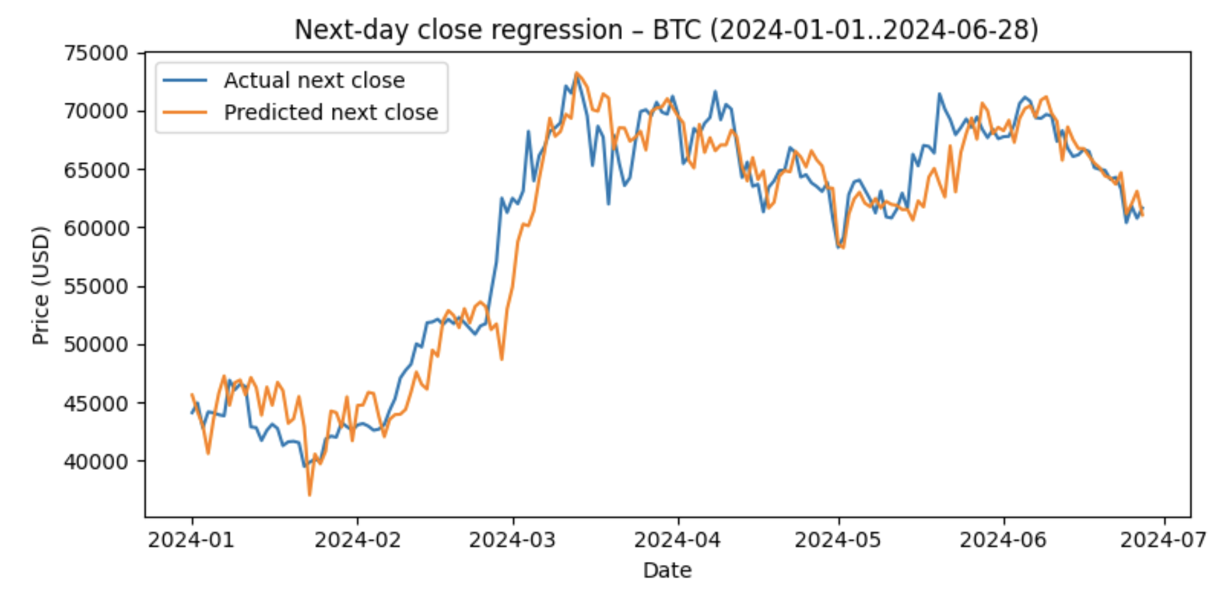
Regression Results – MLP (Best Performing)

Slide 8
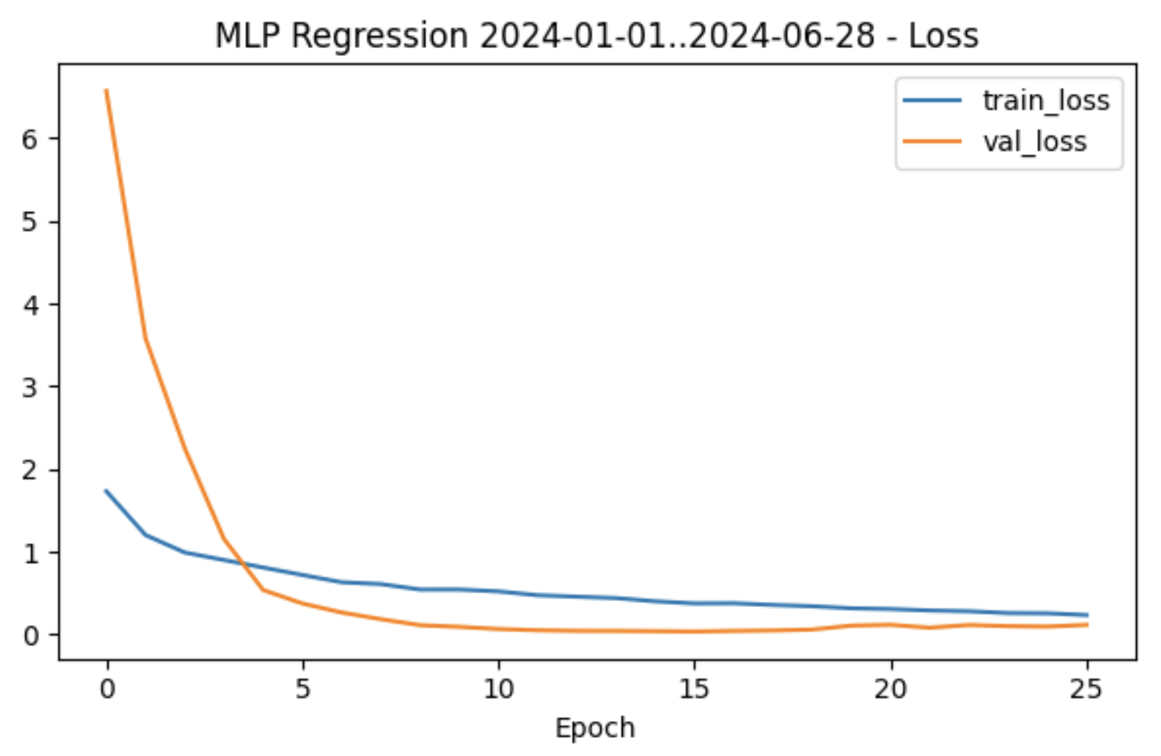
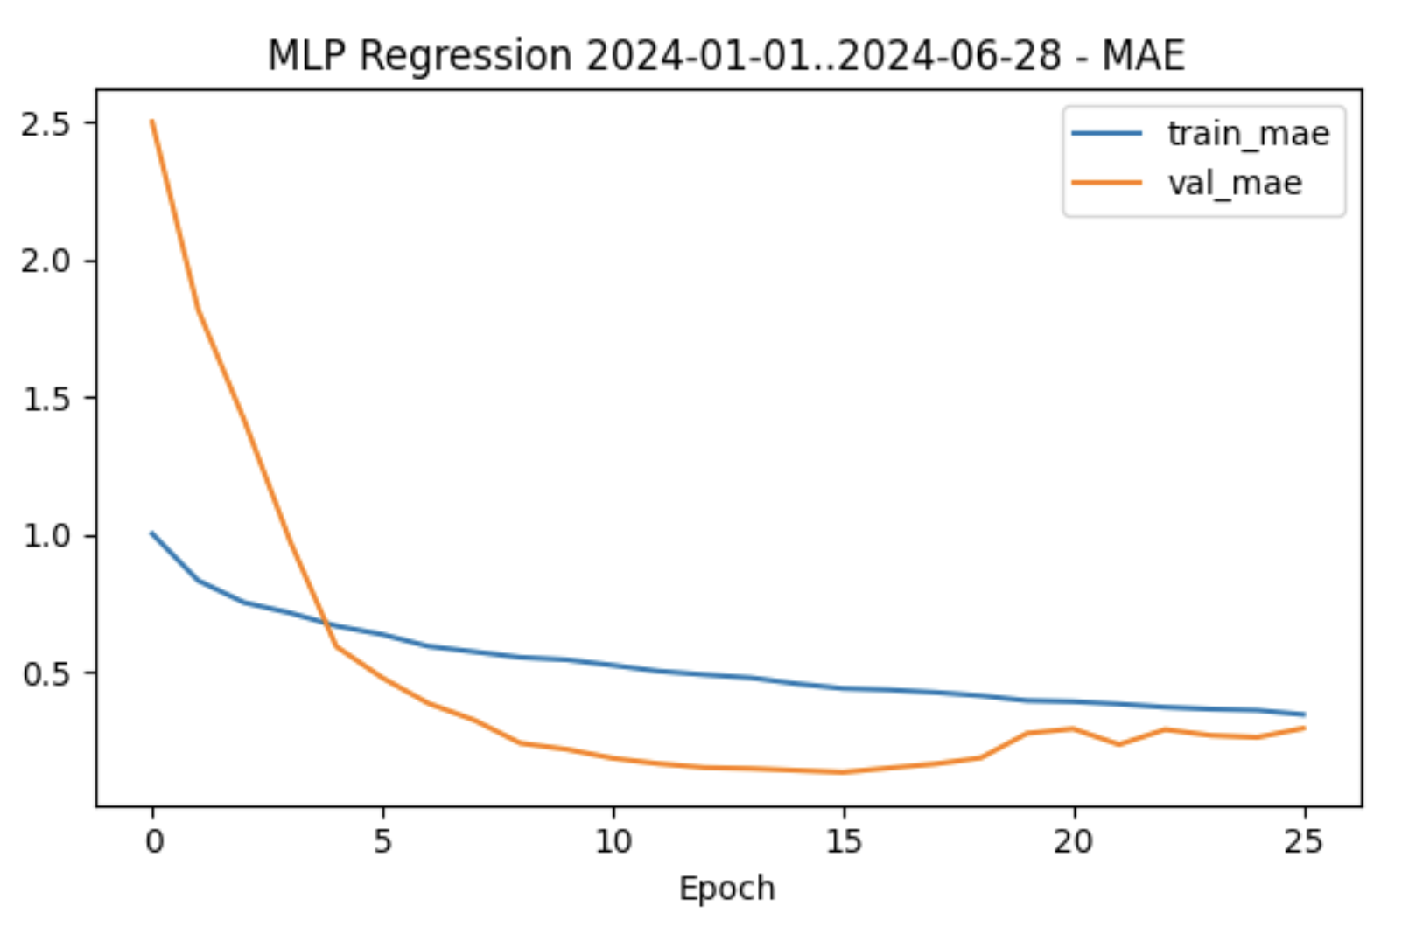
Regression Learning Curves – Loss and MAE for MLP

Slide 9
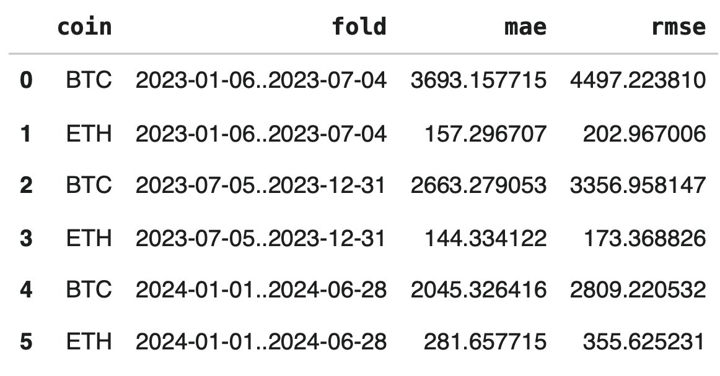
Cross Validation Summary - Regression
Consistency across three temporal folds
BTC MAE drops from 3693 to 2045 across splits
ETH RMSE stable in the 200 to 350 range

Slide 10
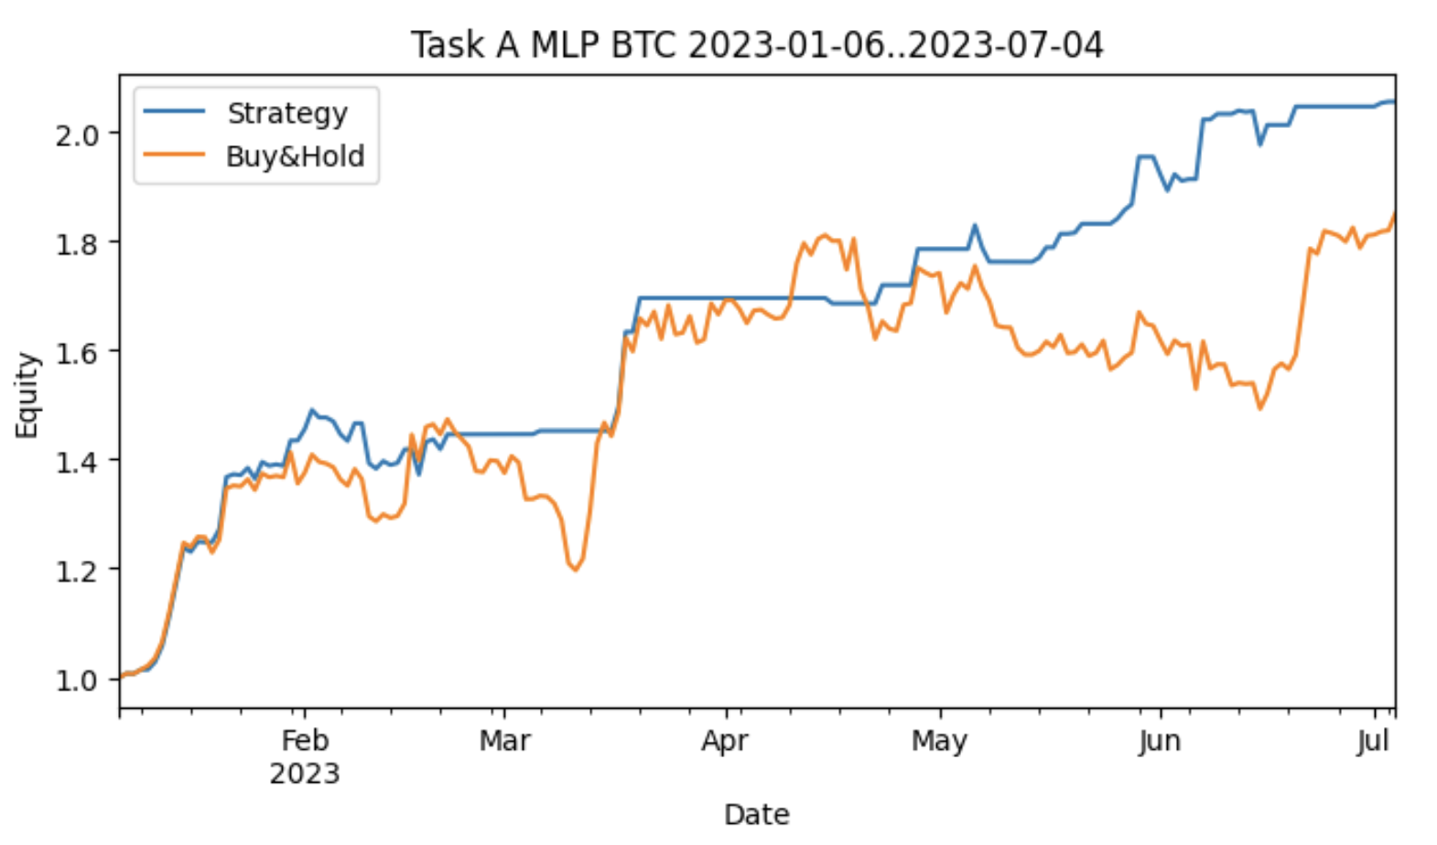
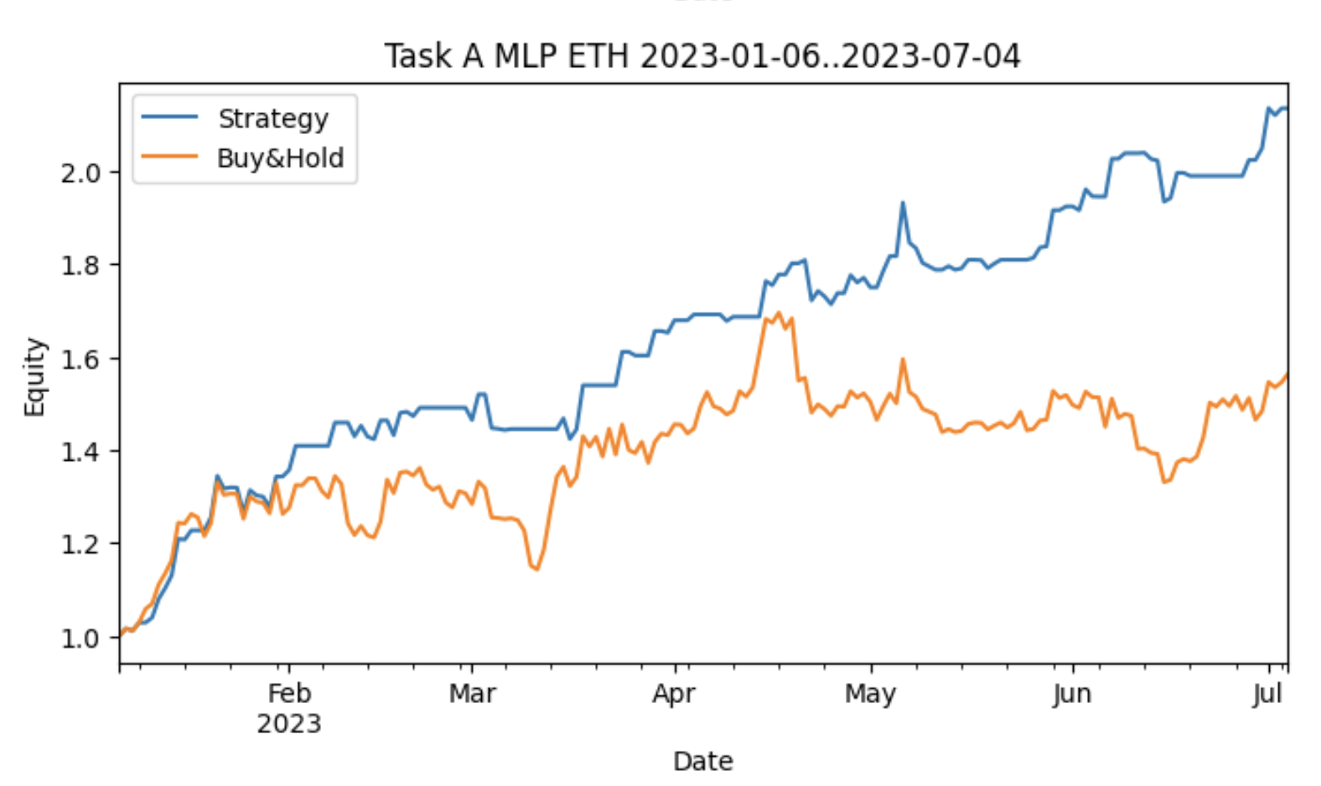
Classification Results: Equity Curves (BTC & ETH)
MLP generates stable and profitable signals.
Outperforms buy and hold in all time windows.
Sharpe ratios between 2.0 and 4.0.
LSTM and CNN LSTM moderate performance.
Transformer classification weaker than baselines.

Slide 11
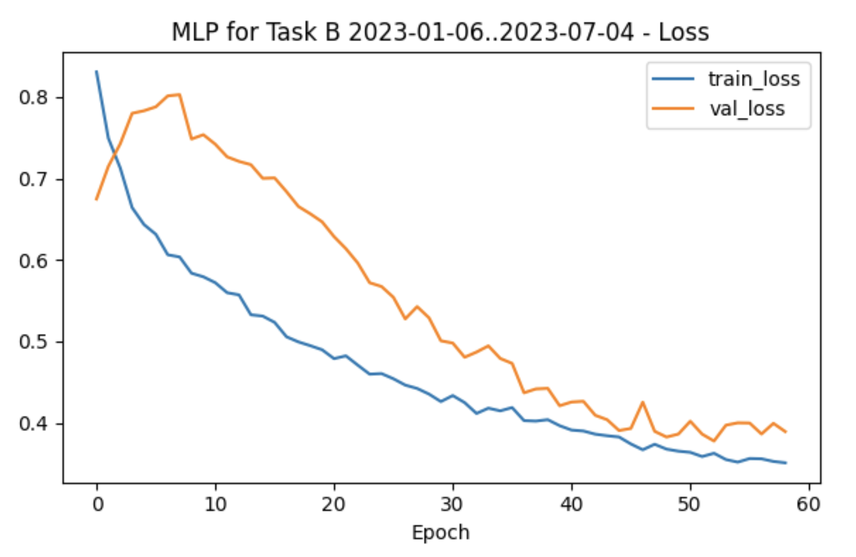
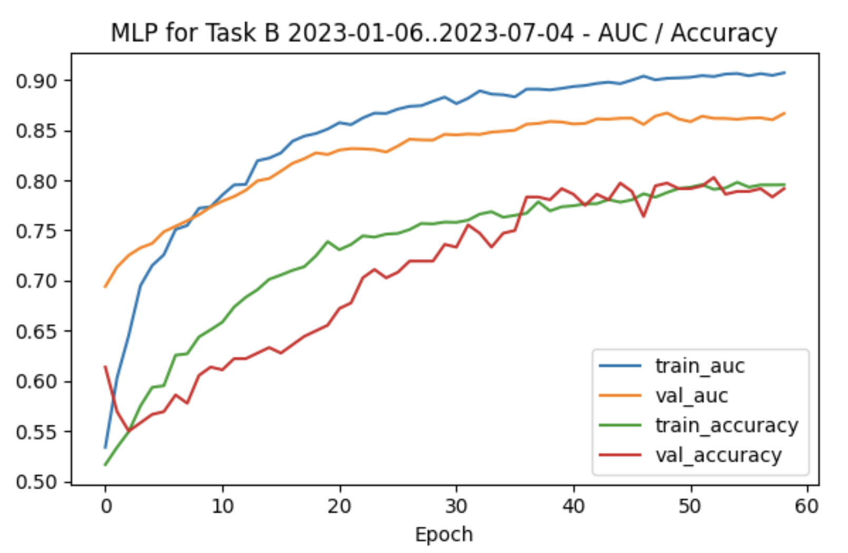
Classification Learning Curves
AUC and accuracy improve steadily across epochs.
Validation metrics closely follow training metrics.
Indicates strong generalization.

Slide 12
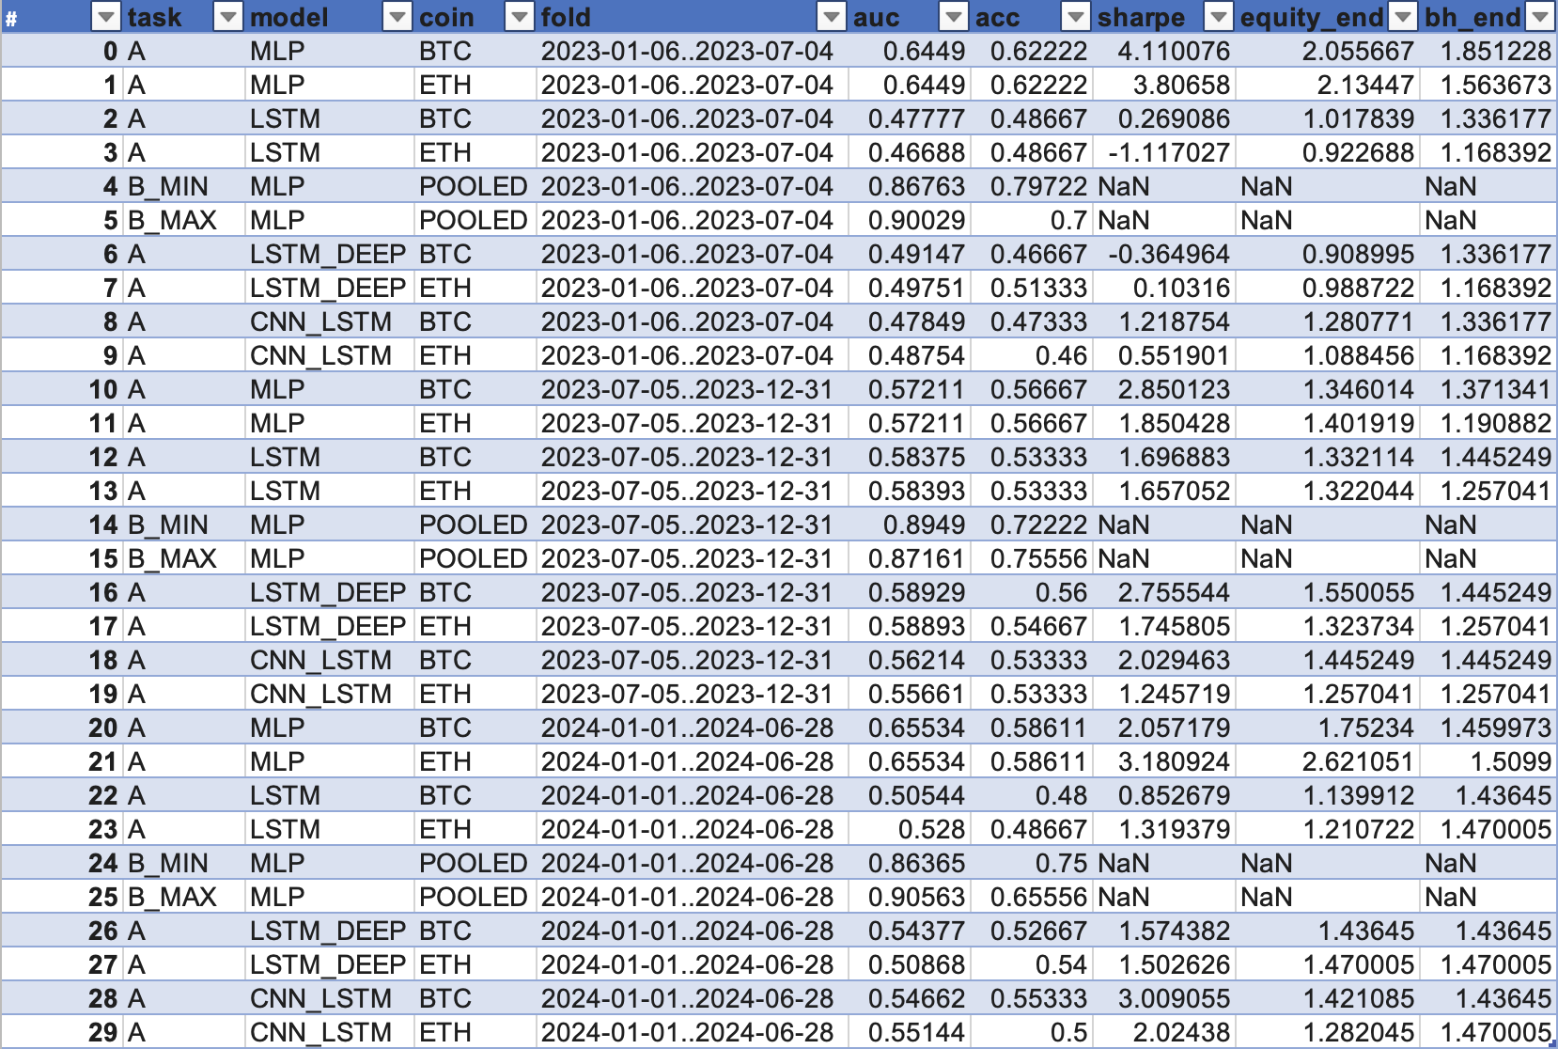
Classification - Overall Model Comparison
MLP is the strongest performer across all tasks.
CNN LSTM performs well in volatile regimes.
Transformers underperform due to data density and horizon mismatch.
Consistent across all folds and metrics.

Slide 13
Ablation Study Insights
Architectural choice matters more than feature choice.
Transformers add complexity without performance gains.
Local extrema classification is harder than direction prediction.
Multimodal features help stabilize performance.

Slide 14
Extended Contributions
Fully reproducible pipeline (no paid APIs).
Comprehensive multimodal dataset.
Transparent comparison across major architectures.
Trading performance analysis (not just accuracy).
Clarifies when complex architectures are unnecessary.

Slide 15
Conclusion and Future Work
MLP and CNN LSTM outperform transformers for short horizon forecasting.
Feature stability and careful preprocessing matter more than model depth.
Future work:
  regime based modeling
  hybrid transformers with CNN encoders
  intraday data
  improved backtesting (slippage, costs)

Slide 16
Q&A
Thank you for listening!

