Slide 1

LUCID++
Enhanced Deep-Learning Solution for DDoS Attack Detection
ICS-590 – Special Topics in Deep Learning
PRESENTED BY
Syed M Minhaj Naqvi

Slide 2

DDoS attacks are evolving and hard to detect in real-time.
  HIGH TRAFFIC VOLUME
  COMPLEX ATTACK PATTERNS
  NEED FOR FAST AND LIGHTWEIGHT DETECTION

Slide 3
Existing Approaches
Traditional → ML → Deep Learning Evolution
  Statistical & Threshold-based → fragile
  ML: SVM, k-NN → heavy feature engineering
  DL: RNNs/LSTMs, CNNs → learn features automatically
  Challenge: Deep models are often too heavy for real-time use

Slide 4
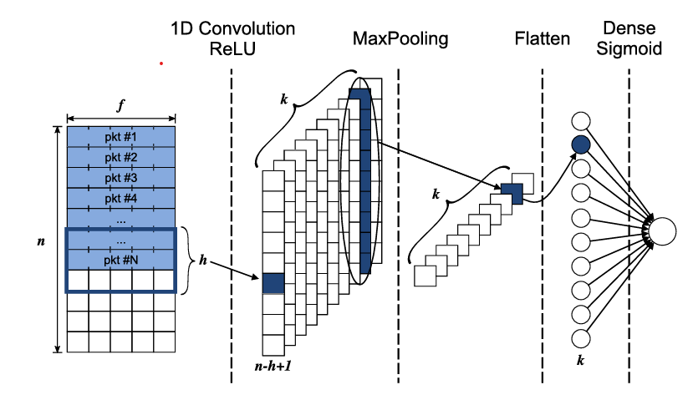
LUCID Lightweight CNN for DDoS detection
  1D CNN with only ~2,241 parameters
  Fast, 40x less overhead than 3LSTM
  Previously tested on older datasets (e.g., CSECIC2018)

Slide 5
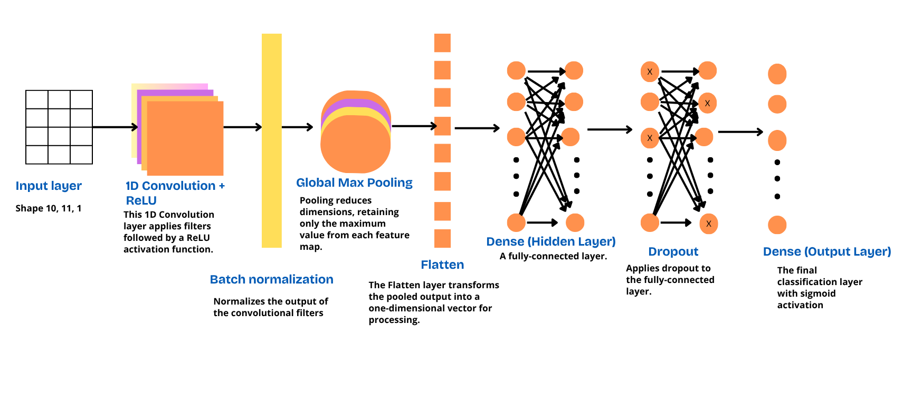
LUCID++ Enhancements
Batch Normalization → stabilizes training
Hidden Dense Layer → learns richer patterns
Dropout → reduces overfitting

Slide 6

Dataset & Preprocessing
Dataset: CIC-DDoS2019
  10-second windows grouped by flow
  11 features per packet (no IPs/ports)
  Shape: (10, 11, 1) → suitable for CNN

Slide 7

Evaluation Setup
  5-Fold Cross Validation with GridSearchCV
  Tested 1920 hyperparameter combinations
  Evaluated on Accuracy, F1, TPR, FPR, ROC-AUC

Slide 8

Dataset Sources and Methodology
TYPES OF TRAFFIC AND VOLUME
We utilize extensive datasets to ensure accuracy and reliability.

Slide 9
Results Summary
LUCID
LUCID++
98.5%
98.93%
ACCURACY
Key statistics for model performance
0.9866
0.9903
F1-SCORE
99.61%
99.22%
TPR
2.86%
1.43%
FPR

Slide 10
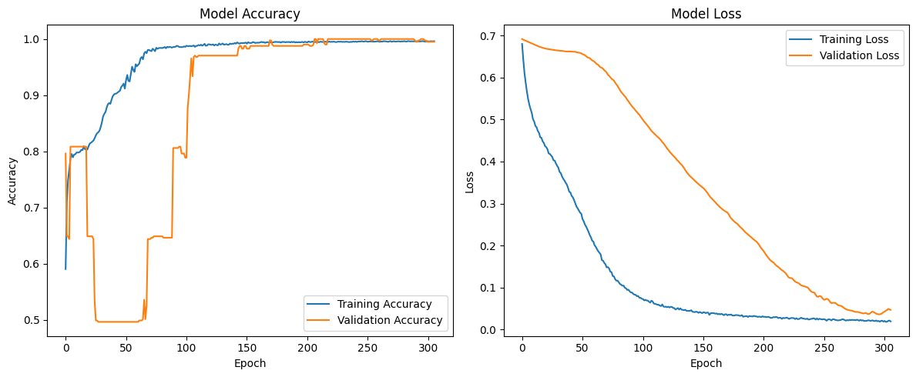
Training Dynamics
  Stable accuracy & loss curves
  No overfitting → thanks to BatchNorm + Dropout

Slide 11
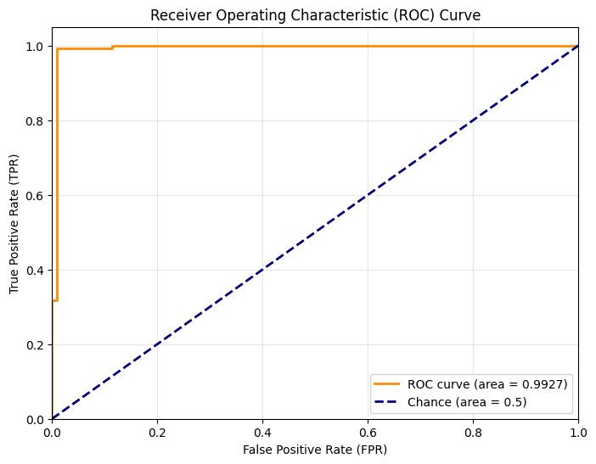
Classification Analysis
  Precision, Recall, F1 ~ 0.99 for both classes
  False Positives cut in half
  ROC AUC = 0.9927 → Excellent performance

Slide 12

Conclusion
  LUCID++ improves detection accuracy & reduces false alarms
  Architecture remains lightweight and fast
  Shows strong performance on modern traffic datasets

Slide 13

Questions?

